Slide 1
Preparing For War
Michael Downes
I.S. 62
The Ditmas Educational Complex

Slide 2
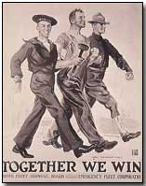
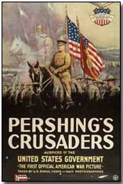
Identify Problem – Gathering unwavering public support for
America’s entrance into World War 1.

Slide 3
Gather the Evidence:
The 1910 Census reported a population of roughly 92 million, of whom 14.7% were foreign-born.
Perhaps more worrying than that was the fact that as the U.S. was about to enter WW1, more than 10 million were immigrants from the nations of the Central Powers.
The German-American and Irish American communities were strongly in favor of neutrality; they spoke out strongly against massive U.S. loans and arm sales to the Allies as a violation of neutrality.
America for 3 years reveled in its moral superiority, staying out of the European war. Many Americans wanted no part of the War, this sentiment was particularly strong in the Mid West.
http://www2.maxwell.syr.edu/plegal/ppa/worksheet2us.doc

Slide 4
Gather the Evidence:
American President Woodrow Wilson campaigned for reelection in November, 1916 with the slogan “He kept us out of war”. Wilson’s policy of neutrality was enormously popular with Americans, It probably was the deciding factor in his reelection.
The absence of public unity was a primary concern when America entered the war on April 6, 1917. In Washington, unwavering public support was considered to be crucial to the entire wartime effort.

Slide 5
Determine Causes
Grass roots opposition to American entry came especially from German and Irish elements.
German Americans by this time usually had only weak ties to Germany; however, they were fearful of negative treatment they might receive if the U.S. entered the war.
Irish Americans Catholics were the most effective domestic opponents of the war. They were adamant against helping the Protestant British Empire because it refused to allow independence to Ireland.
Leaders of most religious groups tended to be pacifists as did leaders of the women movement. Antiwar leaders included Jane Addams, Henry Ford and Carrie Chapman Catt.
http://www2.maxwell.syr.edu/plegal/ppa/worksheet3us.doc

Slide 6
State one of the major historical policies that attempted to deal with the social problem.
The Committee on Public Information, also known as the CPI or the Creel Committee, was an independent agency of the government of the United States created to influence U.S. public opinion regarding American participation in World War I. Over just 28 months, from April 13, 1917, to August 21, 1919, it used every medium available to create enthusiasm for the war effort and enlist public support against foreign attempts to undercut America's war aims.

Slide 7
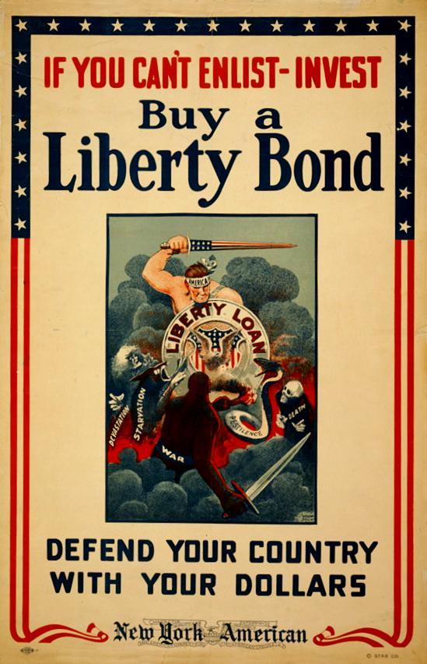
Public Support:
· The government raised over $21 billion through the sale of Liberty Bonds.

Slide 8
Cartooning for Victory:
World War I Instructions to Artists
During World War I, the United States fought a war of ideas with unprecedented ingenuity and organization. President Woodrow Wilson established the Committee on Public Information (CPI) to manage news and solicit widespread support for the war at home and abroad. Under the energetic direction of Mississippi newspaper editor George Creel, the CPI churned out national propaganda through diverse media including films, cartoons, and speeches. The CPI’s home-front propaganda cartoons were no laughing matter. The Bureau of Cartoons, headed by George Hecht, exhorted cartoonists to use their popular medium to support the war effort.

Slide 9
To the cartoonists of America:
The floating of Liberty Loans is largely a problem of education. It is a question of bringing home to the mass of people the fact that it is their patriotic duty to invest all the money they can in Liberty Bonds.
There are few means of publicity that can equal cartoons in effectiveness in bringing home to every American his obligation to buy Liberty Bonds.
I appreciate deeply the splendid service that you, cartoonists of America, have rendered during the past three loan campaigns and I feel confident that you may be counted on in this present drive to do even more.
Make Each Liberty Loan Cartoon Count.

Slide 10
How Your Liberty Bond Will Fight
The cartoonist has here an opportunity to show graphically just what the bond quota of his local community will purchase.
A $50 bond will buy:
14 rifle grenades.
160 first-aid packages to dress wounds.
Truck knives for an entire rifle company.
A $100 bond will:
Clothe a soldier.
Buy 5 rifles.
Feed a soldier for 8 months.
A $1,000 bond will buy:
An X-ray apparatus outfit.
Pistols for an entire company.

Slide 11
$5,000 worth of bonds will buy:
1 Liberty truck.
7 Lewis machine guns.
$50,000 worth of bonds will:
Maintain a submarine for over a year.
Construct a base hospital with 500 beds.
$100,000 Will buy 5 fighting airplanes.
$1,000,000 worth of bonds will maintain a battleship for a year.
$1,800,000 worth of bonds will build one destroyer.
$28,000,000 worth of bonds will build one new battleship complete.

Slide 12
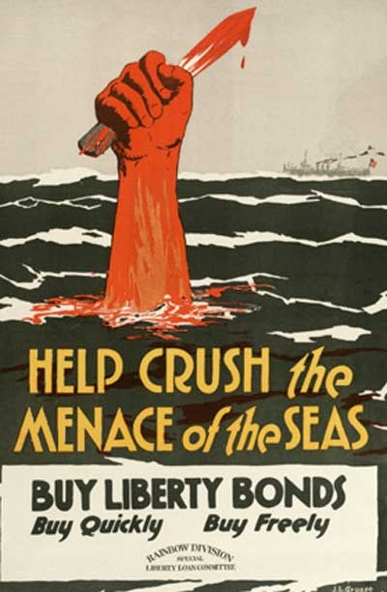
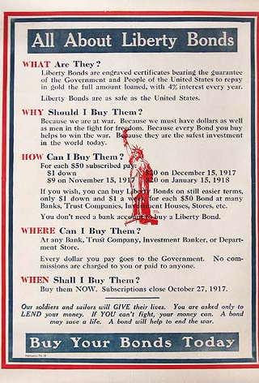

Slide 13
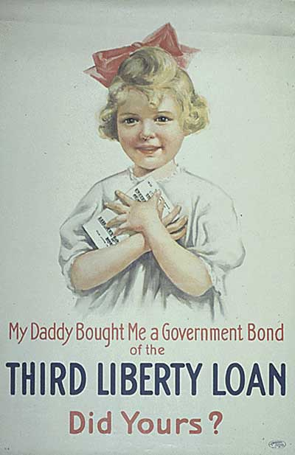
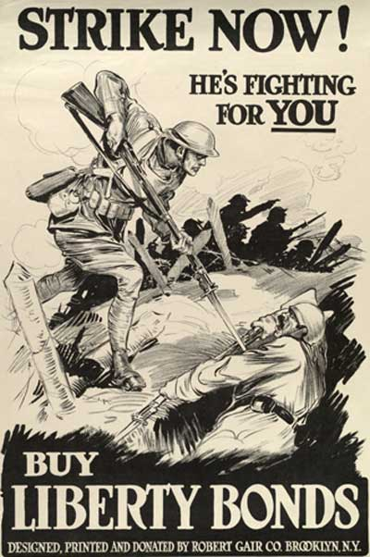

Slide 14
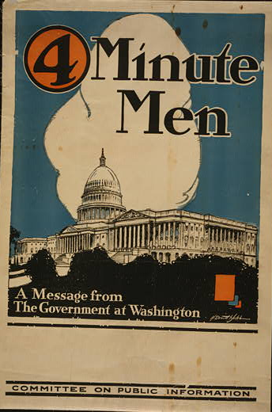
· “Four-Minute Men” made speeches urging Americans to make sacrifices for the goals of freedom and democracy.

Slide 15
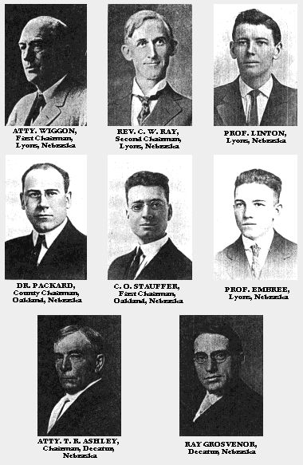
THE FOUR MINUTE MEN OF TEKAMAH, NEBRASKA

Slide 16
Speech by a Four Minute Man
Ladies and Gentlemen:
I have just received the information that there is a German spy among us—
a German spy watching us.
He is around, here somewhere, reporting upon you and me—sending reports about us to Berlin and telling the Germans just what we are doing with the Liberty Loan. From every section of the country these spies have been getting reports over to Potsdam—not general reports but details—where the loan is going well and where its success seems weak, and what people are saying in each community.
For the German Government is worried about our great loan. Those Junkers fear its effect upon the German morale. They’re raising a loan this month, too.

Slide 17
If the American people lend their billions now, one and all with a hip-hip-hurrah, it means that America is united and strong. While, if we lend our money half-heartedly, America seems weak and autocracy remains strong.
Money means everything now; it means quicker victory and therefore less bloodshed. We are in the war, and now Americans can have but one opinion, only one wish in the Liberty Loan.
Well, I hope these spies are getting their messages straight, letting Potsdam know that America is hurling back to the autocrats these answers:
For treachery here, attempted treachery in Mexico, treachery everywhere—one billion.
For murder of American women and children—one billion more.

Slide 18
For broken faith and promise to murder more Americans—billions and billions more.
And then we will add:
In the world fight for Liberty, our share—billions and billions and billions and endless billions.
Do not let the German spy hear and report that you are a slacker.
Committee on Public Information, Four Minute Man Bulletin, No. 17 (October 8, 1917).

Slide 19
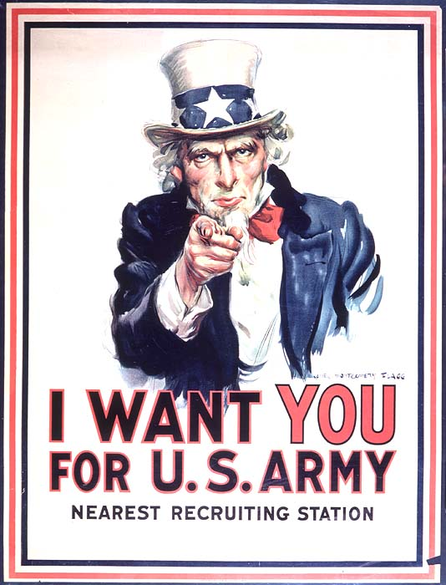
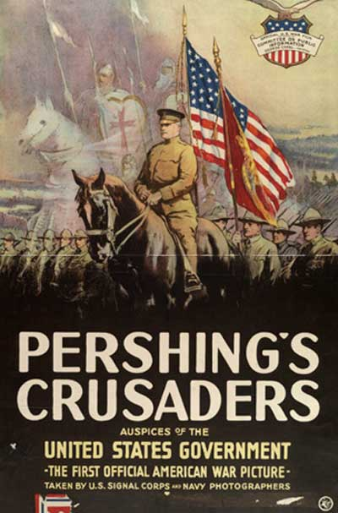

Slide 20
Advantages:
Oftentimes the genius among effective political communications campaigns lies with their leaders. While its existence was brief, its efficiency was remarkable. A meager five million dollars was spent in total to fund the committee both domestically and abroad. The diminutive nature of this amount can be credited both to the thrift of Mr. Creel and also to the substantial amount of charity from the American people. The money invested into this campaign had many lasting impacts. It bred a renewed sense of patriotism for twentieth century America and created war hysteria.
It also created “100% Americanism”.

Slide 21
Disadvantages
The actions of the Creel Committee had numerous unintended consequences: George Creel claimed that he wanted the CPI to be truthful and not create rumors. However, the CPI’s emphasis on the danger of German spies helped create a climate of fear. This made life particularly difficult for German Americans, many of whose neighbors regarded them with suspicion.
The committee stressed “100% Americanism,” meaning that people should be entirely committed to the war effort and completely loyal to the U.S. This attitude led to discrimination against dissenters and nonconformists. For example, some
colleges and universities fired professors who had opposed American entry into the war. “100% Americanism” also encouraged a distrust of immigrants. Foreigners and foreign ideas became suspect. Many high schools even dropped German from their curriculums.

Slide 22
Evaluating the Policy
CPI created a sense of great patriotism in the United States. It raised over 21 billion dollars for the war and developed intense nationalism. Support for the war was tremendous because of this policy, however, this came at a price. German Americans were mistreated and even hated. There became a huge hatred for immigrants.
I believe it was a good policy, but I believe that the government should have been more careful about the backlash against German Americans and immigrants. Perhaps there could have been some outreach to help with this problem.
http://www2.maxwell.syr.edu/plegal/ppa/worksheet4us.doc

Slide 23
Portions of this PowerPoint, I give credit to Adam Berlin, teacher , Long Island, New York.
Sources:
http://westerncivguides.umwblogs.org/2011/11/30/advertising-and-wwi/
http://en.m.wikipedia.org/wiki/Committee_on_Public_Information#section_1
http://histclo.com/essay/war/ww1/cou/us/w1cus-mob.html
http://www.propagandacritic.com/articles/ww1.cpi.html

