Slide 1
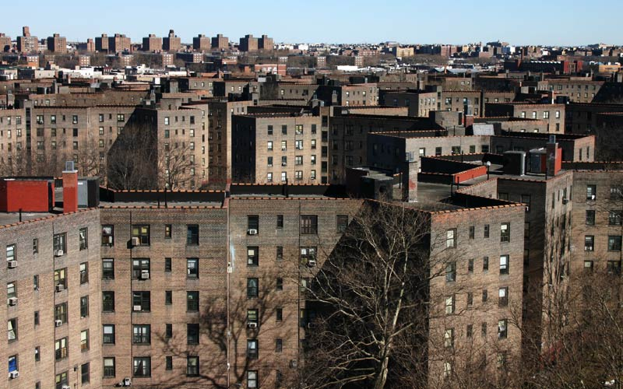
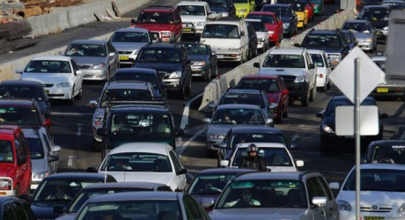
Asthma—An Urban Dilemma
Public Policy Analysis
Notes:
http://www.bing.com/images/search?q=Brooklyn+NY+projects&qs=n&form=QBIR&pq=brooklyn+ny+projects&sc=2-19&sp=-1&sk=&adlt=strict#view=detail&id=24EDB075B18D0C809CF51E7EB8F57F13A4DA5539&selectedIndex=0
http://www.bing.com/images/search?q=urban+congestion&qs=n&form=QBIR&pq=urban+congestion&sc=3-16&sp=-1&sk=&adlt=strict#view=detail&id=E5C5088501F7F0B45CFDD04D2142E777CA8608F9&selectedIndex=21

Slide 2
Steps of the PPA
Define the problem
Gather the evidence
Identify the causes
Examine existing policy
Develop solutions
Select the best solution

Slide 3
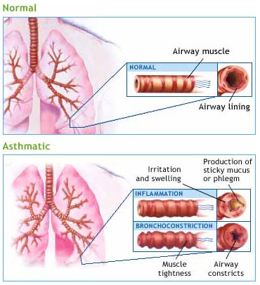
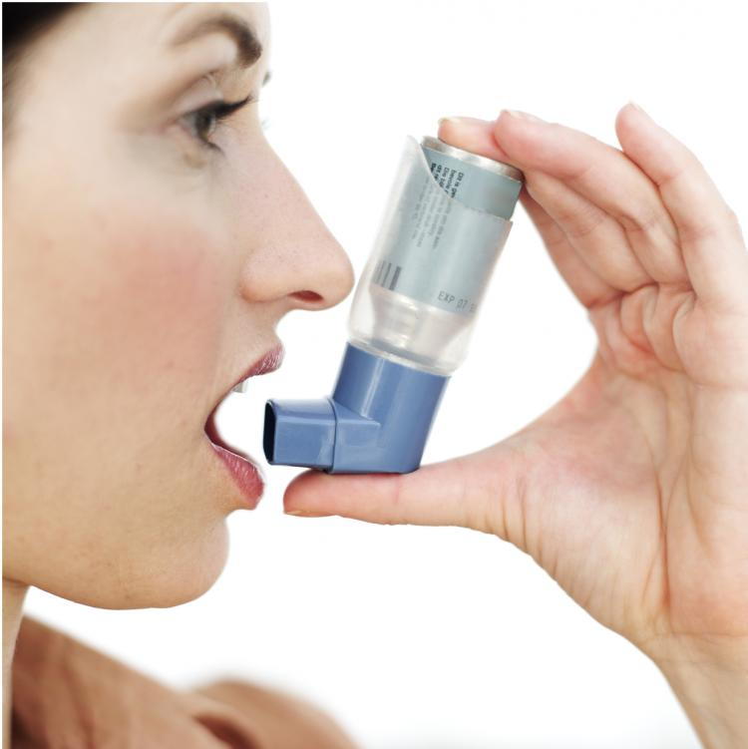
What is Asthma?
Asthma is a chronic lung disease identified by inflammation and narrowing of the airways
Symptoms of asthma include wheezing, coughing, chest tightness, and shortness of breath
People may take medications to prevent the symptoms from returning or to treat symptoms as they are occurring
Source:
National Heart Lung and Blood Institute
Notes:
http://www.bing.com/images/search?q=lung+asthma&FORM=HDRSC2&adlt=strict&view=detail&id=D281CFA34624755C0F9493B7E3A3C5BC298DD3C0#
http://www.bing.com/images/search?q=asthma&qs=n&form=QBIR&pq=asthma&sc=8-3&sp=-1&sk=&adlt=strict#view=detail&id=A564AF0F74323095F088A61F62DAB790C6698757&selectedIndex=38

Slide 4
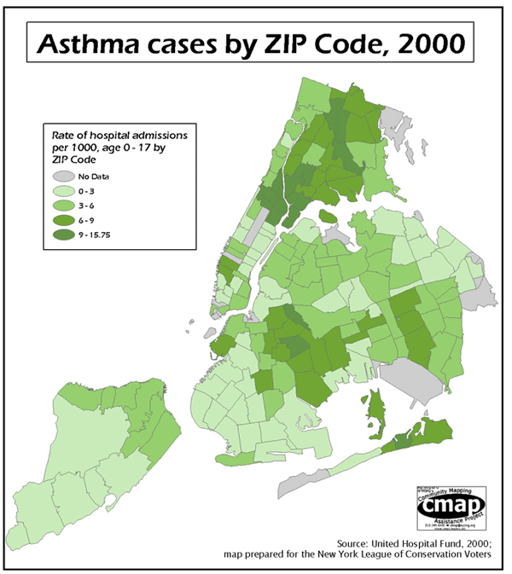
What’s the Problem?
Asthma rates are disproportionately high in urban and impoverished areas.
Notes:
http://www.bing.com/images/search?q=asthma+in+the+city&FORM=HDRSC2&adlt=strict#view=detail&id=2E2BD2C712F0F69E0609C017907887A1CEFBC91F&selectedIndex=9
http://www.ncbi.nlm.nih.gov/pubmed/11747260

Slide 5
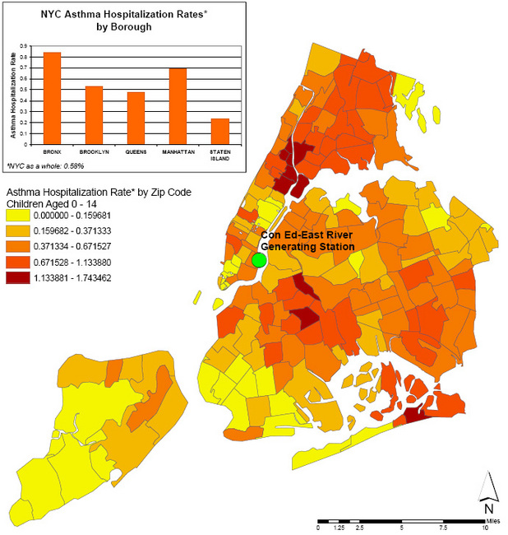
The Evidence
What about this map surprises you?
What do you know about the neighborhoods with the highest concentration of asthma related hospitalization

Slide 6
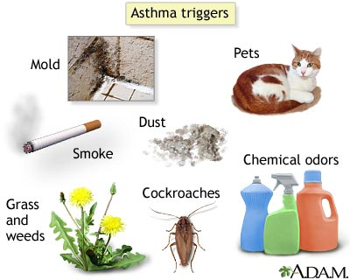
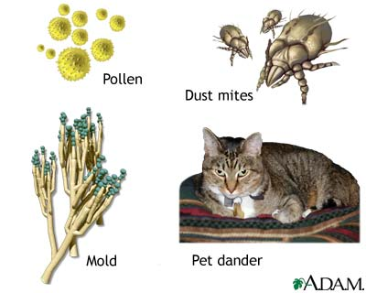
Causes of Asthma
Poor air quality
Emissions from cars, trucks, and buses
Allergens
Dust mites
Roaches
Pets
Smoke
Chemicals
Detergents
Paints
Notes:
http://health.rush.edu/HealthInformation/graphics/images/en/22934.jpg

Slide 7
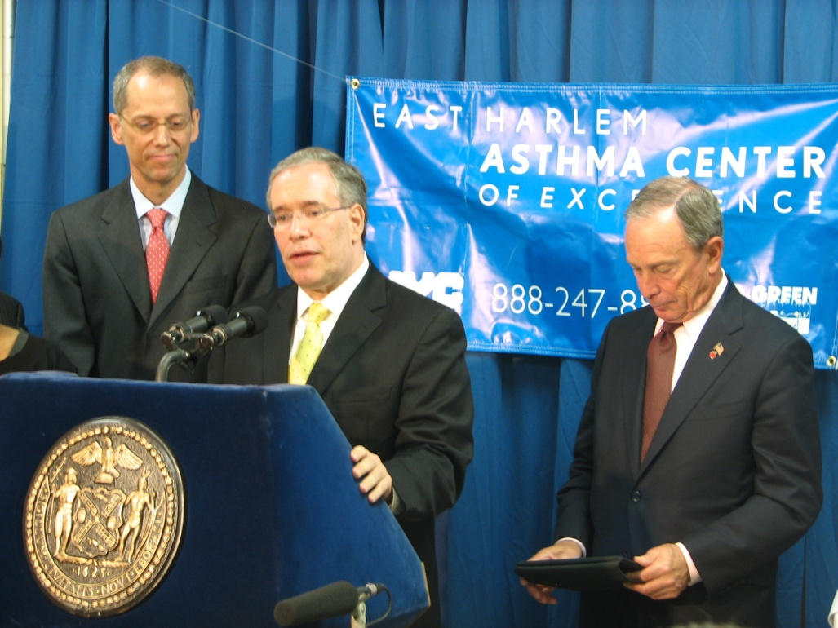
Evaluating Current Policies
East Harlem's Asthma Center of Excellence
NYC Asthma Initiatives
The Fresh Air Fund
Asthma Management Initiatives in Schools

Slide 8
Develop Solutions
Are current policies sufficient to address current issues, why or why not?
What do you think should be done to address the disproportionately high rates of asthma in poor urban areas?
Develop 3 solutions using this:
http://www2.maxwell.syr.edu/plegal/TIPS/solutions.html

Slide 9
Select the Best Solution
Use this worksheet
http://www2.maxwell.syr.edu/plegal/TIPS/worksheet6.doc
To rank the feasibility and effectiveness of each of your proposed solutions?
Ultimately which do you think is the best proposed solution & why?

