Slide 1
Obese Children in the U.S.A. By: Mary cataldo Ditmas is 62 700 Cortelyou road Brooklyn, n.y. 11218
PPA # 3: Identify the Causes
PPA # 5: Develop Solutions

Slide 2
Objective
C.O: Students will be able to inform themselves of child obesity and find solutions to this problem.
L.O: Students will be able to identify the causes of child obesity in the U.S.A.

Slide 3
Causes & Incidence
Why are so many children obese in the USA?
According to: www.ncbi.nlm.nih.gov/pubmedhealth
When children eat more than they need, their bodies store the extra calories in fat cells to use for energy later. If this pattern continues over time, and their bodies do not need this stored energy, they develop more fat cells and may develop obesity.

Slide 4
Infants and young children are very good at listening to their bodies’ signals of hunger and fullness. They will stop eating as soon as their bodies tell them they have had enough.
But sometimes a parent tells them they have to finish everything on their plate. This forces them to ignore their fullness and eat everything that is served to them.

Slide 5
These learned habits lead to eating no matter if we are hungry or full. Many people have a very hard time breaking these habits.
The family, friends, schools, and community in a child’s environment strengthen lifestyle ways regarding diet and activity.

Slide 6
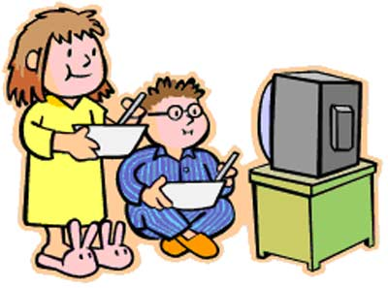
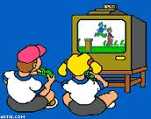
Children are surrounded by many things that make it easy to overeat and harder to be active. The following activities require very little energy.
Watching television,
gaming, texting, and
playing on the computer

Slide 7
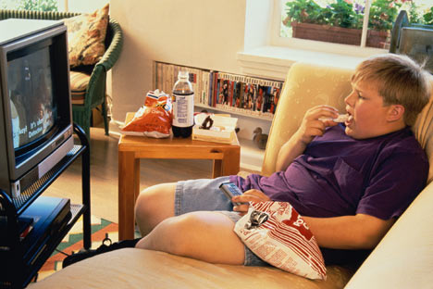
These activities can take up a lot of time and replace physical activity.
And, when children watch television, they often crave the unhealthy high-calorie snacks they see on commercials.

Slide 8
Solutions- What could we do to change?
CHANGING YOUR CHILD'S LIFESTYLE
Eating a balanced diet means you child consumes the right types and amounts of foods and drinks to keep their body healthy.
But sometimes a parent tells them they have to finish everything on their plate. This forces them to ignore their fullness and eat everything that is served to them

Slide 9
What are some other things children and adults can do to stay fit and healthy?
Work with your group. Complete the handout.
worksheet1.doc

Slide 10
Discussion & Review Solutions
Avoid junk-food snacks like chips, candy, cake, cookies, and ice cream. The best way to keep kids from eating junk food or other unhealthy snacks is to not have these foods in your house.
Avoid sodas, sport drinks, and flavored waters, especially ones made with sugar or corn syrup. These drinks are full of calories and can lead to weight gain, even in active children.

Slide 11
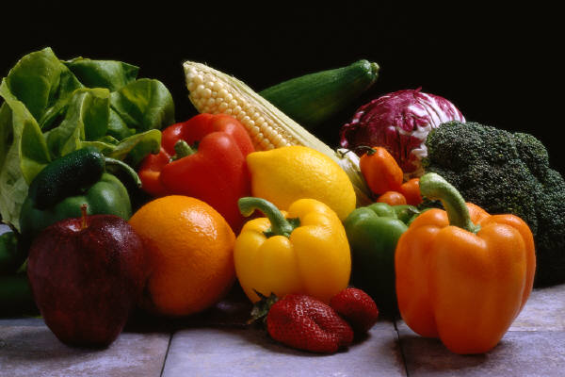
Eat Healthy: Fruits and vegetables are good choices for healthy snacks. They are full of vitamins and low in calories and fat. Some crackers and cheeses also make good snacks.

Slide 12
Children should not watch more than 2 hours of TV a day. This can be difficult because watching TV is part of their daily routine.

Slide 13
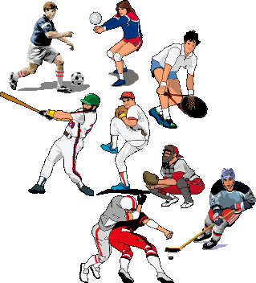
Children should have many chances to play, run, bike, and play sports during the day.

Slide 14
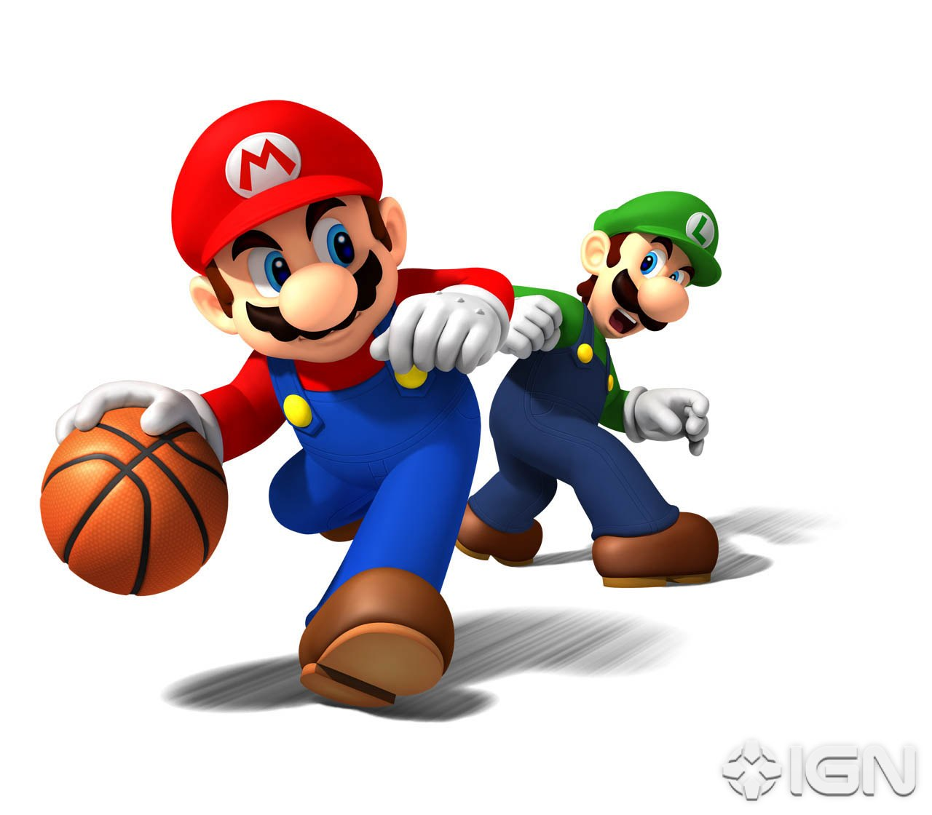
Even Super Mario & Luigi know that!

Slide 15
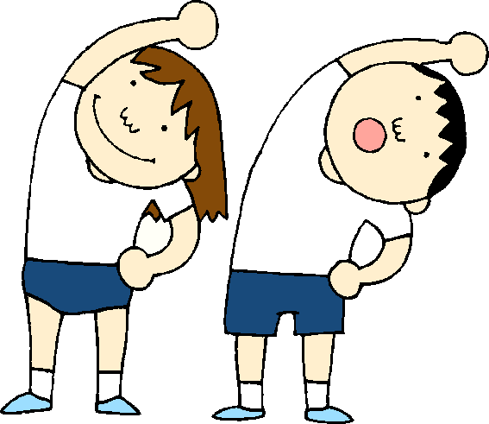
Experts recommend they get 60 minutes of moderate activity every day.
Moderate activity means you breathe and your heart beats faster than normal. If your child is not athletic, find ways to motivate your child to be more active.

Slide 16
Help Yourself!!!
http://www.ncbi.nlm.nih.gov/pubmedhealth

