Slide 1
Obesity A Growing Epidemic
Ms. Carlucci
Science Grade 7
I.S. 62 Ditmas
Acarlucci@schools.nyc.gov

Slide 2
What is Obesity?
It is a medical condition in which too much body fat accumulates in the body and is stored there.
“Obesity” and “overweight” are both terms used to label a weight that is greater than what is considered healthy.
Obesity is linked to a number of health risks, including heart disease and diabetes.

Slide 3
Defining The Problem Which of these facts surprises you the most?
According to the American Heart Association (2012 statistics):
Compared with 1973-74, the number of children 5 to 7 years of age who were obese was 5 times higher in 2008-2009.
Among children ages 2-19, about 1 in 6 are obese.
60 million Americans, age 20 and older, are obese.
1 in 3 children born in the year 2000 will develop Diabetes sometime in their life.
Overweight adolescents have a 70% chance of becoming overweight adults.

Slide 4
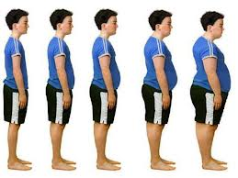
Check out this link for more on AHA statistics:
http://www.heart.org/idc/groups/heart-public/@wcm/@sop/@smd/documents/downloadable/ucm_319588.pdf
Then complete the following with your group:
Worksheet1: Defining the Social Problem

Slide 5
Evidence: Obesity Rates (www.oecd.org)
Notes:
http://www.oecd.org/health/49716427.pdf

Slide 6
Is Obesity Getting Worse in the U.S.?
The number of obese adults, along with related disease rates and health care costs, are on course to increase dramatically in every state in the country over the next 20 years, according to F as in Fat: How Obesity Threatens America's Future 2012, a report released by Trust for America's Health (TFAH) and the Robert Wood Johnson Foundation (RWJF).
Read this article and then answer the following worksheet with your group.
http://healthyamericans.org/report/100/
Worksheet2: Gathering evidence of the problem

Slide 7
Possible Causes:
The average size of a bagel more than doubled between 1983 and 2003, going from 140 calories to 350 calories. (National Heart, Blood, and Lung Institute Portion Distortion and Serving Size, Eat Right, NHLBI, NIH)
In 2009, roughly 94% of schools served a lunch that failed to meet federal standards for healthy school meals. 80% of the lunches served in those schools exceeded federal recommendations for total fat and saturated fat. (USDA.gov 2012 survey)

Slide 8
Food Portions Then and Now
20 years ago Today

Slide 9
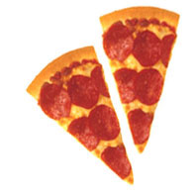
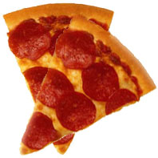
More Food Portions
20 years ago Today
Notes:
http://www.divinecaroline.com/22175/49492-portion-size-vs-now

Slide 10
Some More Causes:
Inactive lifestyles
Lack of access to healthy foods
Food advertising
Genes and family history
Emotional factors like boredom and depression
Smoking
Lack of sleep
For more information on these causes, read this article: What Causes Overweight and Obesity? - NHLBI, NIH

Slide 11
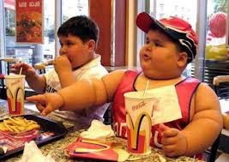
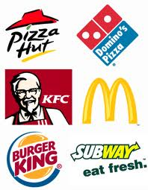
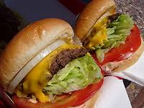
Complete the following for homework:
Worksheet3: Identifying the causes of the problem
Next Lesson: Evaluating a policy and developing solutions.

