Slide 1
The Louisiana purchase
Mrs. Barron
Social Studies

Slide 2
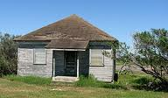
Defining the Problem: Your house is small you have no room to grow as a family, your crops are all cramped together with no room to flourish. You have the opportunity to buy a great deal of land for a small amount of money? Do you discuss it with your family or just purchase it??

Slide 3
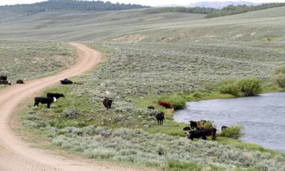
DefinINg the Problem: In early 19th century, Everyone wanted more: more places to live, more livestock for their farms. The one thing that the United States Government wanted more of was land. And the Louisiana Territory had a lot of land. What problem did U.S. face in the early 19th century? http://www2.maxwell.syr.edu/plegal/TIPS/worksheet1.html

Slide 4
Evidence of the problem & solution: Louisiana was owned by France. Many Americans lived in and around New Orleans, and many American ships sailed back and forth on the river. The U.S. Government wanted to protect American shipping and settlements. A policy solution-- purchase the Port of New Orleans.

Slide 5
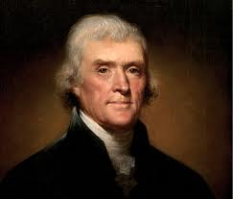
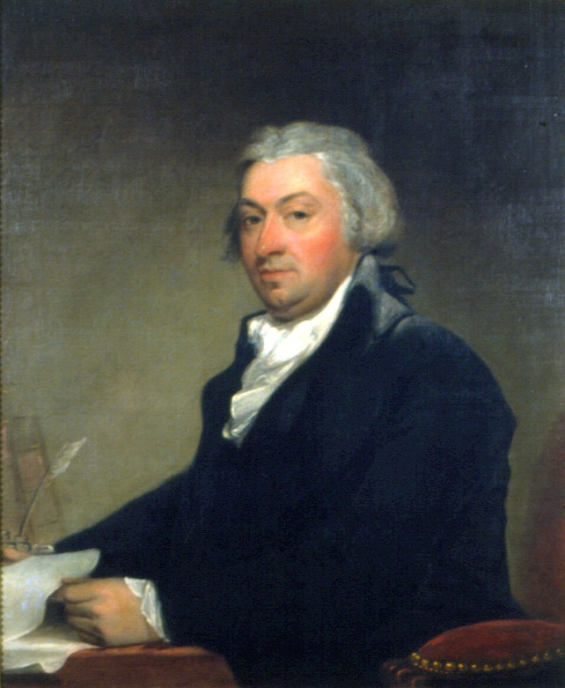
So President Thomas Jefferson sent Robert Livingston to France to buy New Orleans.
Thomas Jefferson
Robert Livingston

Slide 6
Results of Robert Livingston’s meeting with Napoleon
Napoleon offered us the Louisiana territory for the price of 15 million.
Napoleon would use the money from the sale to pay back his debts of the Napoleonic wars.
Napoleon also hoped that Britain would no longer have interest in France.

Slide 7
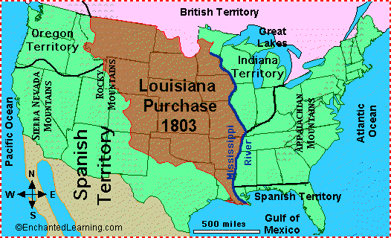
Map of the Louisiana Purchase

Slide 8
Examine Existing Policy Do you think Thomas Jefferson did the right thing by purchasing Louisiana from France without the approval of congress? Why or why not be specific. http://www2.maxwell.syr.edu/plegal/TIPS/worksheet4.html

Slide 9
Take 5 minutes to think about the following?
Do you think the reasons why the United States purchased the Louisiana territory were good? Why or why not? Be specific
Do you think this purchase will benefit the people of the United States? Why or why not?
What can the United States do with this land?
Do you think Britain will now leave France alone?
In your opinion do you think this land purchase was the greatest in United States history?

Slide 10
Information found at:
http://www.socialstudiesforkids.com/articles/ushistory/louisianapurchase.htm

