Slide 1
Obesity in the United States
Public Policy Analyst
Dina Annese
Ditmas IS 62
700-Cortelyou Road
Brooklyn, NY 11218

Slide 2
Objectives
L.O: Students will be able read about obesity in the U.S.A and identify the problem.
C.O: Students will be able to sustain the problem by giving supporting evidence.

Slide 3
Table of contents:
Part 1: Identifying the Problem
Part 2: Supporting Evidence

Slide 4
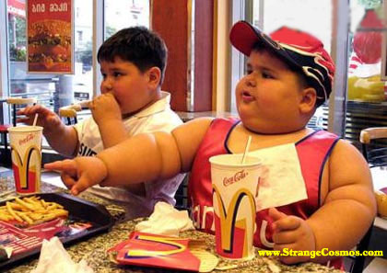
What is one of the United States Major Health Issues?
Obesity

Slide 5
According to Frac.org:
In the U.S.:
68.8% of adults are overweight or obese; 35.7% are obese.
31.8% of children and adolescents are overweight or obese; 16.9% are obese.
30.5% of low-income preschoolers are overweight or obese.
Disparities exist based on race-ethnicity, gender, age, geographic region, and socioeconomic status.
Obesity rates have more than doubled in adults

Slide 6
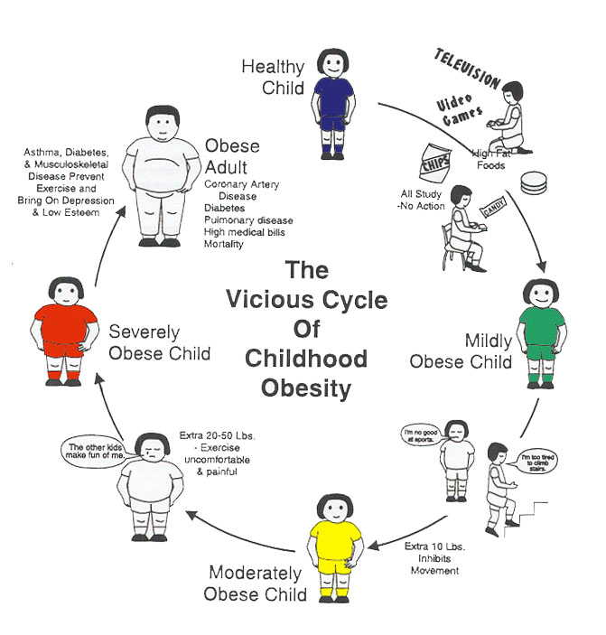

Slide 7
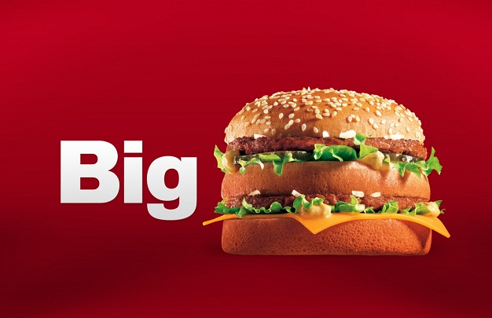
According to http://clinical.diabetesjournals.org/content/22/1/1.full
Nearly two-thirds of adult Americans are overweight or obese. Despite the attention of the health profession, the media, and the public, and mass educational campaigns about the benefits of healthier diets and increased physical activity, the prevalence of obesity in the United States has more than doubled over the past four decades.

Slide 8
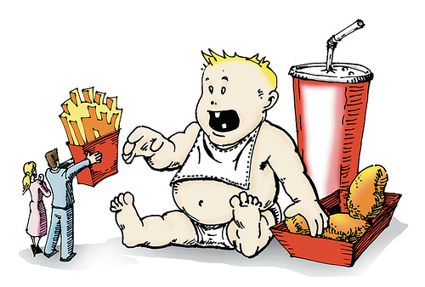
Add the relatively few Americans who practice the habit of regular physical activity to the many who practice the habit of “super-sizing,” and it is no surprise why this has occurred.

Slide 9
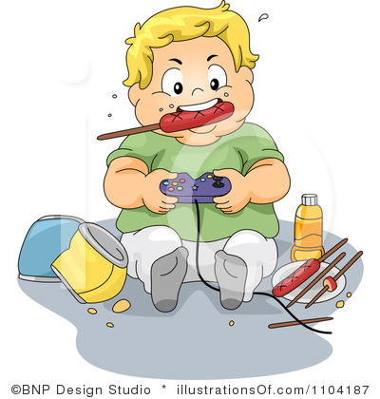
Our Children Today

