Slide 1


Misbehavior During Class Time at
P.S 84 Steinway School
TEDDI WEISS
EMAIL: TWEISS12@SCHOOLS.NYC.GOV

Slide 2
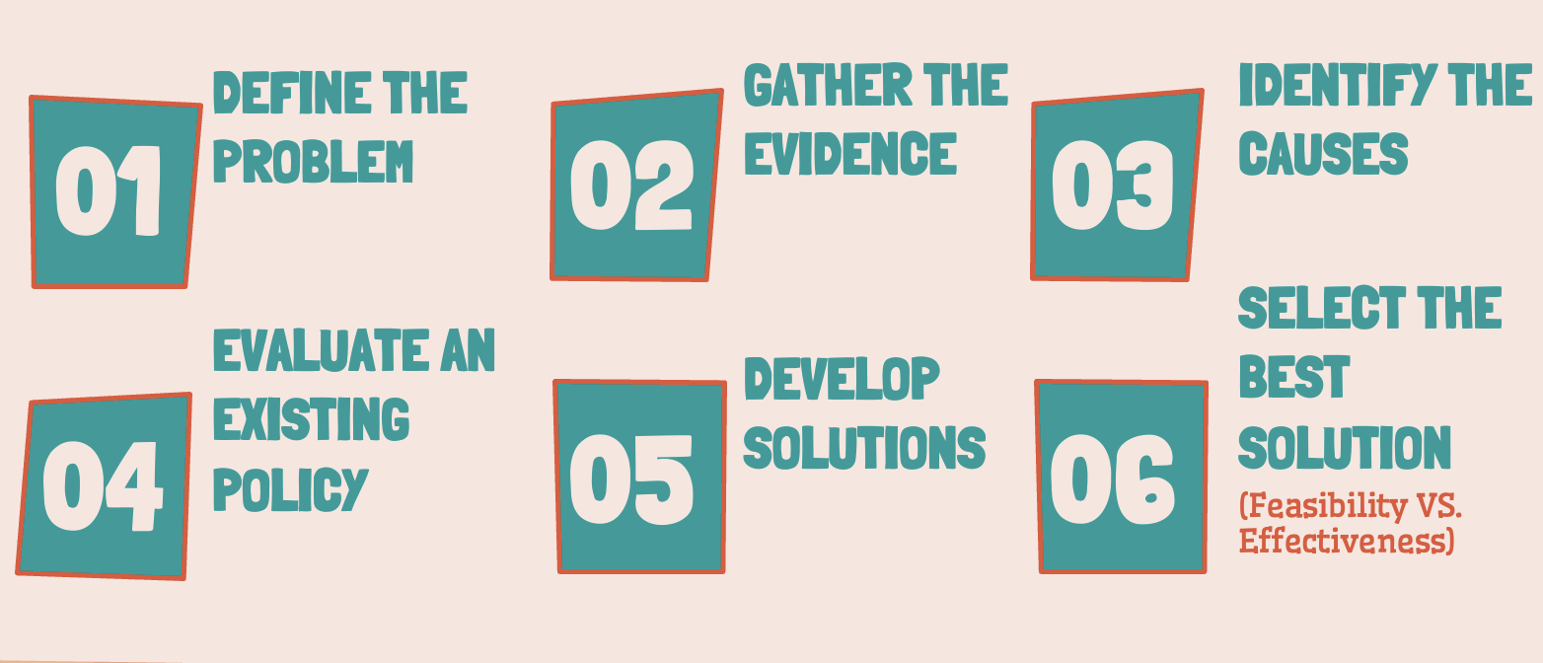
THE SIX STEPS OF THE PUBLIC POLICY ANALYST (PPA)

Slide 3

STEP 1:
Define the Problem
Misbehavior during class time at P.S 84 Steinway School
Our list to define what misbehavior in our school consists of:
Making fun of someone
Getting out of seats and walking around in the middle of lessons
Talking during lessons
Talking about someone or talking down to someone
Refusing to do work
Not listening to directions
*Constant misbehavior negatively affects all student learning. It is a distraction to everyone in the class, including the teacher*

Slide 4

STEP 2:
GATHER THE EVIDENCE
How to collect evidence to show that misbehavior occurs in our school:
1. Survey students and ask if they see others engaging in specific behaviors
2. Keep a log of when misbehaviors occur and who is participating
  a. Anecdotal recording
  b. Interval recording
  3. Survey teachers to see if others are experiencing similar behavioral issues in their classes

Slide 5
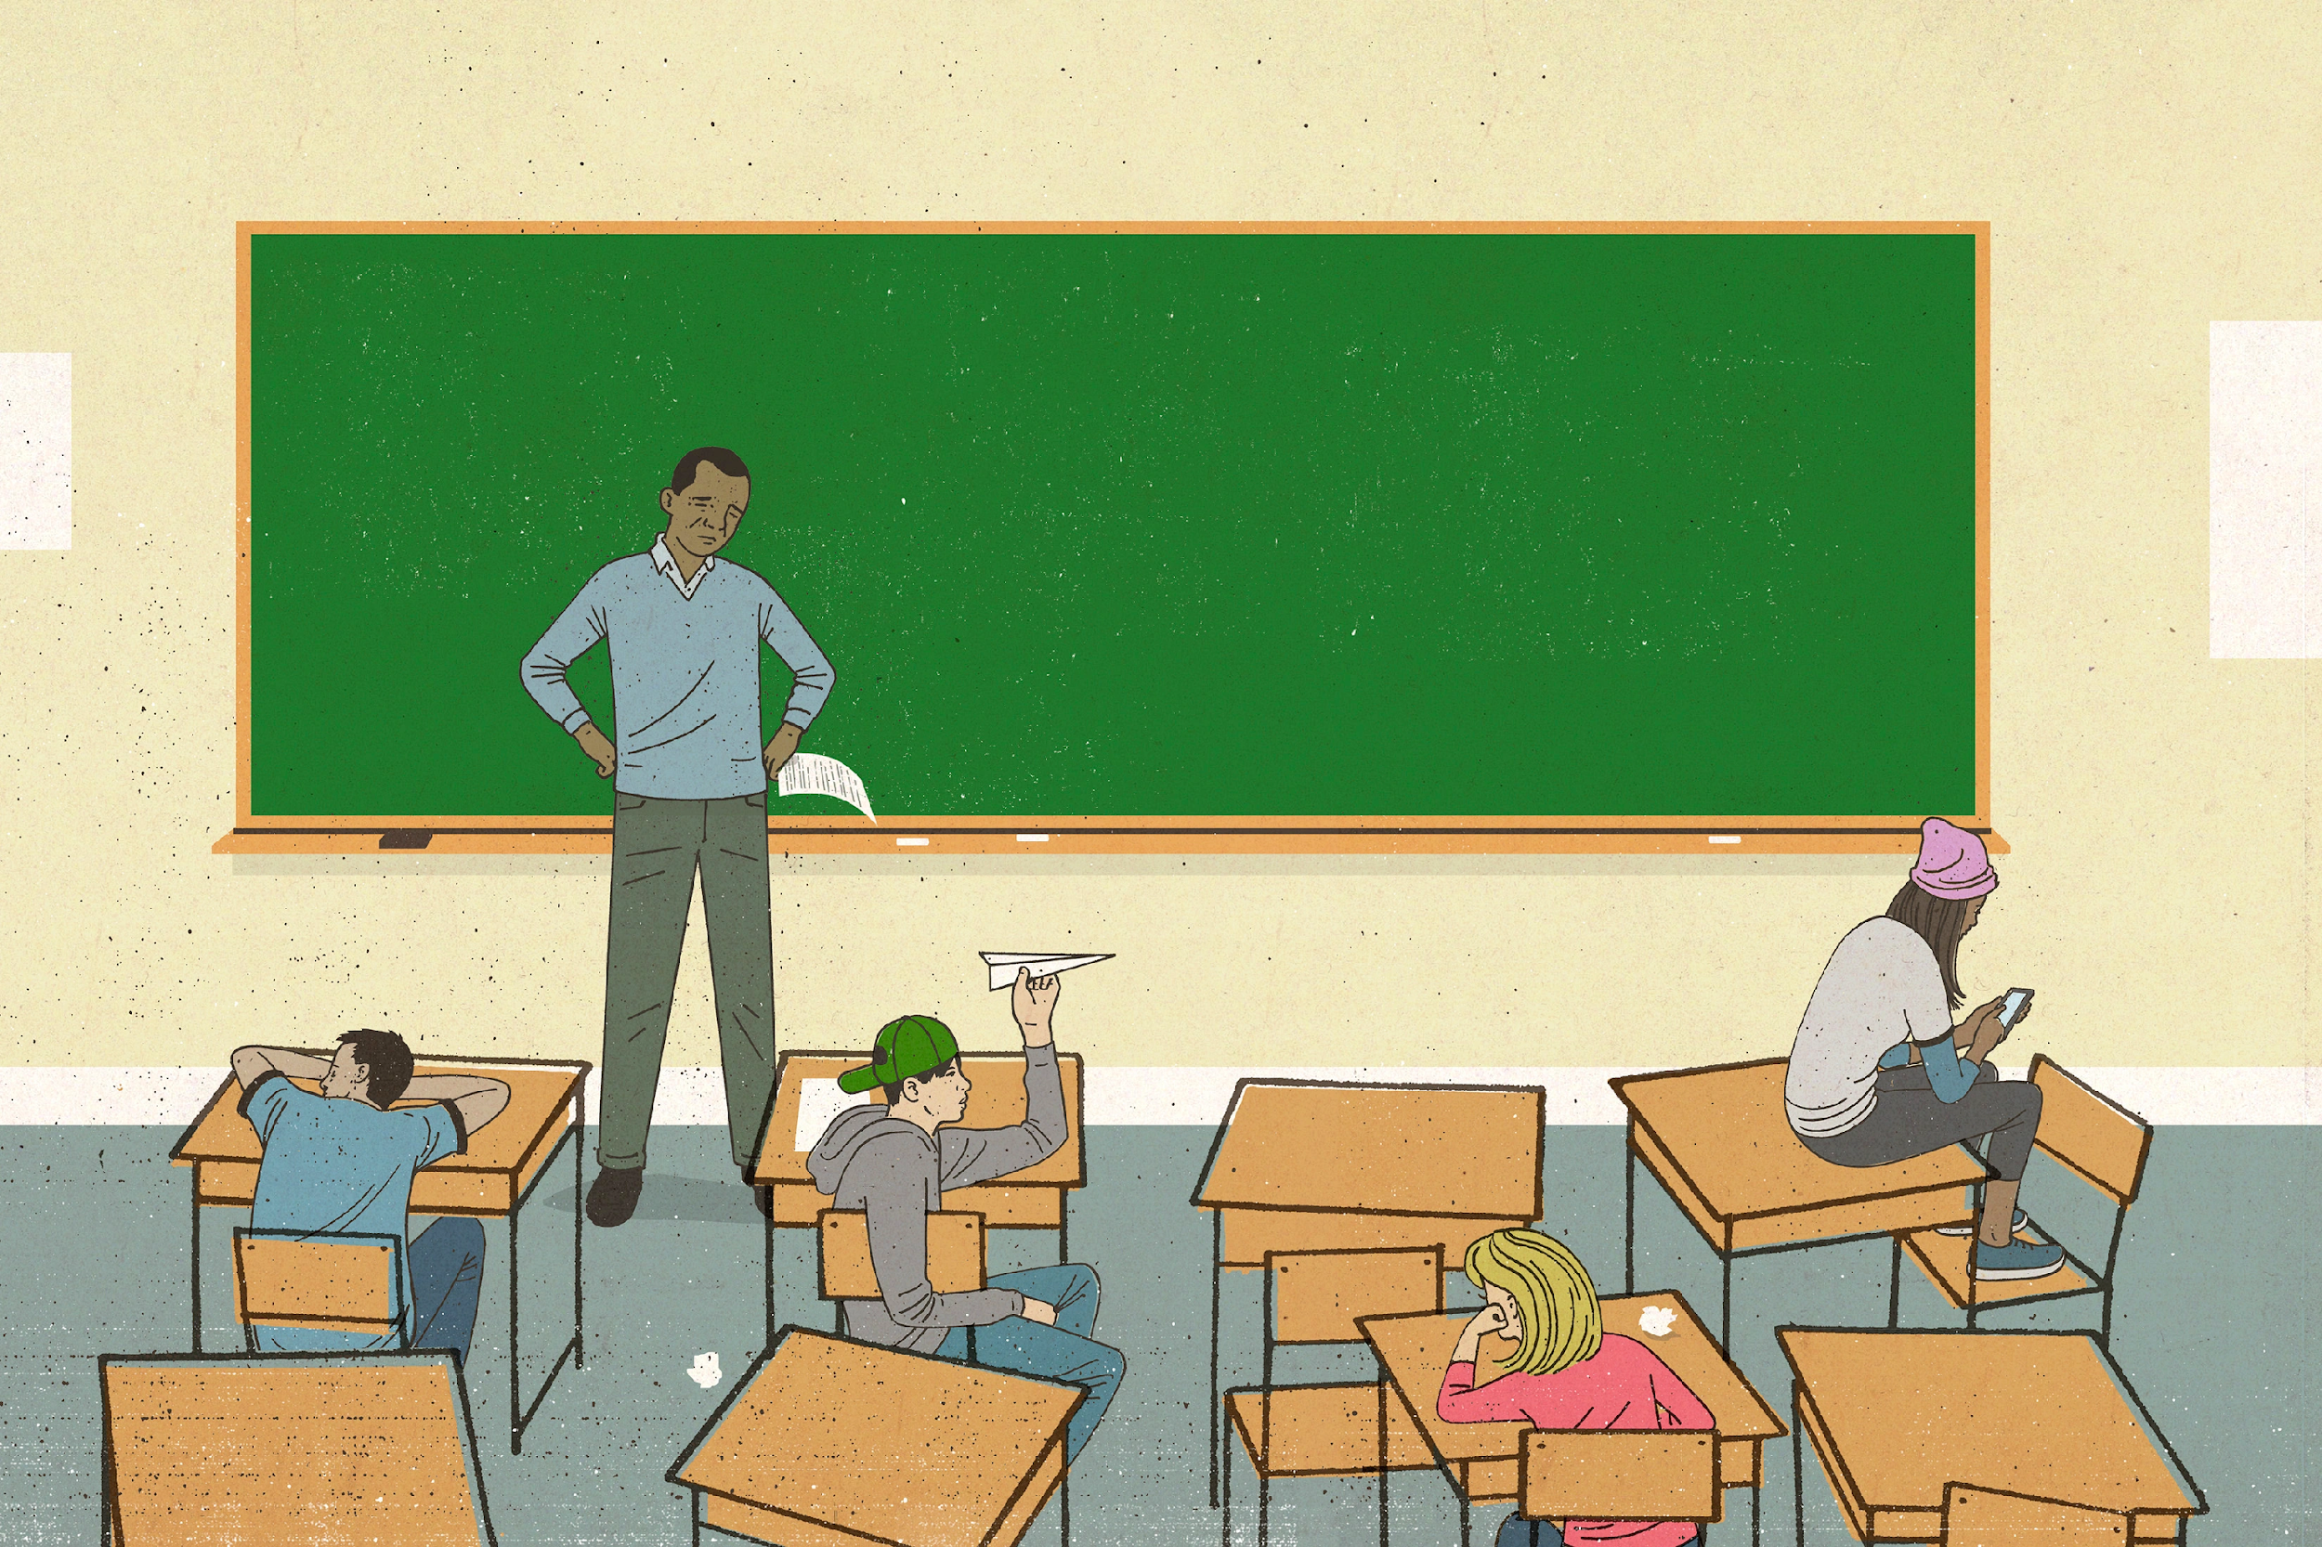
STEP 3:
IDENTIFY THE CAUSES
Some underlying factors that we believe contribute to misbehavior in our school:
  Social recognition (ex: trying to “fit in”)
  Exercising power
  Attention seeking
  Underlying medical issues (ADD, ADHD, etc)
  Jealousy
  Just because
  Escaping class work

Slide 6

STEP 4:
EVALUATE AN EXISTING POLICY
Existing Policies in our school help deal with misbehavior:
  Positive reinforcement (raffle tickets)
  Individualized token economy for higher needs students
  Behavior rating system per period (whole class reflection)
  Class earned marbles in a jar- When it is full the class gets a party
  Individual daily behavior charts

Slide 7

STEP 5:
DEVELOP SOLUTIONS
New Policies we want in our school that will help deal with misbehavior:
  ISS for students who receive three strikes
  3-day suspension for students who get ISS a second time
  Lunch detention
  Support squads (class discussion) twice a week

Slide 8
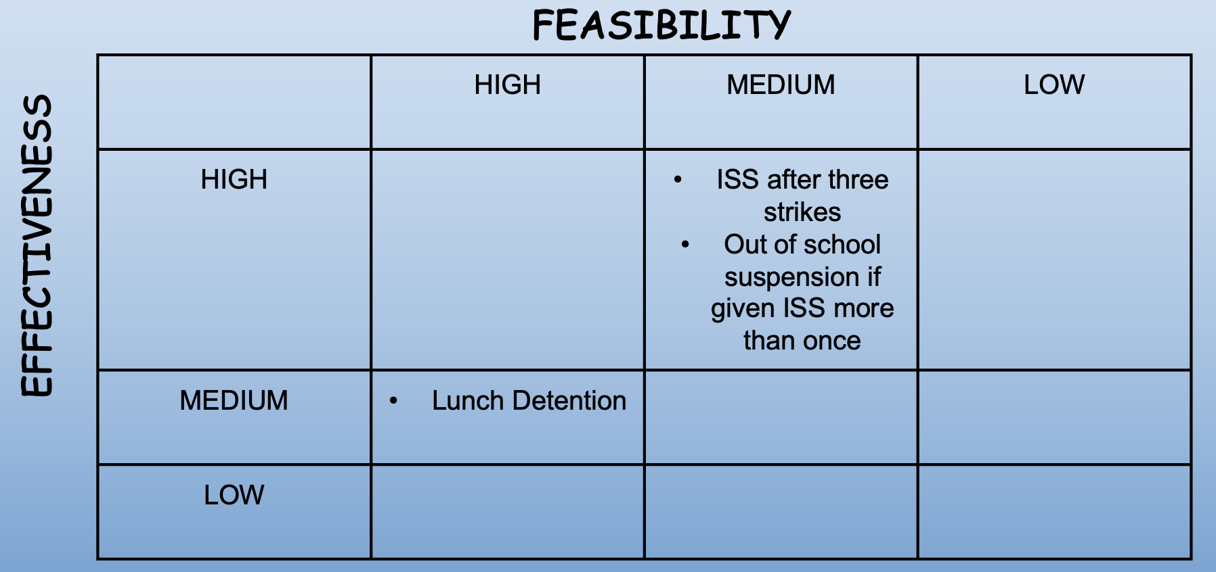
STEP 6:
SELECT THE BEST SOLUTION

