Slide 1
Digital
Divide
Elmer Ventura ~ Grade 4 ~ PS92Q (30Q092)

Slide 2
Overview of the 6 steps Public Policy Analyst (PPA):
1. Define the Problem
2. Gather the Evidence
3. Identify the Causes
4. Evaluate an Existing Policy
5. Develop Solutions
6. Select the Best Solution (Feasibility vs. Effectiveness)

Slide 3
Step One: Define Problem
What is the digital divide?
The digital divide describes the gap between people who have access to affordable, reliable internet service (and the skills and gadgets necessary to take advantage of that access) and those who lack it.
Notes:
Worksheet1: Defining the Social Problem
In one or two sentences, state the nature of the social problem.
The Socioeconomic Digital Divide: Is there a learning gap between students that have access to reliable internet service and those who lack it.
What is the specific community location of the social problem? Your answer should include both the governmental authority (e.g. school-board, city council) and the particular geographic location.
School Community: Our individual school (PS92Q).
List three undesirable social conditions that result from this problem:
Incomplete assignments
Low marking grades
Unable to attend remote learning environments.

Slide 4
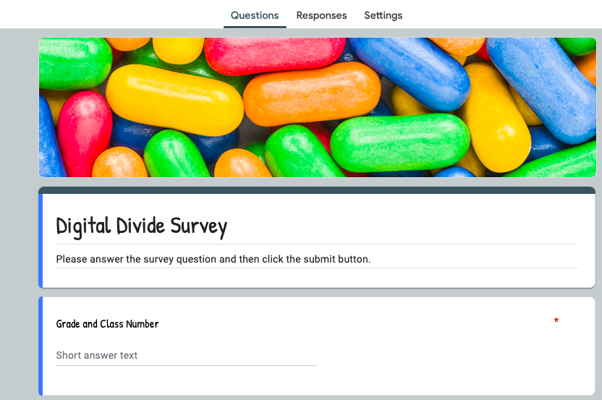
Step Two: Gather Evidence
Click on the video below to watch a news clip about the digital divide.
Click on the image below to complete the “Digital Divide Survey”.
Notes:
Worksheet2: Gathering evidence of the problem
Digital Divide in our school
Present evidence that a problem exists. Be as specific as possible and cite at least one source of data:
Student discussion.
News Clip
Create a school survey via Google Classroom.

Slide 5
Step Three: Identify the Causes
Socioeconomic Digital Divide in our school:
1. Title 1 school
2. Large population of students have a loaned device with cellular data.
3. Large number of new admits who are English Language Learners that have migrated from Latin America countries.
Notes:
Worksheet3: Identifying the causes of the problem
Briefly list several underlying factors that contribute to the problem that you have identified (support these factors with evidence:
Socioeconomic Digital Divide in our school
1. Title 1 school
2. Large population of students have a loaned device with cellular data.
3. Large number of new admits who are English Language Learners that have migrated from Latin America countries.

Slide 6
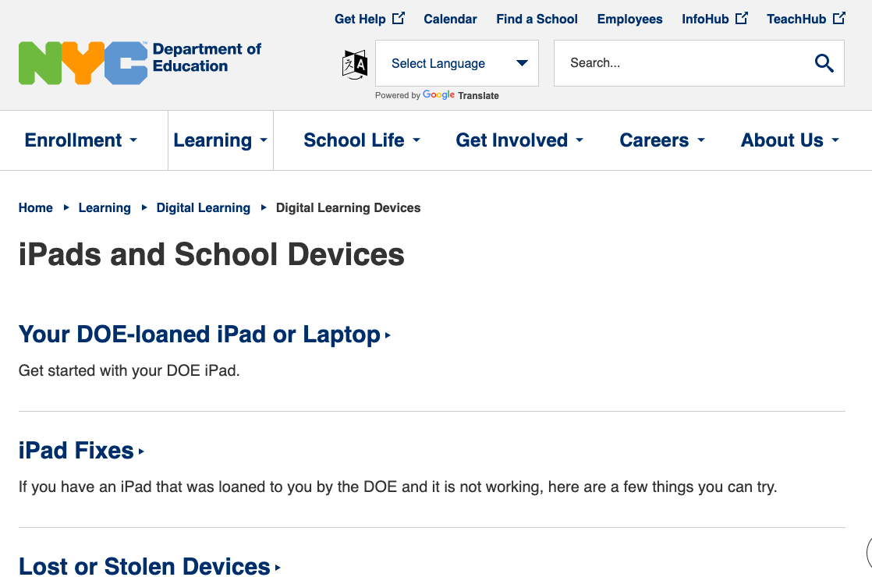
Step Four: Evaluate an Existing Policy
Click on the image to access information on how the NYC Department of Education is providing learning devices to students.
Notes:
Worksheet4: Evaluating existing public policies
Digital Divide in our school
1. State one of the major existing policies that attempts to deal with the social problem:
The New York City Department of Education has provided devices with internet access to students that request them.
2. What are the advantages of this policy (consider effectiveness, costs, enforcement, public acceptance):
Students have access to learning devices and internet access to complete assignments and attend remote learning environments.
3. What are the disadvantages of this policy? Consider effectiveness, costs, enforcement, public acceptance):
Some students and families need assistance in operating some of the devices.
4. Based on your evaluation of the advantages and disadvantages, should the current policy be totally replaced, strengthened, or improved? What advantages, if any, from the current policy should be retained? What disadvantages, if any, should be eliminated?
The current policy can be strengthened or improved by providing families with live support and access to language translation services.

Slide 7
Step Five: Develop Solutions
Public Policy Alternatives:
1- Free cable WIFI for all students.
2- Reduced WIFI cost for families with enrolled students.
3- Government; Free learning devices with internet access for all students.
4- Donors Choose or similar agencies to provide affordable learning devices and internet access.
Notes:
Worksheet5: Developing public policy solutions
Digital Divide in our school
1. Propose at least three new/original public policy alternatives. Be sure that all of your public policy alternatives are at the same geopolitical level as your social problem. Each alternative must specify the actual government or agency that will carry out the proposed action.

Slide 8
Step Six: Select the Best Solutions
FEASIBILITY
 | HIGH | MEDIUM | LOW
HIGH |  | Government Free WIFI | Free Cable WIFI
MEDIUM |  | Reduced WIFI Cost
LOW
EFFECTIVENESS
Notes:
Worksheet6: Selecting the best public policy solution
1. List the three public policy alternatives from Worksheet 5. Create a short word or abbreviation to summarize each policy and write it at the end of each policy.
Free cable WIFI
Reduced WIFI Cost
Government WIFI
2. Use the format in the example to complete the matrix below: See Slide#8
3. Discuss the reasons for your decisions in the matrix.
4. Discuss why your group prefers one alternative over the other two.

