Slide 1
Bullying
Alison Srour
PS 111 Jacob Blackwell
Room 306

Slide 2
Steps to a PPA
06
01
02
03
04
05
Select the best solution
Define the problem.
Gather the evidence
Identify the cause.
Examine an existing policy.
Develop new solutions

Slide 3
The Problem
01
Students are bullying each other inside and outside the classroom.

Slide 4
Turn and Talk:
What does bullying mean to you?
What are some examples of bullying?
Can bullying fall into many different categories? If so, what do you think they would be?

Slide 5
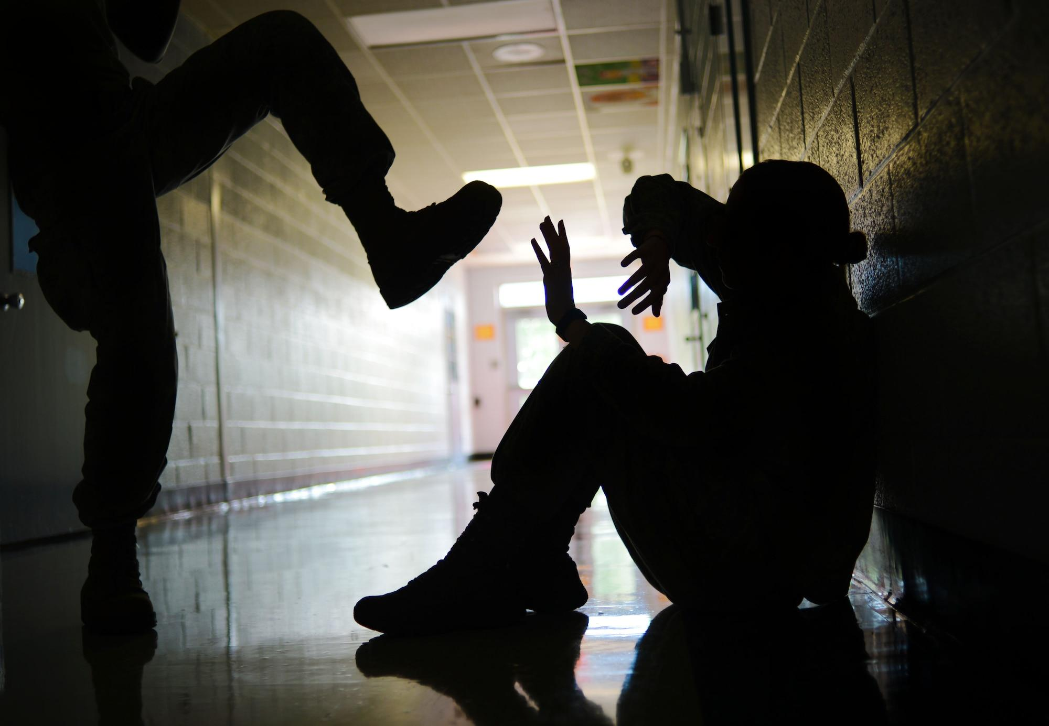
Cyberbullying
Verbal Bullying
Physical Bullying
Intentional and repeated harm inflicted through the use of computers, phones, and other electronic devices.
Cyber bullying can include:
abusive or hurtful texts, emails or posts, images or videos
deliberately excluding others online
nasty gossip or rumours
imitating others online or using their log-in.
Includes name calling, insults, teasing, intimidation, homophobic or racist remarks, or verbal abuse. While verbal bullying can start off harmless, it can escalate to levels which start affecting the individual target.
Includes hitting, kicking, tripping, pinching and pushing or damaging property. Physical bullying causes both short term and long term damage.
Notes:
https://www.ncab.org.au/bullying-advice/bullying-for-parents/types-of-bullying/

Slide 6
The Evidence
02

Slide 7
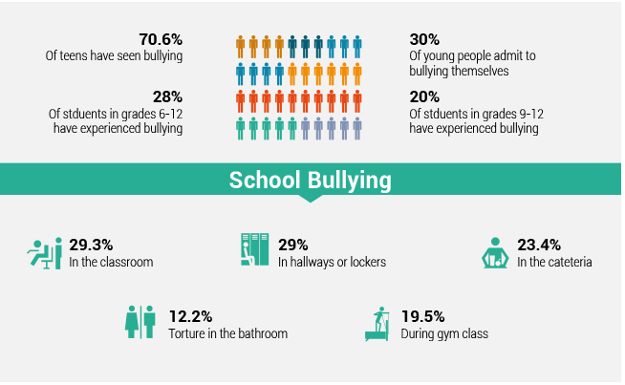
Notes:
https://reolink.com/blog/how-to-stop-bullying-in-schools/

Slide 8
Cyberbullying
There are several challenges for addressing cyberbullying. Parents suggest they lack the knowledge or time to keep up with their children's’ online behaviors. Schools are educating about cyberbullying with policies, training, and assemblies, yet don’t always know when and how to intervene in cyberbullying when it happens off campus. Law enforcement often can’t get involved unless there is clear evidence of a crime of threat to someone’s safety
49.8% of tweens (9 to 12 years old) said they experienced bullying at school and 14.5% of tweens shared they experienced bullying online
Reports of cyberbullying are highest among middle school students, followed by high school students, and then primary school students
The type of cyberbullying tends to differ by gender. Girls were more likely to say someone spread rumors about them online while boys were more likely to say that someone threatened to hurt them online
Notes:
https://www.pacer.org/bullying/info/stats.asp
https://reolink.com/blog/how-to-stop-bullying-in-schools/

Slide 9
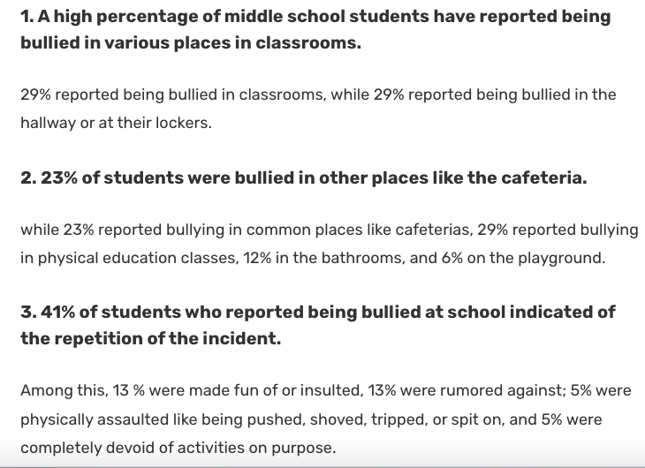
Bullying
Statistics
Notes:
https://admissionsly.com/bullying-statistics/

Slide 10
Identify the Cause
03

Slide 11
Make a list of 2 - 3 ideas per question
●Why do you think someone might be a bully?
●Why do you think someone might get bullied?
●What do you think the biggest cause of bullying might be?

Slide 12
Examine an Existing Policy
04
Notes:
https://www.stopbullying.gov/resources/laws/new-york
https://www.understood.org/en/articles/bullying-laws

Slide 13
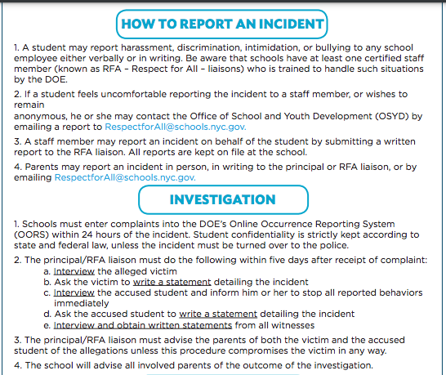
DOE Policy
Notes:
https://includenyc.org/wp-content/uploads/migrate/tip-sheets/What_to_Do_if_Your_Child_is_Bullied_inc.pdf

Slide 14
Anti Bullying Policies in New York
Key Elements
Designation of a school employee responsible for receiving reports of harassment, bullying, and discrimination;
Procedures for reporting, investigations, and documentation;
Requirements for the school to take prompt actions reasonably calculated to end the harassment, bullying, or discrimination, eliminate any hostile environment, create a more positive school culture and climate, prevent recurrence of the behavior, and ensure the safety of the student or students against whom such harassment, bullying, or discrimination was directed;
Prohibitions against retaliation against any individual who reports harassment, bullying, or discrimination;
Strategies to prevent harassment, bullying, and discrimination;
Requirements for notification of law enforcement for any incident of harassment, bullying, or discrimination that constitutes criminal conduct; and
Requirements for how the district policy will be publicized within the district.
New York anti-bullying laws require schools to regularly report data and trends related to harassment, bullying, and discrimination to the superintendent. New York anti-bullying laws also require the State to create a procedure for reporting incidents of harassment, bullying, and discrimination on an annual basis.
Notes:
https://www.stopbullying.gov/resources/laws/new-york

Slide 15
Develop A New Solution
05
Notes:
https://www.stopbullying.gov/resources/laws/new-york
https://www.understood.org/en/articles/bullying-laws

Slide 16
Preventing Bullying
How can we prevent bullying?
What are some things we can do as a school, as a class or as an individual to help prevent bullying?
List some ideas in your notebook with a partner.

Slide 17
Ideas Generated:
Role play scenarios and how we can handle different situations
Consequences for when someone is bullying another person
Educating others on bullying and the consequences that follow
Encourage positive talk and encourage them to do what they love

Slide 18
Select the Best Solution
06
Notes:
https://www.stopbullying.gov/resources/laws/new-york
https://www.understood.org/en/articles/bullying-laws

Slide 19
Solutions:
When we think about solutions, we ask ourselves
Which solution best fits our school and classroom?
How well does it work for us? (effectiveness)
How easily can we make this happen? (feasibility)

Slide 20
Feasibility
 | High | Medium | Low
High
Medium |  | -Consequences for when someone is bullying another person -Educating others on bullying and the consequences that follow
Low |  |  | Role play scenarios and how we can handle different situations Encourage positive talk and encourage them to do what they love
Effectiveness

