Slide 1
Supporting E.N.L Students
Supporting E.N.L Students
By: Seneha Sinanaj
MS/PS- 122Q- The Mamie Fay School
By: Seneha Sinanaj
MS/PS- 122Q- The Mamie Fay School

Slide 2
*What is the problem?
*After the pandemic the rate of language learning has remained stagnant or declined.

Slide 3
*Six Steps of PPA:
➢Define the problem
➢Gather the evidence
➢Identify the causes
➢Examine an Existing Policy
➢Develop New Solutions
➢Select the best solution

Slide 4
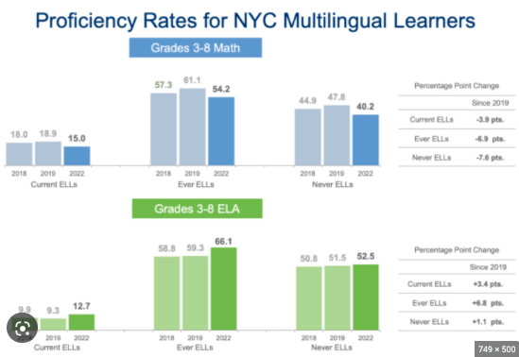
*What is the evidence?
*The evidence is:
Reading levels have dropped
Reading levels remained the same
In class assessment scores
State scores- ELA, Math, Science

Slide 5
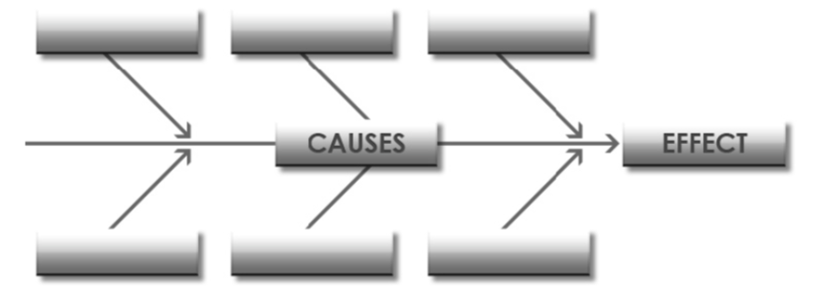
*What are the causes?
(Let’s make a list as a team)
1)
2)
3)

Slide 6
*What are the causes?
Nobody at home speaks English
Parents dont understand English so cannot complete homework
little or no access to technology that can help facilitate language learning
Little access to technology at school
No training to to utilize technology so cannot complete assignment
No translator
No translator device
Curriculum not differentiated to my specific language proficiency level
New to the country currently experiencing culture shock, parents at work all day
Pressure from state tests, in class tests, pressure from parents

Slide 7
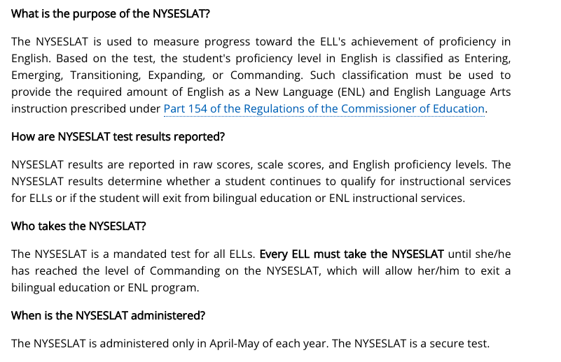
*What is the existing policy?
*The existing policy is to use formal standardized assessments to track growth in learning modalities:
reading, writing, listening, speaking
* New students to country are exempt from ELA state exam only for ONE year
* New students to country are NOT exempt from MATH state exam which entails multiple choice and writing intensive constructed responses
http://www.nysed.gov/bilingual-ed/english-language-learner-and-multilingual-learner-assessment-testing-accommodations

Slide 8
*What policies can we create to correct the problem?
*New students to the country should be exempt from both ELA, MATH, Science state testing for the first 5 years upon arrival. When the student fulfills 5 years in the new country only then will they be eligible for state testing. No exemption should be made for NYSESLAT State administration
* Provide ELLs with more access to technology in the classroom and device to go home with
*Create more remedial programs after school for ELLs targeting literacy

Slide 9
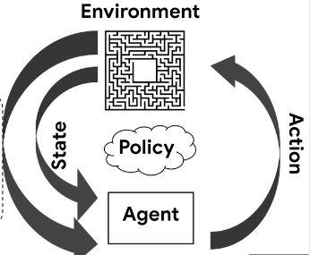
*What is the BEST policy to correct the problem?
*Allow new students to the country more time to learn English before they take state exams. Create more remedial programs after school for ELLs targeting literacy

Slide 10
*Select the Best Possible Solution:
Feasibility
Effectiveness: |  | HIGH | MEDIUM | LOW
 | HIGH | Incorporate more new vocabulary in my writing. Use more compound and complex sentences, cognates, reading on a daily basis and translating my own material
 | MEDIUM |  | Use technology for all uses throughout the day during formal and informal conversations and work
 | LOW |  |  | Use technology for all uses throughout the day during formal and informal conversations and work and a interpreter

