Slide 1
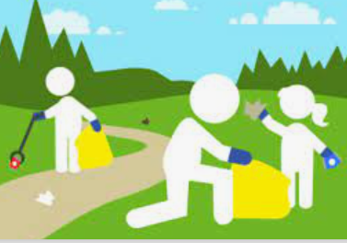
Litter
P.S. 85Q
Jahaira Segarra

Slide 2
6 Steps of the Public Policy Analyst
1. Define the Problem
2. Gather Evidence
3. Identify the Causes
4. Evaluate an Existing Policy
5. Develop Solutions
6. Select the Best Solutions

Slide 3
Step 1: Define the Problem

Slide 4
What is litter?

Slide 5
There is so much garbage being thrown on the streets every day.

Slide 7
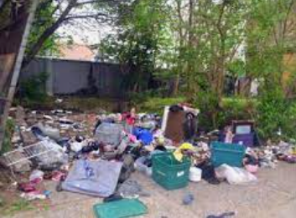
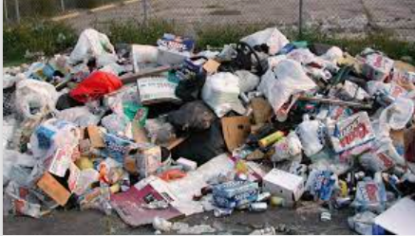
Step 2: Gather Evidence

Slide 8
We can survey the people in our community

Slide 9
Step 3: Identify the Causes

Slide 10
Why is there so much garbage in our community?
There are not enough garbage cans/bins on the streets
There are no many recycling bins many buildings or schools
Cleaning up the streets or recycling has not been such a priority anymore.

Slide 11
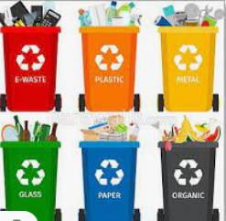
Step 4: Evaluate Existing Policy

Slide 12
According to the DSNY Department of Sanitation New York), it is illegal to litter in New York.
Although it is illegal it is not strongly enforced.
The DSNY has a list of where the garbage bins are in the city.

Slide 13
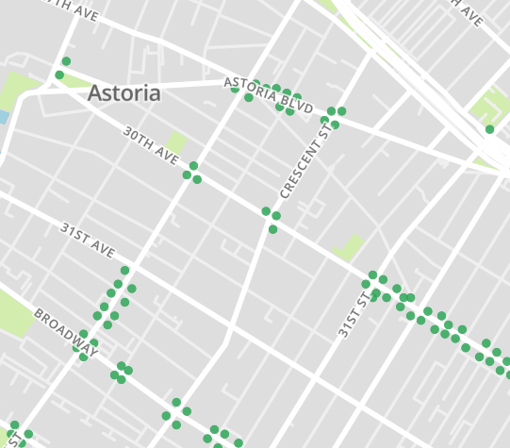
There are barely any garbage bins near our school community.

Slide 14
Step 5: Developing Solutions

Slide 15
Working Together
We can do our part in school and recycle and not throw away stuff on the floor. We can have a class or grade competition on who collects the most.
We can have a competition with other schools in our district.
We can get our community involved. We can have our parents get involved and start a petition to get more garbage bins near our school community.

Slide 16
Step 6: Select the Best Solution

Slide 17
Which one is the best one?

