Slide 1
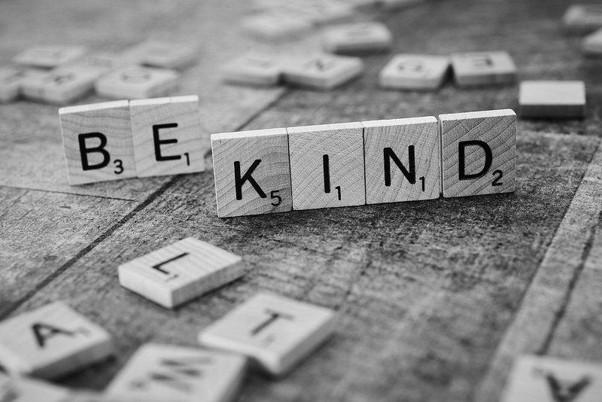
Respect and Kindness
In Elementary Schools
Viki Brenner
PS 148Q
The Ruby G. Allen School
2023-2024

Slide 2
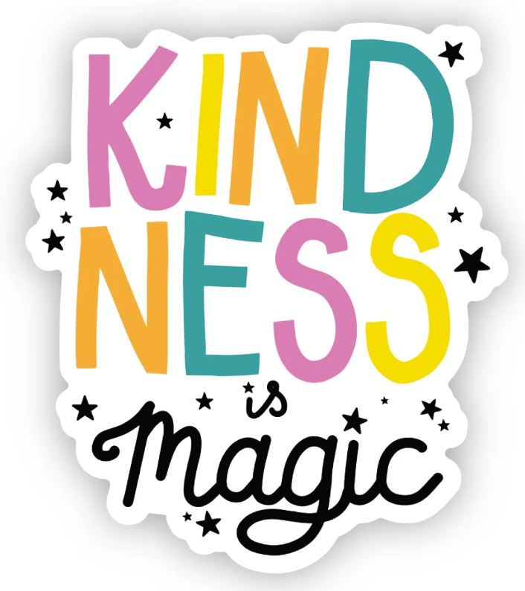
6 Steps of the Public Policy Analyst (PPA)
1. Define the Problem
2. Gather the Evidence
3. Identify the Causes
4. Evaluate an Existing Policy
5. Develop Solutions
6. Select the Best Solution (Feasibility vs. Effectiveness)
PS 148Q - The Ruby G. Allen School

Slide 3
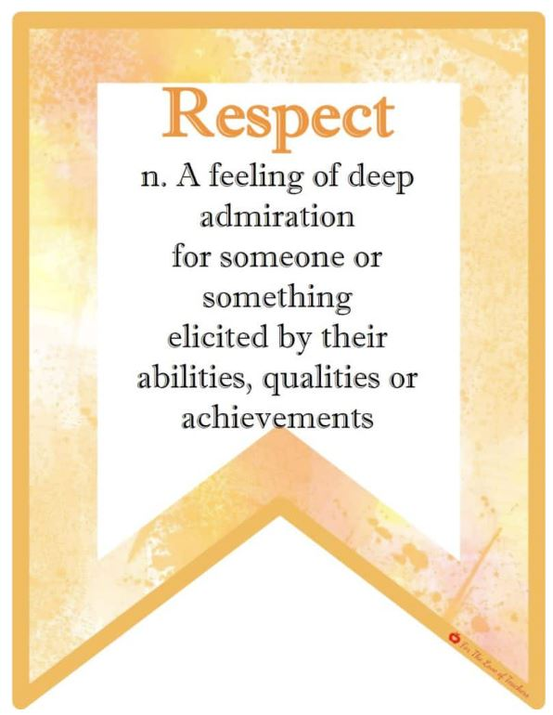
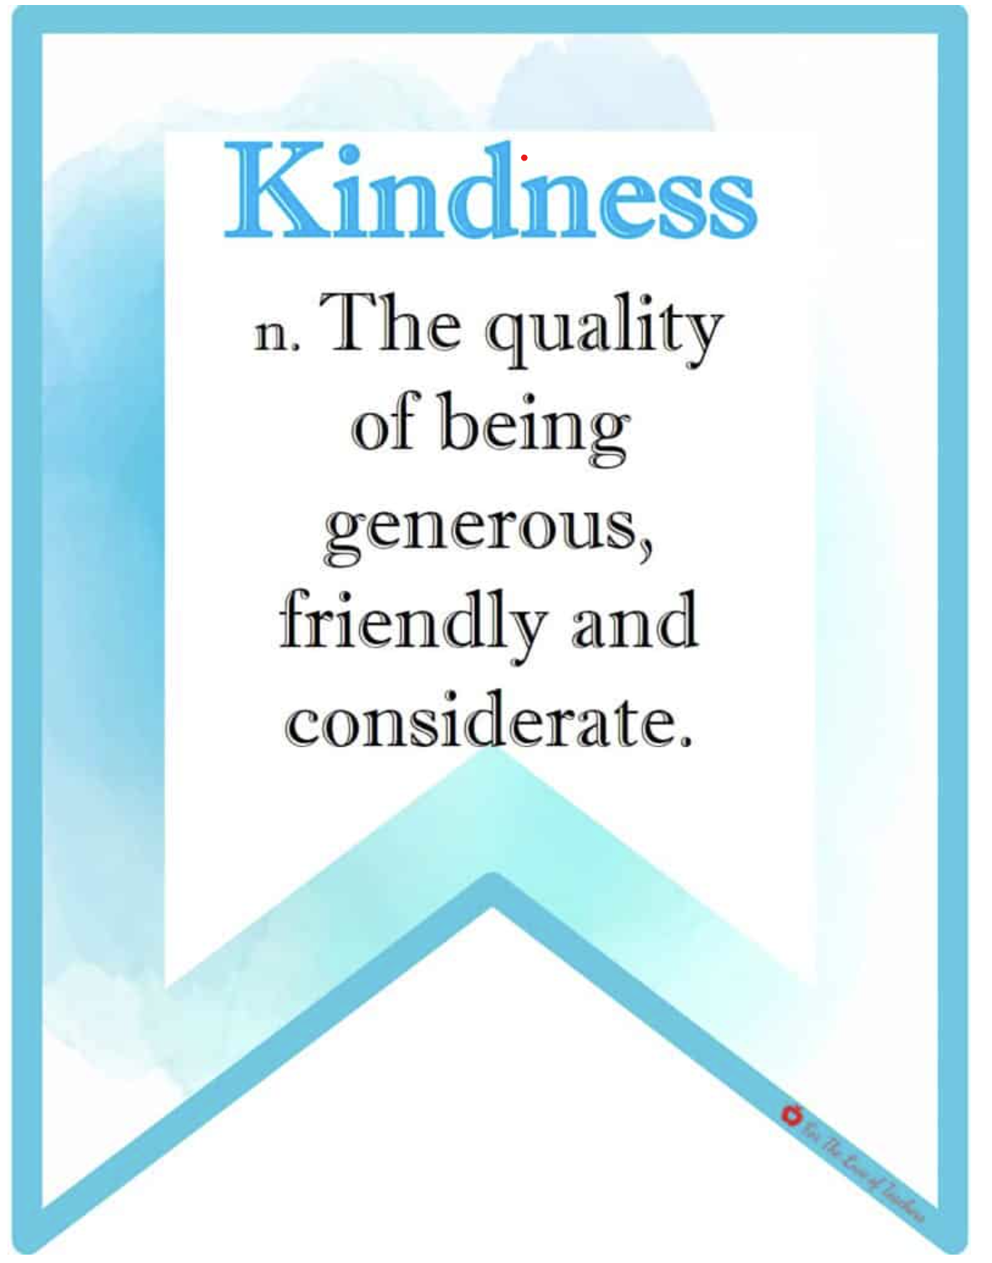
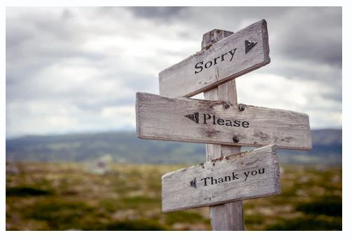
PS 148Q - The Ruby G. Allen School

Slide 4
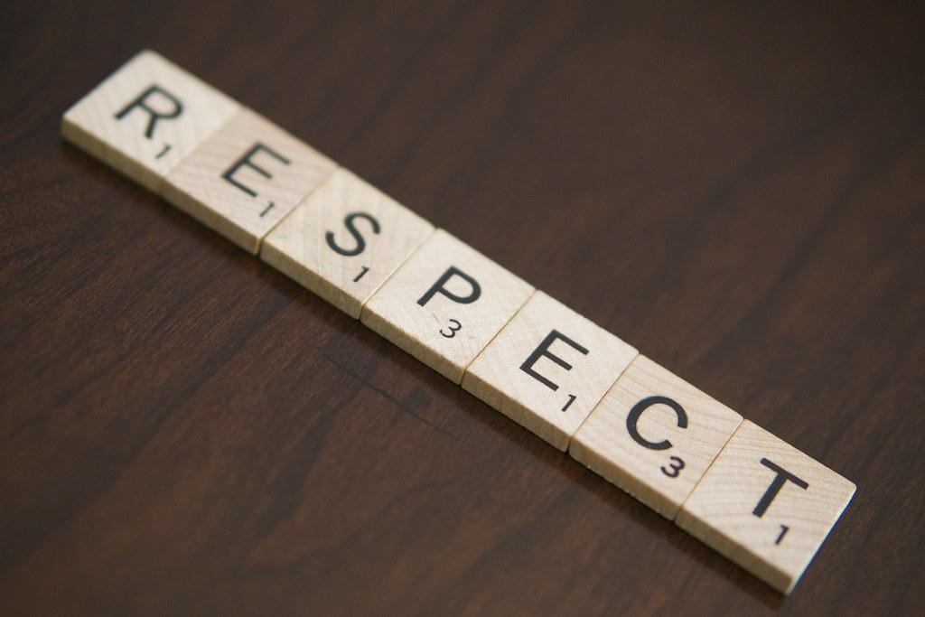
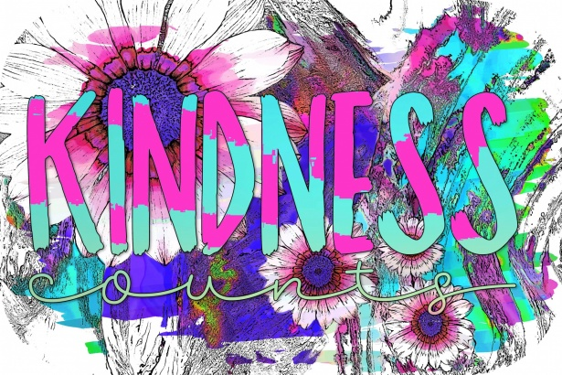
DEFINE THE PROBLEM
Students are speaking rudely to their classmates and their teachers. This is occurring currently at The Ruby G Allen School PS 148Q, East Elmhurst Queens, New York.
PS 148Q - The Ruby G. Allen School

Slide 5
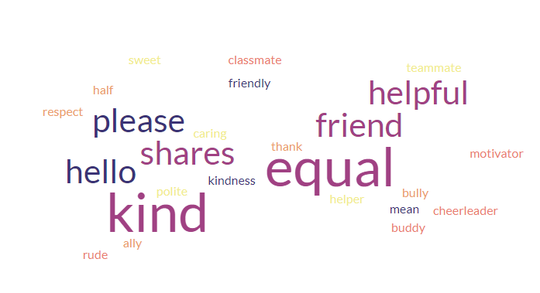
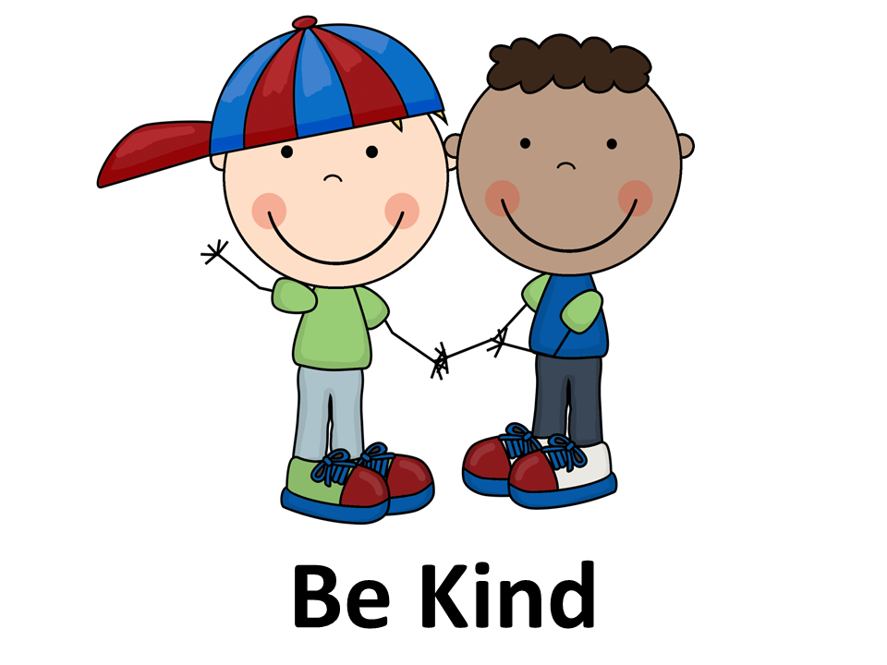
DEFINE THE PROBLEM
What does the word kindness mean to you?
Students in our classroom community used Word Cloud, and came up with words that made them think about how they see kindness.
PS 148Q - The Ruby G. Allen School

Slide 6
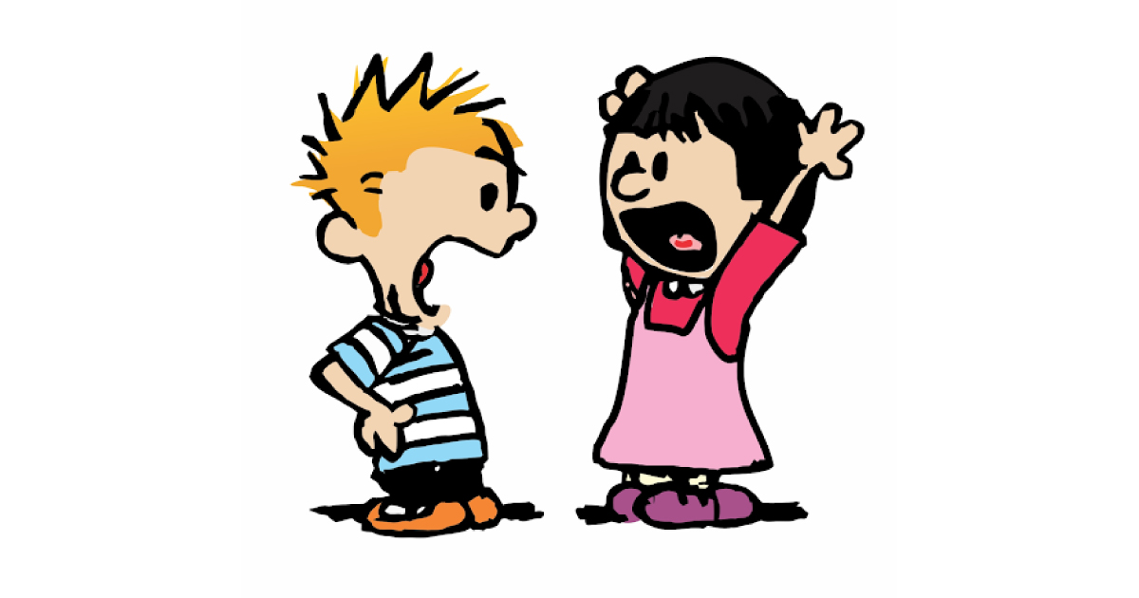
2. GATHER THE EVIDENCE
Students are being disrespectful of their peers in the classroom while learning is happening.
Students are using unkind words towards their peers,
in the classroom and during unstructured time.
(Lunch, recess, hallway transitions, staircase)
Students are not using any manners when
working with peers and talking to adults.
PS 148Q - The Ruby G. Allen School

Slide 7
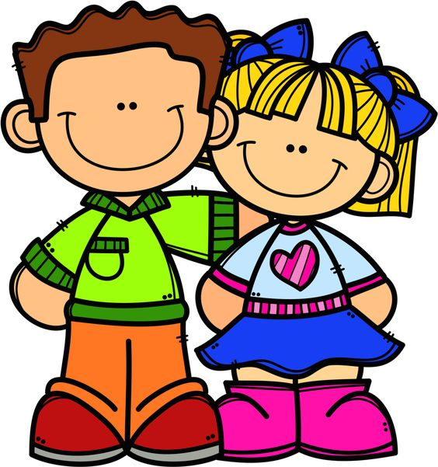
3. IDENTIFY THE CAUSE
Allow students the opportunity to identify why classmates might be unkind toward another peer.
Students unable to speak the same language and are unable to communicate properly.
Students may not have prior school experience
(newcomers, prekindergarten students) and they do not know
how to act in certain situations.
No parental control and students are left with older sibling,
family members, or social media to teach them.
PS 148Q - The Ruby G. Allen School

Slide 8
4. EVALUATE THE POLICY
Currently at the PS 148 school, we use:
Calming words to talk to peers and teachers.
We discuss the proper way to speak and display proper manners.
Provide students with options and opportunities to display kindness and respect.
Provide students with disabilities role playing opportunities.
PS 148Q - The Ruby G. Allen School

Slide 9
5. DEVELOP A SOLUTION
Students are provided opportunities to view via live school assemblies various role playing scenarios.
School wide incentives to highlight positive behaviors and being a kind citizen.
Students will be rewarded with additional incentives for demonstrating kindness and respect.
Meetings with parents and school personnel to create a plan.
PS 148Q - The Ruby G. Allen School

Slide 10
5. DEVELOP A SOLUTION
After having discussions with the students some students were unaware of their behavior. We tend to live in a world where it may be “cool” to roast or be mean to someone in a funny way. Many cultures do not have this as common practice and students are learning from their classmates. Some students were not intentionally being unkind or disrespectful. Some students didn’t have good models of kindness and respect in their lives.
Students need explicit modeling and guidance on how to deal with classroom situations.
Recognize students when they demonstrate kindness, good manners, empathy, and respect for others. This intentional acknowledgment leads to positive outcomes.
School wide assemblies and recognition on social media (with consent). Kindness campaign!
PS 148Q - The Ruby G. Allen School

Slide 11
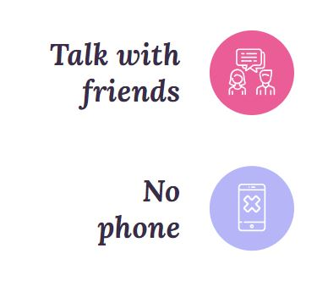
5. DEVELOP A SOLUTION
Use positive approaches when talking about acceptable and unacceptable behaviors.
Provide one-on-one feedback to students, instead of reprimanding them in front of their classmates for unacceptable behavior.
Work with students to develop their classroom expectations.
Together with the class develop a list of behaviors that they should exhibit in the
classroom to make the environment friendly, respect and enjoyable.
Model positive classroom behaviors!
Demonstrate a random act of kindness.
PS 148Q - The Ruby G. Allen School

Slide 12
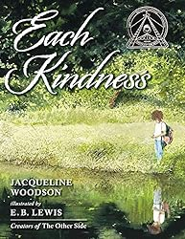
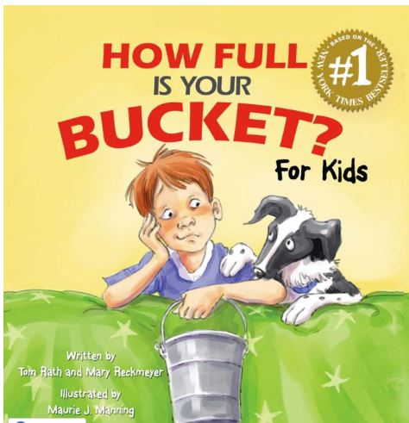
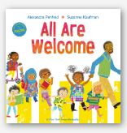
Teaching Kindness
Through Books
PS 148Q - The Ruby G. Allen School

Slide 13
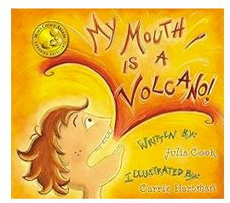
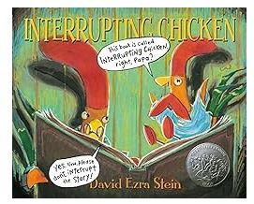
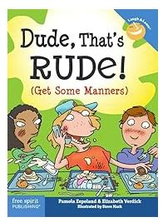
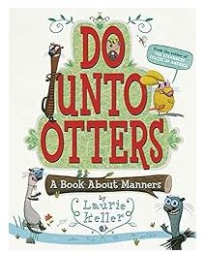
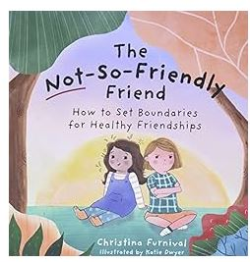
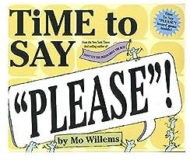
Teaching Respect and Good Social Skills Through Books
Students need to have a clear understanding that kindness, respect and being an overall good person is an important part of being a good citizen.
PS 148Q - The Ruby G. Allen School

Slide 14
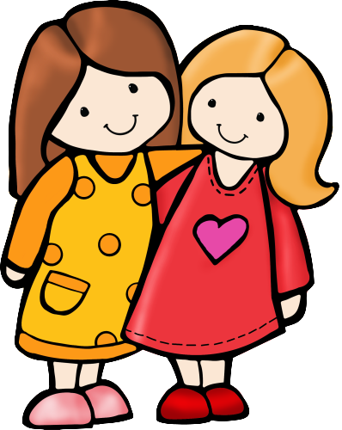
6. SELECT THE BEST SOLUTION
In the world we live in it is critical to bring kindness and respect back into classrooms each and every day to create kind and respectful human beings.
Feasibility
 | High | Medium | Low
High | Kindness campaign Highlights
Medium |  | Teacher and student role play
Low |  |  | Parent Meetings with Guidance and Administration
Effectiveness
PS 148Q - The Ruby G. Allen School

Slide 15
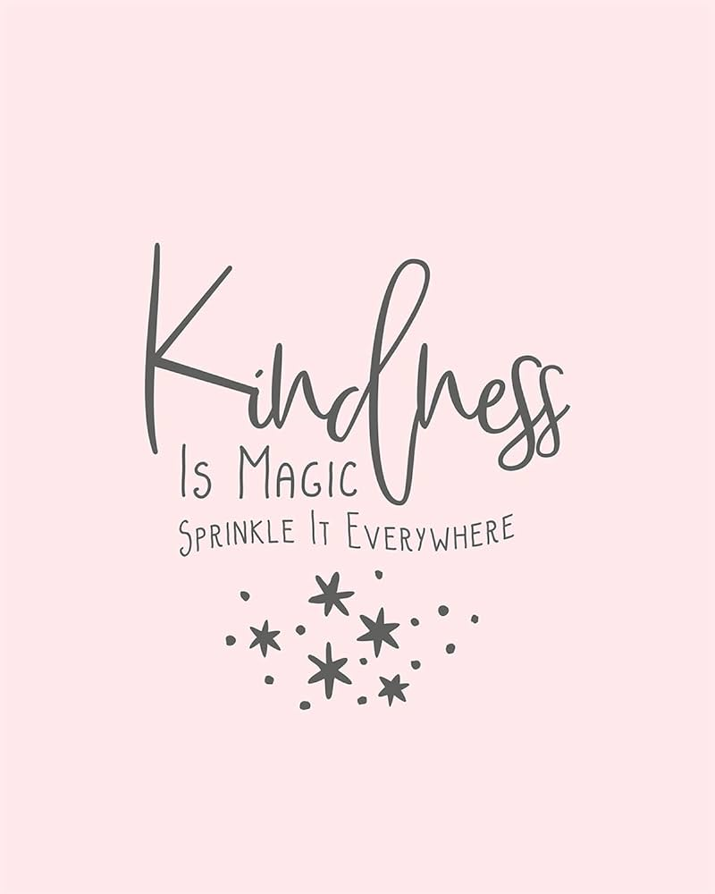
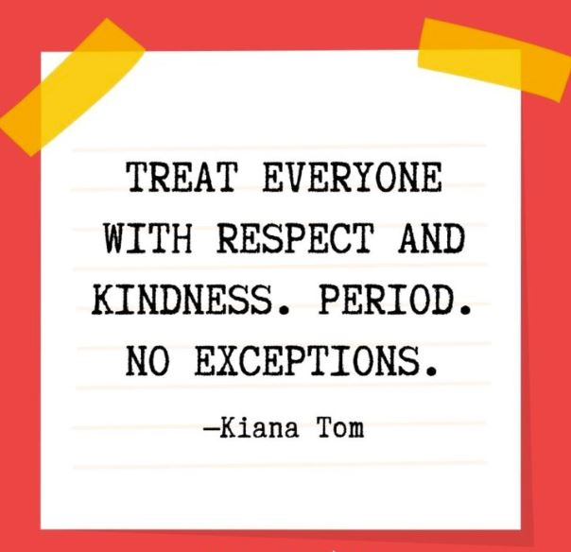
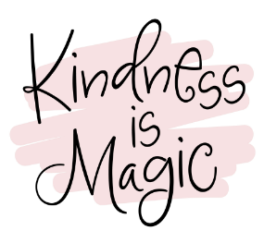
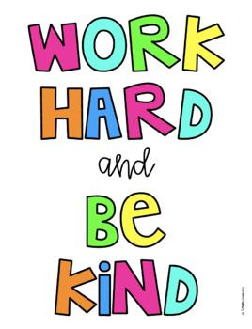
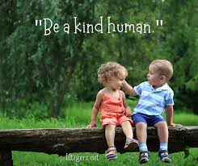
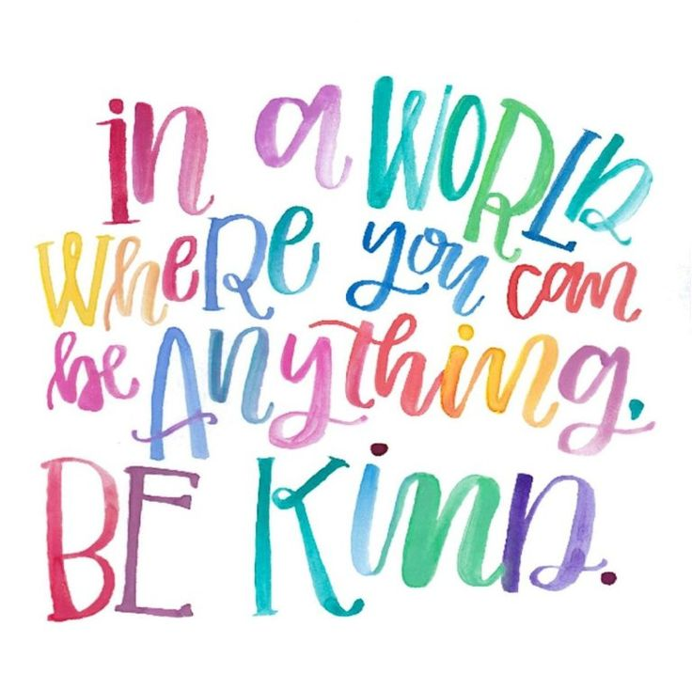
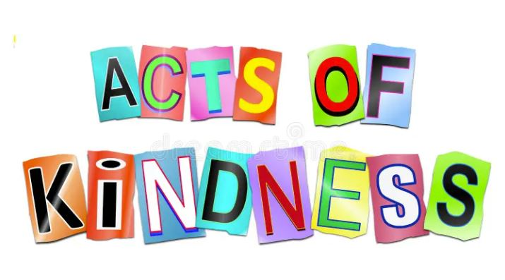

Slide 16
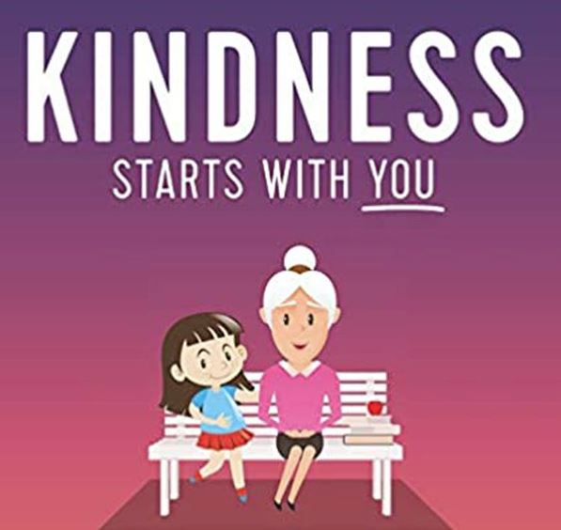
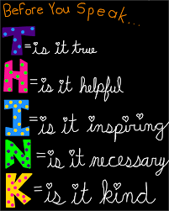
Slide layout from Slidego
Images from Google, various clipart sites

