Slide 1
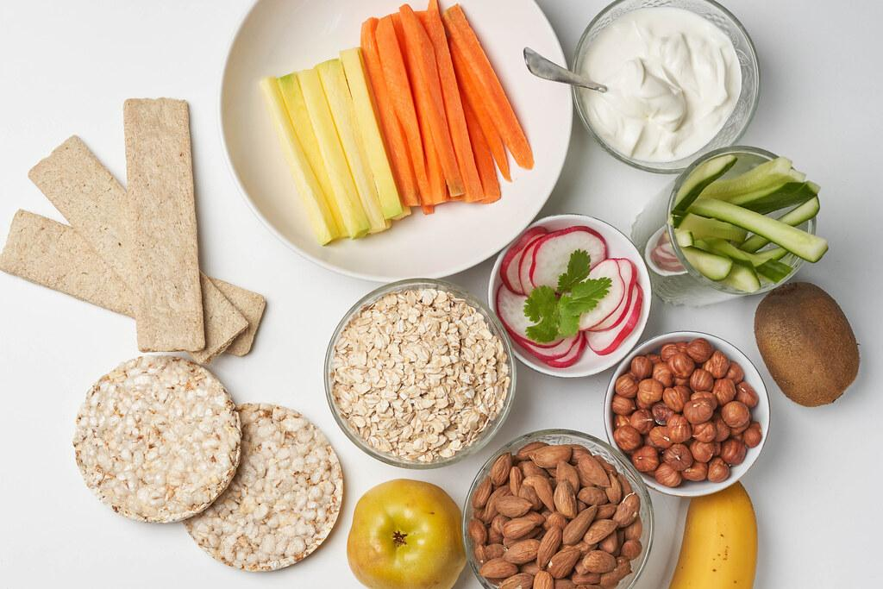
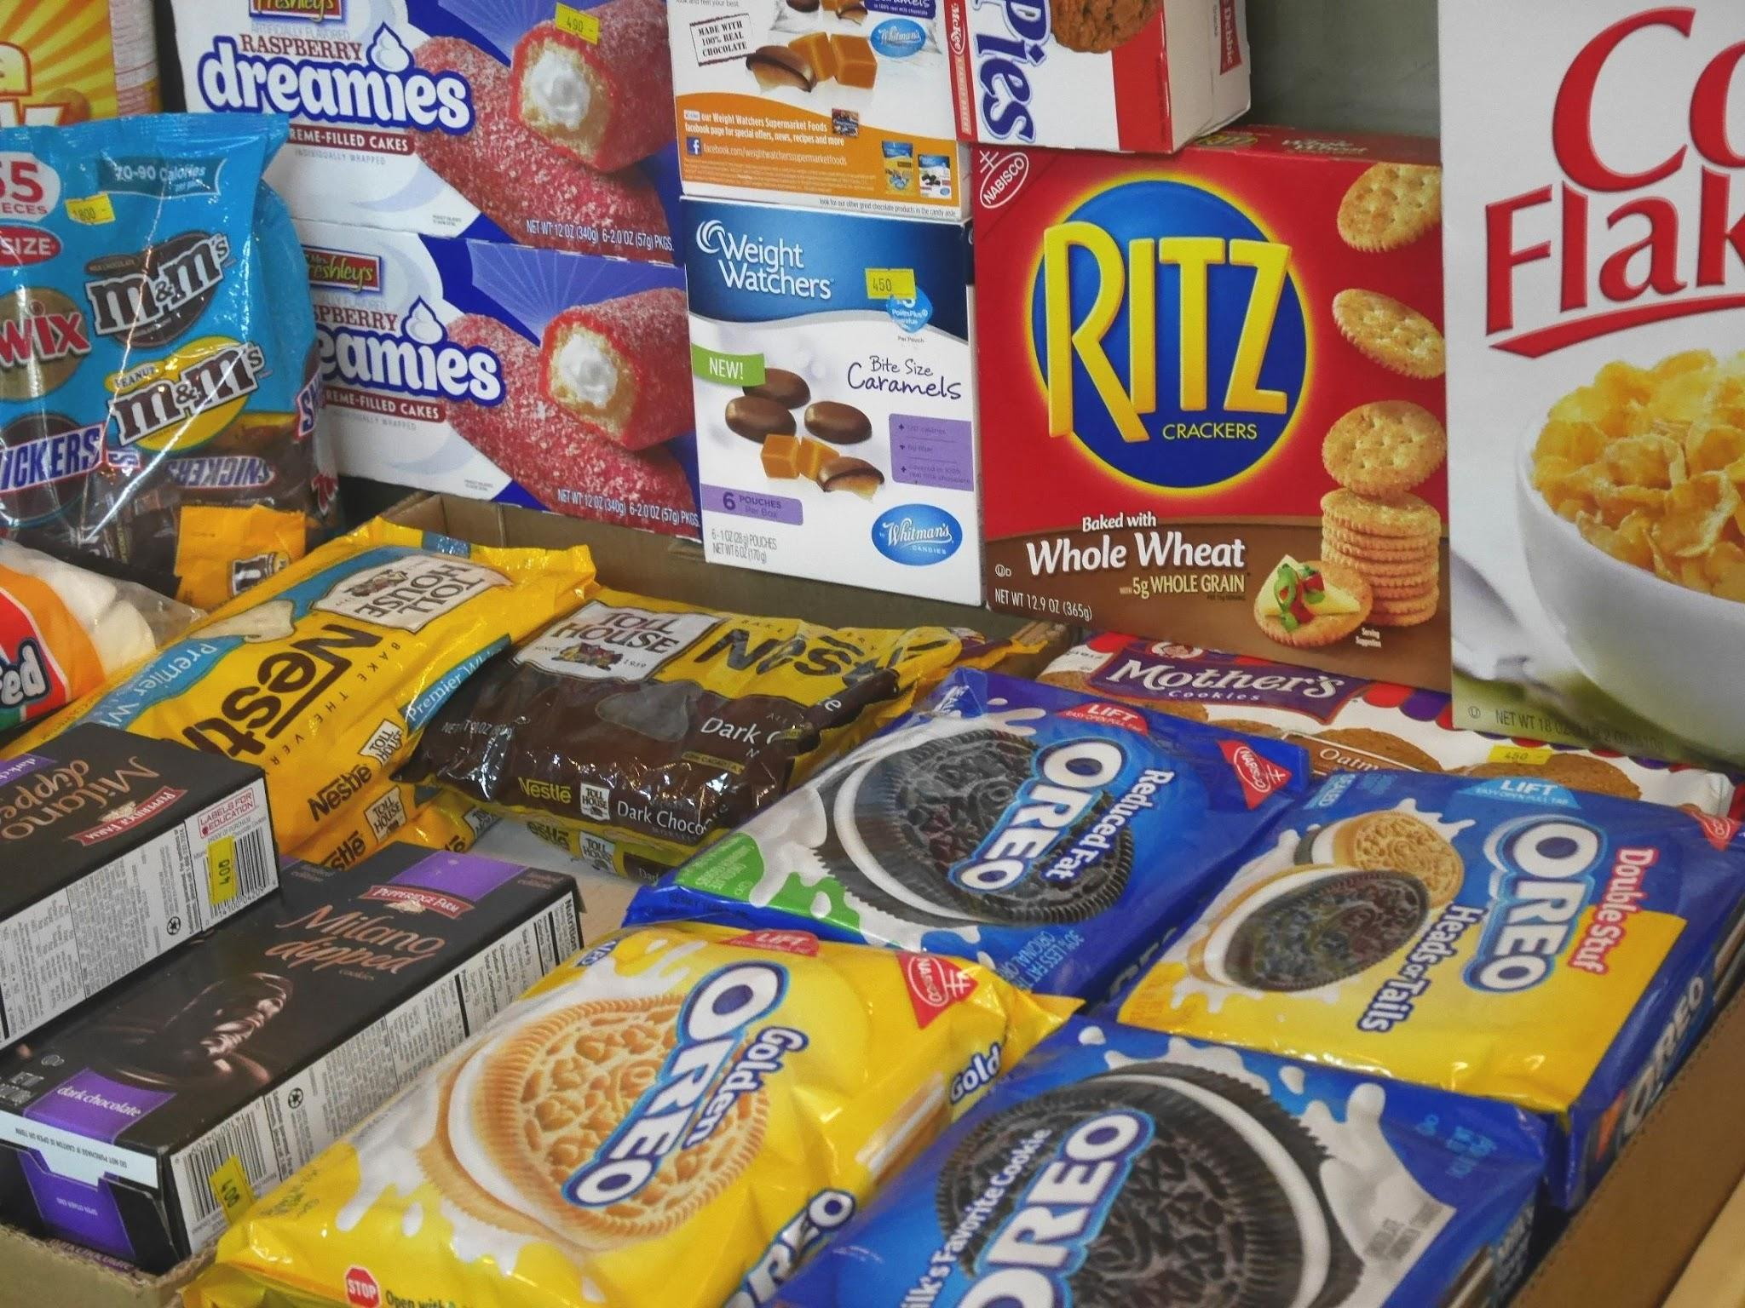
Got Snacks?
Suzanne Saltzman
How can we practice healthy eating in the classroom?

Slide 2
The 6 Steps of the Public Policy Analyst (PPA)
1. Define the Problem
2. Gather the Evidence
3. Identify the Causes
4. Evaluate an Existing Policy
5. Develop Solutions
6. Select the Best Solution (Feasibility vs. Effectiveness)

Slide 3
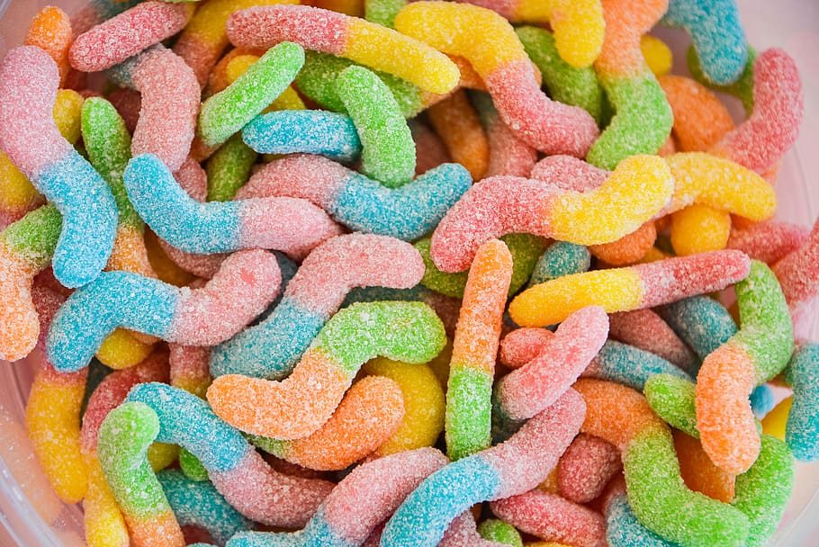
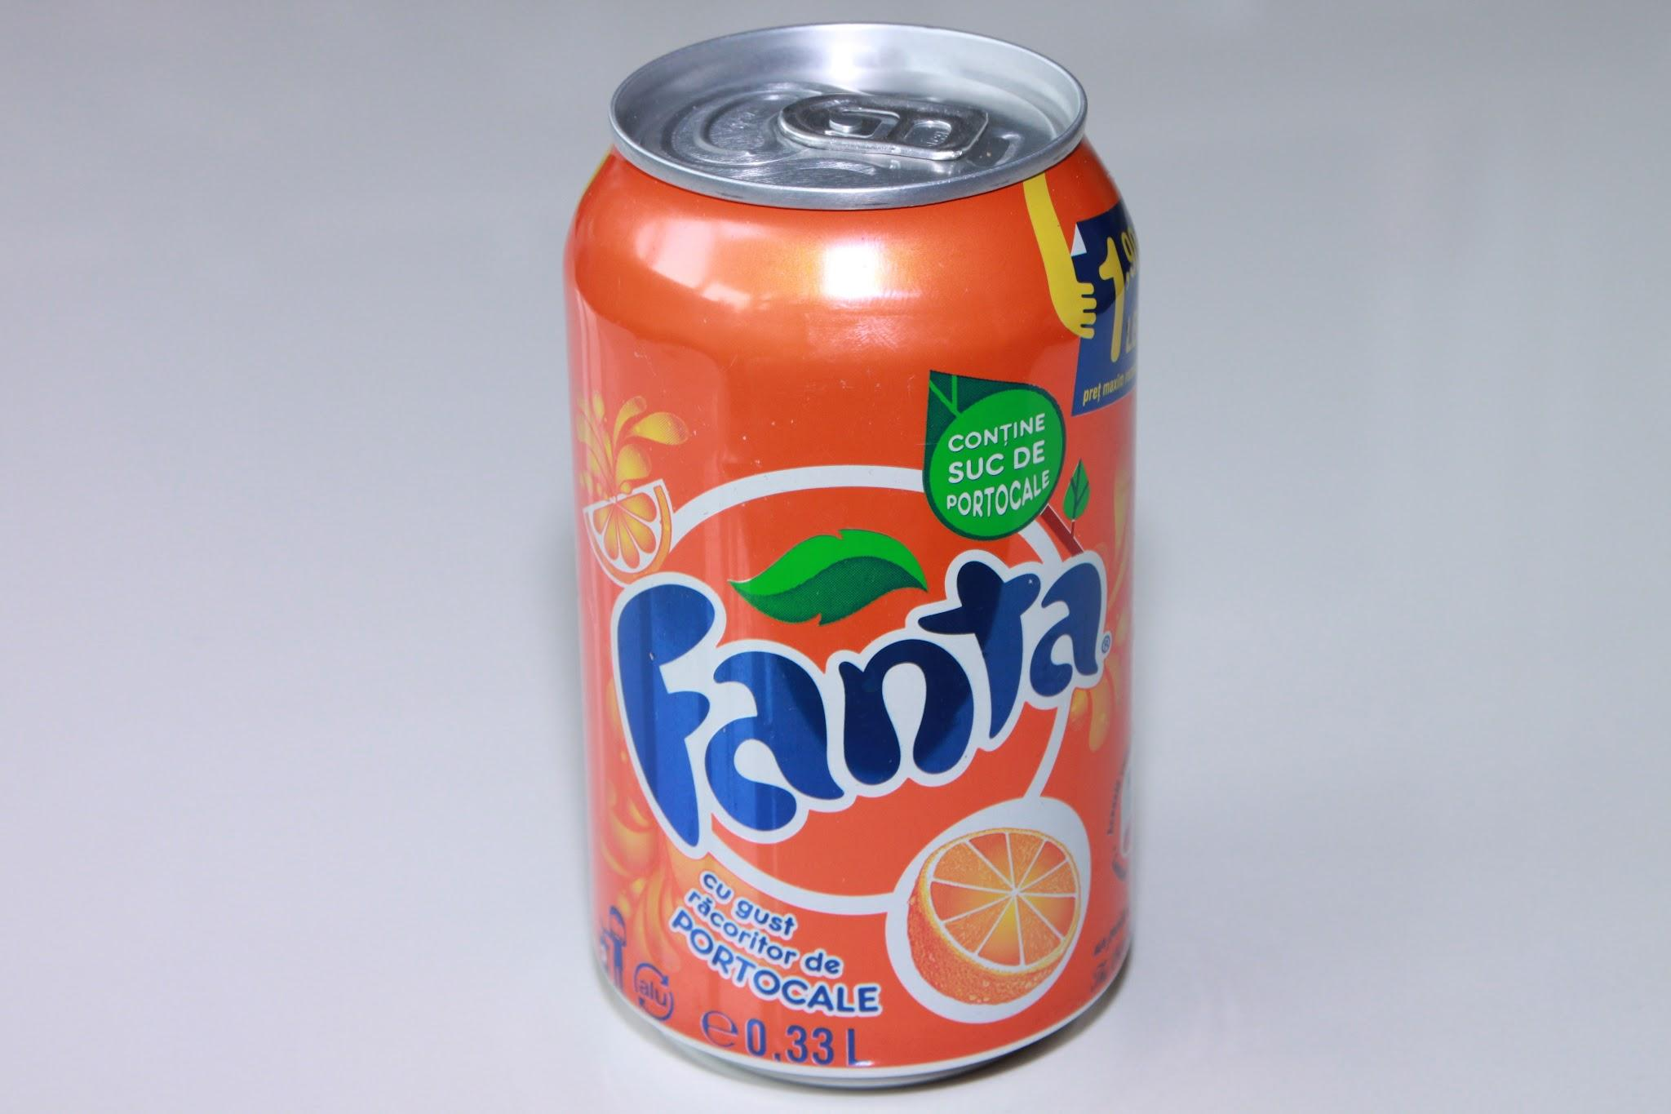
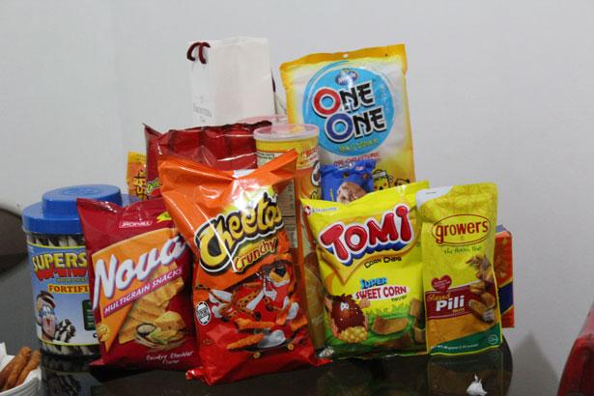
Step 1: What is the problem?
The problem is that students bring unhealthy snacks to school.

Slide 4
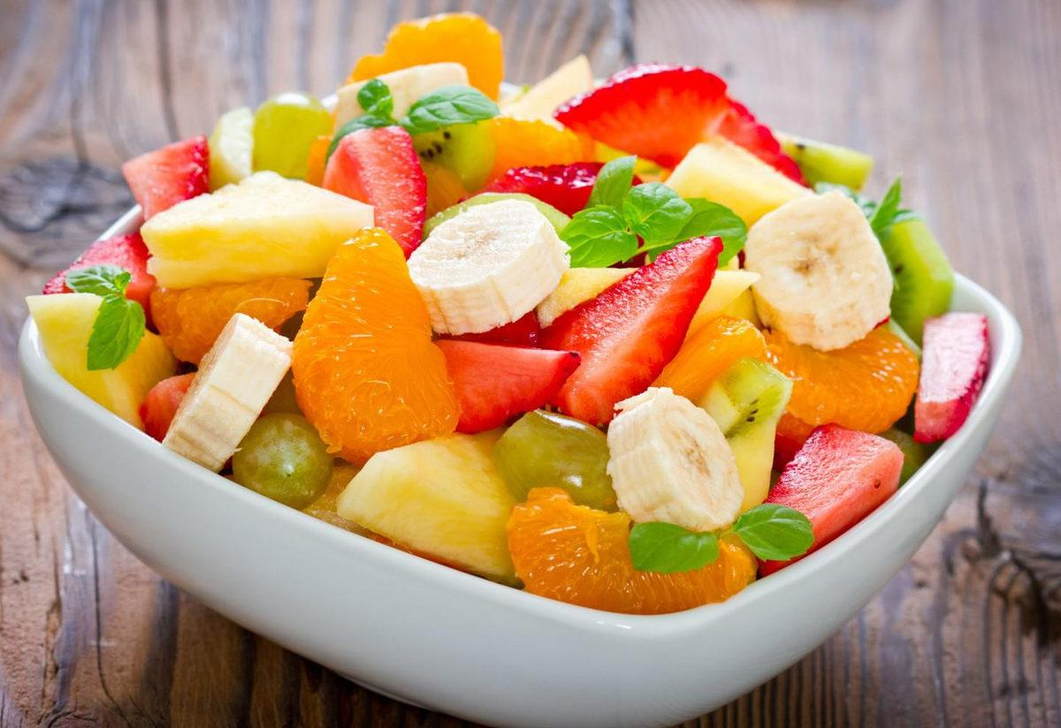
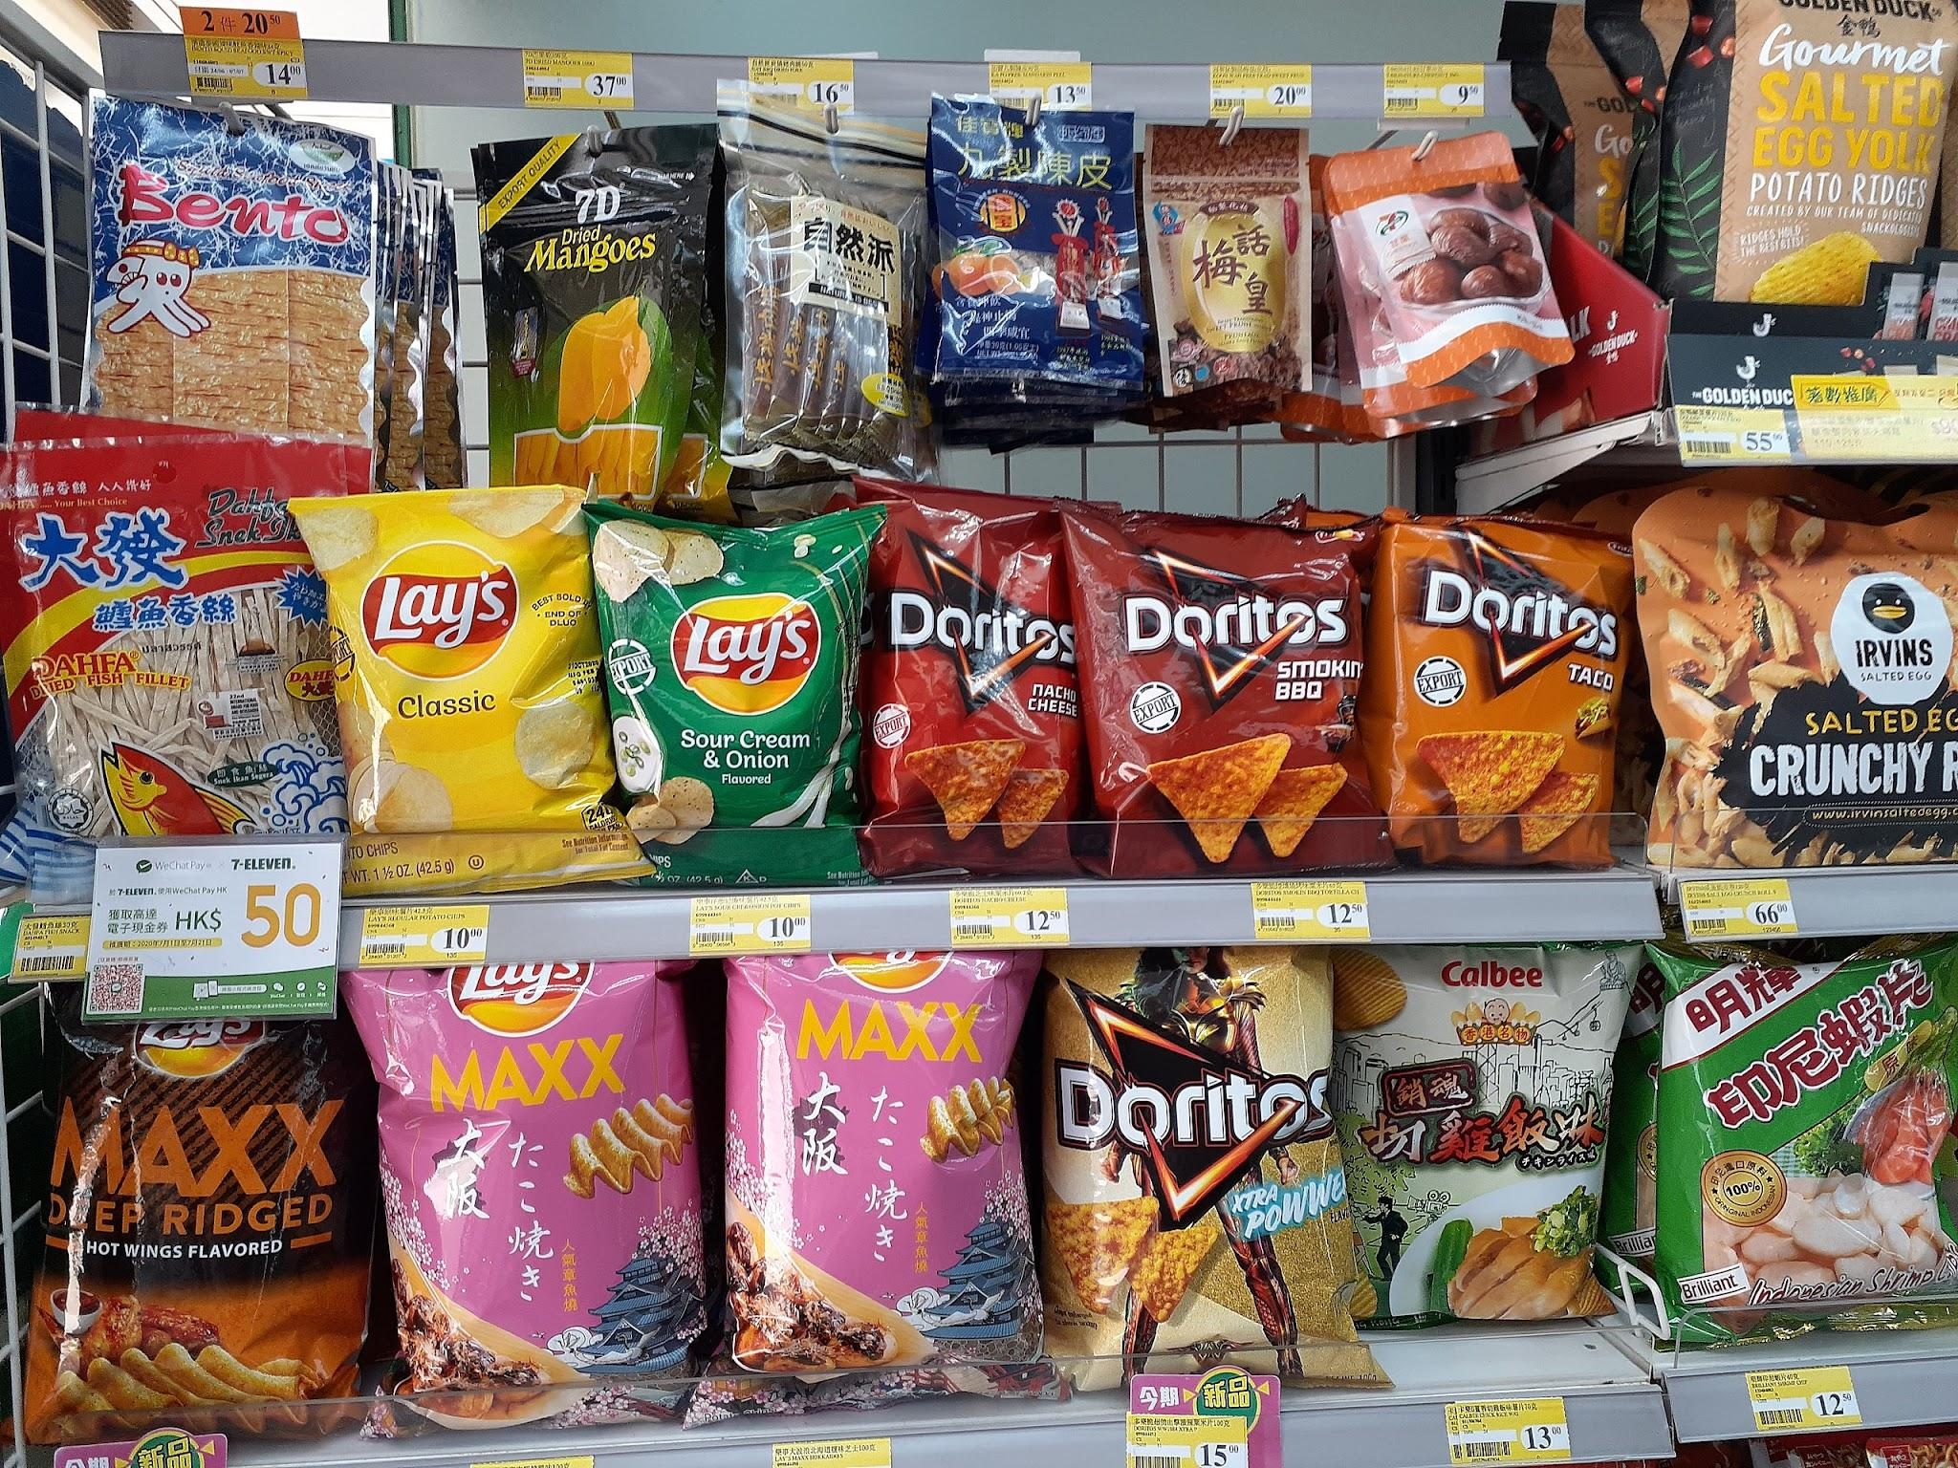
Step 2: Gather the evidence
Turn and talk to your partner what a healthy snack is and what your brought in today?
Healthy Fruit Veggies Cheese Yogurt water | Unhealthy Chips Cookies Candy Soda

Slide 5
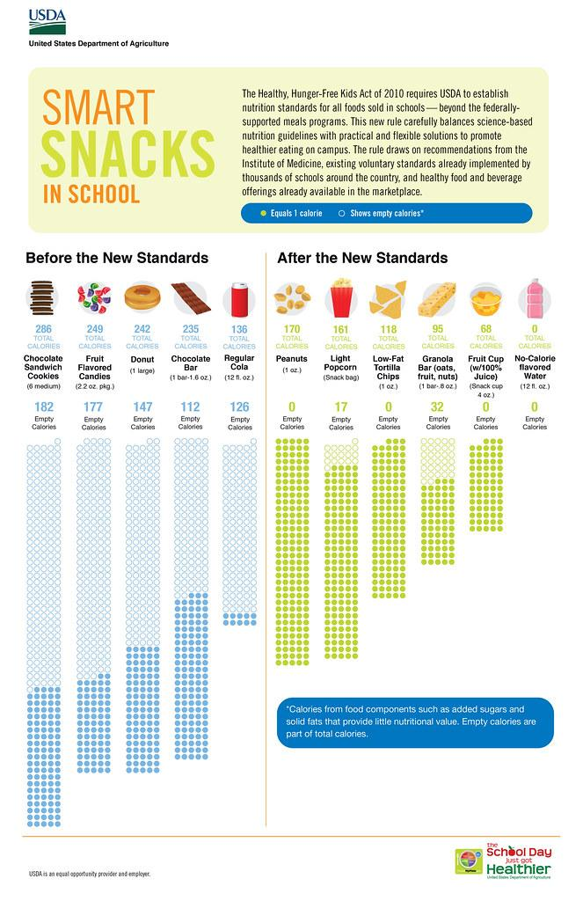
Step 3: Identify the Cause
*Healthy snacks are expensive.
*Takes time to prepare healthy snacks.
*Students rather have junk food.

Slide 6
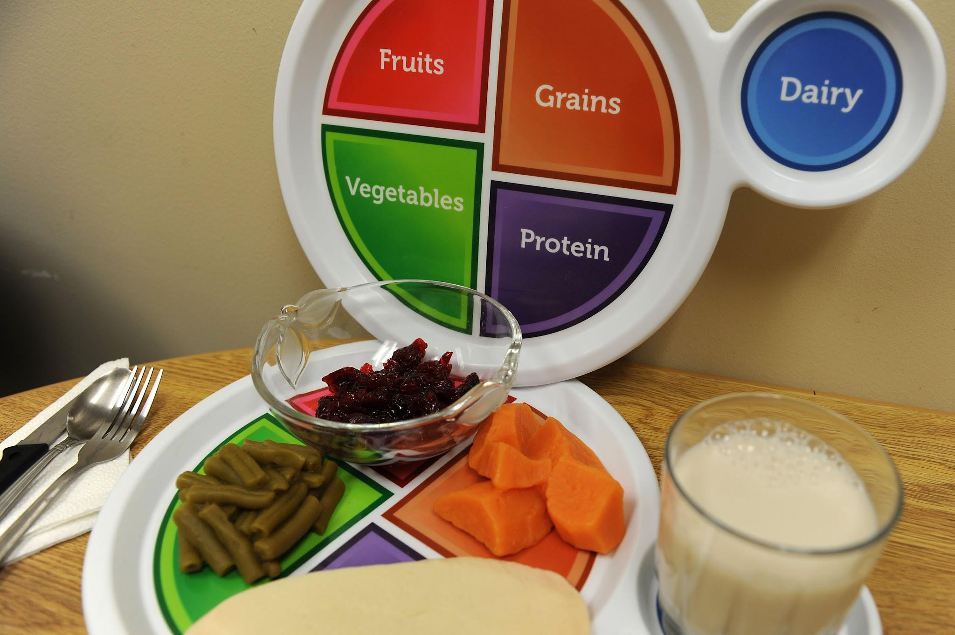
Step 4: Evaluate Existing Public Policy
The Benefits of Healthy Eating
As children grow and develop, they need important nutrients to be strong and healthy. Some of the benefits of healthy eating include:
Stable energy
Strong bones and teeth
Improved mental health: Makes us think clearly and be more alert
Maintaining a healthy weight
Preventing chronic diseases
Good Nutrition

Slide 7
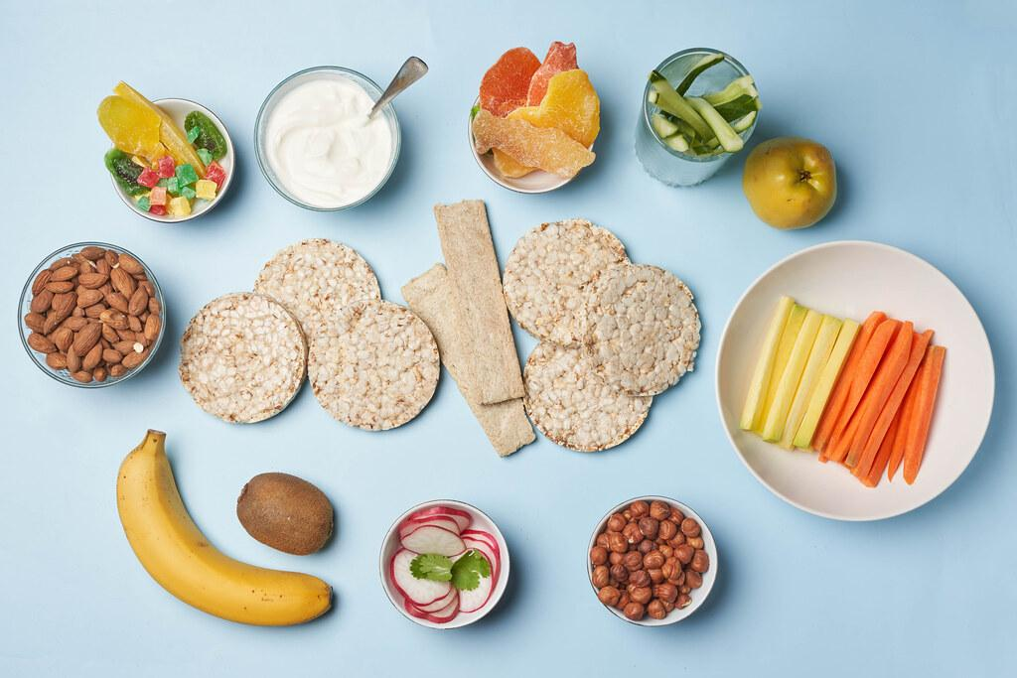
Step 5: Developing Public Policy Solutions
Provide students with healthy choices of different snacks.
Find inexpensive healthy snacks.
Provide parents with information to support them in healthy choice selections.

Slide 8
Step 6: Selecting the Best Public Policy Solution
Feasibility
E
F
F
E
C
T
I
V
E
N
E
S
S
 | High | Medium | Low
High | Provide parents with information of healthy snacks.
Medium |  | Provide healthy snacks for kids.
Low | Find inexpensive snacks.

