Slide 1
No Time to Waste
A look at becoming a Zero Waste School
How can we make sure our waste is going to right spot?
Fred Salamone, Peter G. Van Alst P.S.171Q

Slide 2
What is a PPA (Public Policy Analyst)?
A public policy is a government action usually intended to deal with a social problem.
The Six Steps of the PPA
Define the problem
Gather evidence
Identify causes
Evaluate a policy
Develop solutions
Select best solution

Slide 3
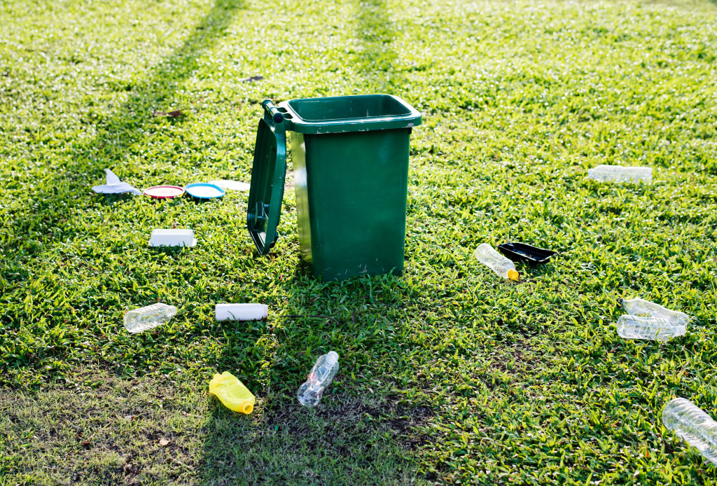
Define the Problem
Our school is not a Zero Waste School. There are many times in the classroom and the lunchroom where our waste is not ending up in the correct space. Discarding waste incorrectly can impact our school, community, and world.
Guiding Question: Why is discarding a waste incorrectly a problem?

Slide 4
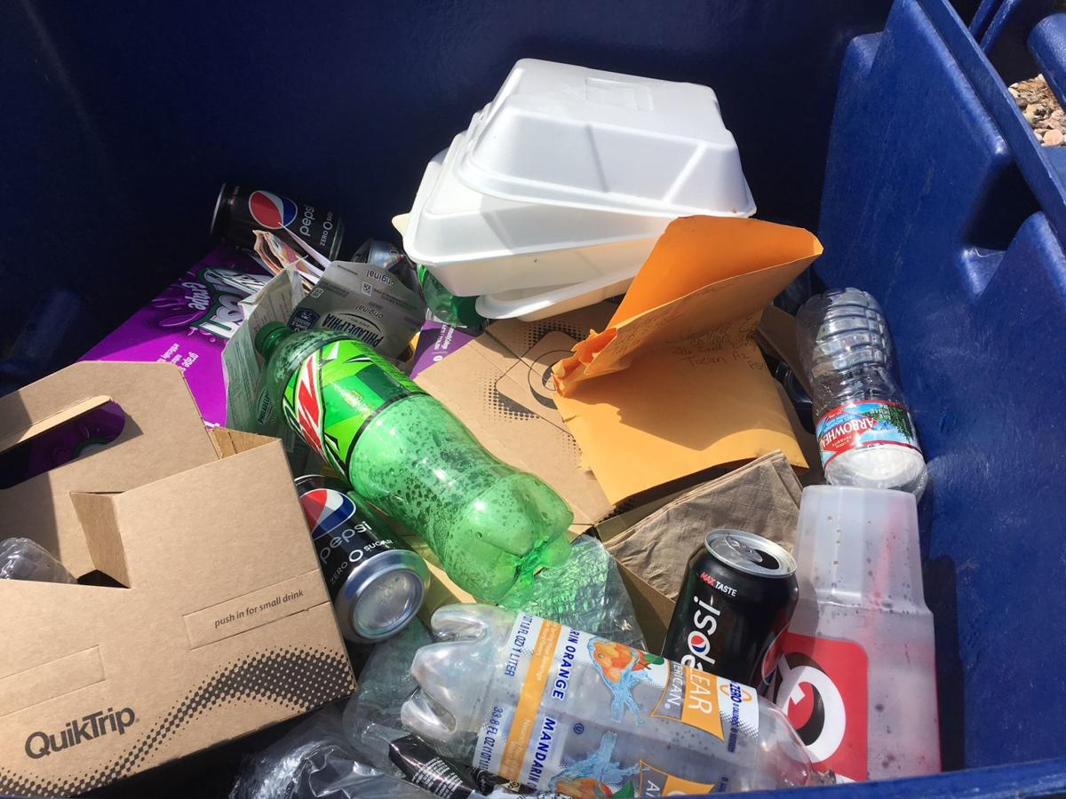
Gather the Evidence
New York City residents currently recycle only about 17% of their total waste--half of what they could be recycling under the current program
Landfills are responsible for 36% of all methane emissions in the US, one of the most potent contributors to global warming.
Currently, about 50 percent of all NYC public schools are enrolled in the Zero Waste School program.
Guiding Question: What do you notice in our school or community about waste?

Slide 5
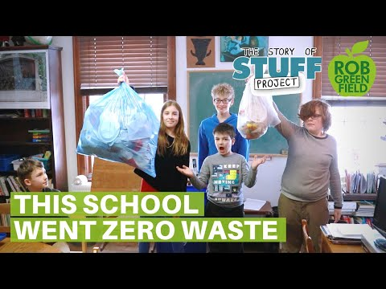
Identify the Causes
Guiding Question: Why does waste not get disposed of properly?
Education about proper disposal of waste
Learning how to compost
No option to compost or recycle
What are some other reasons?

Slide 6
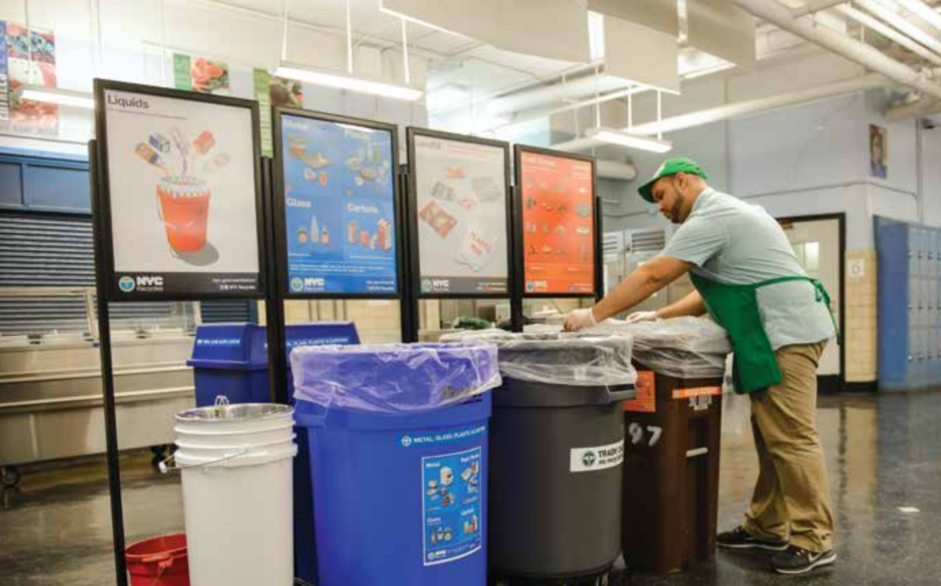
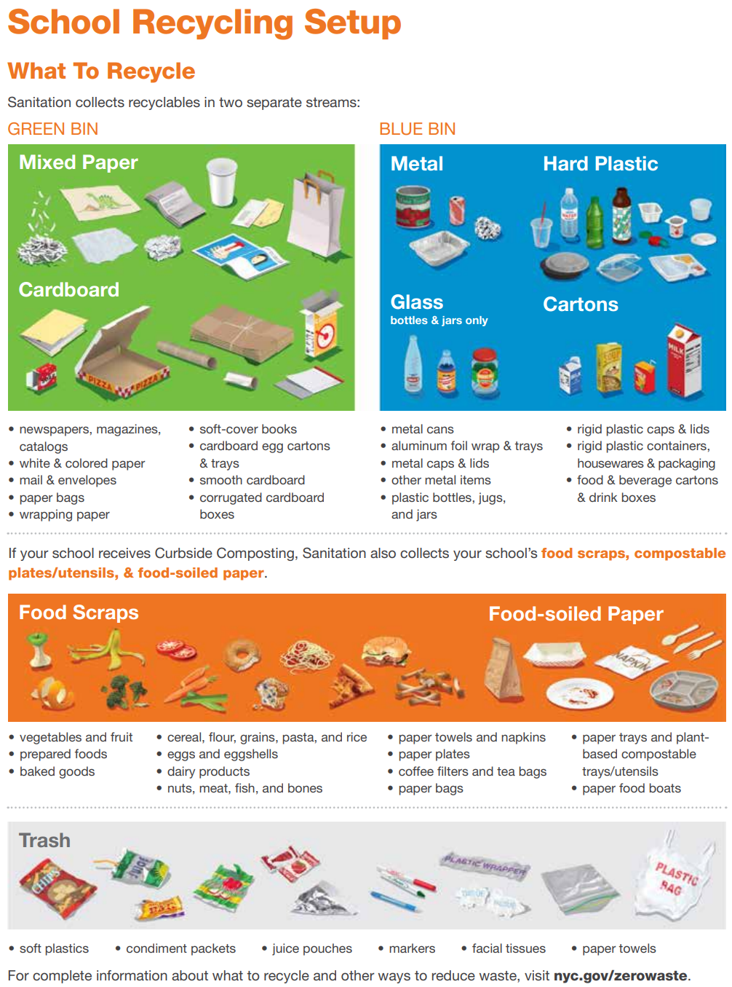
Examine an Existing Policy
Guiding Question: What do we already do to become a Zero Waste School?

Slide 7
Develop New Policies
Guiding Question: What can we do to become a Zero Waste School?
Plan for Success
• Make sure all staff and students are familiar with school recycling procedures. This includes how waste sorting stations work in cafeterias and kitchens, where recycling areas are located throughout the building, and what items go in each bin.
• Educate students about the importance of waste reduction and recycling. Schools that show students why and how to reduce waste and recycle have more successful recycling programs.
• Form a team of dedicated students to help implement the school's recycling program. A student; Green Team can educate the school community and monitor the school recycling bins.

Slide 8
Develop New Policies
Guiding Question: What can we do to become a Zero Waste School?

Slide 9
Select the Best Policy Solution
 | Low | Medium | High
High
Medium | .
Low

