Slide 1
LATE, ABSENT, WHAT’S WRONG?
Amy Ron
PS 112Q
3/24/22

Slide 2
The problem is that many students at Ps 112Q are arriving late or not coming to school.
STEP 1.DEFINE THE PROBLEM

Slide 3
Turn and talk with the person next to you.
Discuss why you think is important to be in school on time.
Why being on time to school matters?

Slide 4
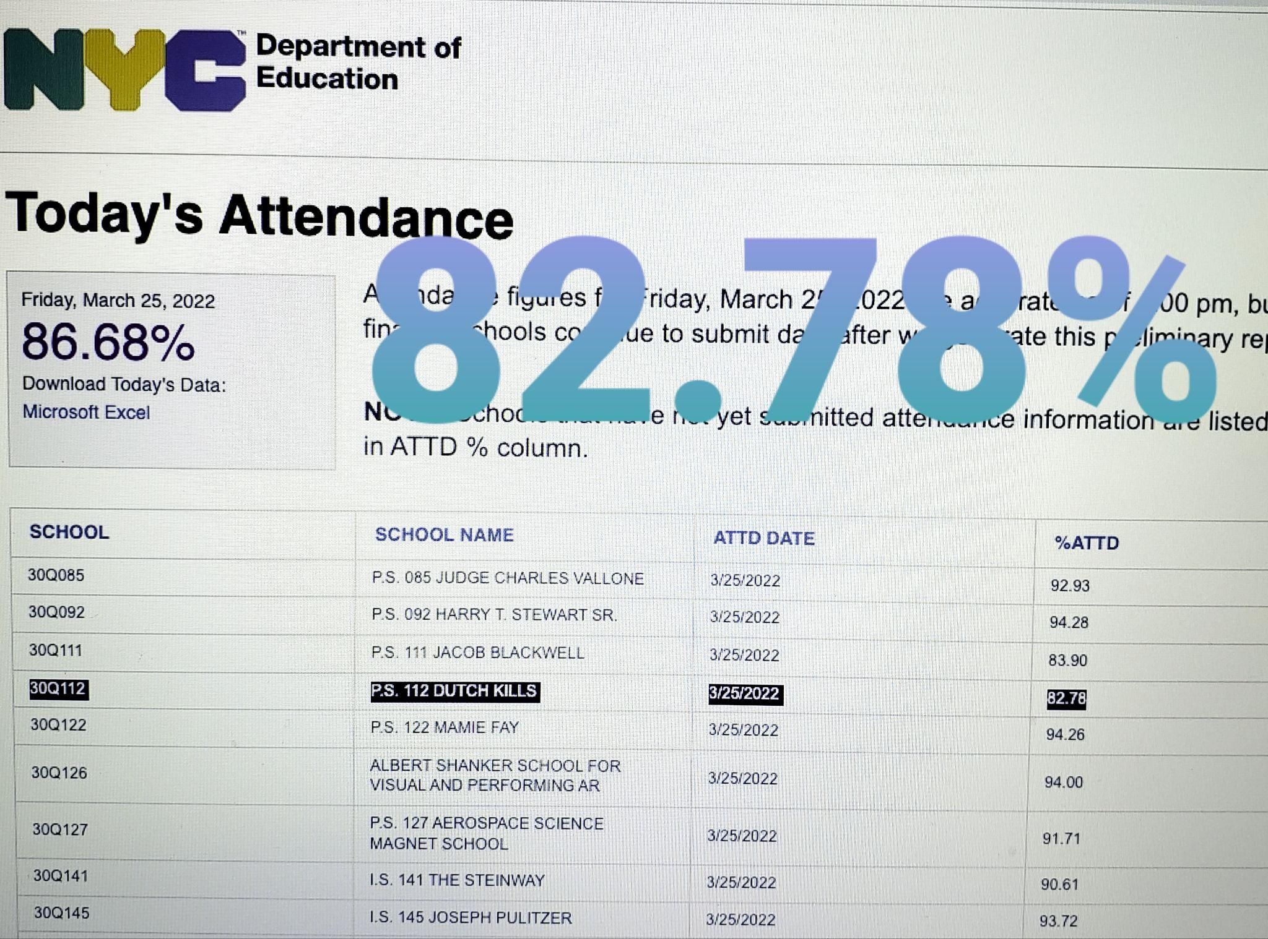
STEP 2: GATHER EVIDENCE
Think how much you are missing when you are not in school?
When you arrive to school late, you don’t get to eat breakfast, learn the announcements of the day, and you are missing valuable learning time.

Slide 5
STEP 3: DETERMINE THE CAUSES
Transportation
School Schedule
Health Issues

Slide 6
STEP 4: EVALUATE EXISTING POLICIES
DOE Attendance Policies
Attendance is a required, legal record
Excused absences are still absences.
Schools must contact the student's family after every absence
https://www.schools.nyc.gov/school-life/school-environment/attendance

Slide 7
STEP 5: DEVELOP NEW POLICY SOLUTION
What can PS.112Q do to improve attendance?
Turn and Talk
Do you have any ideas how to improve attendance and punctuality in our school?

Slide 8
STEP 6: SELECTING THE BEST POLICY SOLUTION
FEASIBILITY
 | High | Medium | Low
High
Medium
Low
EFFECTIVENESS
Why is this solution the best option?

