Slide 1
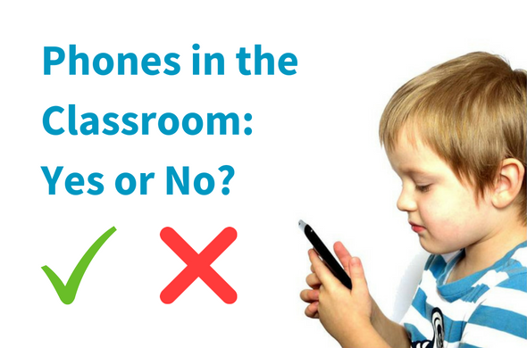
Social Problem:
Many students are bringing cell phones to school and using them.
Jerry Romero
PS 92 Queens

Slide 2
Public Policy Analyst Steps
Define the problem: Many kids are bringing cell phones to elementary school and using them.
Gather evidence: Explore articles and videos about kids bringing cell phones to school.
Causes: What makes parents feel their child is safer with a cell phone?
Evaluate: Look at our school’s and neighboring schools cell phone policies.
Possible solutions: What changes can we make to our present cell phone policy
Select the best solution: Make a change to our present cell phone policy.

Slide 3
Gather Evidence: Read articles and watch videos
Is it a matter of safety or mere child amusement?
Do phones contribute to failing grades?
Tools or Obstacles?

Slide 4
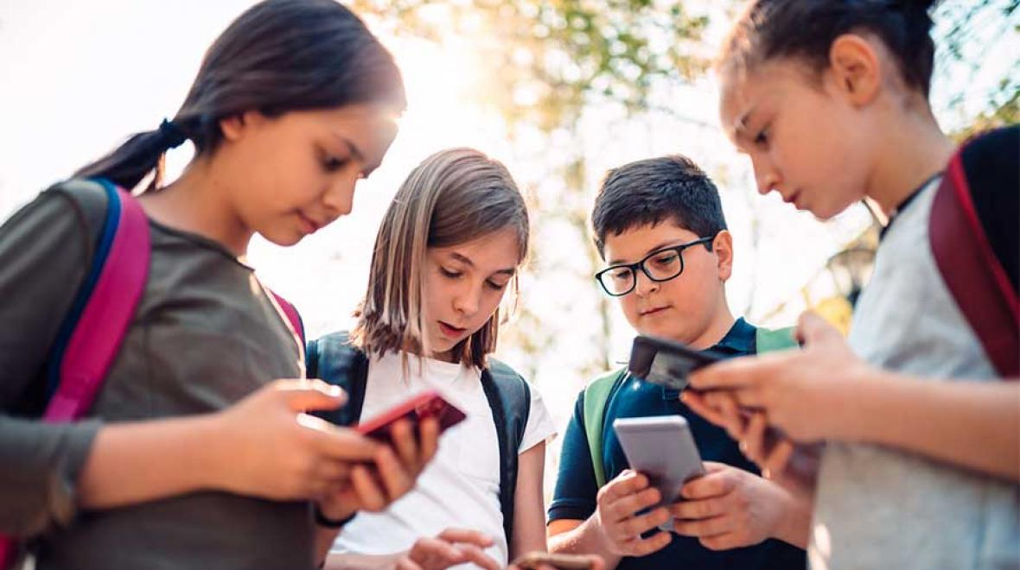
Causes: What are the reasons students at PS 92 bring phones to school? Think and share

Slide 5
How does it affect us at PS 92?
Phones ring or vibrate during class distracting everyone.
Students are checking their phones during lessons.
Students are using their phones for answers instead of using their chromebooks.
Chats (and spats) interrupt lessons and distract students from the task at hand.
Anything else?

Slide 6
Evaluate
Now let’s look at some existing policies:
Chancellor’s Regulations on Devices
PS 92 Cell Phone Policy PS 92’s Cell Phone policies adheres to the Chancellor’s regulations. However, it is up to the Classroom teacher to set restrictions in their classroom.
Sample cell phone policy between teacher and student

Slide 7
Select the Best Solution
Get into small groups of three or four students
In your small groups decide whether the benefits of bringing cell phones to school outweigh the disadvantages. This will decide a new proposed policy
Think about…. The advantages and disadvantages
Think about whether it will be effective? Feasible?

Slide 8
Possible Solutions
Try for at least two!
PS 92 Policy | New York City DOE Policy

