Slide 1
Utilizing a Public Policy Analyst Problem Solving Method
Student Lateness
District 30:
Intermediate School 230
Emily Ram
GREEN

Slide 2
What are the Policy Analyst Problem Solving Steps?
Define a social problem
Gather the evidence
What are the causes?
What is the existing policy?
What policies can you create to solve this problem?
What is the best policy to solve this problem?

Slide 3
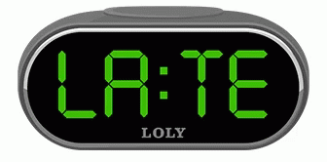
Defining the Problem
Too many students are
showing up late to class
in our school building.
Please put a thumbs up if this is a problem you see happening.
Please put a thumbs down if this is a problem you do not see happening.

Slide 4
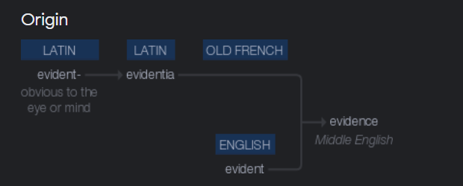
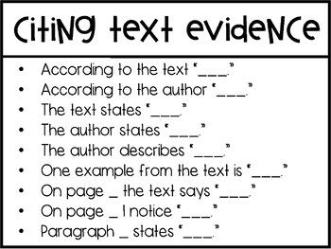
available facts or information that reveals something
DEFINITION
Evidence
MORPHOLOGY
PICTURE
PHOTO

Slide 5
2. Gathering the evidence
Think-Pair-Share
Students are showing up 2-3 minutes after the bell rings.
Teachers mark students Late, “L”, on class section sheets.
How do I find evidence?
If you were a detective, what could be considered a clue for solving the problem?
Step 2: Think of another reason why students are coming late to class.

Slide 6
3. What are the causes?
There are 2 minutes to get to the next class.
Brainstorm with a partner other causes for students arriving late to classes.
The hallways are overcrowded.

Slide 7
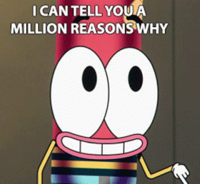
3. What are the causes?
There are 2 minutes to get to the next class.
Due to overcrowded hallways, students are getting trampled and pushed on their way to class.
The hallways are overcrowded.

Slide 8
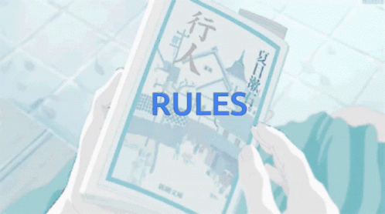
4. What is the existing policy in our building?
After every period, students have 2 minutes dedicated to arrive at the next class before the bell rings.
At our school, we have implemented Hallway Sweeps that happen randomly. If students are late to class, a dean will gather and bring them in the office.
Vocabulary Help
Policy: A principle of action adopted or proposed to help fix something

Slide 9
5. What policies can you create that will help solve the problem?
Step 1: Browse through these articles about different policies implemented regarding hallway and lateness policies in other schools.
Policy about Hallways Article #1
Policy about Hallways Article #2
Step 2: Using the articles below, brainstorm with a person next to you different kinds of policies you could create in order to help solve student lateness evident in our school building.

Slide 10
6. What is the best policy to solve this problem?
Evaluate policies created and place them in this chart.
Feasibility: State of something being easily done
 | High | Medium | Low
High
Medium
Low
Effectiveness: Degree in which something is working

