Slide 1
PPA Project Slideshow
C. Prasinos - 2023-24

Slide 2
Defining the Problem

Slide 3
What is a problem that we see in our school?
Littering
Definition: make (a place) untidy with rubbish or a large number of objects left lying about. (according to Google)
Littering is happening daily.
In our classrooms, the cafeteria and the hallways
Why is this a problem?
Unsafe to walk down the stairs
Prompts other students to mimic littering
This problem can be carried out into the real world
Creates more work of the school janitors

Slide 4
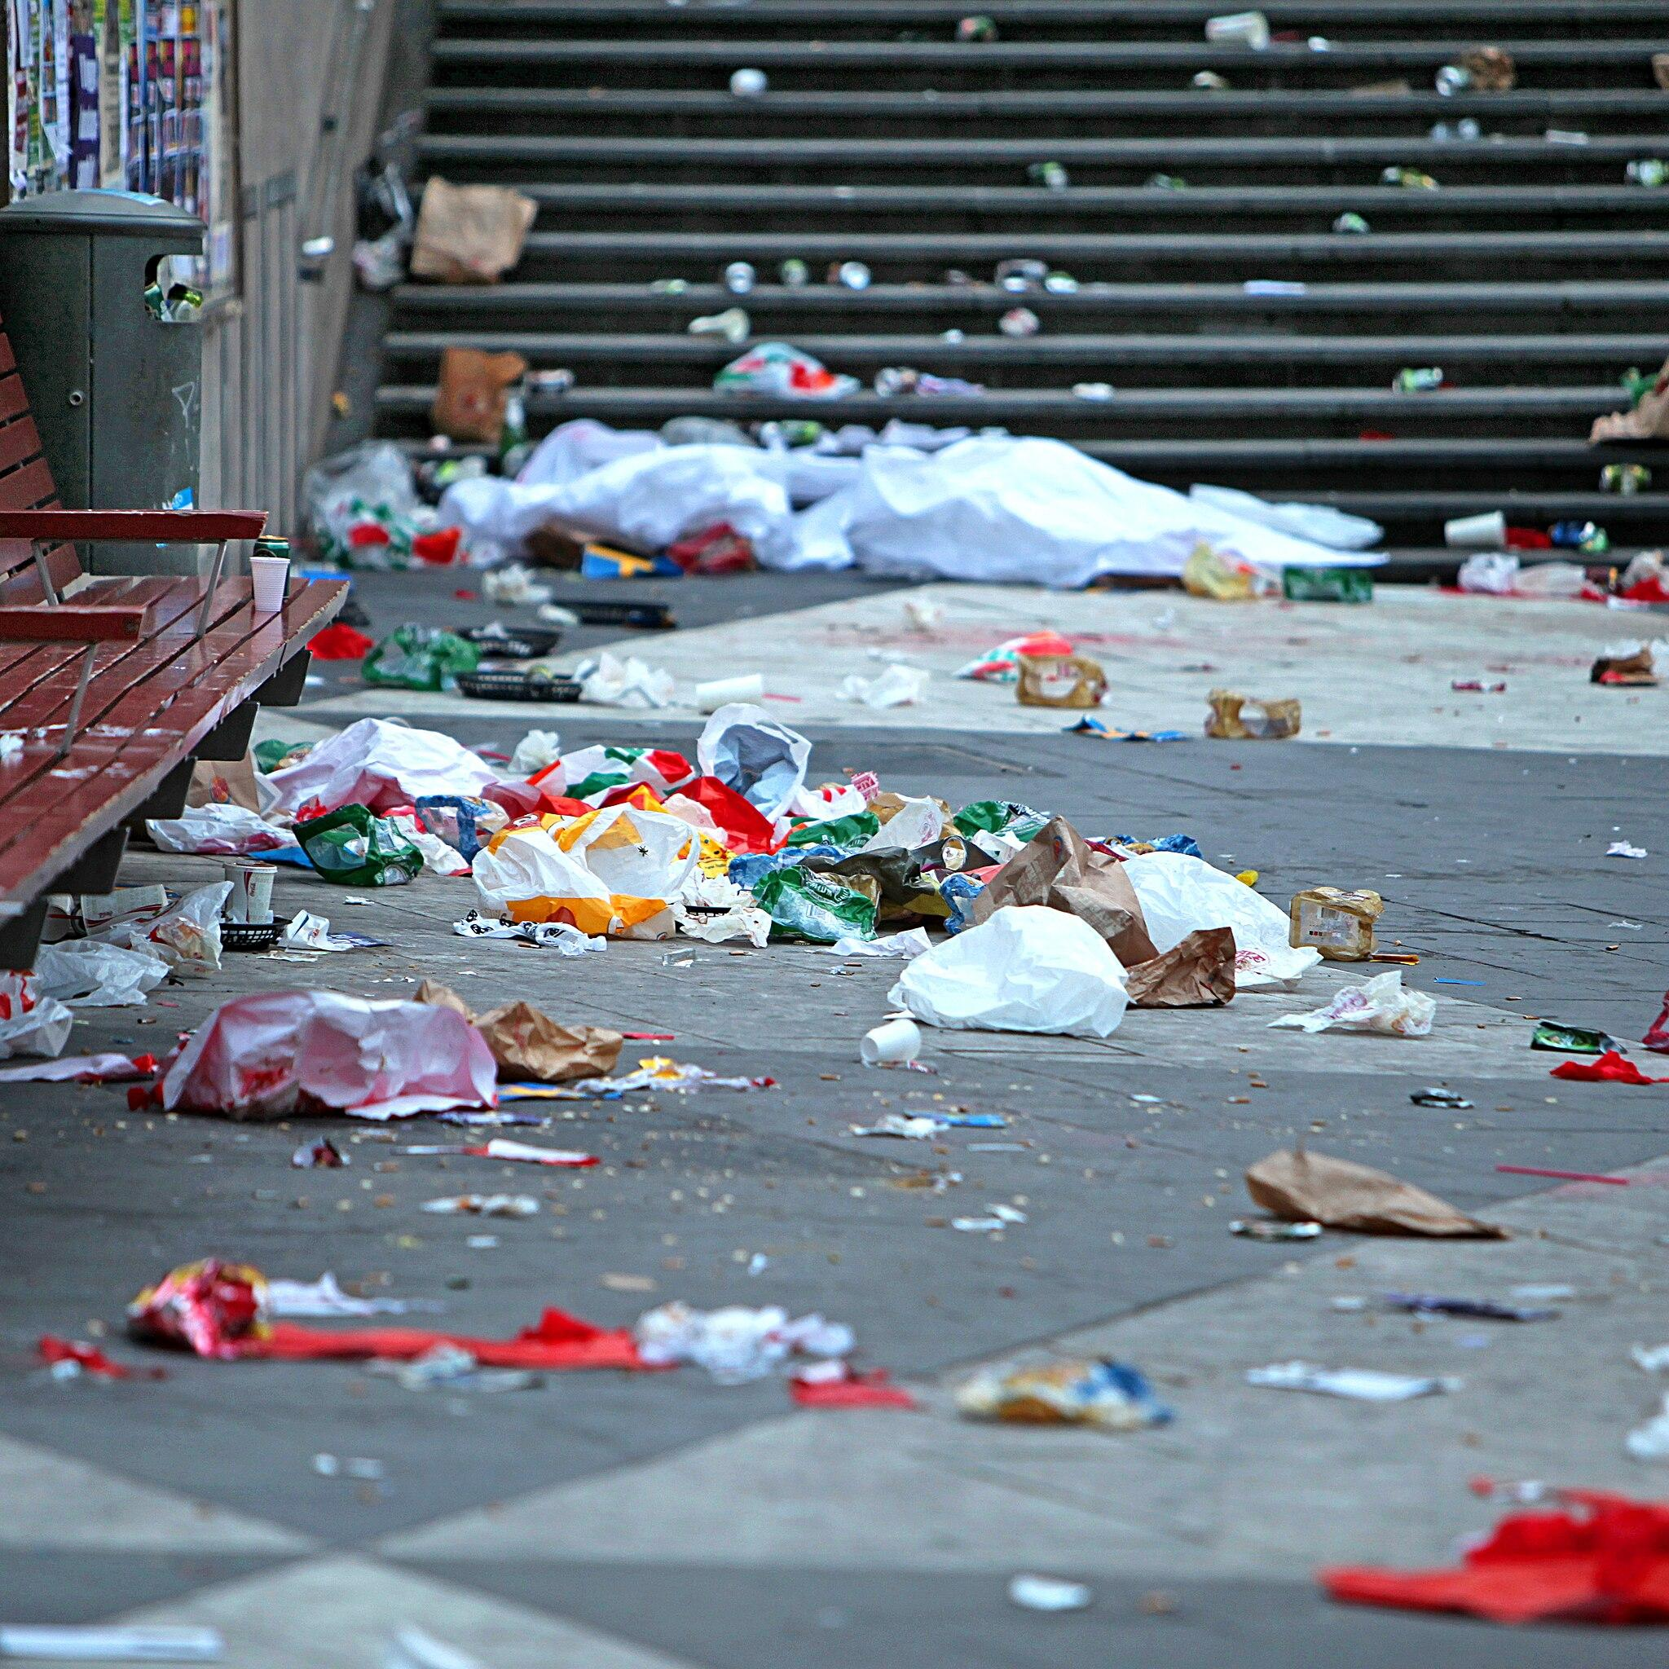
Source: Google Images

Slide 5
Evidence

Slide 6
How do we know it is happening?
Locations: stairwells, classrooms, hallways, cafeteria
When: middle/end of the day or at the end of each lunch period
School staff is complaining
5 out of 29 students litter in one classroom (about 17%)

Slide 7
Evaluate Existing Policy

Slide 8
How does our school solve this problem?
Assigning a Janitor as a classroom job
A student volunteers to help clean litter at the end of the day.
School Janitors
At the end of the day janitors do a sweep to clean up hallways, stairwells and classrooms.
Teaching/Spreading Awareness of the Problem
Teachers can teach students about how littering impacts are school community and what we can do to prevent it.

Slide 9
Developing a Solution

Slide 10
How can we put an end to littering?
School Assembly
Teaching students about the negative effects of littering and learning how to prevent it
2. School-Wide Action
Posters to remind students how to prevent littering
3. More accessible trash and recycling bins.
Having blue, green and black trash bins in the stairwells

Slide 11
Selecting the Best Solution

Slide 12
Feasibility
 | HIGH | MEDIUM | LOW
HIGH | More accessible trash bins
MEDIUM |  | School Wide Action
LOW |  |  | School Assembly
Effectiveness

