Slide 1
Cell Phones and Personal devices in school
Ms. Sara Pascarella
District 30: Learning Technology Grant
PS 2Q Alfred Zimberg

Slide 2
Public Policy Analyst (PPA)
1. Define the Problem
2. Gather the Evidence
3. Identify the Causes
4. Evaluate an Existing Policy
5. Develop Solutions
6. Select the Best Solution

Slide 3
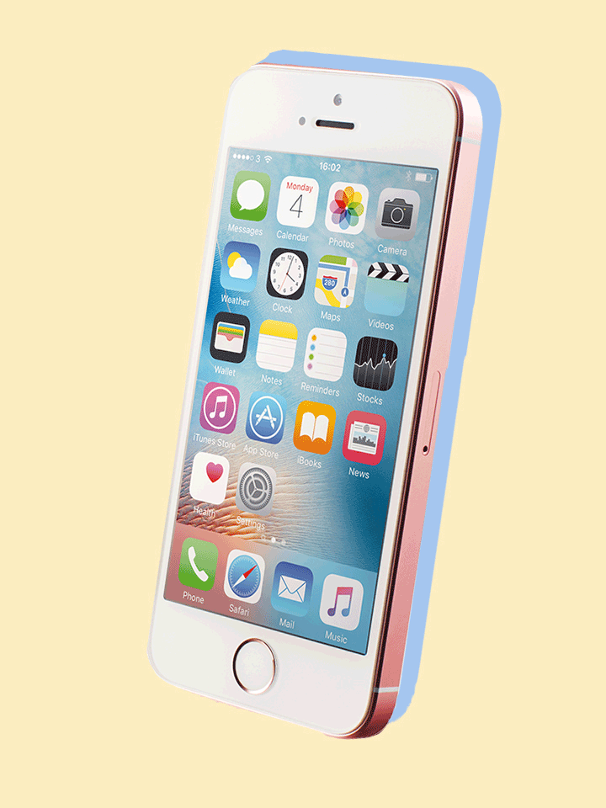
Step 1. Define the Problem
One problem we have at PS 2 Q is that many 5th grade students want to have their phones or personal devices with them in the classroom.

Slide 4
Step 1. Define the Problem
Do you want your phone in school?
Turn and Talk…
What are some reasons for wanting your phone in class?

Slide 5
Step 1. Define the Problem
Having your phone in school…….
-your phone being a distraction to you
-your phone being a distraction to others
-phones causing problems in the classroom (students talking to each other through texting or on social media)

Slide 6
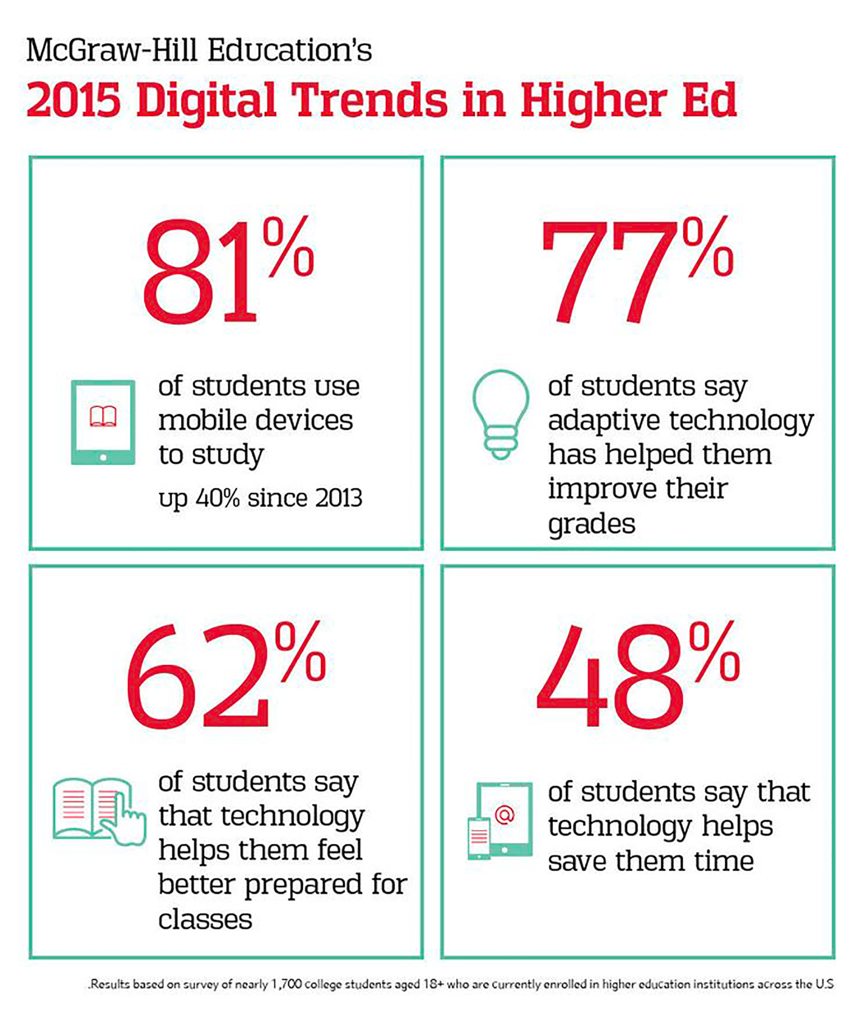
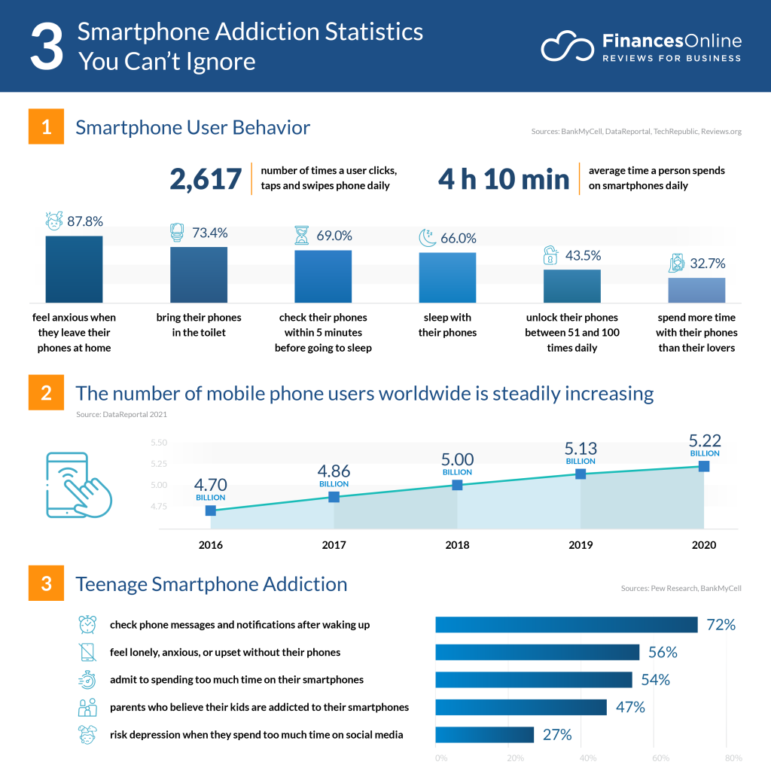
2. Gather the Evidence
https://mirrornews.hfcc.edu/news/2018/01-29/why-students-should-be-using-their-phones-class
https://financesonline.com/smartphone-addiction-statistics/

Slide 7
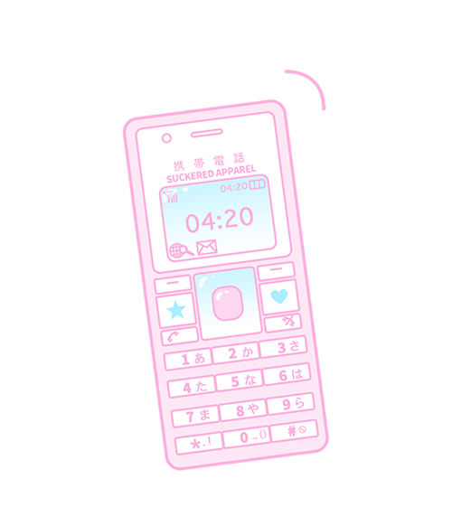
3. Identify the Causes
Determine the causes of wanting phones in school?
Why do you think students want their phones in school?
Why is it important to students?
Who would use the phones?

Slide 8
4. Evaluate an Existing Policy
■Having a phone in school could be important, but students need to use it in the right way (leaving it in their bag).
■When students play with the phone in school, students do not listen to what is.
■Should there be a way to use cell phones in the classroom?

Slide 9
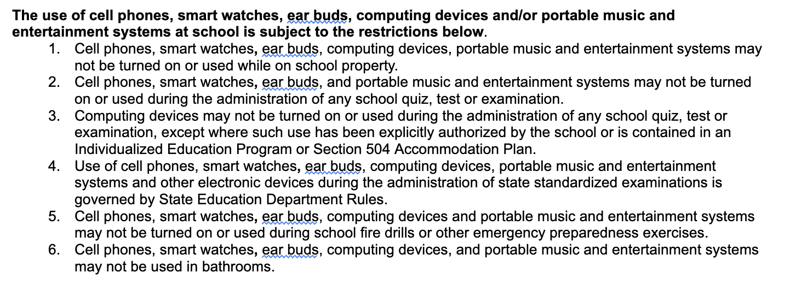

Slide 10
5. Develop Solutions
Turn and talk and there any other solutions?
 | Engage in discussion with families and students about phone and what the rules in the classroom should be.
 | Make rules and designated times for when phones can be used.
 | Come up with ways to use phone in a meaningful way in the classroom.
 | Offer students $100 every day they do not use their phone.
 | Have a bin for students to lock their phones away.

Slide 11
6. Select the Best Solution
Feasibility
 | High | Medium | Low
High
Medium
Low
Effectiveness

