Slide 1
The Growing Landfills in New York
Uncovering the landfill issue in New York State
Stephanie Parada, P.S. 127Q

Slide 2
Do now
Do you recycle all plastic materials? Is your entire family conscious of the amount of trash produced in your home?

Slide 3
Guiding Question/Class Observation
What can we do to minimize the amount of waste in landfills?

Slide 4
Agenda
Do Now
Guiding Question
Agenda
Review PPA
Slides/Class Conversation
Independent work
Exit ticket

Slide 5
Public Policy Analyst- Steps to solve the issue
The PPA is steps we can use to solve the issue. If we check off all the steps in the PPA, we will be closer to solving a problem than when we started!

Slide 6
PPA Steps
What is the problem?
What is the Evidence?
What are the causes?
What is the existing policy?
What policies can we create to correct the problem?
What is the BEST policy to correct the problem?

Slide 7
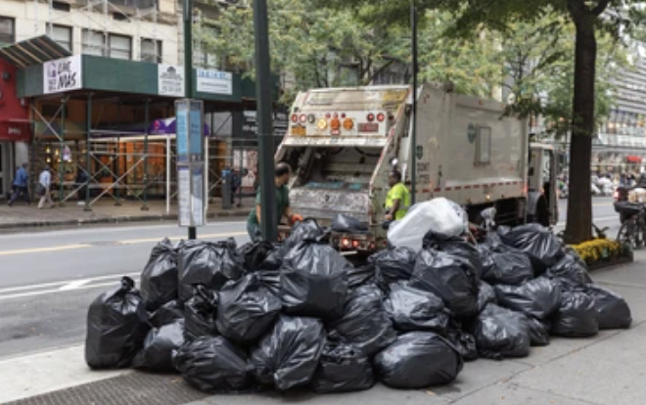
Public Policy Analyst
We will be working as a team to go through the stages of the PPA to try to solve the problem of:
The Growing Landfills in New York State

Slide 8
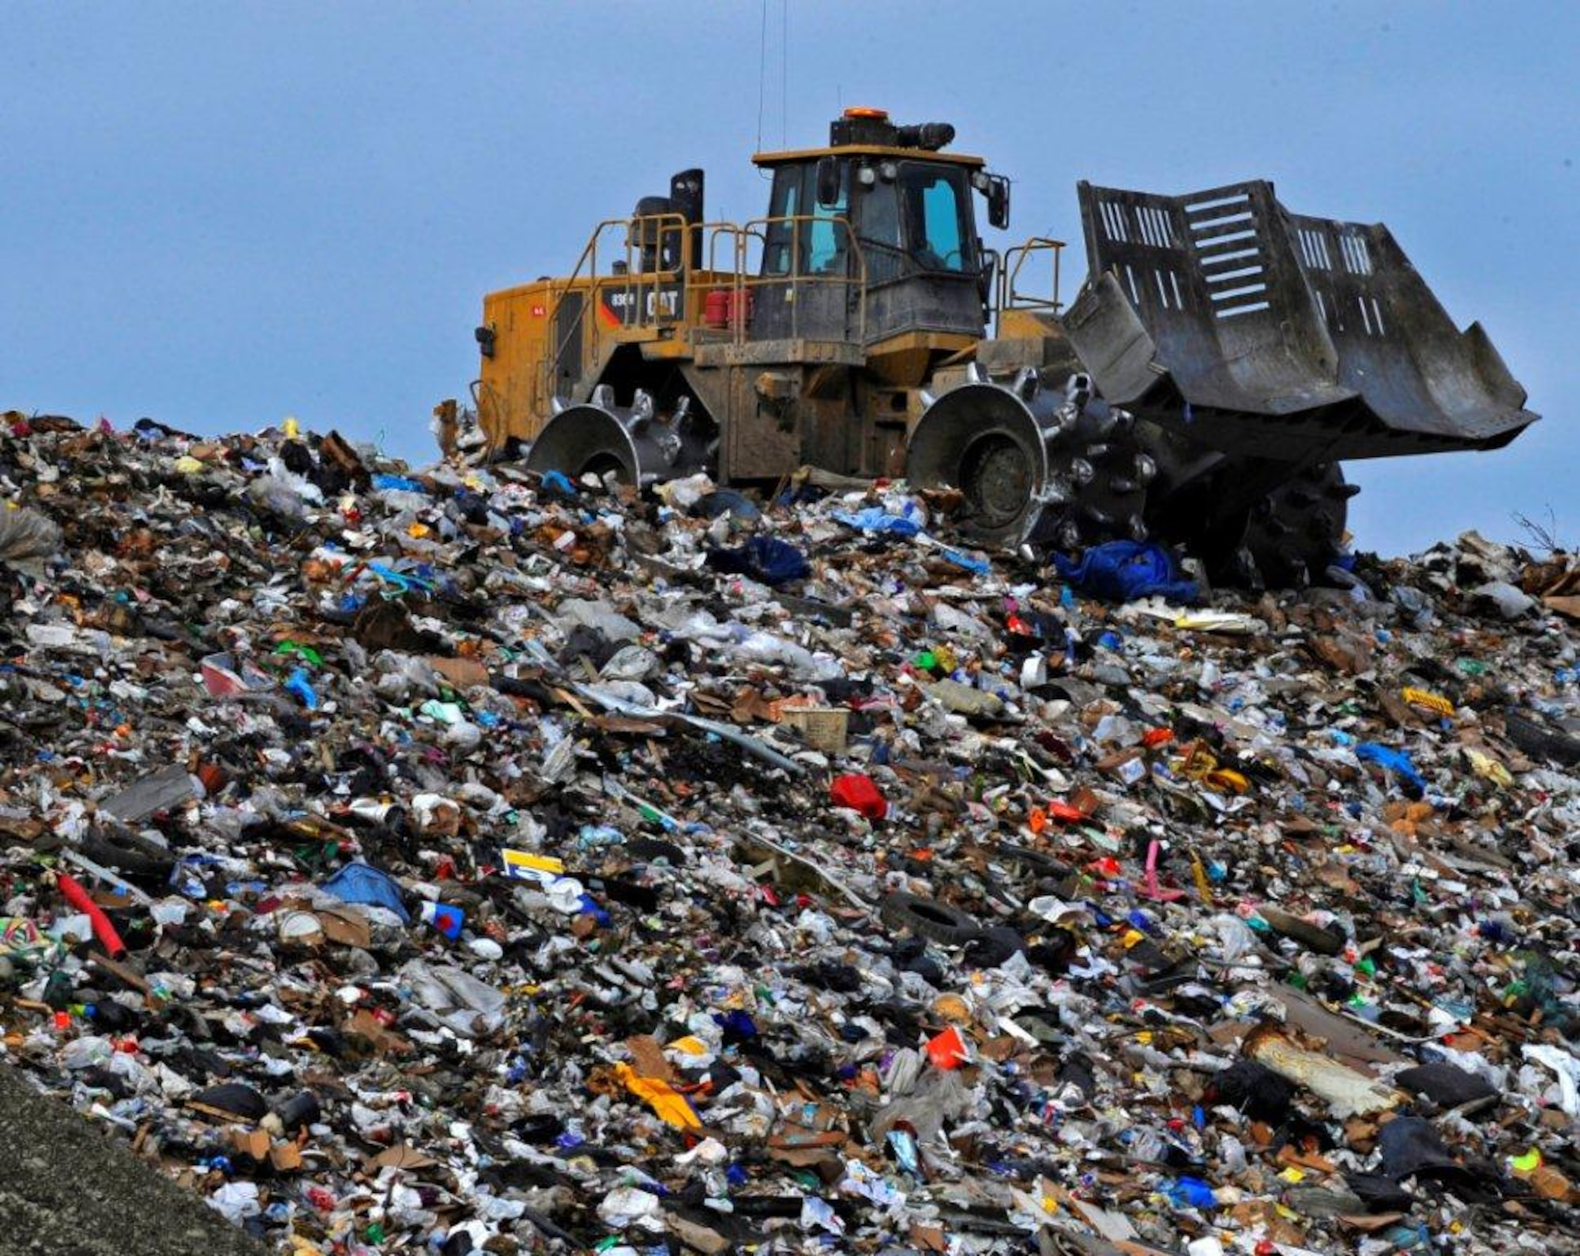
Defining Landfills
Landfills are designed to protect the environment from harmful toxins that can be existing in the waste. From this definition, what are different types of waste that might be found in a landfill?

Slide 9
Step 1: Identifying the Problem
The problem being addressed is that there is number of tons of garbage being added to the landfills nationwide is growing at a rapid rate. In this PPA, we will specifically be focusing on the ones in New York State. Ultimately, these landfills carry toxins, such as greenhouse gasses, which release into the environment and bodies of water.

Slide 10
Step 2: Gather the Evidence
In New York State alone:
There are a total of 25 Municipal Solid Waste (MSW) Landfills, according to the Department of Environmental Conservation
Each landfill has a capacity of 9 million tons of waste per year.
In New York City:
According to the NYC Mayor’s Office of Climate & Environmental Justice, NYC produces nearly 14 million tons of garbage annually.

Slide 11
Step3: Identify the Causes
There are several factors that lead to the growth of landfills:
As the population of people grow, so does the amount of garbage that is produced.
Similarly, if the number of people within society increases, so does our food supply. Agricultural waste makes up a large percentage of solid wastes in landfills.

Slide 12
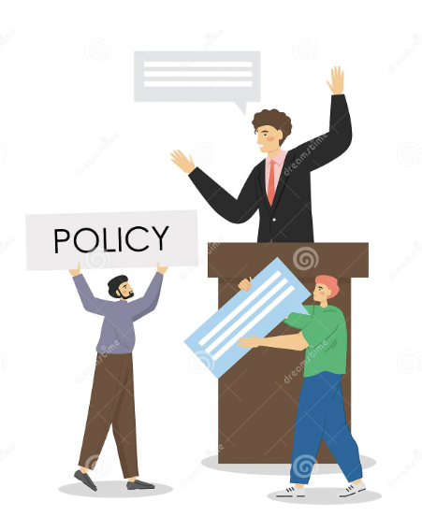
Step4: Examine an Existing Policy
These are the current New York State policy on Landfills:
Policy DMM-SW-09-01 Solid Waste Management Facility Permitting: Improve the use of reusing plastic materials, as well as reduce the amount of waste produced within the state.
Advantage: Greater regulations and the consequence of fines have been implemented in order to get people to recycle.
Disadvantage: Government officials cannot enforce the amount of garbage people decide to produce.

Slide 13
Step 5: Develop New Policy Solutions
Let’s determine our own policy!
Essential question: What can you do to encourage people to reduce their waste and recycle materials?
Spread the public information about the quantity of garbage contained in our state landfills. This can be shared during morning announcements
Bring awareness to your classroom by making your own plastic waste bin. Not all classrooms have one!
Teach your friends how to separate the trash , make it a challenge!

Slide 14
Step 6: Select the Best Policy Solution
 |  | FEASIBILITY
 |  | HIGH | MEDIUM | LOW
 | HIGH | Teach your friends how to separate the trash , make it a challenge amongst your class!
 | MEDIUM |  | Bring awareness to your classroom by making your own plastic waste bin. Not all classrooms have one!
 | LOW |  |  | Spread the public information about the quantity of garbage contained in our state landfills. This can be shared during morning announcements
EFFECTIVENESS

