Slide 1
STUDY FOR A TEST?????
OH NO, WHAT DOES THAT MEAN?
The problem is: Students do not know how to study.
P.S. 69 Q
Class 4-404
Anna Papazoros

Slide 2
What does it mean to study:
devote time and attention to acquiring knowledge on (an academic subject), especially by means of books.
Let’s watch this video find out what studying
Is and why it is important.
TURN/TALK
-Talk to your neighbor about how you study for a test.

Slide 3
Task: You will use the PPA step to identify why not knowing how to study is such a problem and help find ways to better your study habits.
1.Define the problem
2.Gather Evidence
3.Identify The Causes
4.Evaluate an Existing Policy
5.Develop Solutions
6.Select The Best Solution

Slide 4
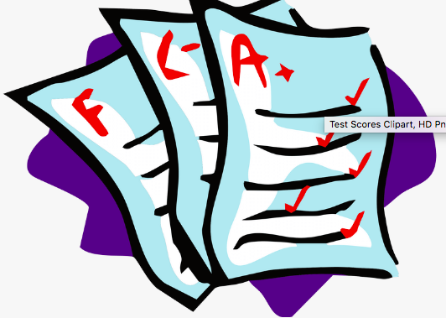
Problem: Kids are not sure what it means to study. They don’t know how to go about it successfully. They have never been
properly shown how to study.

Slide 5
Evidence:
-Students are falling behind in school.
-Students are scoring low on tests
-High school students end up dropping out
-Students become very upset when they receive their tests back and see their low scores. (Emotional outbursts, crying, can’t tell their parents)

Slide 6
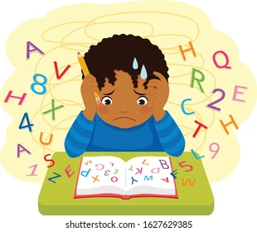
Causes:
Not having an actual study plan.
Cramming everything in without understanding what you are to focus on.
Studying late at night when you are tired.
Disorganized (not having all the material needed)
Distracted while studying (TV, Computer…)
Leaving everything last minute.

Slide 7
Ways in Which Kids Study Now:
Turn/Talk: Share your study habits with a partner.
-The night before a test, the kids look at their notes and read them over.
-For math, they practice a few similar problems.

Slide 8
Feasibility
Effectiveness |  | High | Medium | Low
 | High
 | Medium
 | Low

