Slide 1
Unclean Water in School Fountains
Isidora Papadopoulos (PS111q)

Slide 2
Steps to Public Policy Analyst (PPA)
01
02
03
Defining
Gathering
Identifying
04
05
06
Evaluating
Developing
Selecting
the social problem
evidence of the problem
the causes of the problem
existing public policies
public policy solutions
the best public policy solutions

Slide 3
01.
Defining the Social Problem
Students are unable to drink clean or filtered water at
CS 111Q.

Slide 4
02.
Gathering evidence of the problem
Out of the 54 water fountains, 0 of them are filtered. Additionally, only 32 are working and the remaining water fountains need replacement or fixing.

Slide 5
03.
Identifying the Cause of the Problem
Little custodial funding available for material costs to replace water fountains.

Slide 6
04.
Evaluating Existing Public Policies
CDC - Water Access in Schools
“The Healthy, Hunger-Free Kids Act of 2010 requires schools participating in the National School Lunch Program (NSLP) to make free water available to students during meal times where they are served. The standards also require schools in the School Breakfast Program (SBP) to make drinking water available when breakfast is served in the cafeteria.”

Slide 7
05.
Developing public policy solutions
Ensure that existing water fountains are clean and properly maintained.
Provide access to water fountains, dispensers, and hydration stations throughout the school.
Allow students to have water bottles in class or to go to the water fountain if they need to drink water.

Slide 8
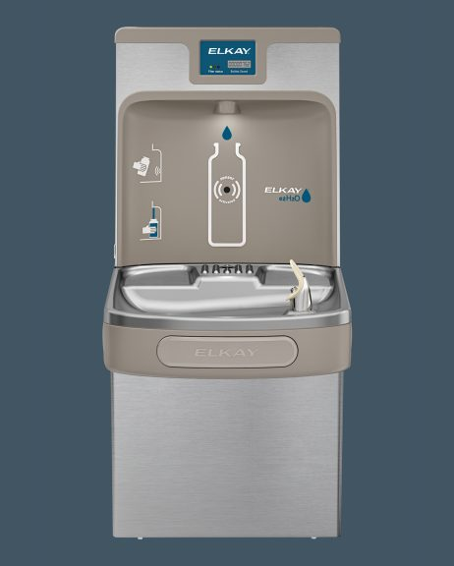
06.
Selecting the Best Policy Solutions
Provide and place at least 7 hydration stations to drink and refill water bottles.
3 placed in the cafeteria
1 placed in the gym
1 placed near the 1st floor bathroom
1 placed near the 2nd floor bathroom
1 placed near the 3rd floor bathroom
Filter to be changed when the fountain light indicates a change of filter.

