Slide 1
Public Policy Analyst:
Speaking a Language
Other than English
Julie Nelkin
Intermediate School 230Q

Slide 2
Problem
Solution
Today we will explore
a problem that is present in many school communities, including ours.
Our goal is to work together to find a solution using the 6 steps of the Public Policy Analyst protocol.

Slide 3
The 6 Steps of the PPA
1. Define the problem
2. Gather Evidence of the Problem
3. Identify the Causes of the Problem
4. Evaluate Existing Policies
5. Develop Public Policy Solutions
6. Select the Best Public Policy Solution

Slide 4
Step 1:
Defining
the Social Problem

Slide 5
Step 1: Defining the Social Problem
In One Green Apple by Eve Bunting, Farah says, “Our teacher gathers us around her. She talks to the class. Then she looks at me in a kind way. ‘One,’ she says. She touches an apple, then picks it. ‘One,’ she says again. I am to take only one, as the other students have done. I nod. I want to say, ‘I understand. It’s not that I am stupid. It is just that I am lost in this new place.’ But I don’t know how to tell her.’”

Slide 6
Step 1: Defining the Social Problem
What is the problem?
Like Farah, many students struggle to communicate in school because they speak a language other than English.

Slide 7
Step 2:
Gathering Evidence

Slide 8
Turn and Talk:
Our school has about 1100 students. How many students do you think have a home language
other than English?

Slide 9
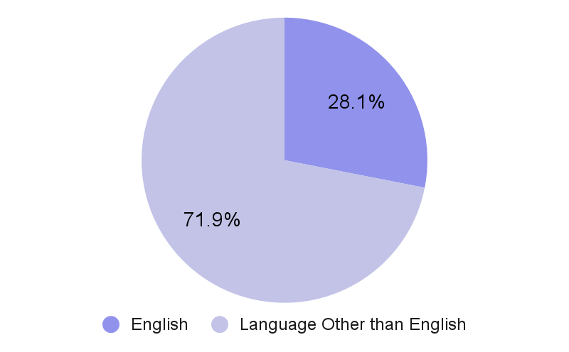
Students’ Home Languages
786 students
in our school have a home language other than English.

Slide 10
Let’s take a look at the languages represented in our student population.

Slide 11
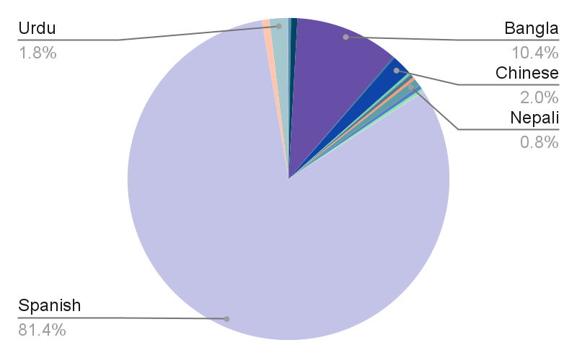
Students’ Home Languages
Home Language | Number of Students
Armenian | 2
Arabic | 5
Bangla | 82
Burmese | 1
Chinese | 16
Dzongkha | 1
Farsi | 1
Hindi | 3
Japanese | 2
Nepali | 6
Punjabi | 3
Polish | 2
Portuguese | 1
Spanish | 640
Tibetan | 6
Urdu | 14
Vietnamese | 1

Slide 12
Discuss:
What does this evidence help us to understand about the problem?
Notes:
Because,

Slide 13
Step 2: Gathering Evidence
Let’s walk through together how we can create data in a chart.
We will use the home languages in our class for this example.

Slide 14
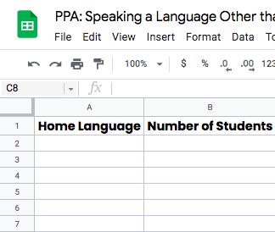
In Google Sheets,
we create a table
with two columns.
We label column A
Home Language.
We label column B Number of Students.

Slide 15
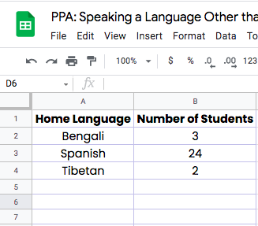
Now we survey the class and insert the number
of students who speak each language.

Slide 16
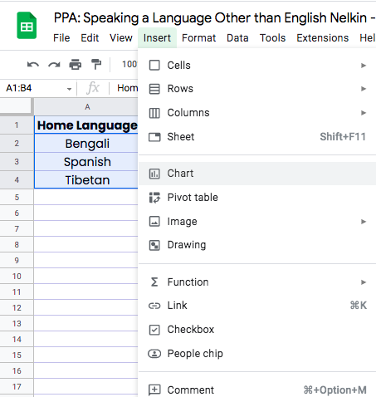
To make the table
into a chart:
We select the table.
We click Insert.
We click Chart.

Slide 17
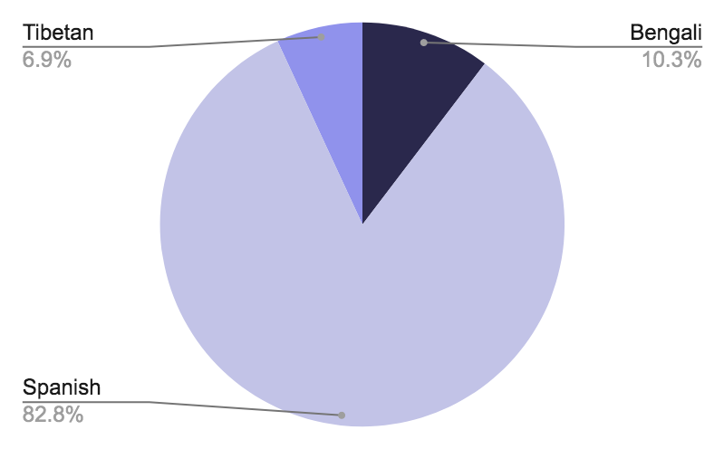
Home Languages in our Class

Slide 18
Step 3:
Identifying the Causes

Slide 19
Step 3: Identifying the Causes
While there is no rule or law in the United States about an official language, the language of school is predominantly English. However, many students speak languages other than English.
In class, what is usually in English only?
Texts and books
Slides, charts and other visuals
Assessments
Teachers’ lessons

Slide 20
Discuss:
How does this make you feel?
How would this make you feel?
Notes:
Because,

Slide 21
Step 4:
Evaluating Existing Public Policies

Slide 22
Step 4: Evaluating Existing Public Policies
In New York City schools, there are resources to help communicate with families in their home language, including:
Interpretation services for teachers to call families on the phone
Translation services for staff to translate important papers for families
Click here to explore the current policy in NYC schools.

Slide 23
Step 5:
Developing Public Policy Solutions

Slide 24
Step 5: Developing Public Policy Solutions
Be the change you want to see in the world.
We understand there are policies in place to support families.
What policies would better support students who speak languages other
than English?

Slide 25
Step 5: Developing Public Policy Solutions
In what ways can we help students who speak languages other than English to succeed in school?
Teachers
and
staff
Technology
Materials and
resources

Slide 26
Step 6:
Selecting the Best Public Policy Solution

Slide 27
Step 5: Selecting the Best Public Policy Solution
Let’s
evaluate!
We will evaluate how feasible and how effective each solution is to help us figure out the best solution.

Slide 28
Drag and Drop
FEASIBILITY
Hiring
bilingual and multilingual teachers.
 | HIGH | MEDIUM | LOW
HIGH
MEDIUM
LOW
Training teachers about the importance of translation.
EFFECTIVENESS
Providing teachers with time to translate their materials.
Purchasing bilingual and multilingual materials.
Provide technology to access bilingual resources and translation services.

Slide 29
Problem
Solution
Together, we have successfully explored the 6 steps of the Public Policy Analyst protocol to better understand a problem and work towards a solution.
Our next step will be to apply this same protocol to a problem we see in our community.

Slide 30
Please keep this slide for attribution

