Slide 1
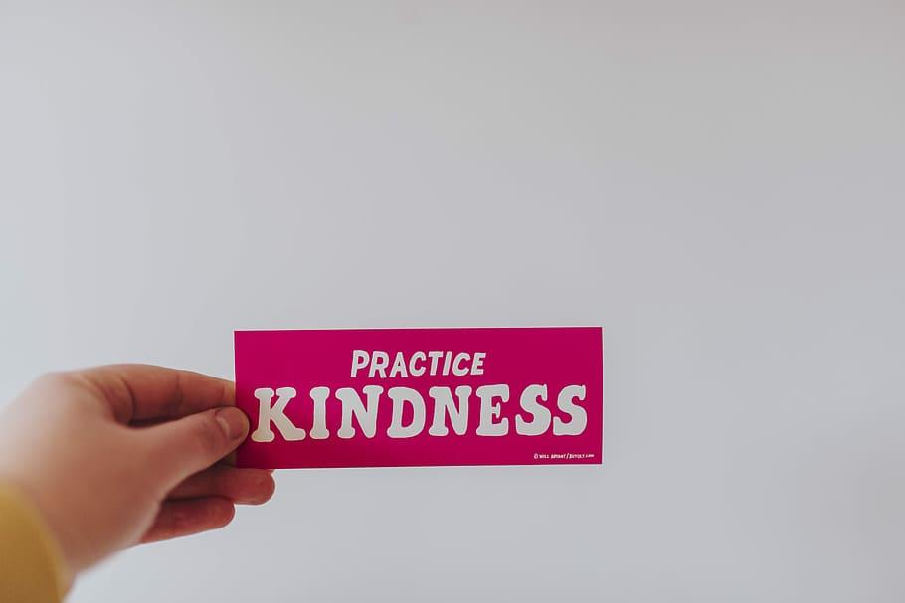
Students are not showing kindness.
Take a social problem of your choosing.

Slide 2
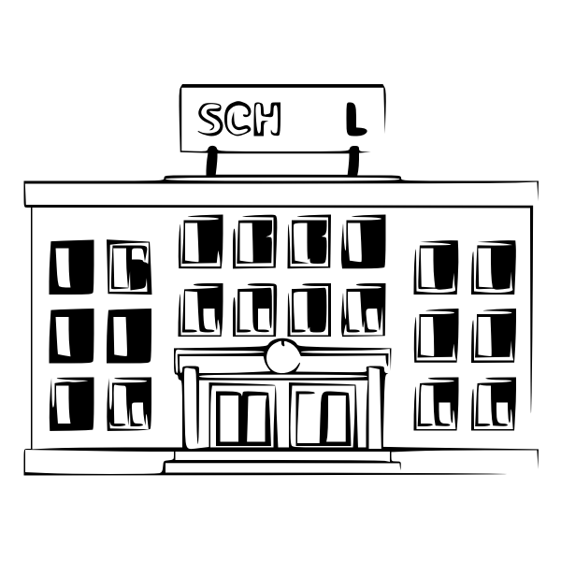
This social problem is happening at… (location)
This social problem is happening at PS 148Q.

Slide 3
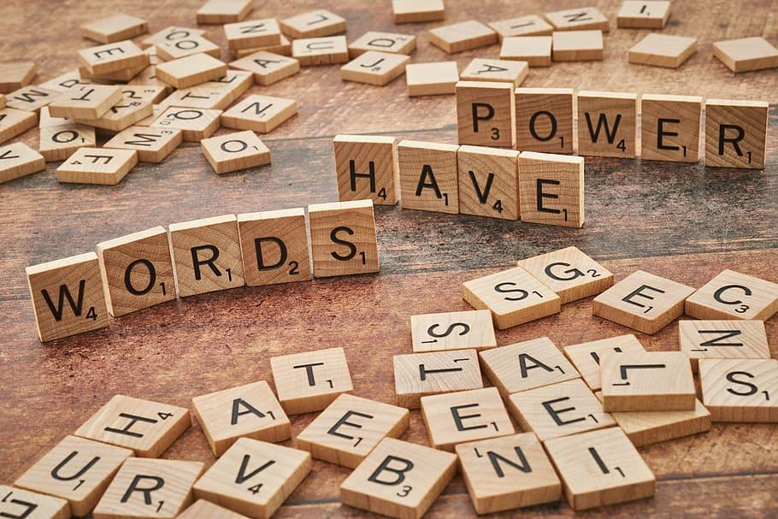
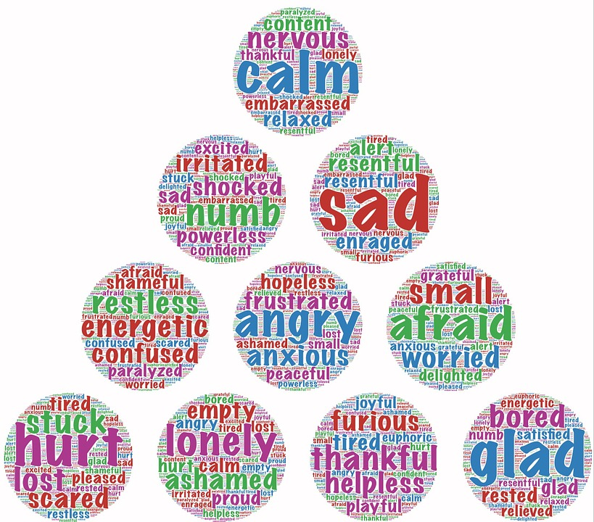
List at least three bad that happen because of this problem:
Students are not using kind words.
Students are hurting the feelings of others.
Students are physical towards others.

Slide 4
Write a short phrase that summarizes the social problem and its location.
STUDENTS ARE NOT SHOWING KINDNESS AT PS148Q.

Slide 5
How do you know that the problem exists?
Students are being disrespectful when speaking with adults—observation.
Students are hurting feelings of others—not knowing how to speak with others.
Students physically hurting others—not knowing self-control or self-awareness.

Slide 6
Why don’t we use kindness in PS148Q?
Students are not using kind words—must teach about what kind words are and how to use them.
Students are hurting feelings of others—must teach what feelings are and how to treat others.
Students are physically hurting others—must teach self-awareness and conflict resolution.

Slide 7
One major existing policy:
*Calm words
*Sitting in a calm area
*Discussing what is going on
*Given options
*Then, call crisis team for help

Slide 8
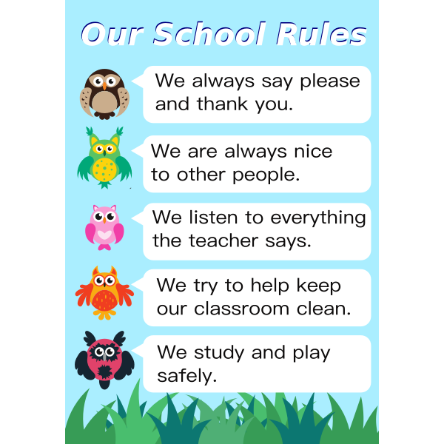
What are the advantages of following the policy?
The effect is that we know how to control ourselves.
The cost is none.
The enforcement of this policy is difficult because many children can’t control themselves.
Everyone in the school knows about it and uses it but sometimes it doesn’t work quickly. Also, sometimes we need help from people outside the classroom.

Slide 9
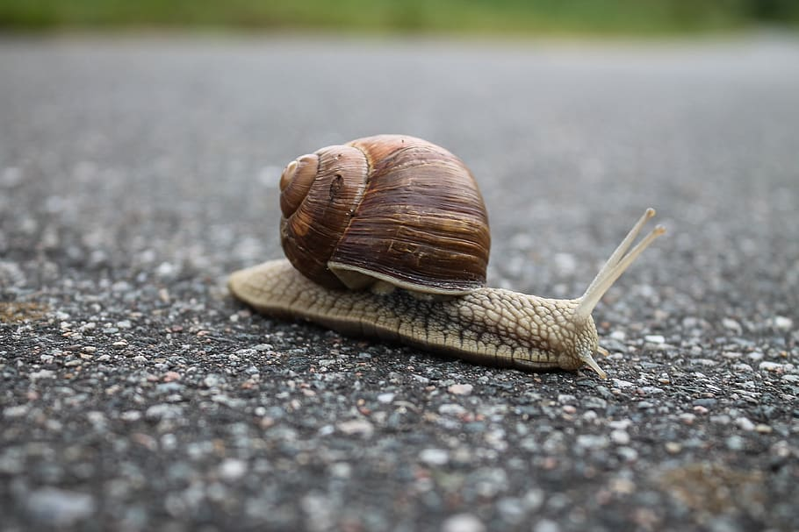
What are the disadvantages of this policy?
The effectiveness is too slow.
Students do not know how to calm down and most times have to be bribed by a toy (cost) to just get into the classroom.
The disadvantages of the enforcement of this policy is that most of these students complete no work.
The entire building knows about this policy and most people agree that their are disadvantages to this policy.

Slide 10
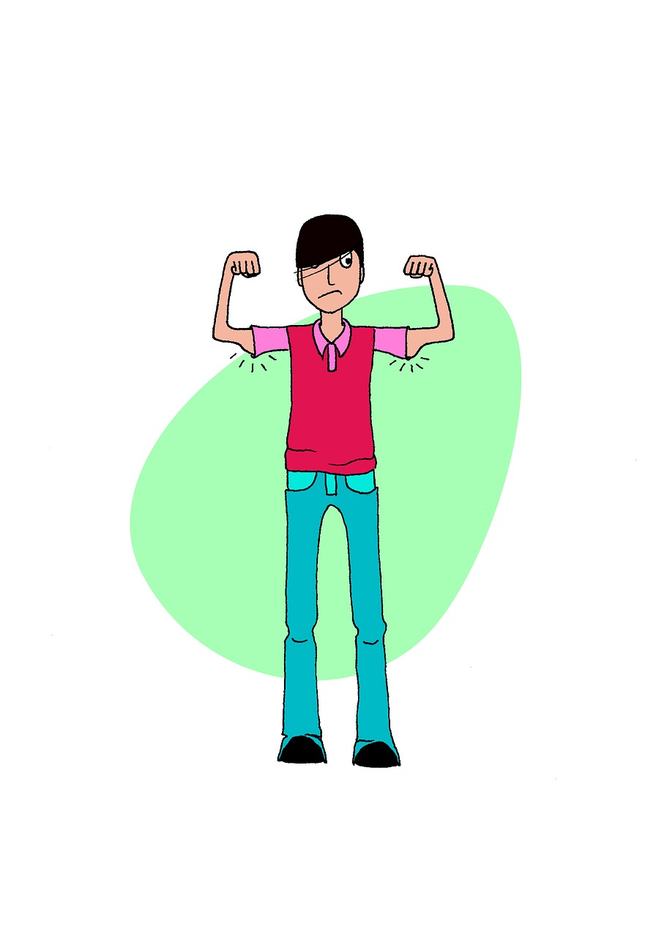
Based on what we just learned should the current policy be totally replaced, strengthened, or improved? What advantages from the current policy should be retained? What disadvantages should be removed?
Policy is ok but it needs to be strengthened by getting adults more training. Also, students need evaluations and help to understand why what they are doing is not working for anyone.
Advantages are that the policy that is in effect and does work some of the time.
Disadvantages are that the policy that is in effect and it sometimes doesn’t work efficiently.

Slide 11
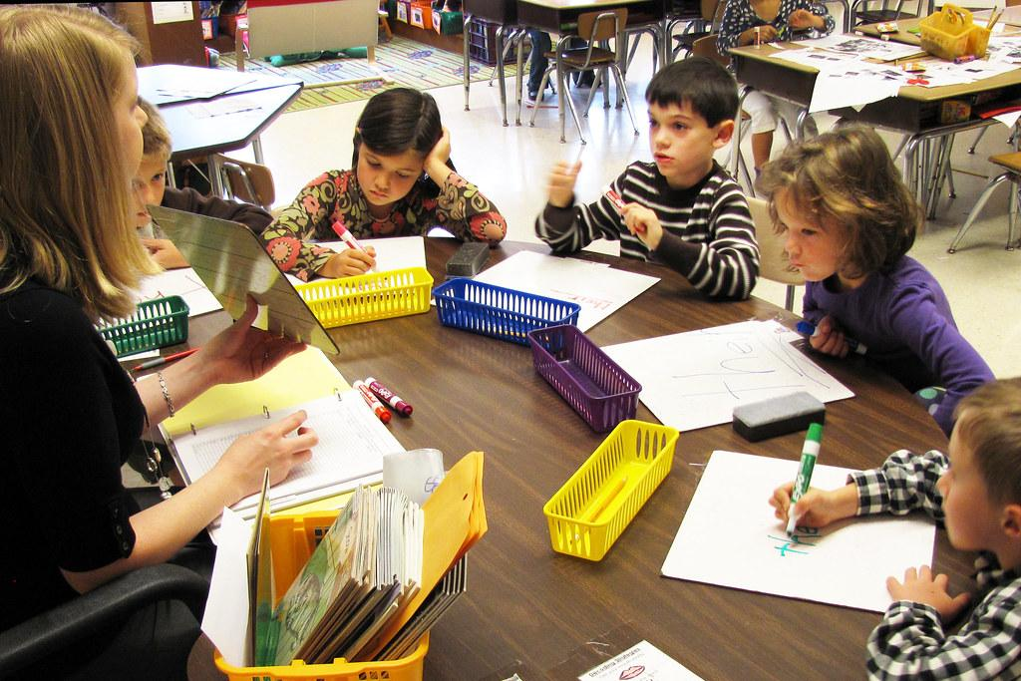
Propose at least three new/original public policy alternatives. List the proposal that your group considers the most promising first.
Students not using kind words will not be allowed to go to recess.--administrators, teachers, school aides–most likely to happen.
Student hurting feelings of others will be possibly placed into a small discussion group about feelings.--teachers–will definitely happen.
Students hurting someone physical will be reported to guidance counselor and principal.--might happen.

Slide 12
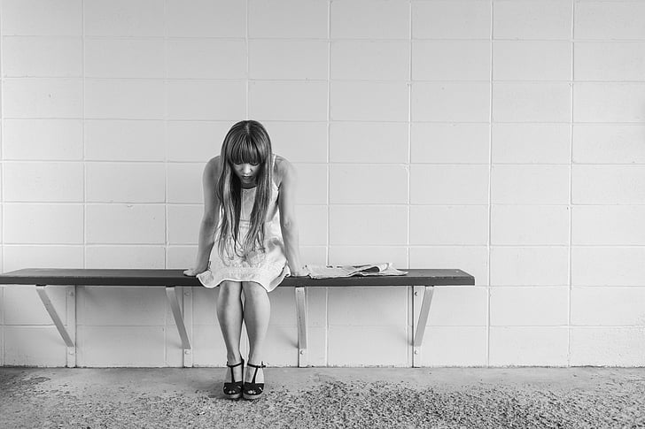
List three public policy alternatives and list a short word or phrase for each one…
Students not using kind words will not be allowed to go to recess.--administrators, teachers, school aides–most likely to happen NO RECESS
Student hurting feelings of others will be possibly placed into a small discussion group about feelings.--teachers–will definitely happen SMALL GROUP DISCUSSION
Students hurting someone physical will be taken out of class then taken out of school and reported to guidance counselor and principal.--might happen REMOVED FROM CLASS

Slide 13
Create a MATRIX:
FEASIBILITY
_HIGH___________ _MEDIUM_____________LOW________________
_HIGH____________________________________________________SMALL GROUP___
Effectiveness _MEDIUM__________________________NO RECESS_________________________________
_LOW________REMOVED FROM CLASS____________________________________________

Slide 14
Discuss the reasons for your decisions in the matrix.
SMALL GROUP–is low feasibility and high effectiveness
NO RECESS–is medium feasibility and medium effectiveness
REMOVED FROM CLASS–is low feasibility and high effectiveness

Slide 15
Discuss why you prefer one alternative over the other two alternatives.
I prefer the small group discussion because it simple to implement and it has a very good impact.
The no recess can work easily as well.
The removal from class isn’t a good alternative because children have the right to an education and legally this one doesn’t work well.

