Slide 1
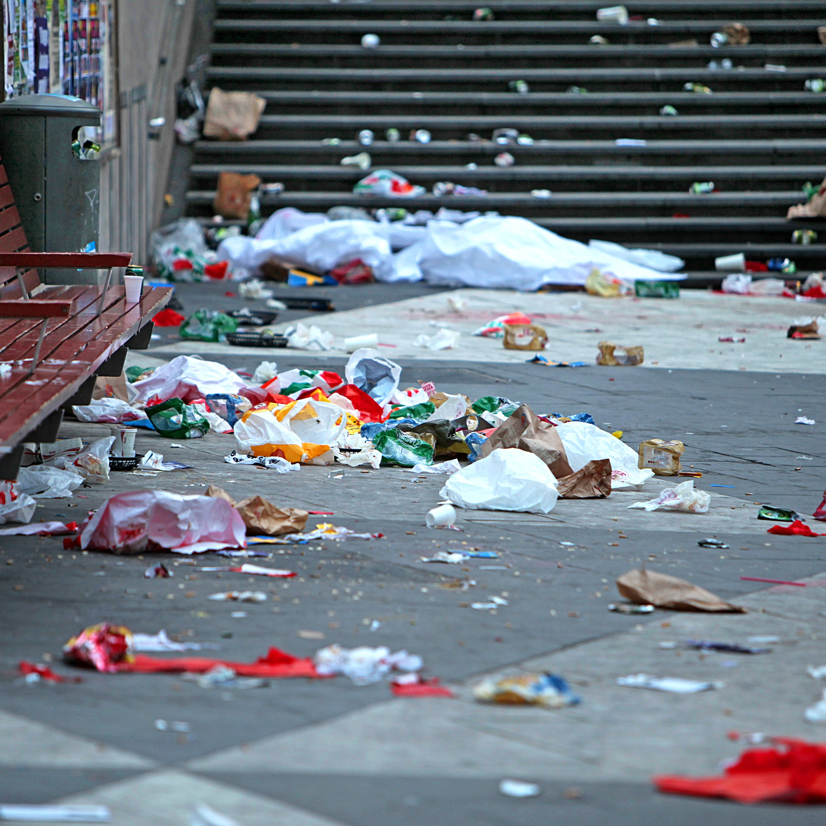
Street Cleanliness in Queens is Awful
Mr. Moncada
PS/IS 127Q

Slide 2
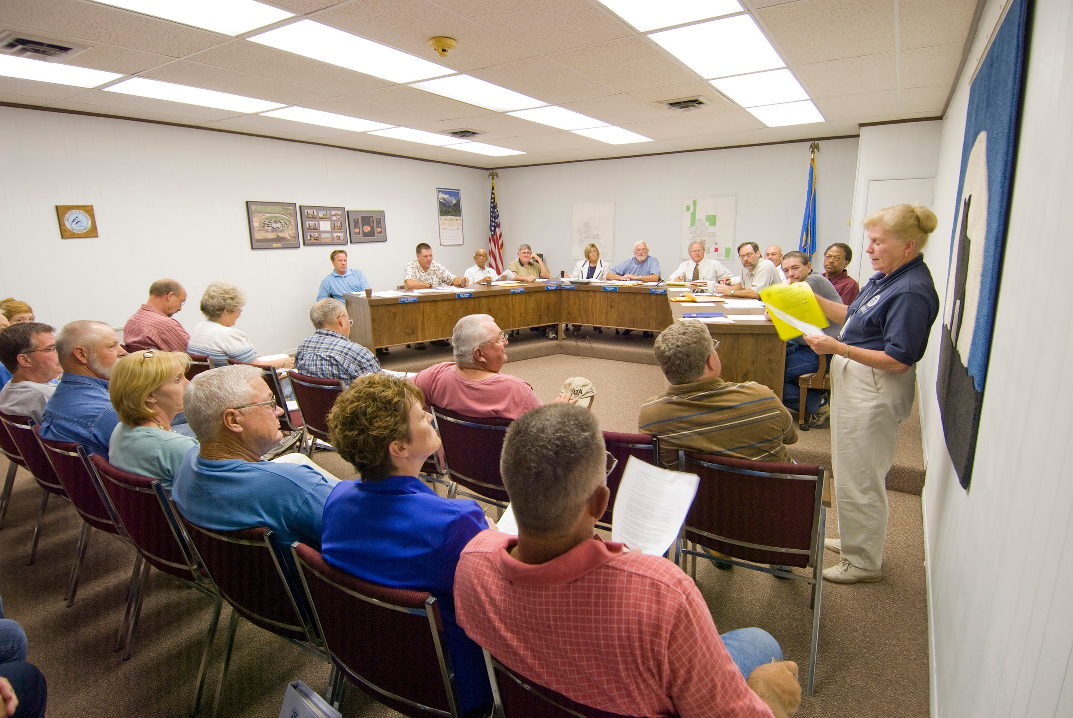
What is a Public Policy Analysis (PPA)? How does it help?
Public Policy Analysis allows for members of the community to carefully study and propose solutions to social issues that are currently affecting our community. By analyzing problems within our community, we can resolve those problems so that we can improve our quality of life.

Slide 3
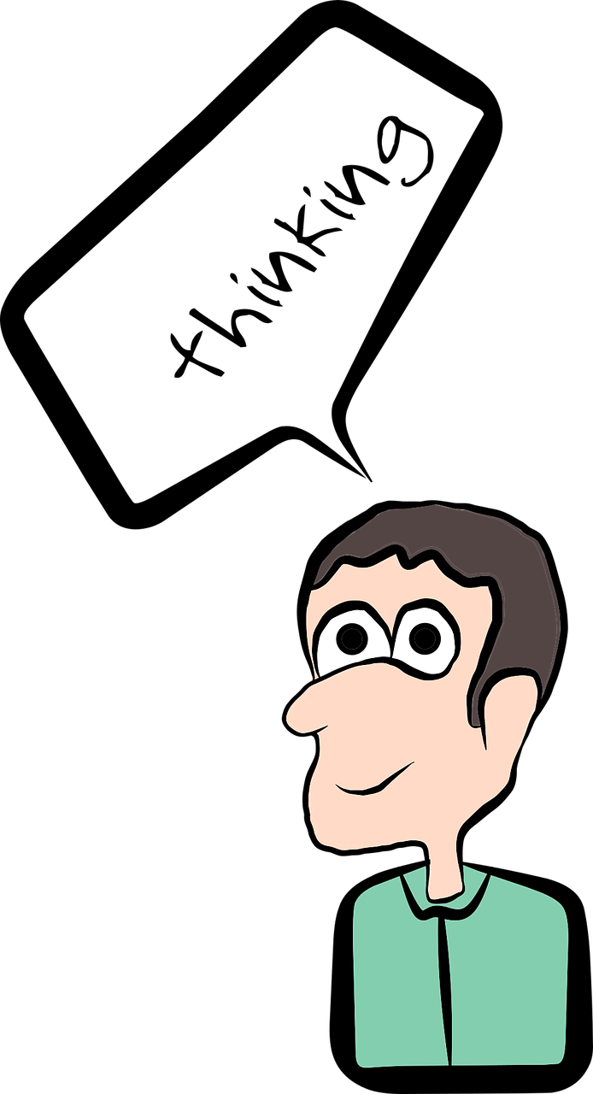
Steps for a Thorough and effective PPA
1.Define the Problem
2.Gather Evidence
3.Identify Causes
4.Evaluate Existing Public Policies
5.Develop Public Policy Solutions
6.Selecting the Best Policy Solution

Slide 4
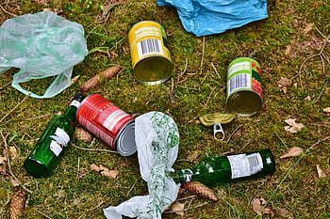
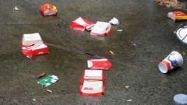
Define the Problem
Queens has always been the place for diversity, small communities, and great food. The backbone of NYC’s workforce mostly reside in the outer boroughs, Queens is the most diverse. Queens unfortunately has been feeling dirty. The streets are littered with garbage, there are food trucks everywhere that do not follow proper sanitation procedures, and the parks are full of garbage and drug paraphernalia. Queens is getting dirtier by the day.

Slide 5
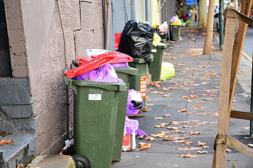
Collect Evidence
According to Politico, sanitation complaint calls to 311 have increased 31% since last year regarding trash and refuse left in the street. If you walk around Queens you can see the littered streets and an obvious change than from the year before.

Slide 6
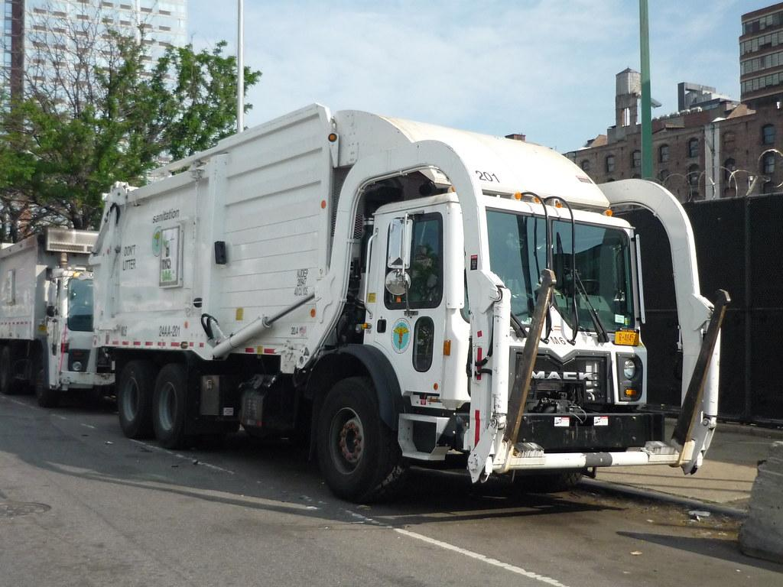
Identify Causes
Fewer sanitation workers because of COVID19 vaccination requirements
Newcomers in the community are not educated, do not understand proper etiquette for cleanliness.
People are frustrated with other personal issues, sanitation is the last thing on their minds
Less money towards sanitation

Slide 7
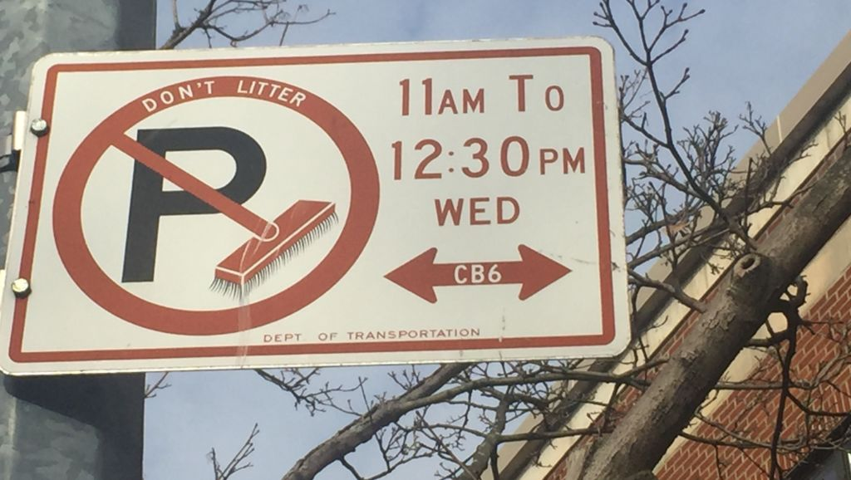
Evaluate Existing Public Policies
Street cleaners clean the streets 2 times a week
Fines are given out to homes and businesses for not recycling or disposing of trash properly
Minimal garbage cans on city blocks
Littering can lead to a fine

Slide 8
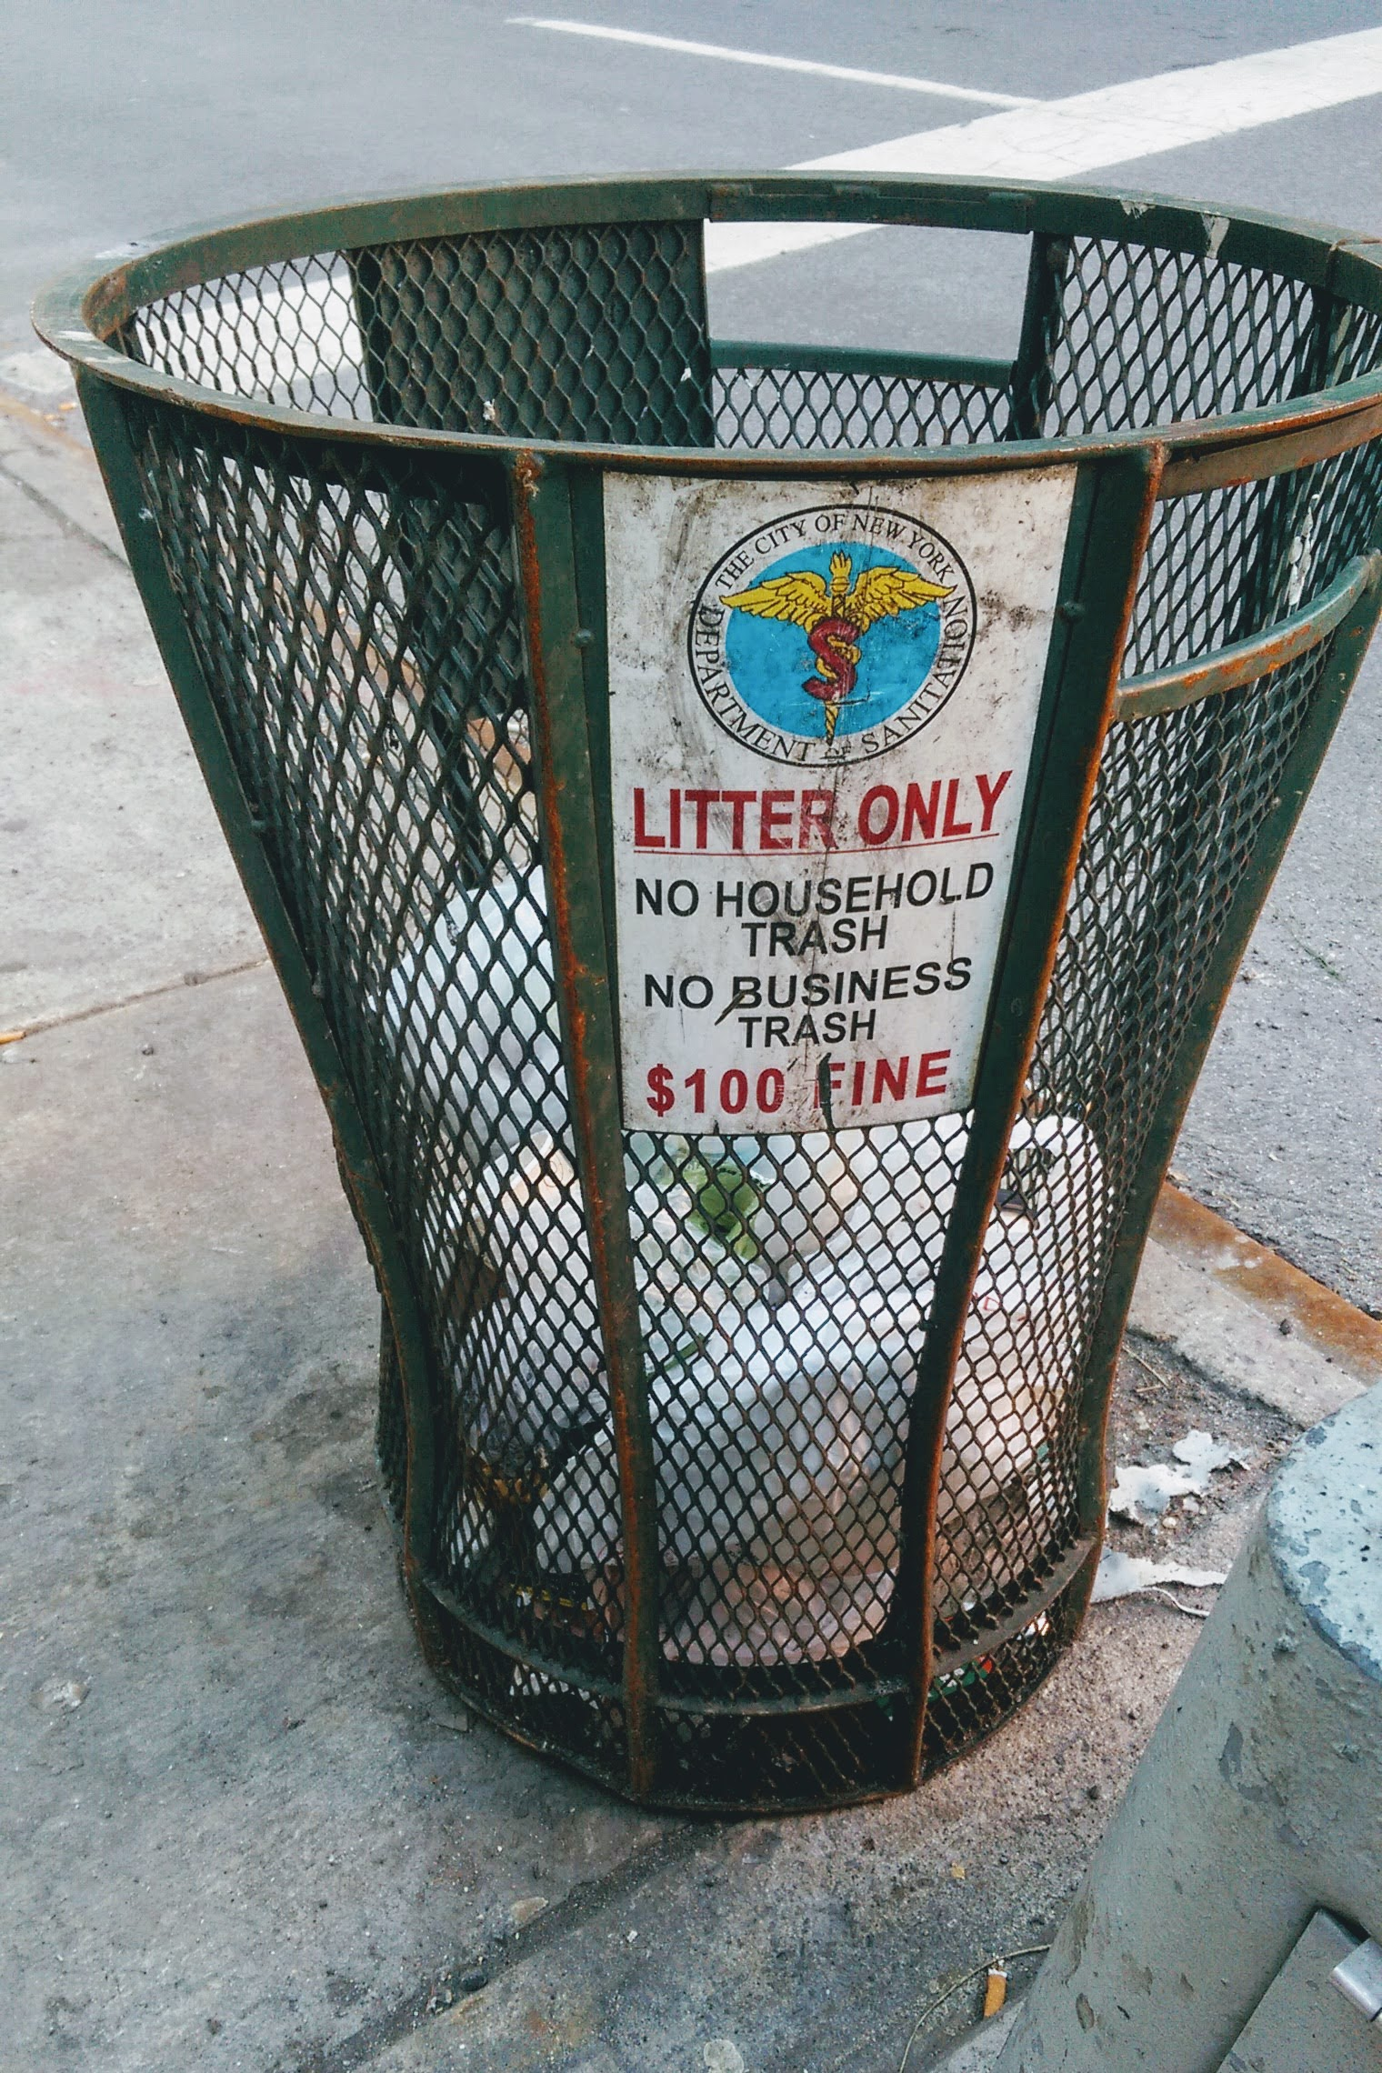
Develop Public Policy Solutions
Enforce the laws regarding littering and dumping trash in public places
Educate people on the effects of pollution
Have trash cans in almost every corner of public streets
Enforce food cart rules and regulations
Hire more sanitation workers.

Slide 9
Most Effective and feasible Solution
Feasibility
 | High | Medium | Low
High
Medium
Low

