Slide 1
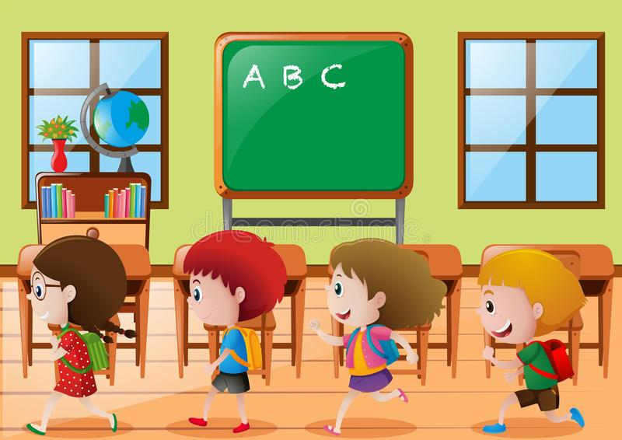
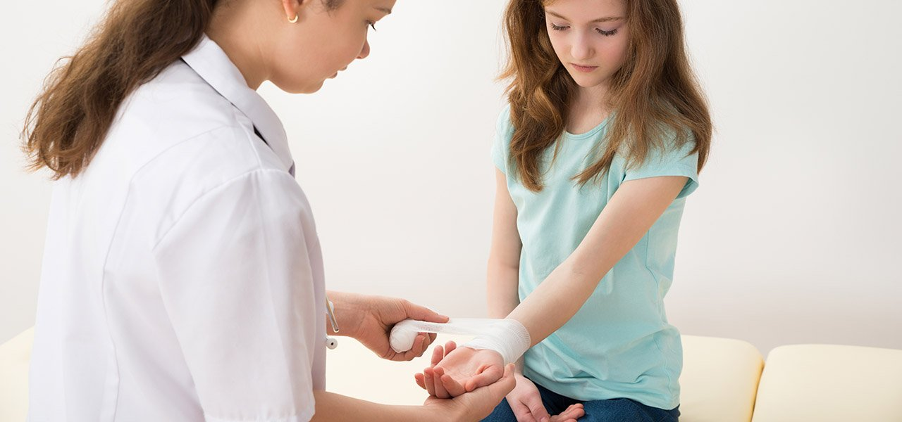
Running in the Art Room in PS 148
Kindergarten and First Grade Classes
November 2022
By Mrs. D. Mimnaugh

Slide 2
The 6 Steps of the Public Policy Analyst (PPA)
1. Define the Problem
2. Gather the Evidence
3. Identify the Causes
4. Evaluate an Existing Policy
5. Develop Solutions
6. Select the Best Solution (Feasibility vs. Effectiveness)

Slide 3
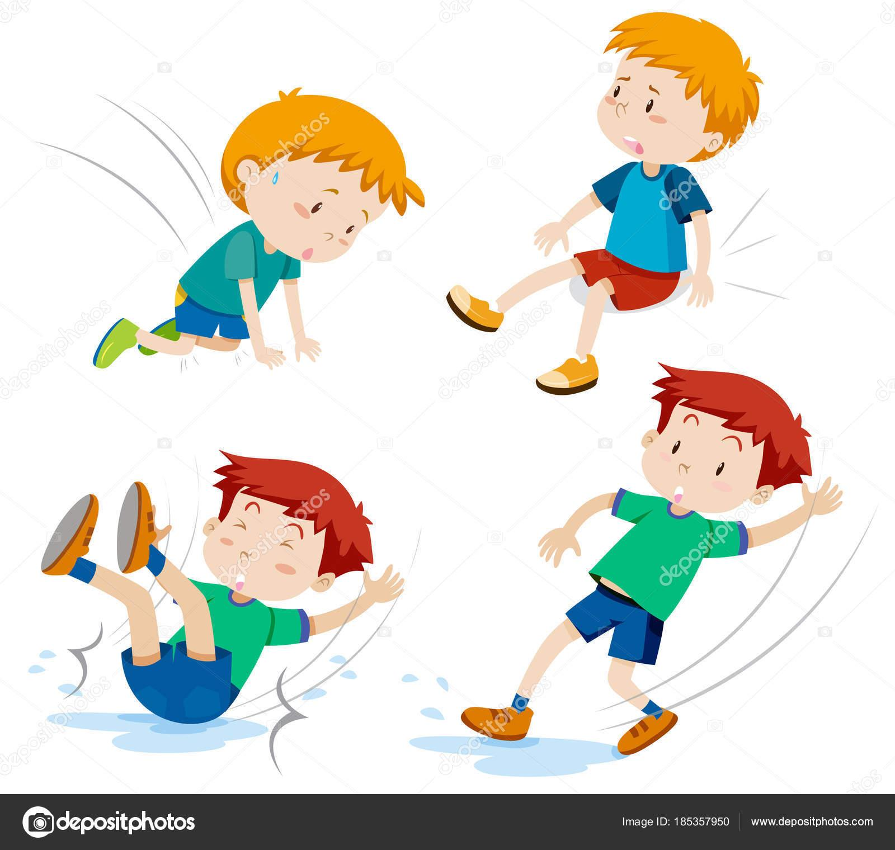
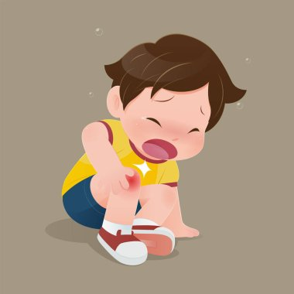
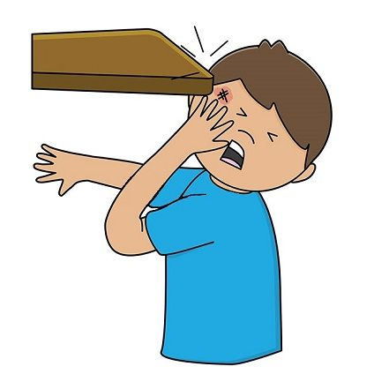
Step 1: Define the Problem
The kindergarten and first grade students run around in the art room at PS 148Q, East Elmhurst, NY.
Students are unaware of the dangers of running around the art room.
Students are falling down.
Students are hurting other students.

Slide 4
Step 2: Gather the Evidence
Observing running/jumping upon arrival in the art room.
Classroom teacher also observes running into the art classroom.
Teacher complaints - similar situation in their classrooms
School aide complaints also observing running in the hallways/lunchroom
Parent complaints that their children got hurt
In-House accident reports
Nurse Log / Nurse slips

Slide 5
Step 3: Identify the Causes
Students are young and energetic
Students are unaware of the dangers
Students do not remember the school/classroom rules
Students do not care about the classroom rules
Students are excited about being in the art classroom
This is the first time students are in-person learning since the pandemic
Students run around like this in their home
Lack of structure / rules at home
Lack of parent support
Lack of parent understanding/support of school structure

Slide 6
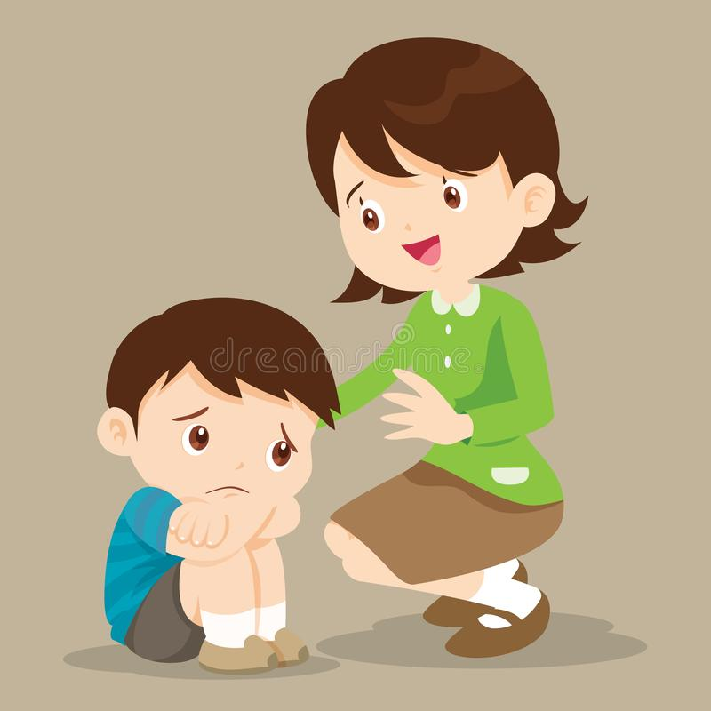
Step 4: Evaluate the Existing Policy
Speak with students about running in the classroom
Whole group mini-lessons about classroom safety
Positive reinforcement for good behavior - stickers, high-fives, positive feedback
Talk to the homeroom teacher
Use Class Dojo to contact parents
Parent Engagement on Tuesday afternoons
Make calls home
Disadvantages:
Too many messages on Class-Dojo
Too many parent contacts can cause stress
Get others involved:
Call SBS team for support
Guidance
School Psychologist
Assistant Principal

Slide 7
Step 5: Develop Solutions
Rewards
Reminders of the Rules
Take away a privilege
Reach out to Guidance Counselor / an assembly / class meeting
Talk to Administration
School Wide Behavior Intervention Plan
Parent Coordinator / Parent Workshop
Safety-in-house classroom trip with a safety group /EMS/Police Youth Officer
Theater Group / Puppet Show about school safety

Slide 8
Step 6: Selecting the Best Public Policy Solution
FEASIBILITY
EFFECTIVENESS
 | HIGH | MEDIUM | LOW
HIGH |  |  | Puppet Show (comes out of school budget)
MEDIUM |  | Rewards
LOW | Reminders of the Rules

Slide 9
Discussing the Matrix
Reminders of the Rules - low effectiveness/high feasibility. It’s something I already do and students continue to forget the classroom rules/it doesn’t cost anything.
Rewards - medium effectiveness/medium feasibility. Stickers, positive reinforcement, compliments do help some of the time. I spend a decent amount of money on stickers and the prize jar.
Puppet Show - high effectiveness/low feasibility. For younger learners a puppet show or fun theater group presentation can help them to see safety issues and how to act in the classroom. It’s low feasibility because it would cost the school a decent amount of money to bring a group into the classroom.

