Slide 1
Hitting in our classroom -
How do we fix it?
PS85Q
L.Meletiadis

Slide 2
Public Policy Analyst Steps (PPA)
1. Define the problem
2. Gather the Evidence
3. Identify the Causes
4. Evaluate an Existing Policy
5. Develop Solutions
6. Select the Best Solution (feasibility vs. effectiveness)

Slide 3
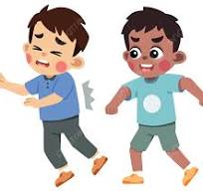
# 1 Define the Problem
Students are hitting each
other in our classroom.
Turn & Talk : Why is this a big problem?

Slide 4
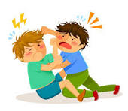
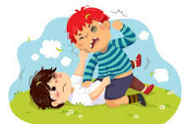
# 2: Gather the Evidence
Students are hitting each other almost on a daily basis.
Students are using their hand inappropriately.

Slide 5
Hitting is a form of bullying
Bullying is being mean to another kid over and over again.
Kids Who Are Bullied Feel
Kids who are bullied can feel like they are:
Different
Powerless
Unpopular
Alone
Sad, lonely, or nervous
Feel sick
Have problems at school
Bully other kids

Slide 6
# 3: Identify the cause of the problem
Why do you think students are hitting each other in our classroom?
Activity: Write down at least 2 ideas you have and then share them with your group.
Students are hitting each other because _____

Slide 7
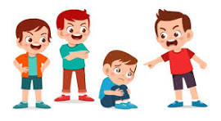
Kids bully others for many reasons, they may:
Want to copy their friends
Think bullying will help them fit in
Think they are better than the kid they are bullying
Cultural differences

Slide 8
# 4: Evaluate an Exciting Policy
What happens in our classroom now when someone hits?
What happens if we see someone hit another student?

Slide 10
# 5: Develop a Solution
What can we do to stop hitting our classmates?
Turn & Talk

Slide 11
What can we do about the hitting?
Learn more about hitting affects others.
No recess!
Messages to our family.

Slide 12
Working Together
When we work together we create a respectful classroom environment.

