Slide 1
Am I Making Good Choices?
What am I Doing?
How do my classmates feel?
By Athena Manessis
Class 2-202 PS 69Q

Slide 2
The Six Steps of The Public Policy Analyst:
Define the problem
Gather Evidence
Identify The Causes
Evaluate an Existing Policy
Develop Solutions
Select The Best Solution

Slide 3
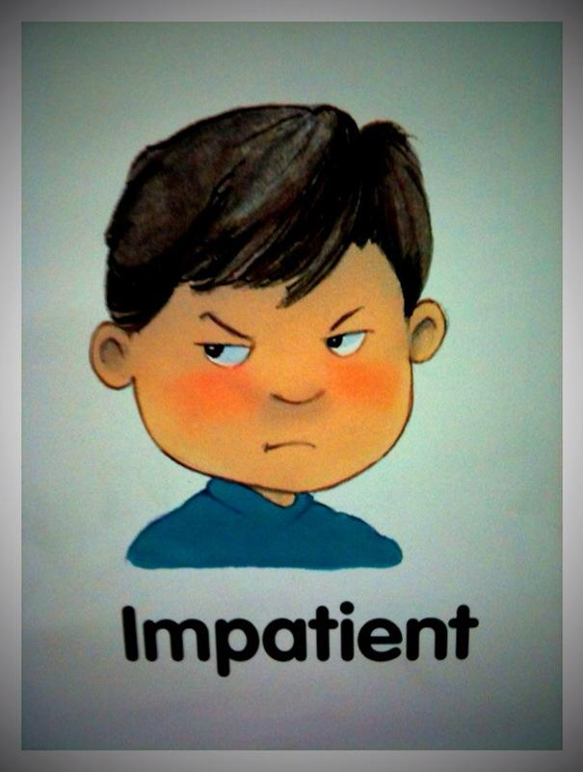
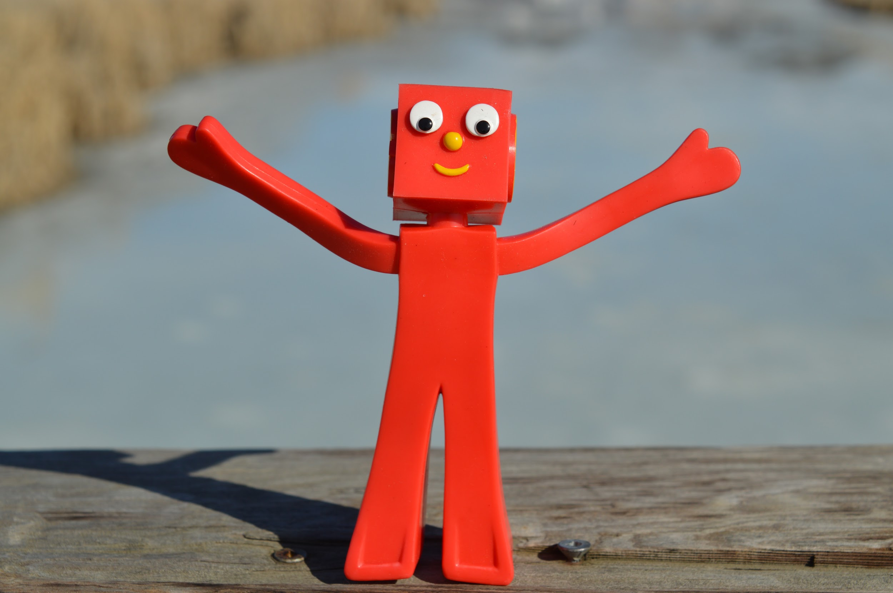
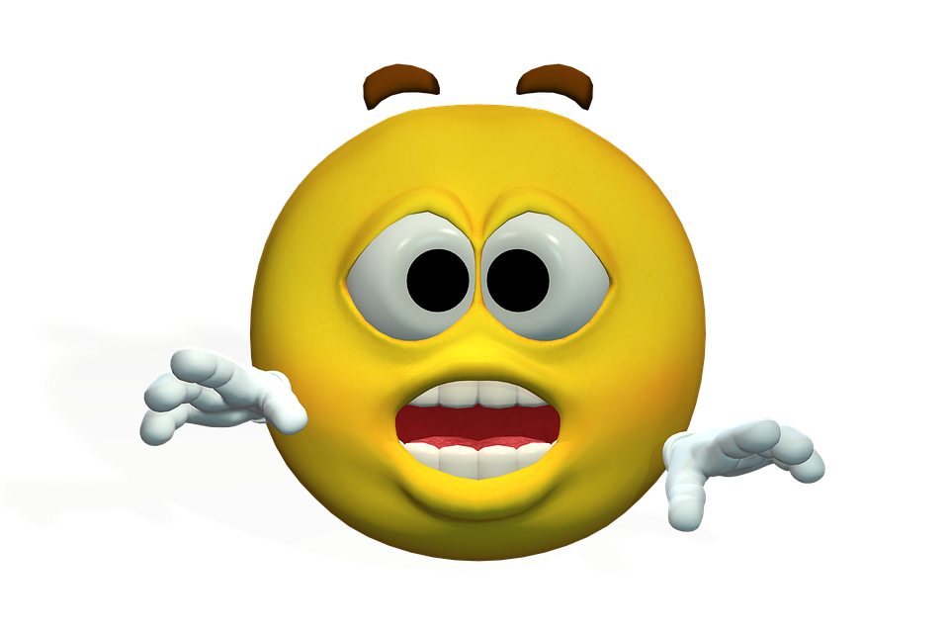
Think-How do you feel when someone else calls out in class and you were about to say that answer?

Slide 4
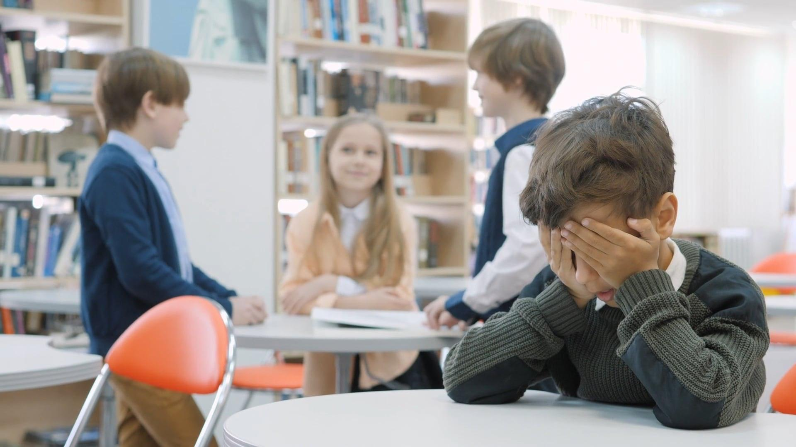
Step 1- Defining The Problem
Students in our class do not consider the feelings of others.

Slide 5
2.Gather Evidence
Students shout out answers without raising their hands.
Students make unpolite comments if someone gives an incorrect answer.
Students don’t give others enough time to correct their answers if they make a mistake.
We don’t listen to each other’s questions and answers.
We repeat the same things another person said.

Slide 6
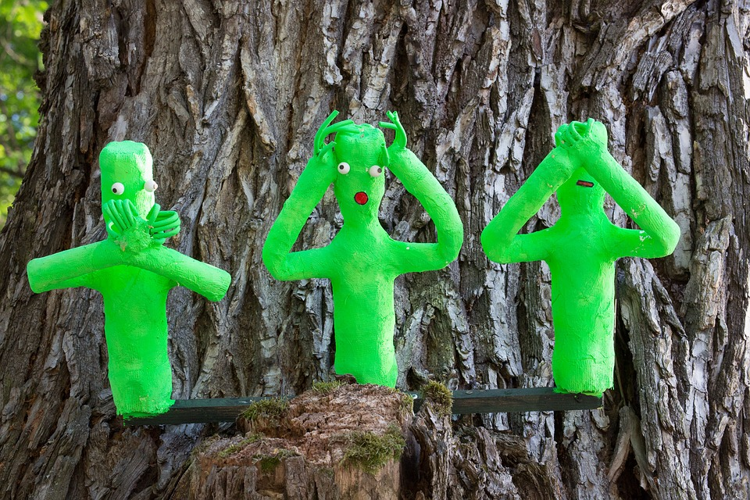
3.Identify The Causes
Students don’t think of others feelings.
Students forget to follow school rules.

Slide 7
Do You Know What It Means To Be Patient?
Are You Patient?

Slide 8
Step 4-Evaluate an Existing Policy-(SEL)
Why can’t we all make the best choices?
Why Can’t We Be Patient? Turn and Talk

Slide 9
Let’s watch this video to learn about making the best choices. Will you make the best choice?

Slide 10
Step 5-Develop Solutions-What Can I Do?
What are some things you learned that you can do to make the right choices?
Turn and Talk

Slide 11
Step 6-Develop and Select The Best Solution
FEASIBILITY
EFFECTIVENESS
 | HIGH | MEDIUM | LOW
HIGH |  | Follow School Rules
MEDIUM
LOW |  | Consider others feelings.

