Slide 1
Students Acting Impulsively in the Classroom
Dimitrios Liapis
P.S. 85 Q

Slide 2
The 6 Steps of the Public Policy Analyst (PPA)
1. Define the Problem
2. Gather the Evidence
3. Identify the Causes
4. Evaluate an Existing Policy
5. Develop Solutions
6. Select the Best Solution (Feasibility vs. Effectiveness)

Slide 3
What does being impulsive mean to you?
Turn and Talk with your partner and share your thoughts.

Slide 4
The definition of being impulsive is…..
the tendency to act without thinking

Slide 5
STEP 2 of the PPA: What is the evidence?
Examples of impulsivity in our classroom/school include….
Calling out-instead of patiently waiting to be called on, blurting out answers or random requests
Doing something without thinking of the consequence-destroying school property like for example bulletin boards or student restrooms
Uncontrollable physical and emotional reactions- running and screaming and exhibiting unsafe and improper school behavior
Saying the first thing that pops into their head- speaking without thinking of if what we’re saying is appropriate or most importantly kind.
Interrupting a teacher or classmate instead of saying “excuse me”- waiting for the person to be available to help or respond to you instead of getting out of your seat to approach them or repeating their name regardless of if they are speaking or are in the middle of helping someone else.

Slide 6
Can you identify with any of these impulsive behaviors?
Why do you think students act impulsively?

Slide 7
Think about this image….

Slide 8
What kind of feelings do you have when waiting for the 5 second “Skip Ad” to finish before watching a YouTube video…
Let’s share some feeling words that come to our minds….

Slide 9
Why do you think we feel this way ?

Slide 10
STEP 3 of the PPA: What is the cause?
Instant Gratification
Instant gratification, or immediate gratification, is the urge to satisfy a craving without considering its long-term effects or the bigger picture.

Slide 11
Students and Technology
Children live in a world of instant gratification….
Unlike previous generations, we get social media sites, YouTube videos, Netflix programs, online shopping, Amazon same-day delivery, and Doordash instant meals in this digital age.
How do you think technology affects our need for instant gratification?
Turn and Talk with your partner

Slide 12
Do you think our need for instant gratification changes as we get older? Lets watch a video…

Slide 13
Video:
The Marshmallow Test
The marshmallow test is a classic psychology experiment first conducted by researchers Walter Mischel and Ebbe B. Ebbesen at Stanford University in the late 1960s.^{​1​}
https://www.youtube.com/watch?v=Yo4WF3cSd9Q

Slide 14
In this video…
Researchers were trying to identify the processes that underlie self-control in preschoolers when they face temptation.
In the marshmallow experiment, preschoolers had a choice between eating one marshmallow immediately or waiting for a greater reward of two marshmallows later.
The children were then measured on how long they could wait to eat the first marshmallow.
The researchers found that the longer the wait times shown by the preschoolers, the better the outcome in adolescence, such as higher SAT scores, better social cognitive, and more emotional coping.^{​2​}
They were also rated as having greater self-control, less prone to temptation, more intelligent, and less distracted when concentrating.

Slide 15
This video ultimately shows us that as we grow older our maturity level affects our ability to exhibit less impulsive and impatient behavior.

Slide 16
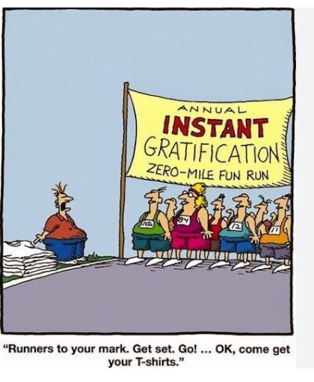
Look at this comic…
How does this comic show the humor of instant gratification ?
Let’s share…

Slide 17
We defined impulsive behavior and looked at an image, a video and a comic to understand what instant gratification means. What kind of solutions can we find to limit our impulsive behaviors?

Slide 18
STEP 4 of the PPA: Solutions we use already
Stop, Think, Act- three step system used to think out behavior in order to diminish acting on impulse
One Mic, One Voice- used in order to allow one person to speak at a time and diminish interruptions and disrespectful behavior
Keep the Conversation Going- used in order to speak in response to the person and add on to an existing conversation or topics
One Glow, One Grow- used in order to give appropriate positive feedback as well as constructive criticism
Class Reward System- points system used to commend appropriate behavior and allow teacher to highlight what students are doing right, rather than

Slide 19
STEP 5 of the PPA: Solutions:
Teach students that people who take turns and act in a deliberate fashion are more successful than those who act impulsively.
Use positive reinforcement based on the length of time the student can be successful at controlling his/her impulsive behavior. As the student demonstrates higher levels of success, gradually increase the length of time required for reinforcement. When the student demonstrates impulsive behavior, try to use a predetermined signal, such as a hand signal or verbal cue, to remind the student to slow down and think of the consequences that may result from the anticipated impulsive behavior.
Closely monitor behavior and intervene early when a problem presents itself. This should prevent a more serious problem from developing. Close monitoring is especially important in situations that tend to trigger impulsive behavior (e.g., playground, lack of structure, etc.). When correcting the student, focus on the specific impulsive behavior and not the global self (e.g., communicate “what you did was wrong,” and not “you’re a bad student”.
Source: University of Delaware: Impulsivity Recommendations
https://www.education.udel.edu/wp-content/uploads/2013/01/Impulsivity.pdf

Slide 20
In addition to the solutions we have in place already are there any other solutions we could add?
What works and what does NOT work?

Slide 21
I hope that we understand impulsive behavior better after this presentation and will be able to use the strategies to portray proper fifth grade behavior in the future !!!

