Slide 1
Children Bullying each other during Lunch/Recess
Mrs. Lewis
PS 148Q
Class 3-323

Slide 2
Step 1: Define the problem
Problem: Students are claiming to be bullied during lunch and recess.

Slide 3
With your table partners.. Think:
What does it mean to be a bully?
What does it mean to be bullied?

Slide 4
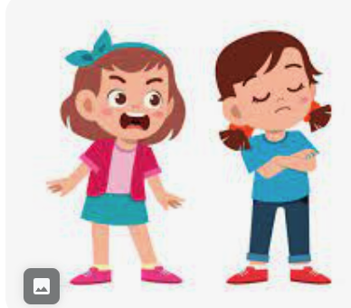
What does it mean to bully someone?
Bullying:
unwanted, aggressive behavior.
behavior is repeated, or can be repeated, over time.
Bullying

Slide 5
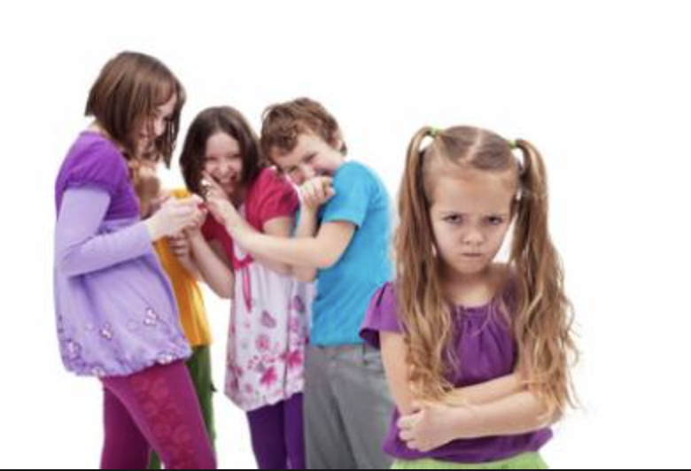
Bullying can be through your words:

Slide 6
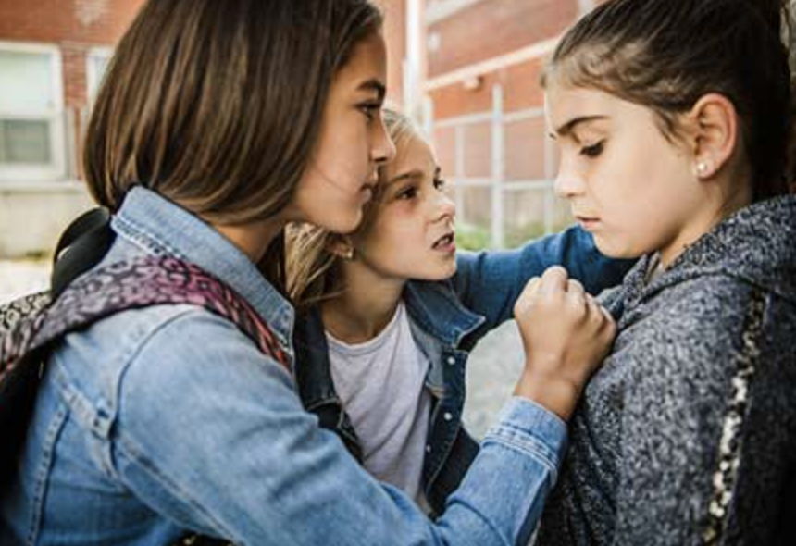
This can be through your actions:
Physical Bullying
Physical bullying involves real bodily contact between a bully and his/her victim. Some examples of physical actions include:
Hitting
Kicking
Stealing the belongings of others
Punching
Shoving
Slapping
Spitting
Scratching
Teasing

Slide 7
This can also be ONLINE!
Cyberbullying
Cyberbullying is when a student uses the internet, cell phones or other devices to send or post text or images intended to hurt, embarrass, threaten, torment, humiliate, or intimidate their victim.

Slide 8
Step 2: Gather Evidence
…41% of students who reported being bullied at school indicated that they think the bullying would happen again.[1]
https://llcbuddy.com/data/new-york-bullying-statistics/
Nearly 43% of kids have been bullied online https://www.ny.gov/cyberbullying
Class 323 Survey of bullying:
https://docs.google.com/forms/d/1fjH1JULRZ--TnqCMof362tsnC_5BUlUKpZ2dPK2MFmI/edit
Notes:
**Google Survey was posted on 12/27 as I did not have time to do so prior. It will reviewed with students and be the basis of SEL lessons about bullying in Jan 2024.

Slide 9
323 Bullying Survey Results
Notes:
Student Survey results (not yet available)

Slide 10
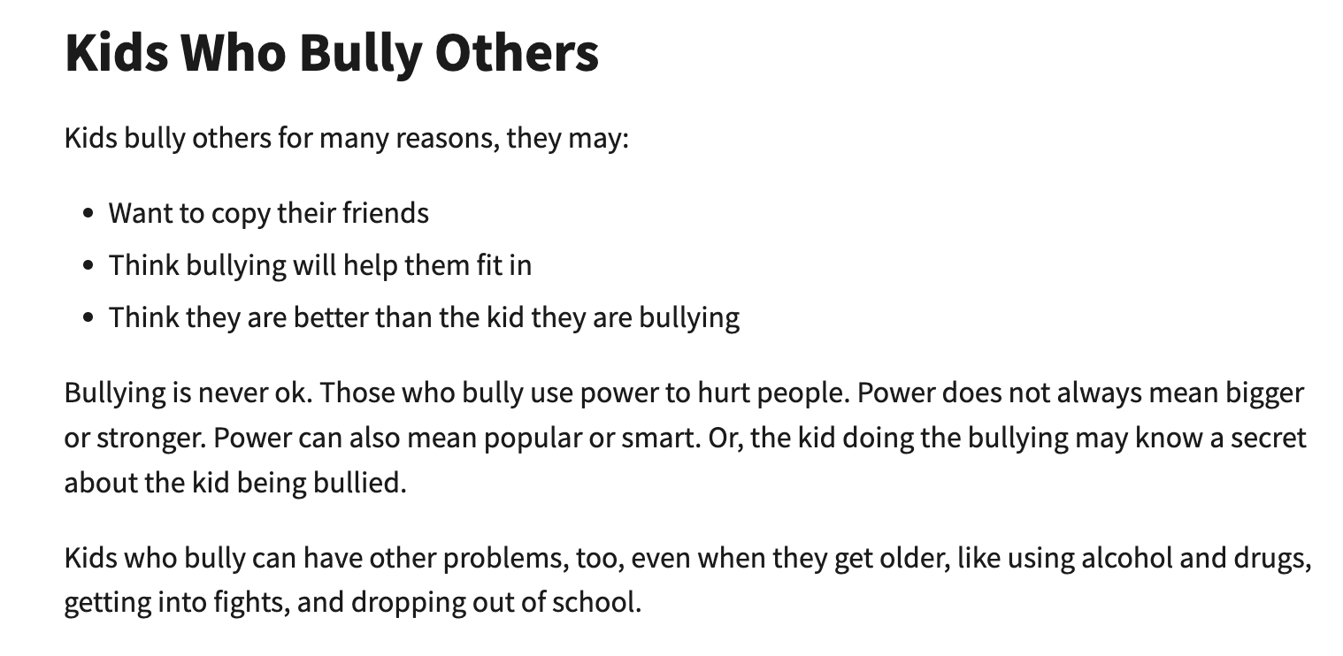

Slide 11
Step 3: identify the causes of the problem
Why do you think someone might be a bully?
Why do you think someone might get bullied?
What do you think the biggest cause of bullying might be?
Write down 2-3 ideas for each and share with your table !

Slide 12
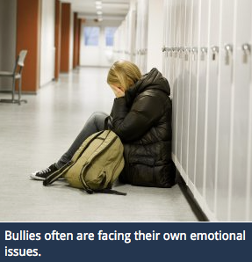

Slide 13
Step 4: Evaluate an existing policy
What are some ways we prevent bullying at school?
How do your teachers/parents prevent bullying?
How can you prevent bullying?

Slide 14
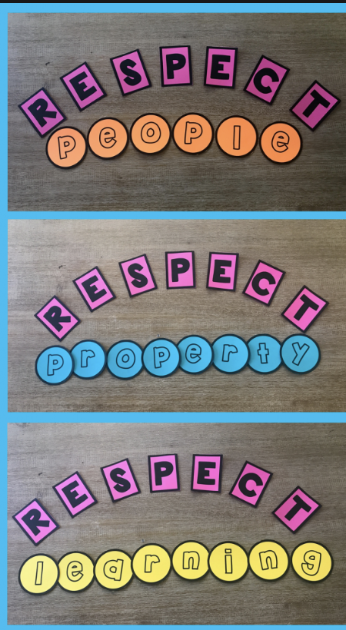
Our Policy
Our Class Rules

Slide 15
Step 5: Develop a Solution
How can we stop bullying?
What are some things we could do, as a school, to help prevent bullying?
With your group, think of some ideas!

Slide 16
How can we help to prevent bullying?
More strict punishments/implementation of these punishments
Increased education in schools about bullying and the consequences that come with it
More support from guidance counselor/social worker- Push in program

Slide 17
Step 6: Choose the best Solution
Which Solution fits our school best?
Effectiveness: how well will it work?
Feasibility: how easily can we make this happen?
Notes:
Lead SEL lessons on Empathy/Speaking up

Slide 18
Feasibility
 | high | medium | low
high |  |  | More support from guidance counselor/social worker- Push in program
medium |  | -Increased education in schools about bullying and the consequences that come with it -More strict punishments/implementation of these punishments
low
EFFECTIVENESS

