Slide 1
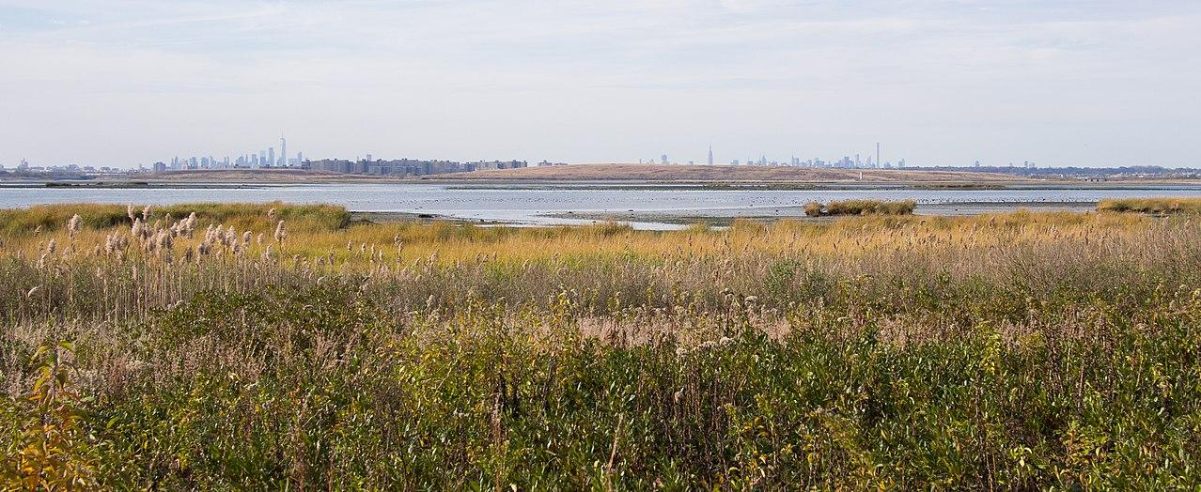
Public Policy Analyst Project:
Think of our field-trips with:
Jamaica Bay - Rockaway Parks Conservancy
Department of Environmental Protection
Problem-Solving with
Class 5-220 @ PS69Q
Ms. Lee
April 2022

Slide 2
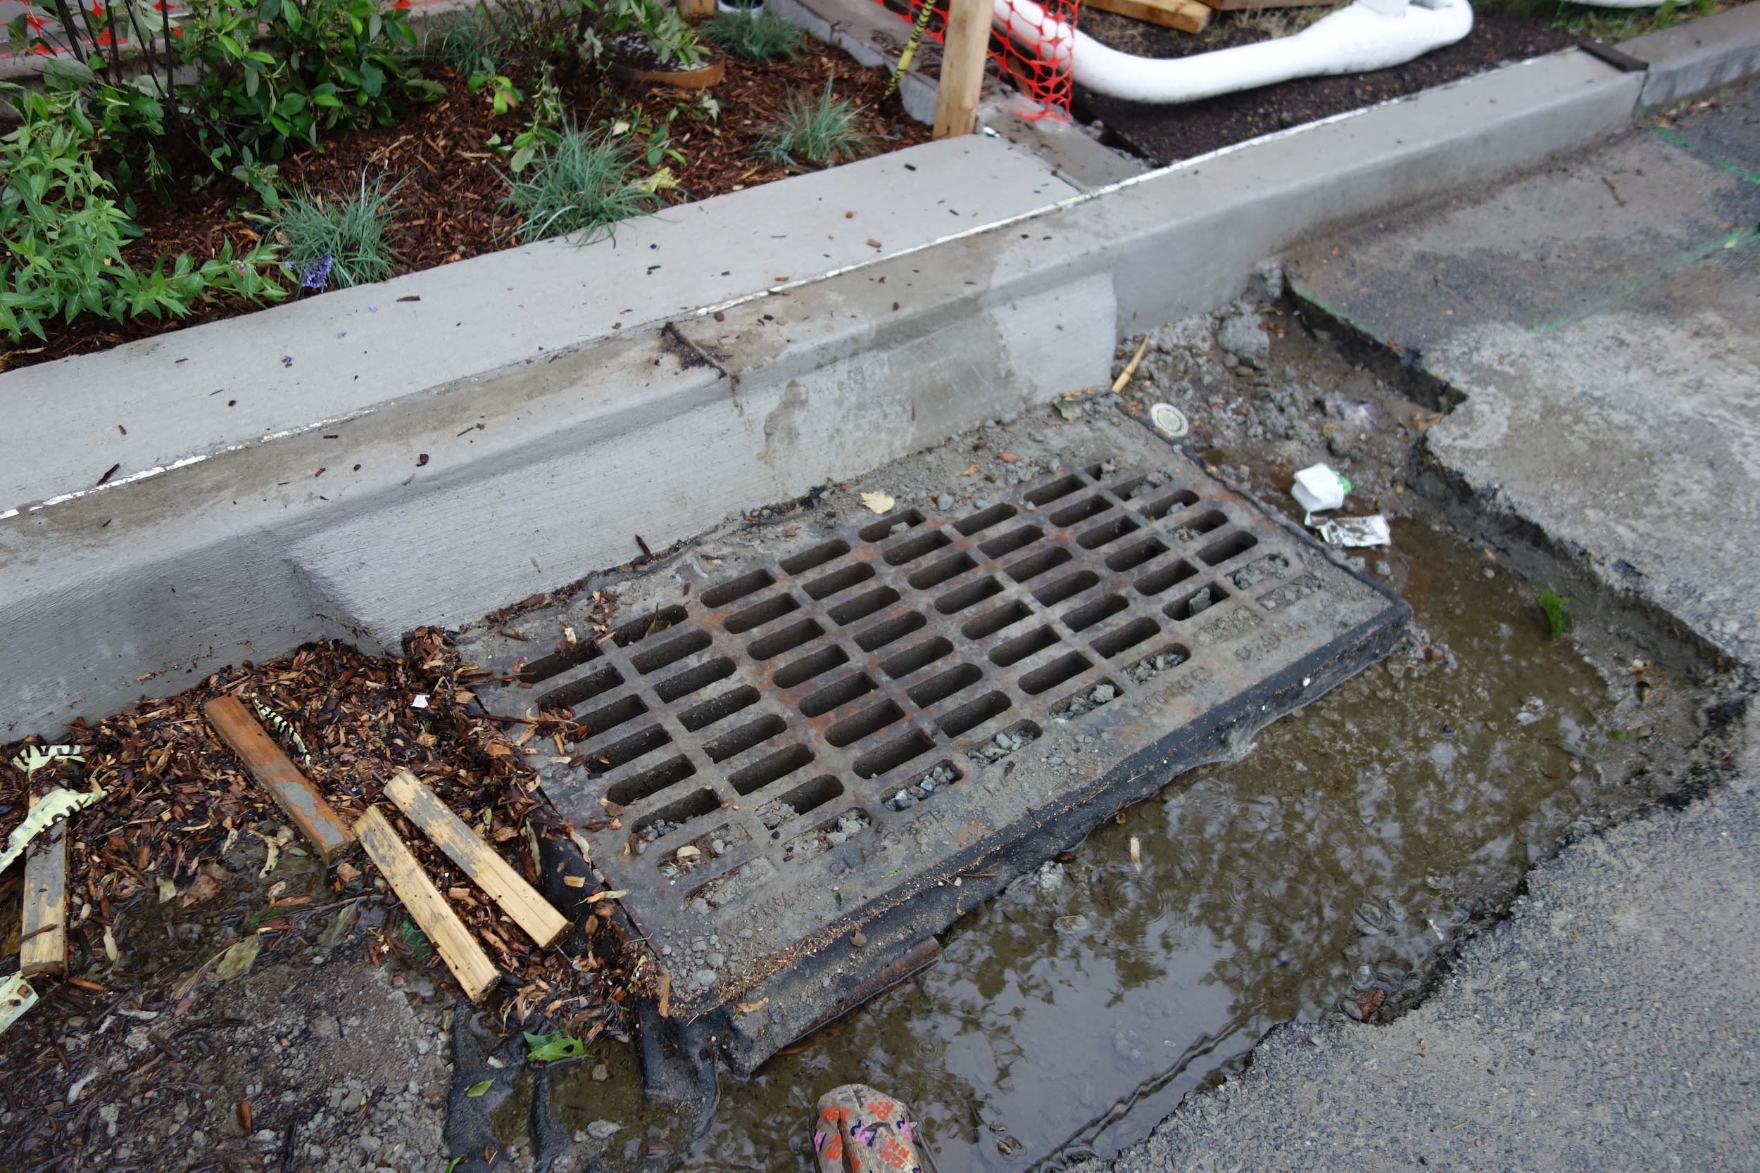
Public Policy Steps:
Define the problem
Gather information and evidence
Identify causes
Evaluate existing policies
Develop novel solutions
Select best solution
Firstly, what problems were discussed on our two field-trips?
Notes:
Noise pollution, garbage in water, overflow from sewage system into the ocean and waterways, excess of plastic garbage —> Overuse of man-made resources

Slide 3
Define the problem.
Marine debris - a lot of plastic and trash; ocean pollution
Trash ending up in the sewer; trash where there shouldn’t be
A LOT of plastic pollution and litter
Air pollution
Notes:
Undesirable conditions - whom does it affect, where does it happen?

Slide 4
Gather information and evidence.
When animals eat plastic, they could die or it ends up in their digestive system and we eat the animal (fish); animals could get hurt or get sick
Plastic takes very long to break down, to decompose (rot); it sits in landfills taking up a lot of Earth space
Plastic has chemicals that are not good for people
Chemicals can also get in our water system that we use for drinking, showering, etc.
Plastic ends up washing up or into the oceans
Notes:
How do we know the problem exists? Where do we see the problem?

Slide 5
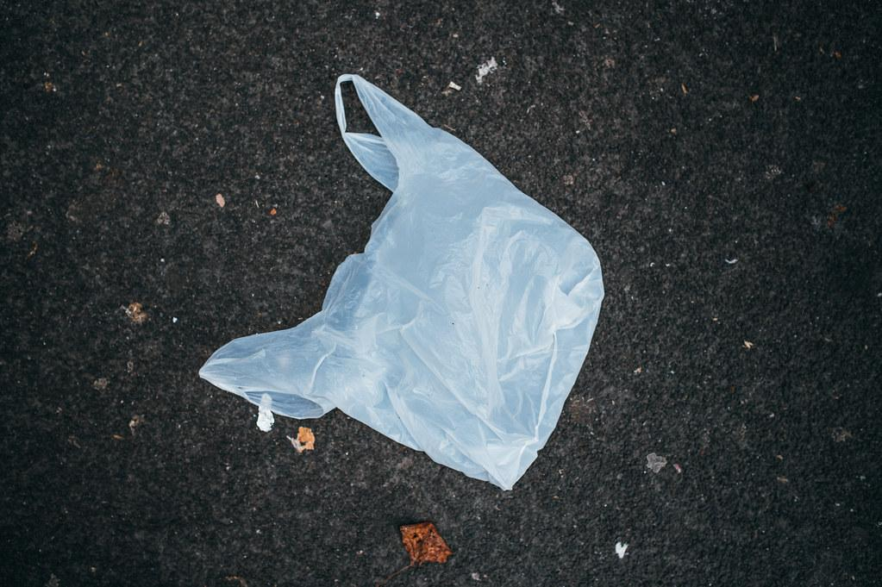
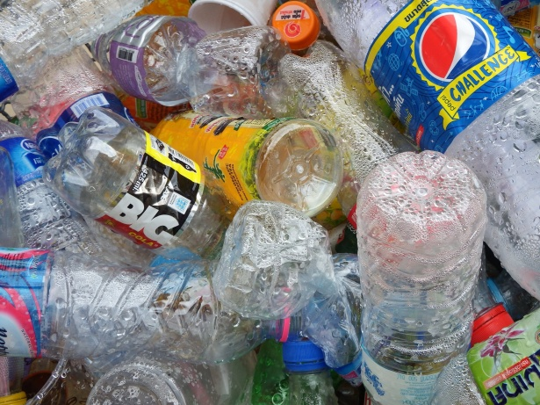
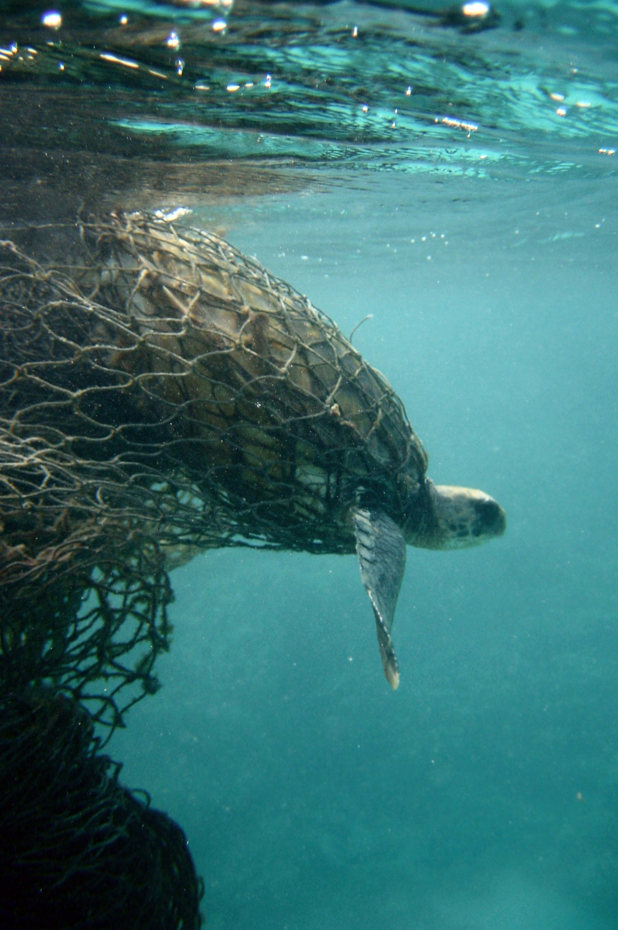
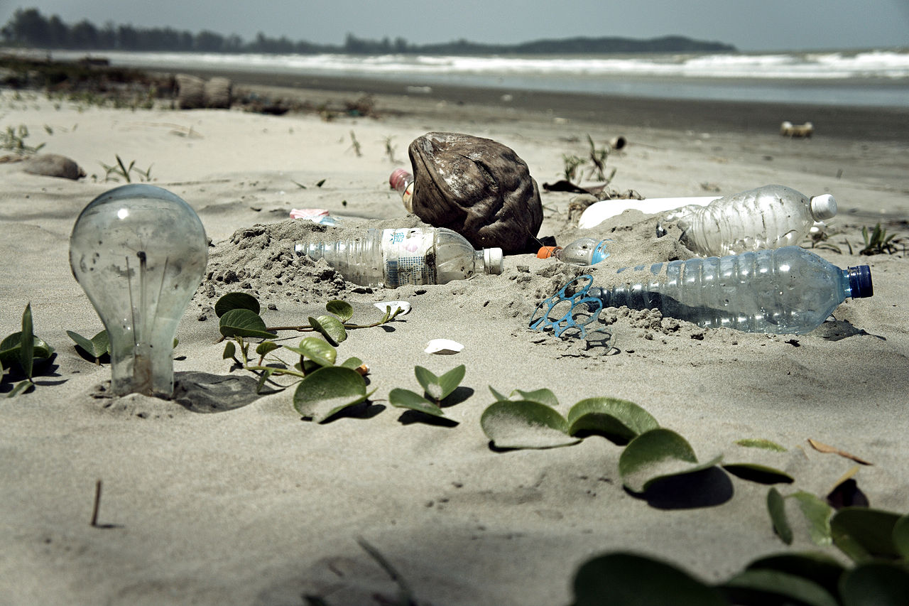

Slide 6
Identify causes.
Too lazy to pick up plastic, keep places litter-free
Disposable, convenient, cheaper to use
Financial investment in more sustainable alternatives
Pattern of overuse; widespread availability
It takes effort to recycle
Lack of education on the part of many people
Notes:
Underlying, contributing factors, motivations

Slide 7
Evaluate existing policies.
In NYC, a surcharge for disposable bags
There are recycling bins in most public areas
You could get fined for littering
Machines sort/filter out water in our water system
Some transition to paper and cardboard (paper straws, paper bags, take out boxes)
Notes:
What are some laws, regulations, policies in place already?

Slide 8
Develop new solutions.
Advocate lawmakers to make and enforce plastic bag/bottles ban
Campaign and spread awareness about the use of plastic and encourage people to seek reusable alternatives (metal, glass)
Invest in science and technology seeking to keep Earth cleaner
More beach clean-ups
Accountability for people and companies that dump garbage
Encourage companies to use more Earth-friendly resources
Increase the plastic fee
Notes:
What else can we do about the problem?

Slide 9
 | Feasibility
Effectiveness |  | High | Medium | Low
 | High
 | Medium | Campaign and spread awareness about the use of plastic and encourage people to seek reusable alternatives (metal, glass) | Invest in science and technology seeking to keep Earth cleaner
 | Low

Slide 10
