Slide 1
Cover Your Sneeze, Please! Lack of Hygeinic Habits
Class 1-101 PS 84
How can we practice healthy hygienic habits in our classroom?

Slide 2
PPA Steps:
Step #1: Defining the Social Problem
Step #2: Gathering Evidence of the Problem
Step #3: Identifying the Causes of the Problem
Step #4: Evaluating Existing Public Policies
Step #5: Developing Public Policy Solutions
Step #6: Selecting the Best Public Policy Solution

Slide 3
Step 1: What’s the Problem?
The problem is there is a lack of hygienic practices in our classroom.

Slide 4
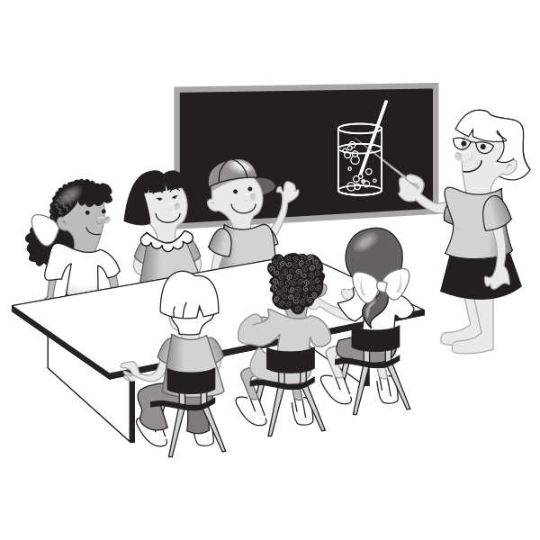
Step 2: Gather the Evidence
Children are getting sick and illness is spreading throughout our class!
Article on The Importance of Hygiene in Schools

Slide 5
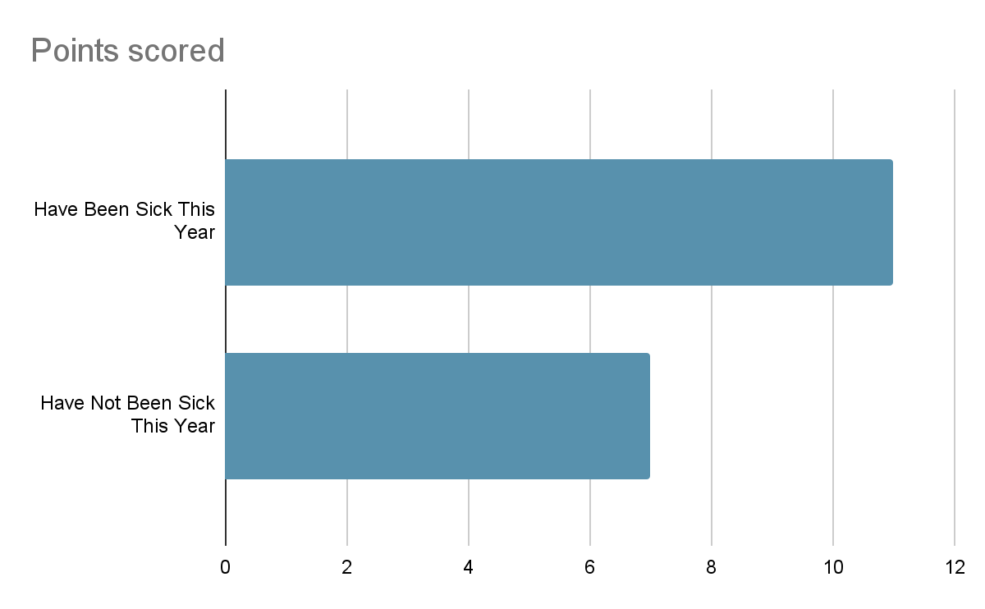
Turn and talk to your partner about whether you have been sick this year.

Slide 6
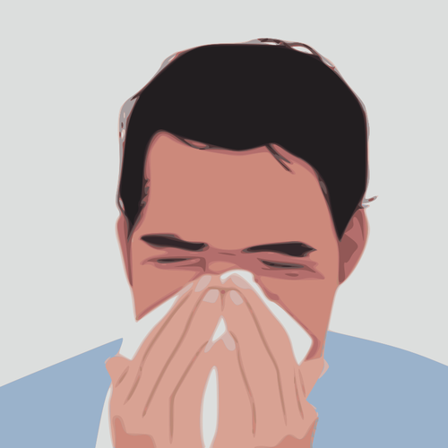
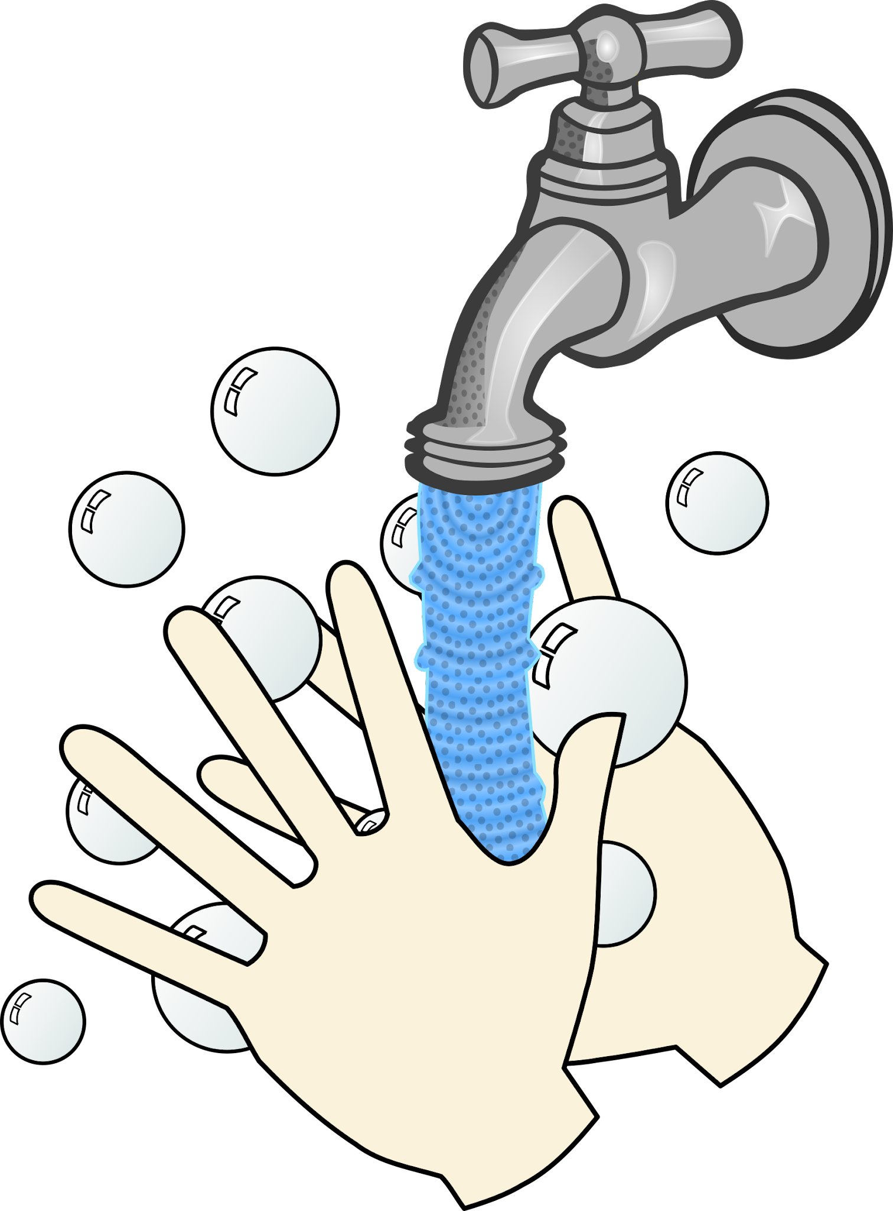
Step 3: Identifying The Causes of the Problem
*Children do not know how to properly wash hands.
*Children do not cover sneeze/cough properly.
*Children do not give each other enough personal space.
*Children do not stay home when sick.

Slide 7
Step 4: Evaluating Existing Public Policies
NYC Schools encourage: Stay Home When Sick, Cover Your Cough, Wash Hands Often, See Healthcare Provider Regularly, Utilize Health Insurance.
Anyone with a fever should stay home until 24 hours after being fever free or until their doctor says it is okay to go back to school or daycare. They should stay home for at least 5 days if they are diagnosed with COVID-19.
Please call your school or school nurse to let them know if your child has a confirmed diagnosis of an illness that can spread to others.
Click Here for a link to the DOE website regarding Staying healthy

Slide 8
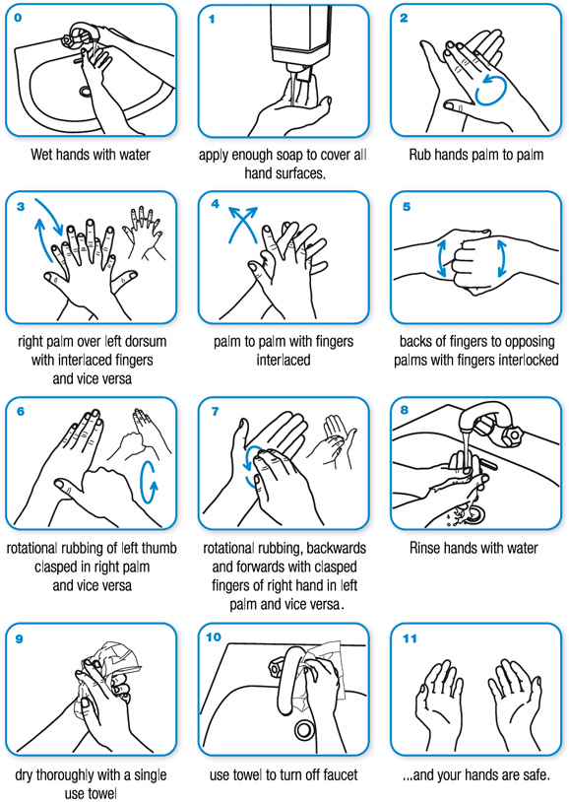
Step 5: Developing Public Policy Solutions
*Provide children with time each day to properly wash hands.
*Provide visuals in classroom showing proper way to cover cough/sneeze and wash hands.
*Provide classroom with resources to properly space out students.
*Provide students with a weekly health class.

Slide 9
Step 6: Selecting the Best Public Policy Solution
Feasibility
 | HIGH | MEDIUM | LOW
HIGH |  |  | Provide classroom with resources to properly space out students.
MEDIUM |  | Provide children with time each day to properly wash hands. | Provide students with a weekly health class.
LOW | Provide visuals in classroom to show proper way to cover cough/sneeze and wash hands.
Effectiveness

