Slide 1
What is PPA?
How Can It Help You Solve a Problem?
Why is there so much food waste during lunch time in the cafeteria?
Created by:
Jena Lanzetta,
STEM Teacher
P.S. 2Q

Slide 2
The 6 Steps of the Public Policy Analyst (PPA)
1. Define the Problem
2. Gather the Evidence
3. Identify the Causes
4. Evaluate an Existing Policy
5. Develop Solutions
6. Select the Best Solution
(feasibility vs. effectiveness)

Slide 3
1. Define the Problem
Why is there so much food waste during lunch time in the cafeteria?

Slide 4
2
evidence
proof
reasons
How do you know?

Slide 5
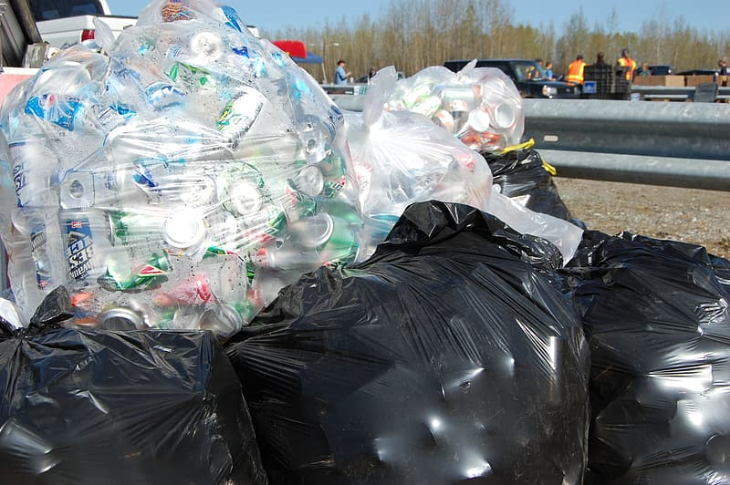
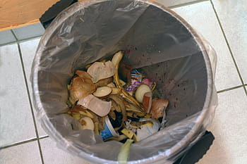
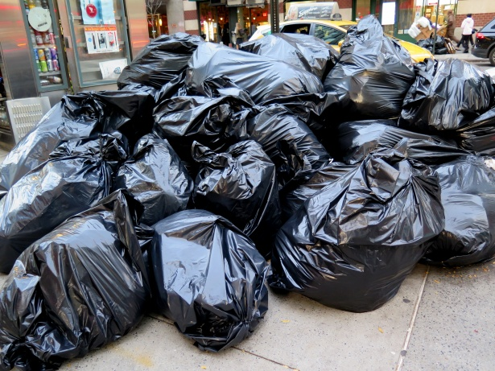
2. Gather the Evidence
(How do you know?)
Food waste is seen piled up inside the trash cans and outside of school.
Students observed throwing away trays with uneaten food on them

Slide 6
3. Identify the Causes
(reasons why)
Dislike the taste of the food
Do not like the choices
Feeling rushed/do not have enough time
Students afraid to try new things

Slide 7
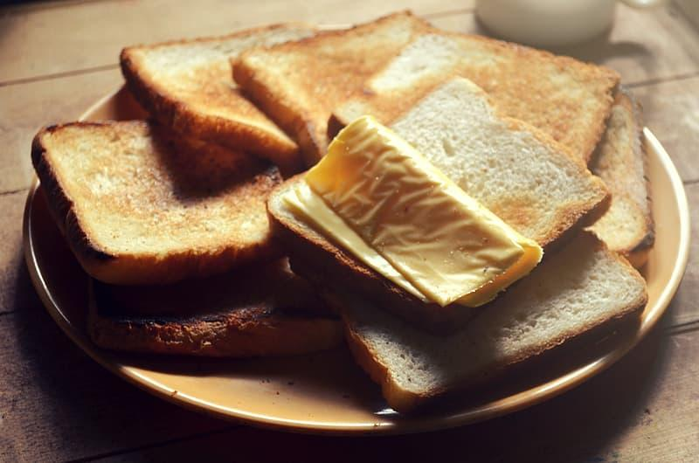
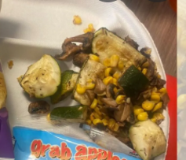
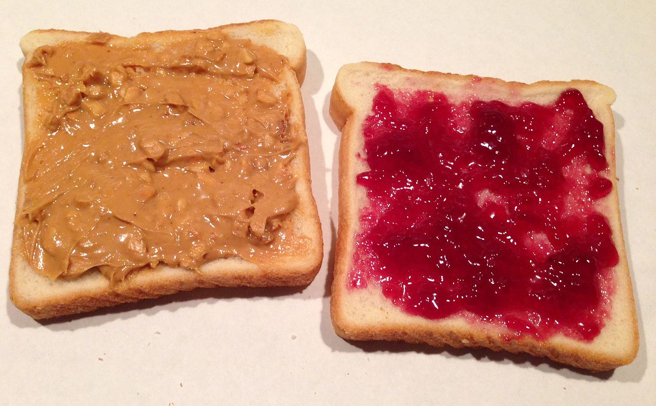
4. Evaluate an Existing Policy
Vegan Fridays- vegan options only
Only milk is offered at lunch
Sandwich options are peanut butter & jelly or cheese
Students must take certain items on their tray

Slide 8
5. Developing Solutions
Let’s brainstorm a list!
What do you think might be an answer to the problem?

Slide 9
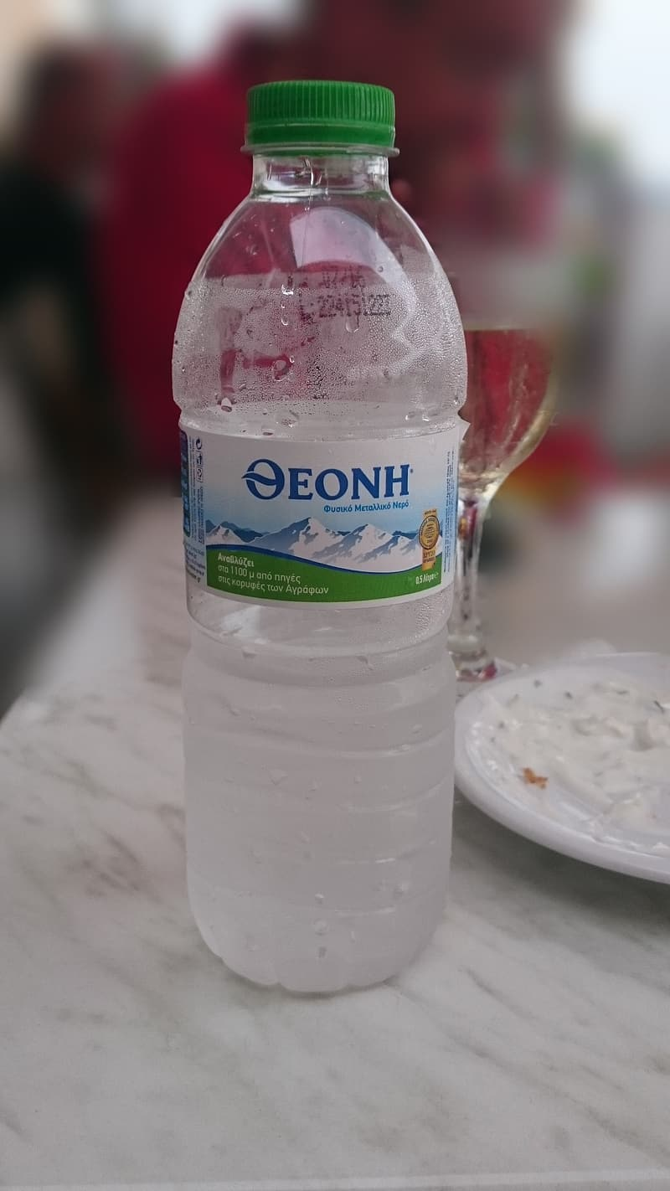
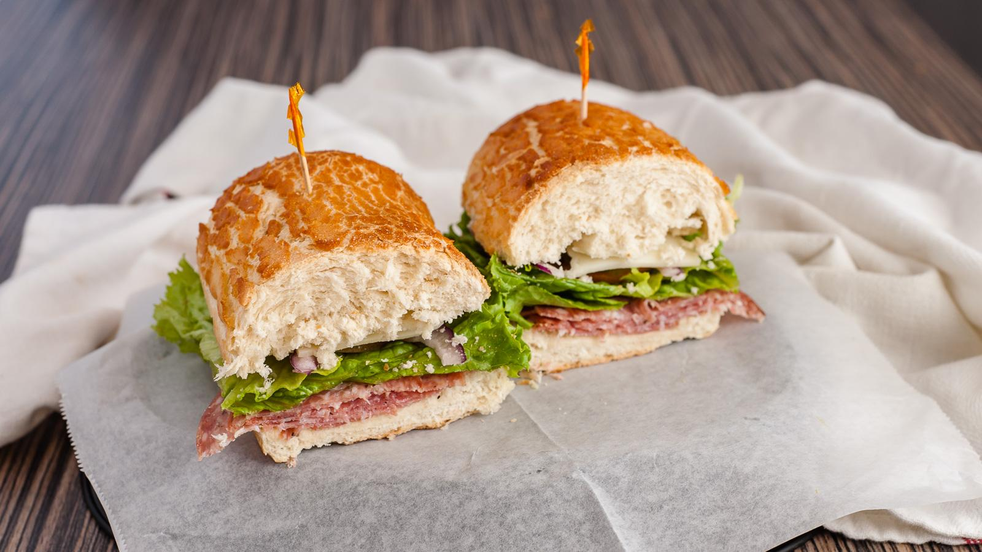
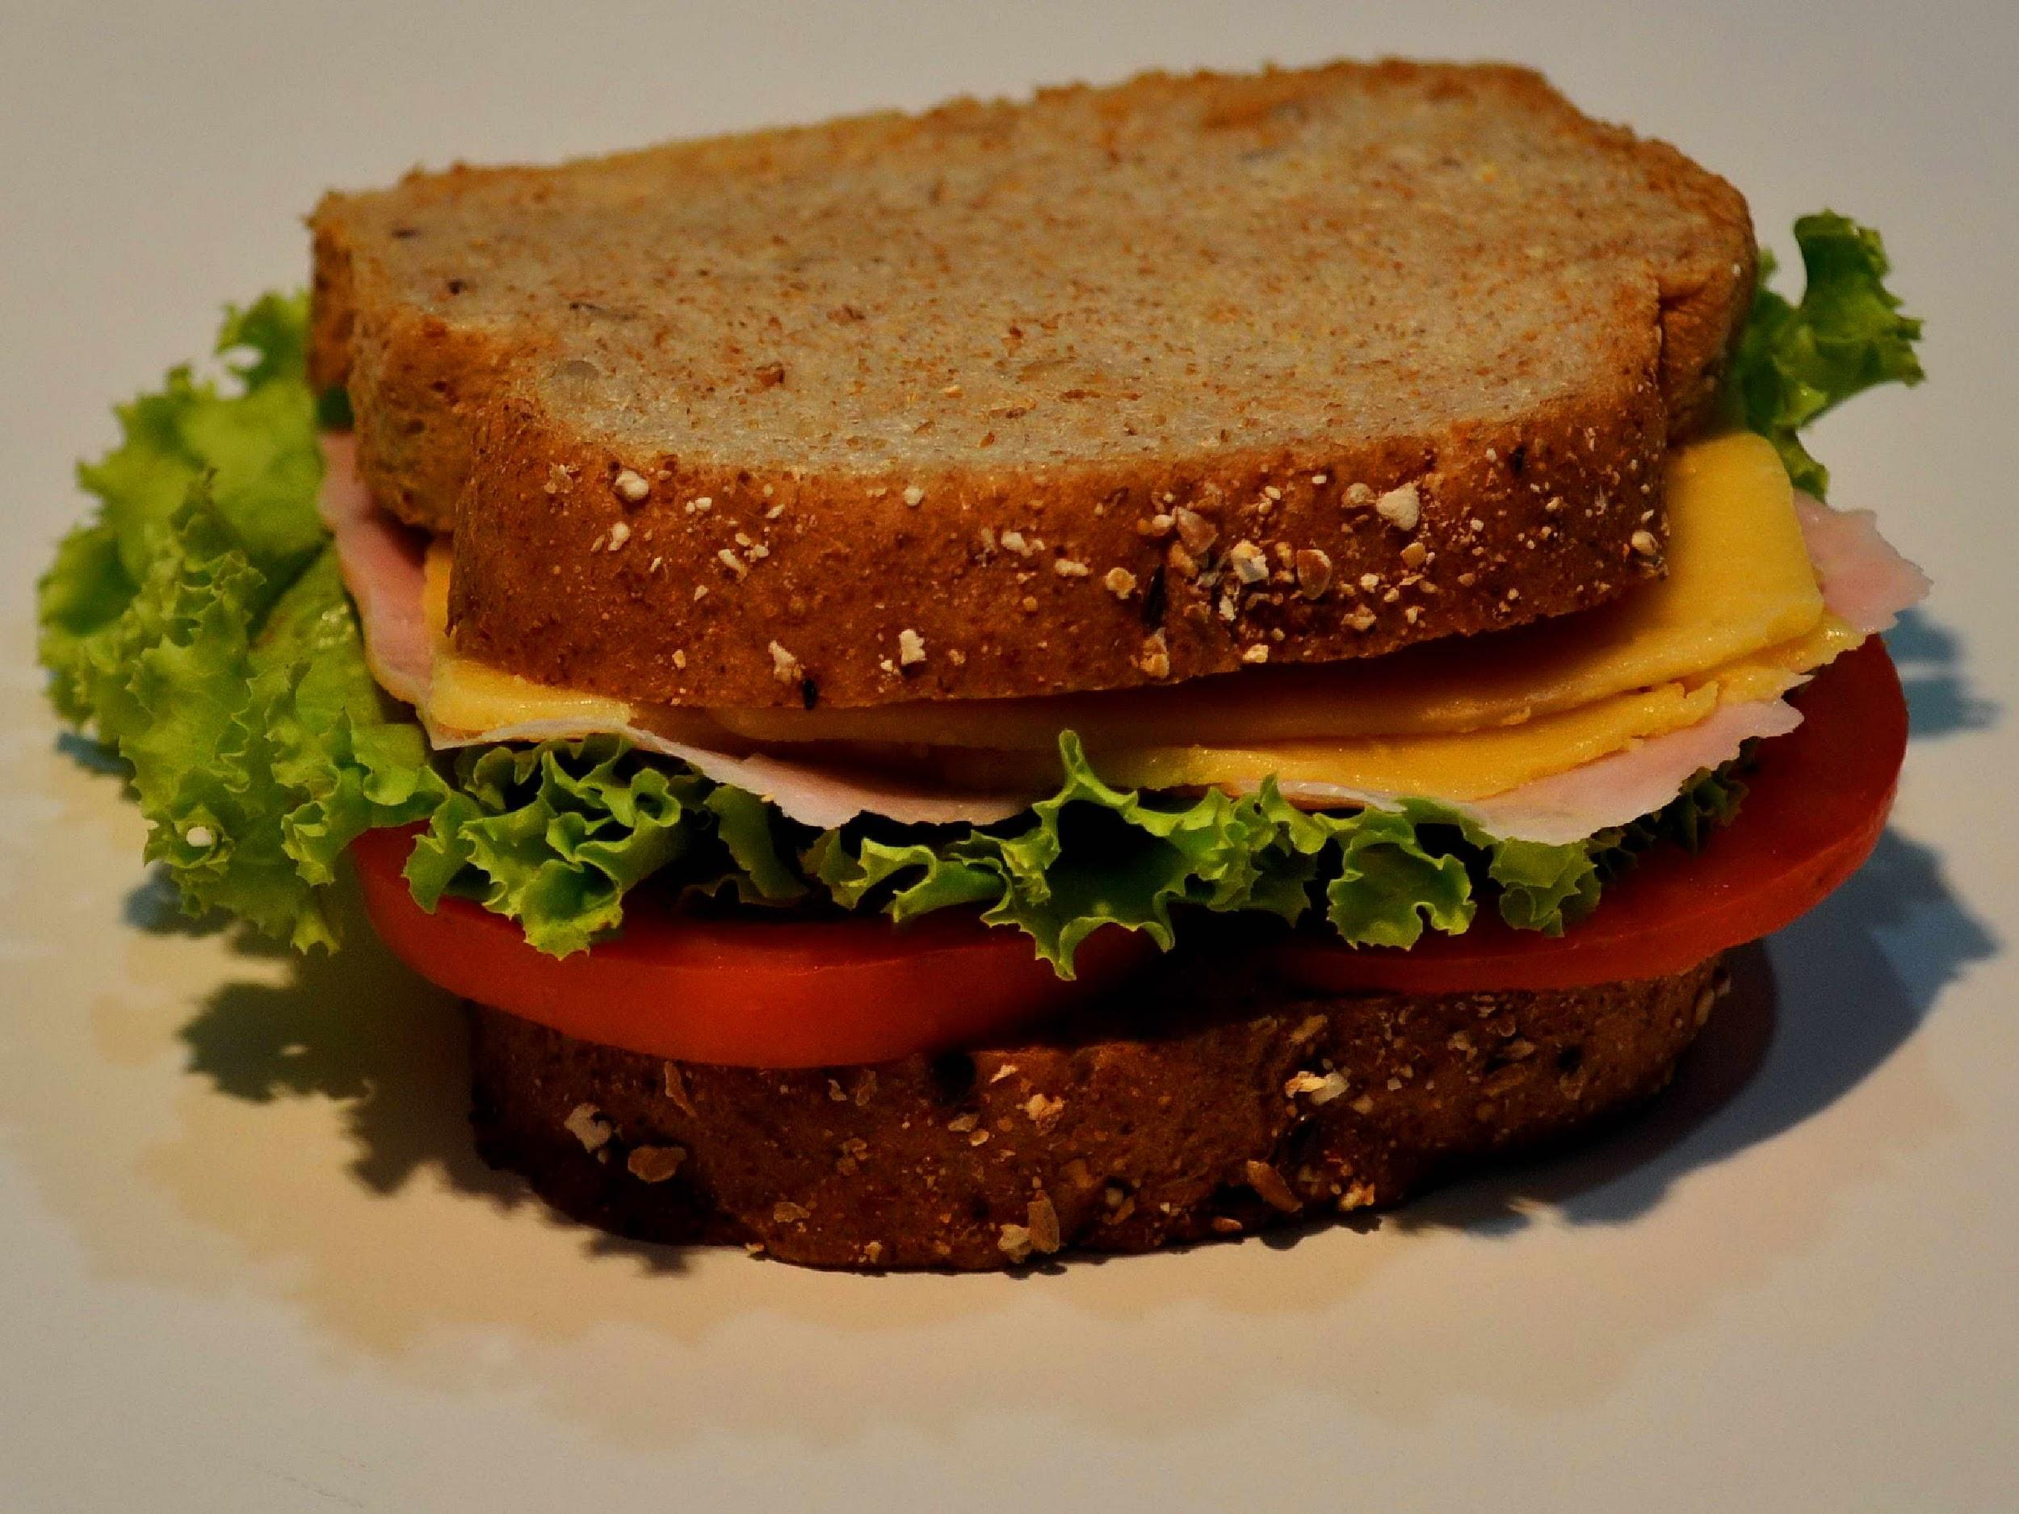
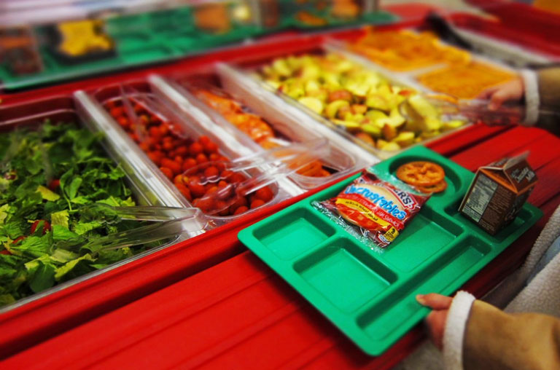
5. Develop Solutions
Eliminate Vegan Fridays
Offer bottled water in addition to milk
Make other sandwiches/alternatives available
Allow students to take what they want to eat
Force students to eat everything
School works with student government to encourage kids to try different foods

Slide 10
feasibility
reasonable
doable
Can it be done?
6

Slide 11
effectiveness
successful
useful
Will it work well?
6

Slide 12
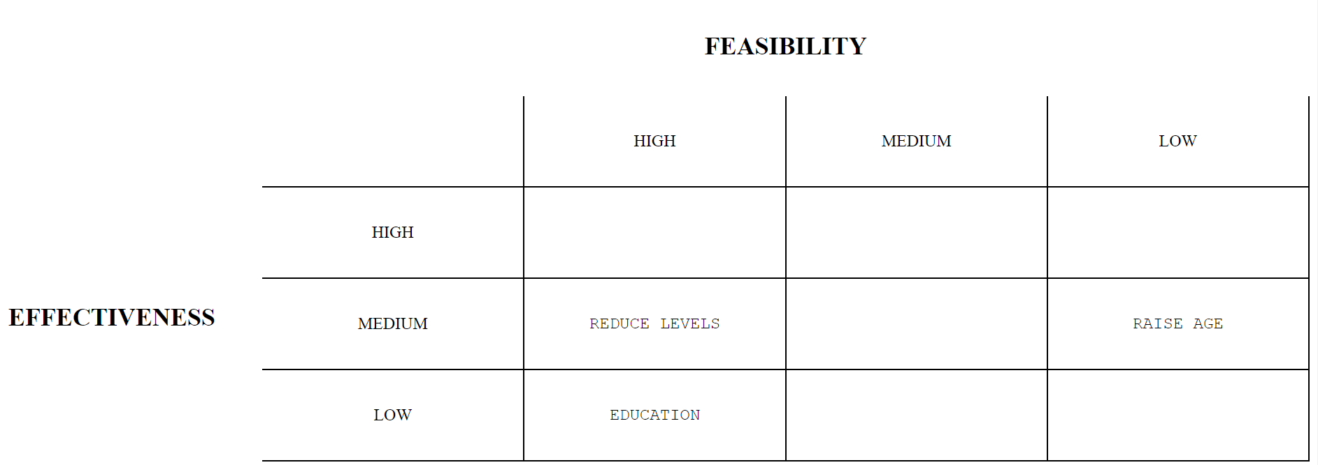
6. Select the Best Solution
(feasibility vs. effectiveness)
Work to encourage trying new foods
Students take what they want to eat
Offer other alternatives
Force kids to eat everything

