Slide 1
Lost & Found
Hye Kyong Lee Kim
PS 212 Q

Slide 2
Components of Public Policy Analysis
Defining the Social Problems
Gathering Evidence of the Problem
Identifying the Cause of the Problem
Evaluating Existing Public Policies
Developing Public Policy Solutions
Selecting the Best Public Policy Solution

Slide 3
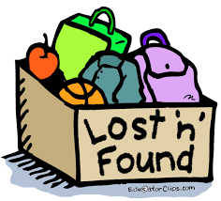
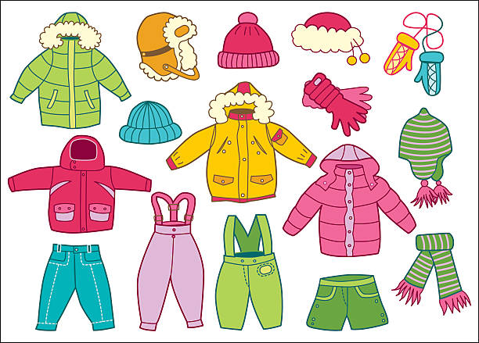
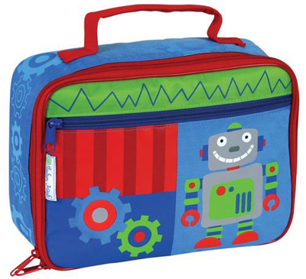
Define the Problem
There are too many lost items
throughout the school building.

Slide 4
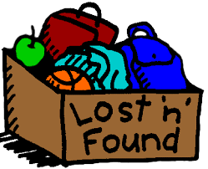
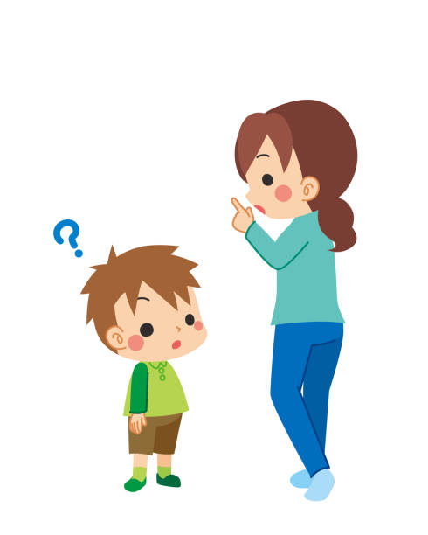
2. Gather Evidence
*The items found throughout the building are placed in the lobby of the building waiting to be claimed.
*Parents are asking for their children’s belongings.
*Parents have to purchase new things.

Slide 5
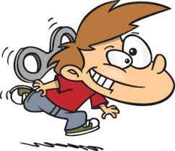
3. Identify Causes
Careless
Distracted
Not Being Responsible
Child’s name is not labelled.

Slide 6
4. Evaluating Existing Public Policies
*The children are allowed to go to the Lost and Found Bin or the table to claim their belongings.
*Reminders are being sent to the parents to come to look for their belongs.
*Parents are consistently reminded of Labelling child’s name on belongings, such as, bookbag, folder, notebook, pencil-case, Lunchbox, sweater, coats, etc…

Slide 7
5. Developing Public Policy Solutions
*Parents should label all of their child’s belongings.
*Unclaimed items should be donated.
*Remind the children to check for their belongings on a daily basis.

Slide 8
Select the Best Public Policy Solution
Feasibility
Effectiveness |  | High | Medium | Low
 | High | Label Belongings
 | Medium |  |  | Daily Reminder
 | Low |  |  | Donate Lost&Found Items

Slide 9
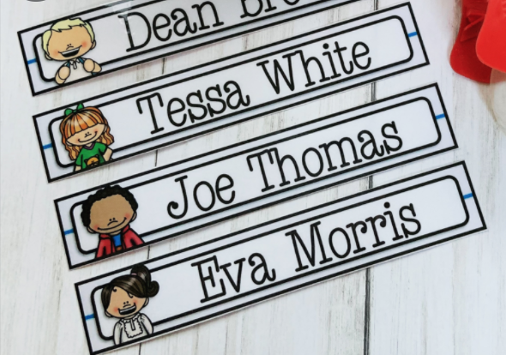
6. Select the Best Public Policy Solution
Considering the FEASIBILITY and EFFECTIVENESS,
Parents should labeling
their child’s belongs
would be
the best solution!

Slide 10
Lost & Found
Hye Kyong Lee Kim
PS 212 Q

