Slide 1
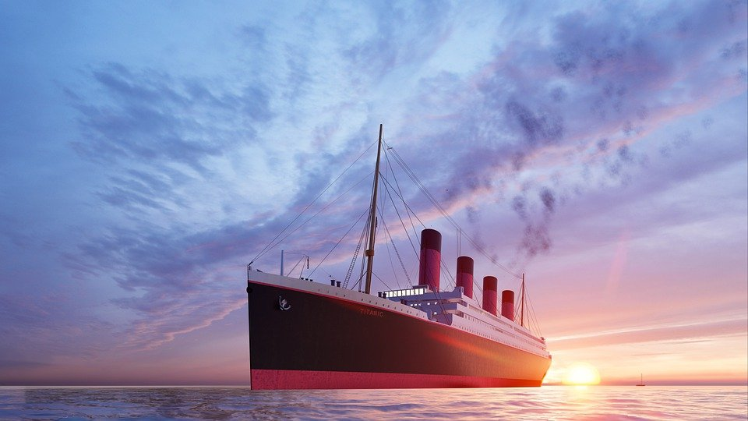
The Titanic: Social Class and Survival
Kelly Kielar P.S. 171Q

Slide 2
Public Policy Analysis PPA
Define the Problem
Gather the Evidence
Identify the Causes
Evaluate an Existing Policy
Develop Solutions
Select the Best Solution (Feasibility vs. Effectiveness)

Slide 3
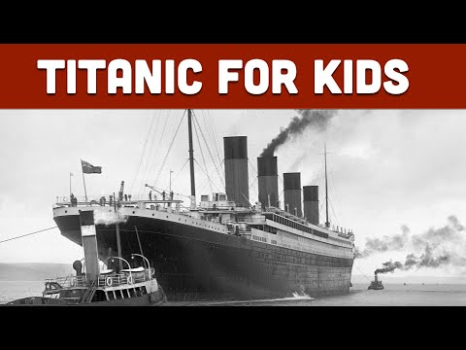
Define the Problem
The problem would be "rigid caste/class system existed on the Titanic.
“In societies where classes exist, one's class is determined largely by:
occupation
education and qualifications
income, personal, household and per capita
wealth, including the ownership of land, property, means of production, et cetera
family background.
In the United Kingdom there are upper class, middle class, working class and underclass people.”https://kids.kiddle.co/Social_class

Slide 4
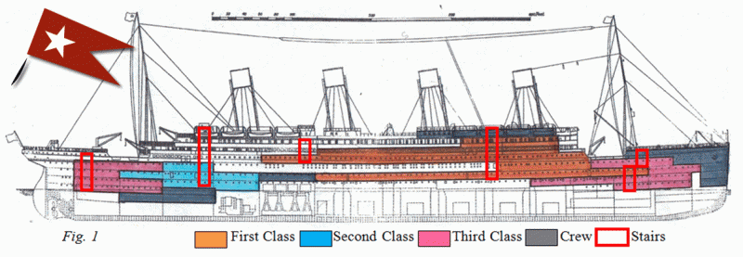
Gather the Evidence
The evidence would be the different quarters for the people on the ship.
Titanic 100 Years Later: Social Class and Survival - Soapboxie
Titanic: Class Differences by Ava Snyder
Class and Gender in Shaping the Memory of the Titanic Disaster Since 1912 - Ending the Edwardian Summer? Class and Titanic

Slide 5
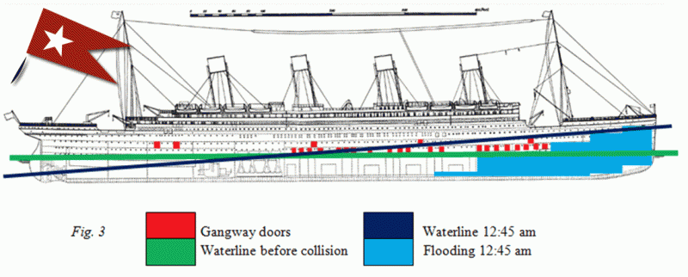
Identify the Causes
The causes would be the lack of equality due to existing power structures in England during the 1910s.
http://ariliablog.blogspot.com/2010/06/social-class-differentiation-and.html

Slide 6
Evaluate an Existing Policy
The policy would be what the happened during the disaster and then if you want you could examine whether we still have these problems today. How do we travel in the U.S.? Is the issue of social class still an issue? Could it lead to another disaster?
Let’s examine flying by plane. How do you want to fly? Can you actually fly the way you want? Do you think your social class has anything to do with it?

Slide 7
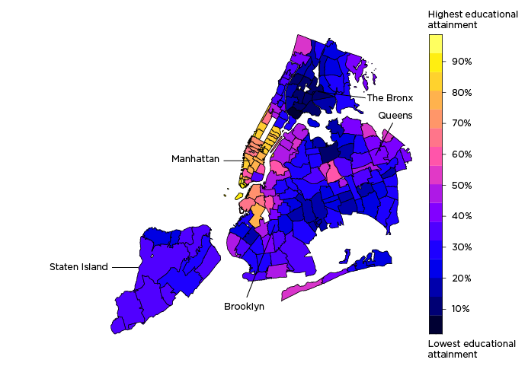
Let’s examine Covid and Social class! Did social class play any part in the amounts of death is certain socio-economic communities?
Socioeconomic factors explain why some New York ZIP codes were hit hardest by COVID-19 - SAVI
COVID-19 positivity rates are highest in ZIP codes where a low share of residents have a bachelor’s degree.
Percent of population age 25+ with a bachelor’s degree by ZIP code
Positive COVID-19 tests as a percent of all COVID-19 tests by ZIP code

Slide 8
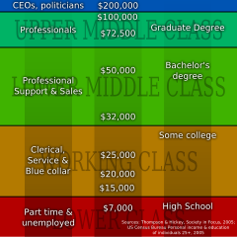
Do we still have these problems today?
Let’s look at our neighborhood and see where we fall in the class system https://bestneighborhood.org/household-income-astoria-ny/

