Slide 1
Nutrition
Unhealthy school snack choices at CS111Q.
By: Rabina Kaur
rkaur24@schools.nyc.gov

Slide 2
The Six Steps of the PPA
Define the Problem
Gather the Evidence
Identify the Causes
Examine an Existing Policy
Develop New Policies
Select the Best Policy Solution

Slide 3
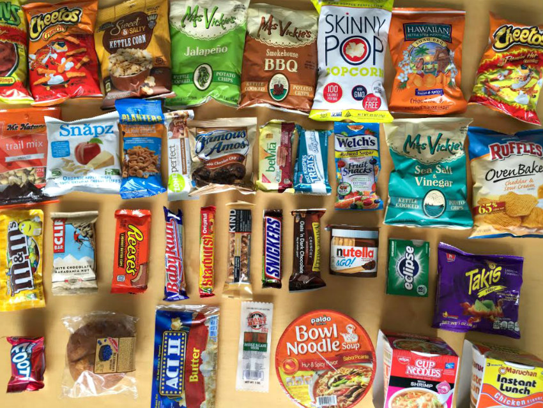
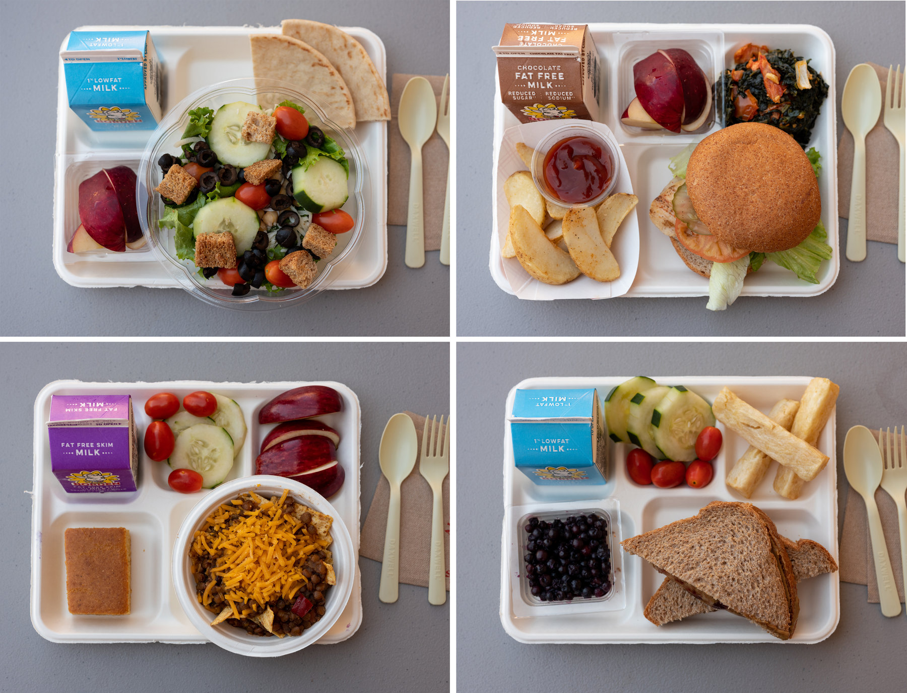
Warm Up
What do you want to have for lunch today?

Slide 4
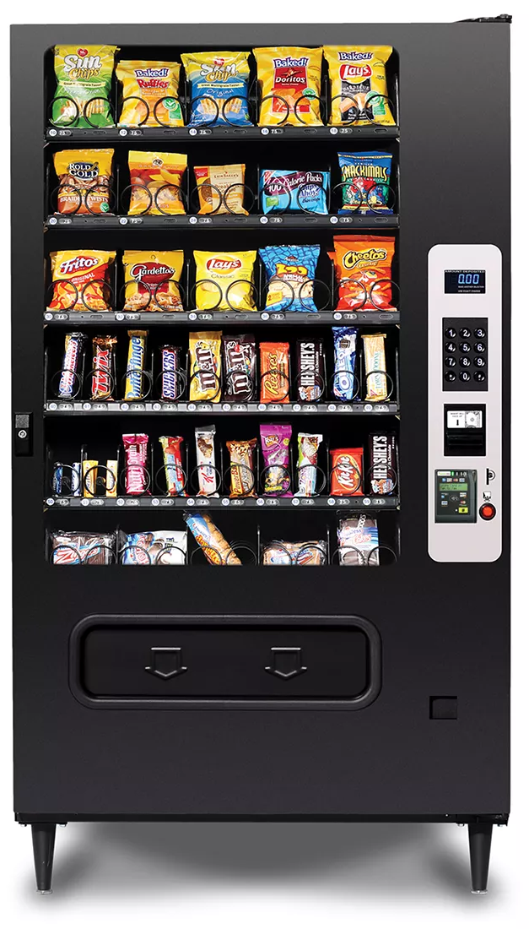
Step 1: Defining the Problem
Students are making unhealthy food choices at CS 111Q.

Slide 5
Step 2: Gather the Evidence
The school offers free lunch to all students.
Many students in the classroom choose to not eat the lunch and buy ice cream or something unhealthy (chips or candy) from the vending machine for $1-$1.50 every day.
There are two vending machines in the school. One machine has snacks and the other offers water.

Slide 6
Step 3: Identify the Causes
Students are given the option to buy ice cream and snack from vending machines every day.
Bake sales and fundraisers also include unhealthy options.
Students don’t like what is served or offered in school lunch.
Students are not familiar with the options available in school lunch.
“I don’t know what that is”

Slide 7
Step 4: Examine an Existing Policy
Menu Nutritional Evaluations
“Our meals are evaluated through a USDA-certified nutritional database. We also provide an extensive nutrition evaluation taking into account calories, fat, sodium, total sugars, added sugars, protein, cholesterol, iron, calcium, Vitamin A, and Vitamin C.”
Fruit and Vegetables
“Fresh fruits and vegetables are offered daily throughout our menu and salad bars. We serve a variety of vegetables from five different subgroups, ensuring our students receive a diverse nutrient profile (dark green, red-orange, beans-legumes, starchy, and others.)”
Source: DOE Website, Menu Nutrition Information
Notes:
Source Link: NYC DOE: Menu Nutrition Information
Video Link: Food Culture in Schools

Slide 8
Step 5: Develop New Policy Solutions
Promote food and nutrition benefits in school.
Add more healthier options than unhealthy options in vending machines
Involve students and families in changes to nutrition options.

Slide 9
Step 6: Select the Best Policy Solution
(Feasibility VS. Effectiveness)
Feasibility
 | High | Medium | Low
High | Promote healthy food and nutrition benefits in school.
Medium |  | Develop nutrition policies or school rules for vending machines, fundraising and special events. | Involve students in planning and implementing changes to the snack options to ensure foods offered meet the nutrition guidelines. Encourage families to pack healthy lunches to support healthy eating and nutritious food choices.
Low
Effectiveness
Notes:
Source Link: Simcoe Muskoka District Health Unit- School and Child Care

