Slide 1
Problem: The State Exams Are Very Stressful!
Katty Gonzales
P.S. 152Q

Slide 2
Hello! I’m...
Katty Gonzales, and I have been teaching at P.S. 152q for 21 years. I currently teach math in the fifth grade departmentalized program.

Slide 3
PPA: 6 Steps
Step 1: Defining the social problems
Step 2: Gathering Evidence of the problem
Step 3: Identifying the causes of the problem
Step 4: Evaluating the existing school policies
Step 5: Developing public policy solutions
Step 6: Selecting the best public policy solution

Slide 4
Survey: What Are Your thoughts About the State Tests?

Slide 5
Step 1: Are the State Exams Making Us Anxious ?

Slide 6
Step 2: Look At Our Survey Results…
Class 5A310: 19 students
Class 5A307: 16 students

Slide 7
Step 2: Making Sense of Our Survey Results…
Class 5A310: 19 students
Class 5A307: 16 students
7 students are taking the state exams for the first time
15 students feel that the state exams are very important
12 students feel somewhat prepared
2 students feel very confident, and 5 do not feel confident at all
9 students feel very nervous about the state exams and 2 do not feel nervous at all
12 students feel anxious about the state exams
About 10 students reported that there is someone in who can help them when feeling nervous or anxious
8 students are taking the state exams for the first time
14 students feel that the state exams are very important
14 students feel somewhat prepared
1 student feel very confident, and 2 do not feel confident at all
8 students feel very nervous about the state exams and 1 does not feel nervous at all
5 students feel anxious about the state exams
About 4 students reported that there is someone in who can help them when feeling nervous or anxious

Slide 8
Read Aloud: Big Test Jitters

Slide 9
Step 3: What Is Causing Us To Feel Anxious About the State Exams?
Test prep is tiring

Slide 10
Step 3: What Is Causing Us To Feel Anxious About the State Exams?
2. Too many passages in one seating

Slide 11
Step 3: What Is Causing Us To Feel Anxious About the State Exams?
3. Some students do not feel prepared enough

Slide 12
Step 4: Evaluating the Existing School Policies

Slide 13
Step 4: Evaluating the Existing School Policies
This policy includes:
Building confidence (positive affirmations)
Incorporating Relaxation Techniques (deep breathing, progreassive relaxation)
Calming techniques
In addition:
The students participate in S.E.A.L. daily activities

Slide 14
Step 4: Evaluating the Existing School Policies
This policy lacks:
Creation span (presented to the staff on March 7th)
Enforcement
Day to day implementation

Slide 15
Step 4: Evaluating the Existing School Policies
Assessment:
The positive affirmations and relaxation techniques are helpful
The policy was presented in March (not enough time to implement nor to make it effective for the students)

Slide 16
Step 5: Developing Public Policy Solutions
Here are our proposals:
Fun Test Prep Fridays
Spirit week during the state test week
Dance lessons
Art lessons
Yoga
Peer sharing (listen and share)

Slide 17
Step 6: Selecting the Best Public Policy Solution
FEASIBILITY
EFFECTIVENESS
 | HIGH | MEDIUM | LOW
HIGH | Fun Test Fridays | Peer sharing/ Talking
MEDIUM |  | Dance/Art Lessons | Spirit Week
LOW |  |  | Yoga
These placements were completed based the school accessibility and time management!

Slide 18
Why Did We Select This Choice?
The students in classes 5-A307 and 5-A310 decided that having fun test Fridays along with listening to positive affirmations will be the best way to ease their anxiety about the state tests. This will be a fun way to practice without feeling stressful.
The students decided that even though having yoga lessons sound like fun, this will not be feasible given that not all teachers can be yoga instructors. In addition, the kids also realized that the attire needed to do yoga is not conducive to the uniform they have to wear to school everyday. However, this idea will be brought up to the GYM teachers in hopes to have them investigate and perhaps add this to the curriculum.
The students thought that even though Spirit Week was a fantastic idea, the five day span did not appeal to most.

Slide 19
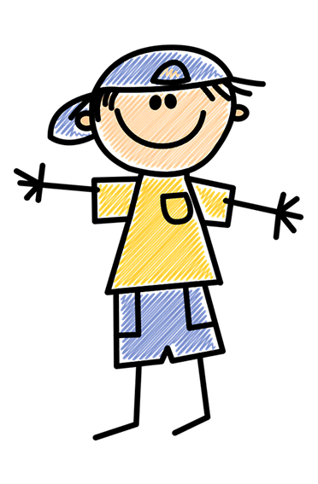
Thank you!
Credits
Class 5A307
Class 5A310
Ms. Efstathiadis (school policy)
Various internet articles

