Slide 1
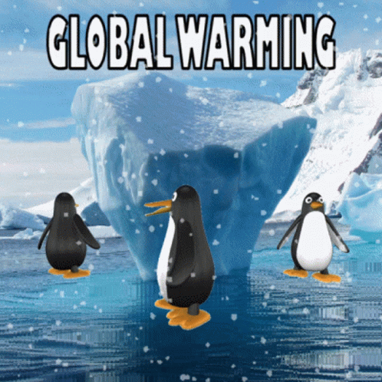
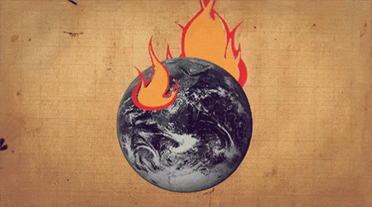
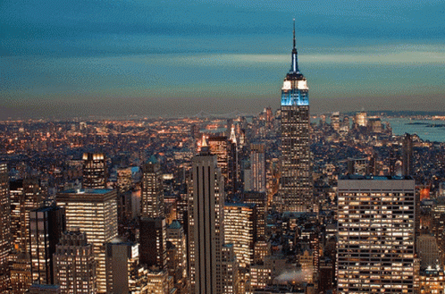
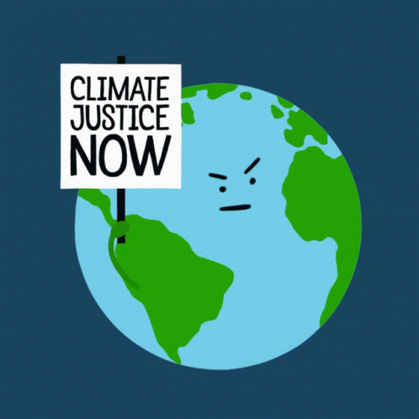
Global Warming and Climate Change
M.George 92Q

Slide 2
DEFINE THE PROBLEM
GATHER THE EVIDENCE
IDENTIFY THE CAUSES
EXAMINE AN EXISTING POLICY
DEVELOP NEW SOLUTIONS
SELECT THE BEST SOLUTION
CLICK
HERE Î
CLICK
HERE Î
CLICK
HERE Î
CLICK
HERE Î
CLICK
HERE Î
CLICK
HERE Î

Slide 3
Define the problem
How does Global warming affect climate change in the NYS?

Slide 4
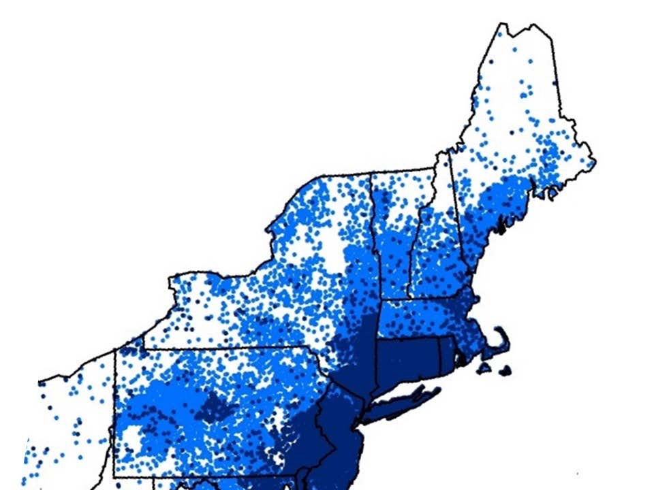
2. Gather the EVIDENCE
HOW DO WE KNOW THE PROBLEM? STATISTICS/EVIDENCE
The most recent report by the Intergovernmental Panel on Climate Change (IPCC) states that greenhouse gas (GHG) emissions from human activities are responsible for accelerating global warming and climate change.
Higher temperatures, more frequent precipitation and storms, faster rates of ocean warming, and sea level rise are some of the key physical effects of climate change that are impacting communities and ecosystems around the world.
Climate change impacts will continue to worsen as global temperatures and greenhouse gas emissions increase (see Climate Change 101).
These climate change reports clearly show, based on scientific data, that significant climate change impacts are already occurring. People, plants and wildlife, and ecosystems are facing an uncertain future unless adequate actions are taken to adapt to climate change impacts already unfolding and expected to intensify over time. GHG emissions must also rapidly and significantly be reduced in the near future and eventually eliminated to prevent the increasingly harmful impacts of climate change over the next several decades.
Scientists have recognized climate change works as a global threat multiplier. The direct effects of climate change, like extreme heat, sea level rise, and intensifying storms are exacerbating other social threats or stresses, such as poverty, famine, and immigration. For example, climate change is a significant threat to the global food supply. Changes to regional temperature and precipitation affect crop production and threaten food security around the world.
Extreme heat will have a greater impact on urban areas which have many heat-absorbing surfaces like roads, parking lots, and buildings, and few cooling green spaces and trees. This "heat island effect," when urban areas experience higher temperatures than the surrounding suburban or rural areas, increases the risk of heat-related illnesses and death for urban residents, particularly for vulnerable populations like the elderly. Extreme heat can also stress infrastructure, like electrical transmission lines, railroad tracks, and airport runways.

Slide 5
2. Gather the EVIDENCE~NY
In New York, winters have warmed three times faster than summers. Warmer winter temperatures, with fewer days below freezing, are bringing more winter precipitation to New York as rain, less snow, reduced snow cover, and earlier spring snowmelt.
Less snowfall and earlier snowmelt are already having and will continue to have increasing economic impacts on New York's winter recreation industry.
Reduced snow cover will increase the vulnerability of certain plants that depend on snow for insulation, and wildlife that depend on snow for protection from predators during the winter.
Less snowfall in the winter can also cause drier summer soil conditions, increasing the risk of wildfires. Lake effect snow will increase snowfall amounts in the next few decades for parts of New York State, as warmer winters continue to cause less ice cover on Lake Erie, Lake Ontario, and the Finger Lakes. However, lake-effect snow will eventually decrease with continued global warming, as temperatures below freezing in New York become less frequent and more winter precipitation falls as rain.
Warmer winters in New York are also affecting the winter-spring season transition, impacting the timing of blooming for trees and flowers which migrating and hibernating wildlife depend on for food. Changes to the timing of the winter-spring transition can also impact agriculture by extending the length of the growing season, with the last frost of winter occurring earlier in the year. Although increasing the length of the growing season can have advantages, it can also impact the types of crops that can be grown, encourage invasive species, weed growth, and crop diseases, and increase demand for irrigation
The annual frequency and length of heat waves in New York State are expected to continue to increase.
As the frequency and duration of heat waves increase, the impacts on agriculture could be felt by all New Yorkers through rising food costs. In addition to increasing risks to human, animal, and ecosystem health, prolonged periods of extreme heat increase energy demand for cooling using air conditioners, producing more greenhouse gas emissions and worsening future warming and climate change.
Warming oceans contribute largely to sea level rise but are also affecting the productivity and distribution of many marine species and ecosystems. Warming oceans are already impacting the economies of New York's commercial fishing and tourism industries, as well as the economies of local communities that depend on the revenue from those industries.

Slide 6
2. Gather the EVIDENCE~NY
Sea Level Rise Projections for New York State The table provides projections for New York State based on projected rates of low, low-medium, medium, high-medium, and high sea level rise for the Long Island, New York City/Lower Hudson, and Mid-Hudson regions. Throughout the state, development, land use, and infrastructure decisions made now will determine how vulnerable future generations will be to rising sea levels.
New York City/Lower Hudson | Descriptor | Low | Low-Medium | Medium | High-Medium | High
Time Interval | 2020s | 2 | 4 | 6 | 8 | 10
 | 2050s | 8 | 11 | 16 | 21 | 30
 | 2080s | 13 | 18 | 29 | 39 | 58
 | 2100 | 15 | 22 | 36 | 50 | 75
Mid-Hudson | Descriptor | Low | Low-Medium | Medium | High-Medium | High
Time Interval | 2020s | 1 | 3 | 5 | 7 | 9
 | 2050s | 5 | 9 | 14 | 19 | 27
 | 2080s | 10 | 14 | 25 | 36 | 54
 | 2100 | 11 | 18 | 32 | 46 | 71
Long Island | Descriptor | Low | Low-Medium | Medium | High-Medium | High
Time Interval | 2020s | 2 | 4 | 6 | 8 | 10
 | 2050s | 8 | 11 | 16 | 21 | 30
 | 2080s | 13 | 18 | 29 | 39 | 58
 | 2100 | 15 | 21 | 34 | 47 | 72

Slide 7
3. IDENTIFY THE CAUSES
Our climate is changing because the earth is warming. People have increased the amount of carbon dioxide in the air by 40 percent since the late 1700s.
Other heat- trapping greenhouse gases are also increasing. These gases have warmed the surface and lower atmosphere of our planet about one degree during the last 50 years.
Evaporation increases as the atmosphere warms, which increases humidity, average rainfall, and the frequency of heavy rainstorms in many places—but contributes to drought in others

Slide 8
4.EXAMINING EXISTING POLICY
Community Engagement works to inform, support, and empower local governments and communities as they reduce greenhouse gas emissions and adapt to unavoidable impacts, especially through coordination of the Climate Smart Communities program and grants.
Greenhouse Gas Mitigation uses the best available science to develop regulations to reduce greenhouse gas emissions, establish greenhouse gas accounting practices, conduct research and demonstration projects, and to aid in the development of climate change plans.
Climate Change Adaptation and Communication conducts climate change impact analysis, coordinates climate adaptation planning, coordinates communication and public outreach, and supports the development of climate change resilience and adaptation policies and strategies to help New York respond to current and future impacts of climate change.
Climate Leadership and Community Protection Act
Signed into law in 2019, the Climate Leadership and Community Protection Act (Climate Act) is New York State's flagship climate change statute. The Climate Act requires New York to reduce economy-wide greenhouse gas emissions 40 percent by 2030, and no less than 85 percent by 2050 from 1990 levels. In addition, the Climate Act includes requirements for renewable energy generation and end-use energy savings, and calls for 100 percent zero-emission electricity by 2040 for New York State, with 70 percent renewable energy by 2030.
SOURCE: new-york-response

Slide 9
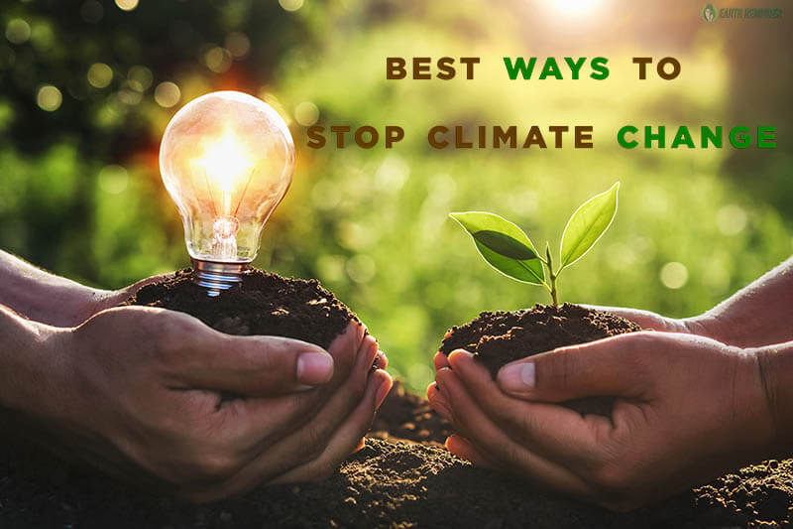
5. Develop New Solutions
Need to Control the Use of Fossil Fuel Fossil fuel is one of the main reasons for climate change. The fossil fuels (coal, oil, gas, etc.) when burn releases CO2 (carbon dioxide) gas mainly and many other greenhouse gases. Now the amount of carbon dioxide has been increased a lot in the atmosphere. Carbon dioxide can hold the heat from the Sun and thus the Earth is becoming warm day by day. If we can minimize the use of fossil fuels, we can stop climate change -Use appliances with the ENERGY STAR labeange somehow. Use LED light bulbs,Turn off the lights, Turn off your television,Reuse products, Purchase goods manufactured with recycled materials, Recycle, Take public transportation, Invest in reusable containers,Power your home with solar energyand use more environmentally friendly gardening practices
Electric vehicles: The healthy growth rate of e-vehicles across the globe solidifies the urgency to transition to green energy. E-vehicles are one of the foremost types of sustainable transport that help in minimizing carbon emissions without sacrificing comfort or performance.
Bicycles: One of the most economical alternatives, using bicycles over short distances can help not only the environment but also an individual’s health. Cycling is considered a healthy activity that can help individuals stay fit while keeping pollution at bay.
Natural gas transport: A reliable type of sustainable transport, natural gas has a significantly lower carbon footprint and is cheaper when compared to petrol and diesel. Moreover, CNG has become the primary fuel for public transport across various countries.
Source: https://www.earthreminder.com/ways-to-stop-climate-change/
https://blog.arcadia.com/top-20-ways-can-reduce-reliance-fossil-fuels/

Slide 10
5. Develop New Solutions
Stop Deforestation
We all are very well aware of the importance of plants and trees for the environment. We cannot deny the importance of trees in climate regulation on the planet. Trees help in balancing the amount of carbon dioxide in the atmosphere to make our planet a healthy place to survive. Unfortunately, we are losing our natural treasure just to fulfill our selfish demand such as industrialization, urbanization, agricultural needs, etc. We all should work together to plant more trees and by stopping the cutting down of trees. If we can grow more trees, it will help to balance the amount of carbon dioxide in the environment and thus helps to stop climate change.
Source: https://www.earthreminder.com/ways-to-stop-climate-change/

Slide 11
5. Develop New Solutions
Save Energy We all are facing the problem of climate change across the world. Excessive pollution is undoubtedly one of the main reasons for climate change. We can control pollution somehow by saving energy. Everyone can contribute by accepting a few small changes in their daily lifestyle.
Recycle the Waste Manufacturing industries release a much amount of carbon dioxide in the atmosphere. These manufacturing industries are engaged with the production of various goods of our daily uses; hence it is unavoidable. However, we can go for an alternative solution which is recycling. Recycling is a process that is eco-friendly and cost-effective as well. Recycling is a process that remakes the waste into another recyclable material by preventing the emission of greenhouse gases. Go to the recycling center available in your city and contribute to stop climate change.
Control the Population Growth The world’s population is increasing at an alarming rate every year which is pressuring more loads on our planet. Population growth is a big challenge for us in terms of food, water, shelter, etc. It is not only becoming a big issue for the biodiversity of our planet but climate change as well. Population growth is affecting the climate in various means-
It is polluting the planet with more use of vehicles.
Emitting more greenhouse gases with the use of fossil fuels.
More trees are cutting down to fulfill the needs of the growing population.
Excessive energy is getting waste due to population growth.
Minimize the Wastage of Water
It requires a lot of energy to supply and heat water. We can minimize the amount of carbon pollution in the environment by saving water. Hence, try to take a relatively short bath, do not forget to turn off the tap when not in use (especially while brushing teeth), preferable buy water-sense labeled installations & applinces. These small changes can make big differences to stop climate change.
Source: https://www.earthreminder.com/ways-to-stop-climate-change/

Slide 12
5. Action on Global Warming: NYC's Green New Deal
Apriaction-global-warming-nyc-s-green-new-deal l
New Solutions
New York City's Green New Deal
Committing to carbon neutrality by 2050, and 100% clean electricity.
Requiring buildings cut their emissions – a global first.
Banning new inefficient glass-walled buildings
Hydro-powered City government.
Mandatory organics recycling
Reducing waste and carbon-intensive consumption.
Comprehensive resilience planning.
Help New Yorkers get moving energy efficiently.

Slide 13
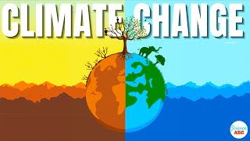
5. Develop New Solutions=WATCH AND LEARN MORE ABOUT CLIMATE CHANGE & GLOBAL WARMING. TO UNDERSTAND THE CAUSE & EFFECTS. ALSO TO IDENTIFY A FEASIBLE AND EFFECTIVE SOLUTION.
Source: https://www.earthreminder.com/ways-to-stop-climate-change/

Slide 14
Chart our policies based on Feasibility and Effectiveness
Feasibility: How easy it is to dosomething
It is feasible to run in the yard at school. It is not feasible to run on the moon.
Effectiveness: How good of a job it does at solving our problem
Water plants and giving them sunlight is an effective way to help them grow.

Slide 15
Create your own sentence for feasible and effectiveness!
In your notebook, spend 5 minutes creating your own sentence that describes feasibility and effectiveness

Slide 16
Feasibility/Effectiveness Chart
Feasibility
 | High feasibility | Medium Feasibility | Low Feasibility
High Effectiveness | 1.Plant Trees/Stop Deforestation If we can grow more trees, it will help to balance the amount of carbon dioxide in the environment and thus helps to stop climate change. 2.Reduce/Reuse/Recycle Reuse products, Purchase goods manufactured with recycled materials,Invest in reusable containers | 3. Control Fossil Fuel Minimize the use of fossil fuels, we can stop climate change -Use appliances with the ENERGY STAR labeange somehow. Use LED light bulbs,Turn off the lights, Turn off your television,Power your home with solar energy 4. Sustainable Transportation hicles: The healthy growth rate of e-vehicles across the globe solidifies the urgency to transition to green energy. E-vehicles are one of the foremost types of sustainable transport that help in minimizing carbon emissions without sacrificing comfort or performance. Bicycles: One of the most economical alternatives, using bicycles over short distances can help not only the environment but also anindividual’s health. Cycling is considered a healthy activity that can help individuals stay fit while keeping pollution at bay. Natural gas transport: A reliable type of sustainable transport, natural gas has a significantly lower carbon footprint and is cheaper when compared to petrol and diesel. Moreover, CNG has become the primary fuel for public transport across various countries.
Medium Effectiveness
Low Effectiveness
Effectiveness

Slide 17
Exit Ticket
Based on our chart, which solution do you think is the best option to reduce pollution in the Hudson River and why??
Notes:
Possibility for next class to either make something with single use plastic (Like a planter or other arts and crafts project), or also create a newsletter as a class to give to principal/school about reducing our footprint at NDMS.

