Slide 1
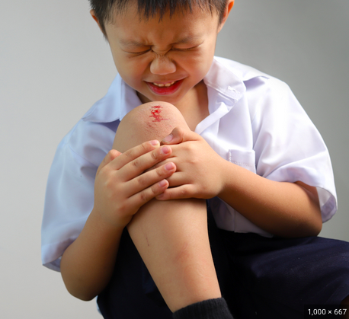
Are You Safe at Recess?
How can we decrease injuries during recess in our school?
Ms. Genao
Health Educator
K-5

Slide 2
The 6 Steps of the Public Policy Analyst
Define the Problem
Gather the Evidence
Identify the Causes
Evaluate the Existing Policy
Develop Solutions
Select the Best Solution

Slide 3
STEP 1: What’s The Problem?
The problem is that many
students are getting injured
during recess at our school.

Slide 4
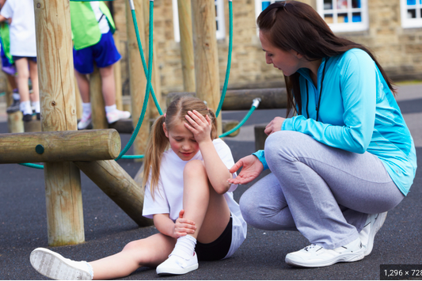
STEP 2: Gather The Evidence
How many students have been injured at recess in our school this year?
Let’s take a Poll:
Give me a thumbs up if
you were injured two or
more times this school year.

Slide 5
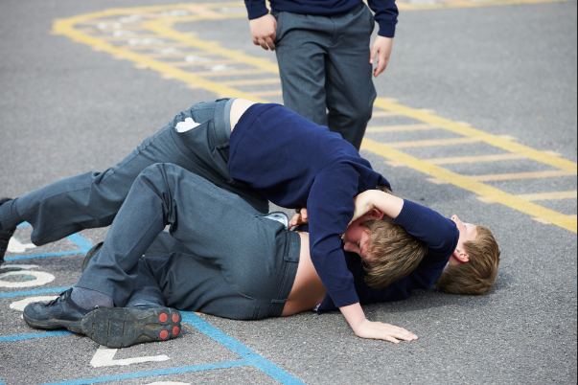
STEP 3: Identifying The Causes Of The Problem
The cause of this problem is
that students are not playing safely
with other students during recess.

Slide 6
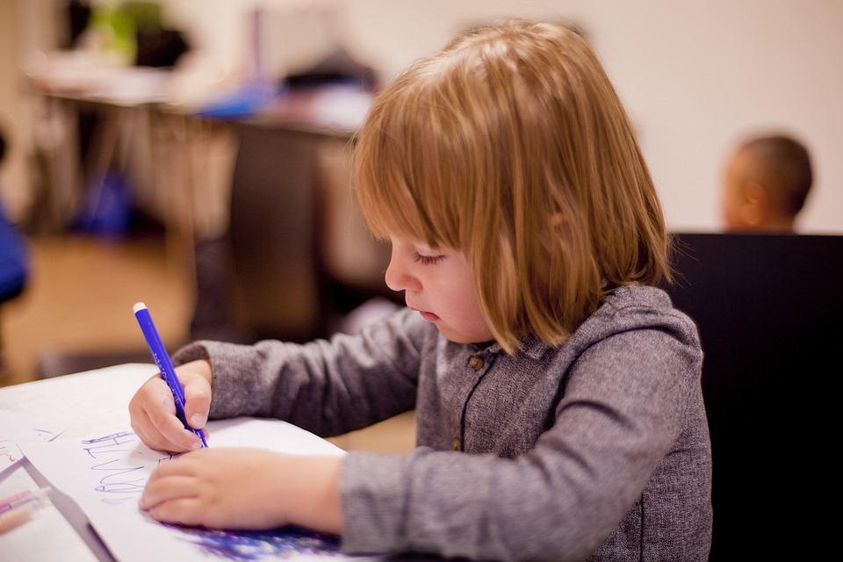
STEP 3: Identifying The Causes Of The Problem
Why do you think students are not playing safely with other students during recess?
Think About IT!
Jot down your ideas!
Talk to your partner about it!

Slide 7
STEP 3: Identifying The Causes Of The Problem
Most people think that students should just know how to play safely with other students.
However, the article below discusses how students need behavior management skills to learn how to play safely with each other.
Article: https://playworld.com/blog/recess-behavior-management/#gref

Slide 8
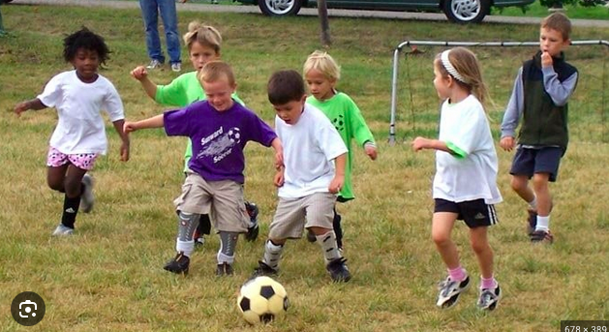
STEP 4: Evaluating Existing Public Policy
At recess there are a few ways the school tries to keep students safe…
Two Lunch Aids to monitor students
Sport equipment for play
Removal of Sport equipment and Recess time due to increase of injuries

Slide 9
STEP 5: Developing Public Policy Solutions
Provide all students and recess staff with
training and practice around the topic of
Injury prevention and behavior
management at recess.
Post signs in the cafeteria and recess yard
around the topic of injury prevention and behavior
management at recess.
Offer a reward system to all students who follow
the Injury prevention and behavior management skills at recess.

Slide 10
STEP 6: Selecting The Best Public Policy Solution
Feasibility
 | High | Medium | Low
High |  |  | Provide all students and recess staff with training and practice around the topic of Injury prevention and behavior management at recess.
Medium |  | Offer a reward system to all students who follow the Injury prevention and behavior management skills at recess.
Low | Post signs in the cafeteria and recess yard around the topic of injury prevention and behavior management at recess.
Effectiveness

