Slide 1
Are you feeling sick?
How can we decrease the spread of illness in our school?
Melissa Genao
Ps. 149Q
K-5

Slide 2
The 6 Steps of the Public Policy Analyst
Define the Problem
Gather the Evidence
Identify the Causes
Evaluate the Existing Policy
Develop Solutions
Select the Best Solution

Slide 3
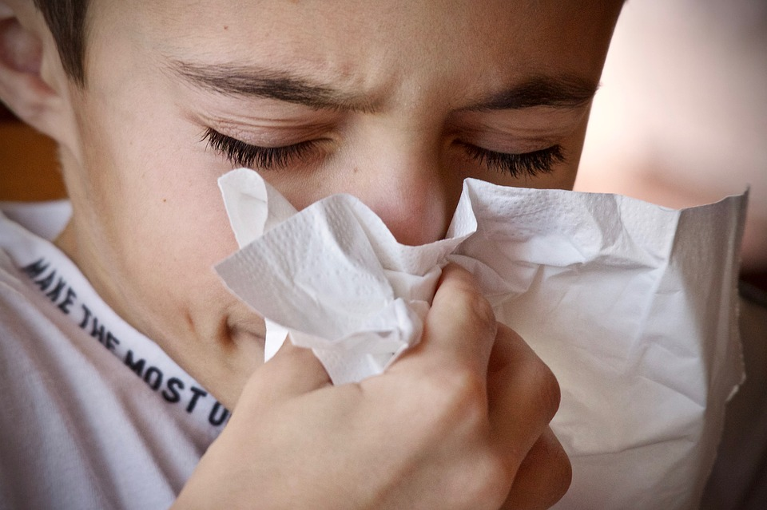
STEP 1: What’s The Problem?
The problem is that students
and staff are getting
sick at our school.

Slide 4
STEP 2: Gather The Evidence
How many students and staff members have gotten sick or missed time in school because they were sick?
Let’s take a Poll:
Give me a thumbs up if
you were sick three or
more times this school year.

Slide 5
STEP 3: Identifying The Causes Of The Problem
What is causing this problem is
that illness spreads
throughout the school
building making many people sick.

Slide 6
STEP 3: Identifying The Causes Of The Problem
Why do you think illness spreads in our school building?
Think About IT!
Jot down your ideas!
Talk to your partner about it!

Slide 7
STEP 3: Identifying The Causes Of The Problem
Most people think the bathroom is one of the only places where germs hide and spread.
However, the article below discusses how germs hide and spread in places we don’t really think much about!
Article: https://www.singlecare.com/blog/news/why-kids-get-sick-at-school/

Slide 8
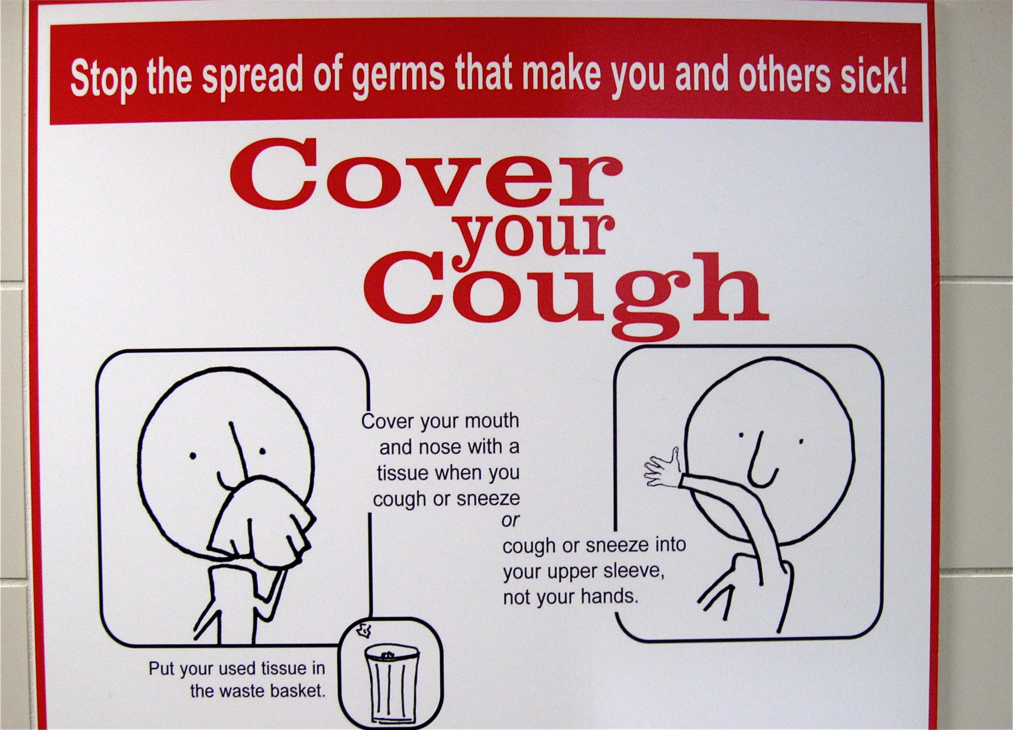
STEP 4: Evaluating Existing Public Policy
In our school building there are signs in the hallways instructing students to …
Wear Masks
Wash your Hands
Cover your Cough

Slide 9
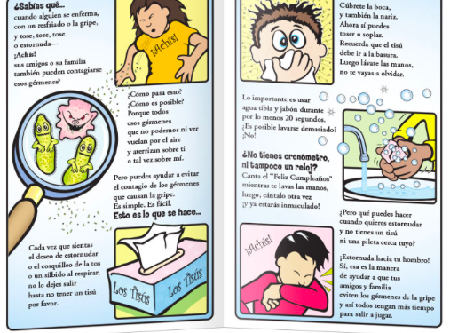
STEP 5: Developing Public Policy Solutions
Provide all students and staff with
health education around the topic of
illness prevention.
Provide all parents/guardians with
health education around the topic of
illness prevention.
Provide all students and staff a take
home handout on the topic of
illness prevention.

Slide 10
STEP 6: Selecting The Best Public Policy Solution
Feasibility
Effectiveness
 | High | Medium | Low
High | Provide all students and staff with health education around the topic of illness prevention.
Medium
Low | Provide all students and staff a take home handout on the topic of illness prevention. |  | Provide all parents/guardians with health education around the topic of illness prevention.

