Slide 1
Bullying
P.S. 85Q
Irene Garoutsos

Slide 2
6 Steps of the Public Policy Analyst
1. Define the Problem
2. Gather Evidence
3. Identify the Causes
4. Evaluate an Existing Policy
5. Develop Solutions
6. Select the Best Solutions

Slide 3
Step 1: Define the Problem
Bullying in Schools

Slide 4
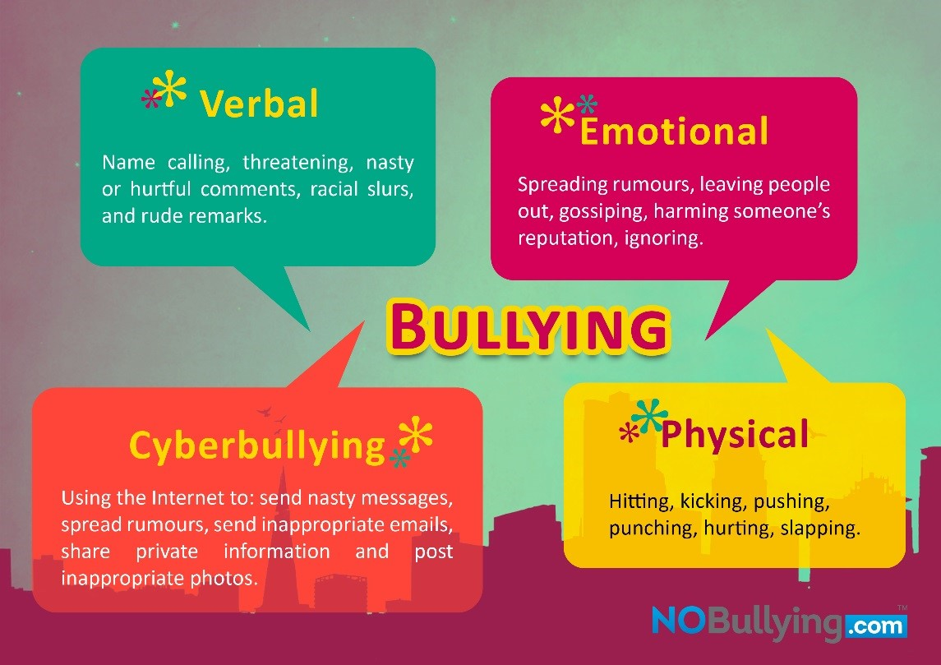
What is Bullying?
What is bullying?
bul·ly
[ˈbo͝olē]
VERB
bullying (present participle)
seek to harm, intimidate, or coerce (someone perceived as vulnerable)
Notes:
https://www.stopbullying.gov

Slide 5
What is Bullying?
https://www.youtube.com/watch?v=KQZ9hDDz704
Notes:
https://www.stopbullying.gov

Slide 6
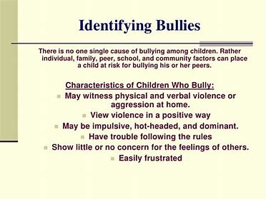
Step 2: Gather Evidence
Talk to all parties involved. Ask each party for details about the bullying and record the information in as much detail as possible.
Inform Parents/Guardians
Collect any tangible evidence of the bullying. Screenshot messages and emails, record audio messages, and take videos and photographs of any visible injuries.
Save all records from nurse,school based support team medical treatment or therapy for the bullying of child
Follow school/district protocol about bullying
Notes:
https://www.stopbullying.gov

Slide 7
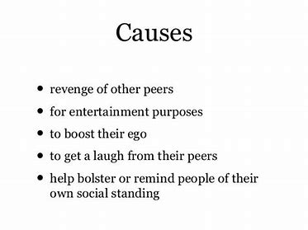
Step 3: Identify the Causes/Effects

Slide 8
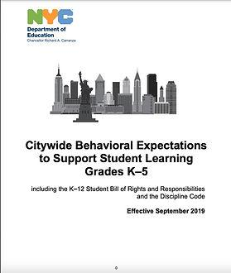
Step 4: Evaluate Existing Policy
.
NYC DOE Discipline Code
Please click above to be directed to the NYC DOE Discipline Code page where the Citywide Behavioral Expectations can be found in multiple languages.
The Discipline Code is also known as the Citywide Behavioral Expectations to Support Student Learning. It:
Is age-specific with one set for grades K-5 and another for grades 6-12.
Explains the standards for behavior in the New York City public schools.
Describes supports, interventions, and disciplinary responses that schools can use when students demonstrate unwelcome behavior.
Explains how you can appeal decisions.
Includes the K-12 Student Bill of Rights and Responsibilities.
Bullying pgs. 18-20

Slide 9
Step 4: Evaluate Existing Policy
Integral to preventing student-to-student bullying and/or bias-based behavior is effective social emotional learning that helps students develop core competencies.
Clarifying schoolwide rules that prohibit bullying and discrimination and discouraging bystander behavior (on-looking) are vitally important to helping students play a pivotal role in bullying prevention.
Each school is expected to promote a nurturing school culture that promotes positive interpersonal and intergroup relations and respect for diversity among students and between students and staff.

Slide 10
Step 5: Developing Solutions
To assist the school community in addressing bullying and bias-based behavior, the NYCDOE Respect for All (RFA) Library (https://www.schools.nyc.gov/school-life/policies-for-all/respect-for-all) offers many kinds of resources for parents, students, school staff, and school leaders.
-Social Emotional Mood Meter check in throughout the day
-Squared Box Breathing
-Yoga
-Sanford and Harmony/Kavu
Training and supporting all school staff on social emotional and bullying workshops by providing yearly professional development.
Creating anti bullying committee to raise awareness with staff and students( i.e. posters, school assembly)

Slide 11
Step 6: Select the Best Solution
Use A Multifaceted Approach
Add Character Education to the Curriculum
Implement Peer-Support Strategies
Teach Everyone to Watch for Warning Signs
Involve the Community

Slide 12
Which one is the best one?
Creating an anti bullying committee with school staff and students to help promote the awareness of bullying

Slide 13
Bullying Lesson Plan
Irene Garoutsos
P.S.85Q
Bullying Kindergarten - Grades K,1, 2
Teaching Point: Students will recognize the characteristics of a buddy and a bully.
Students will understand how to respond to a bully.
Next Generation Standards:
KR1: Develop and answer questions about a text. 1
KR4: Identify specific words that express feelings and senses.
R1: Develop and answer questions about key ideas and details in a text.
1R4: Identify specific words that express feelings and senses
2R1: Develop and answer questions to demonstrate an understanding of key ideas and details in a text.
2R4: Explain how words and phrases in a text suggest feelings and appeal to the senses.

Slide 14
Materials:
BenQ Board
Read Aloud Book(i.e. Chrysanthemum, Stand Tall Molly Lou Melon, The Recess Queen, or Enemy Pie).
Circle Map
Double Bubble Map
Situation Cards
Characteristics of a Buddy or Bully
Pencils/Markers/Crayons
Drawing Paper
Vocabulary:
Bully
Buddy
Verbal
Emotional
Cyberbullying
Physica

Slide 15
Introduction/Building Background Start the lesson with a class discussion about the meaning of a bully and chart responses on a Circle Map.
i.e . Bullying is when someone hurts another person with their words or actions, and they do it over and over to the same person just to be mean.
Next - read aloud on the topic of bullying (i.e. Chrysanthemum, Stand Tall Molly Lou Melon, The Recess Queen, or Enemy Pie).
Model: Create a double bubble map with the topics of buddy and bully. Have students compare and contrast characteristics .
Differentiation:
Group 1 Give each student the “Characteristics of a Buddy or Bully” worksheet. Have them cut and paste the pictures into the correct columns.
Group 2 • Divide students into small groups(2-4). Give each group the Situation Cards. Give them time to read and discuss the situation cards. Students Draw pictures or Act it Out

Slide 16
Time Permitting: Teacher/Peer/Whole Group Talk
Have a discussion on how you respond to a bully.
How you respond to a bully is very important
Having a plan in case you are ever faced with a bully is very important.
Teach students the 4 rules of a Safety Plan for Bullying
Exit Slip: Students view Edpuzzle and answer the multiple choice question on slates
or open ended questions students record their answer on chart paper
.

