Slide 1
Absenteeism
Irene Garoutsos
P.S.85Q

Slide 2
1: Defining the Social Problem
Chronic Absences in our School

Slide 3
Chancellor’s Regulation A-210
https://www.schools.nyc.gov/docs/default-source/default-document-library/a-210-english#:~:text=This%20regulation%20supersedes%20Chancellor%E2%80%99s%20Regulation%20A-210%20dated%20December,school%20attendance%20services%2C%20attendance%20reporting%20and%20follow-up%20procedures.

Slide 4
What is the specific community location of the social problem?
District 30- P.S.85 Q

Slide 5
List three undesirable social conditions that result from this problem:
Students miss vital academic information
Failing at school
Unable to keep and maintain friendships

Slide 6
4. Gathering evidence of the problem
Students are chronically absent at PS.85Q
Miss two or more days of school in a row
Have a pattern being absent once a week (ex. every Thursday)

Slide 7
Identifying the causes of the problem
Health/ Mental Issues
Lack of parental involvement not placing education as a priority
No mean of transportation getting to and from school daily

Slide 8
State one of the major existing policies that attempts to deal with the social problem:
Teacher calls home or send message thru Class Dojo
every time student is absent
Attendance officer is notified and call/pays a house visit

Slide 9
P.S.85Q Attendance Policy
Attendance
In order for your child to be successful in school, it is important that your child be in school regularly. When your child is absent from school, please contact Ms. Nikol. You will also receive a call from our School Messenger system alerting you to whether or not your child was late or absent.
Families check attendance on report cards, ask the school for attendance records, or view your child's attendance on your NYC Schools account.
Every absence counts. Excused absences are still absences.
Schools can excuse absences when a student misses school for religious, medical or emergency reasons, but the excused absences is a legal part of the student's record. Excused absences may not count against a student for school awards or participation in school activities.

Slide 11
What are the advantages of this policy (consider effectiveness, costs, enforcement, public acceptance)
Parents & Teachers are held accountable attendance regularly
Positive relationships with students and families
Positive, supportive and engaging school climate
Attendance expectations and goals for all stakeholders is clarified
Ensures accurate data collection and reporting and monitor attendance data (School Staff)

Slide 13
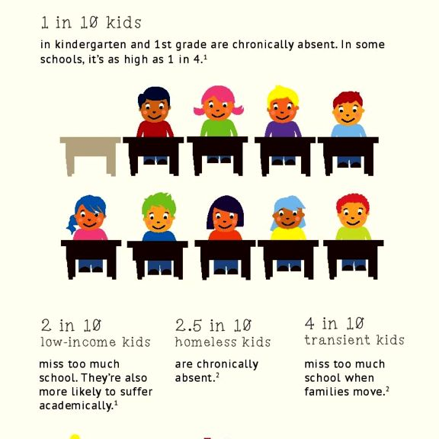
What are the disadvantages of this policy? Consider effectiveness, costs, enforcement, public acceptance:
Parents not answering teacher/school phone calls to follow up on students
Parents/Students miss vital school information (i.e academic tasks,school events, school closures)
Notes:
Big Education Ape: What to Do to Support Students Who Are Chronically Absent from School? | janresseger

Slide 14
Based on your evaluation of the advantages and disadvantages, should the current policy be totally replaced, strengthened, or improved? What advantages, if any, from the current policy should be retained? What disadvantages, if any, should be eliminated?
Educate and engage students and families about the impact of attendance on achievement
Include parent association
Develop personal connections with students who are in danger of, or are currently chronically absent
Support families facing additional barriers to daily school attendance
Develop a mentoring program in our school • (Guidance Counselor/Social Worker may lead)
Place students with mentors based on attendance records from prior year(s). Assign mentors at a ratio of 3:1, students to mentors
Refer the student and parent/guardian to outside agencies and legal intervention

Slide 15
Propose at least three new/original public policy alternatives. Be sure that all of your public policy alternatives are at the same geopolitical level as your social problem. Each alternative must specify the actual government or agency that will carry out the proposed action.
Create an attendance committee(1 administrator , a teacher from each grade,attendance officer, 1 paraprofessional,school secretary,1 school aide)
that meets weekly
Discuss options to have meetings with families to identify the cause of the student not attending school daily
Provide a reward system for children to attend school on time.(attendance award ceremony,

Slide 16
List the three public policy alternatives from Worksheet 5. Create a short word or abbreviation to summarize each policy and write it at the end of each policy.
Develop a mentoring program in our school
● Place students with mentors based on attendance records from prior year(s). Assign mentors at a ratio of 3:1, students to mentors
Weekly Student Attendance Celebration
Monthly Grade/Class Attendance Ceremony

Slide 17
EVIDENCE
School Attendance, Truancy & Chronic Absenteeism: What Parents Need to Know - HealthyChildren.org
Chronic absenteeism | American Federation of Teachers (aft.org)
Home (ps85q.org)
Chancellor's Regulations (nyc.gov)

