Slide 1
Let’s Go Out To Play.
Arlene Fuerst
Prek Teacher
P.S. 69

Slide 2
PUblic POlicy Analysis
1. Define the Problem
2. Gather the Evidence
3. Identify the Causes
4. Evaluate an Existing Policy
5. Develop Solutions
6. Select the Best Solution

Slide 3
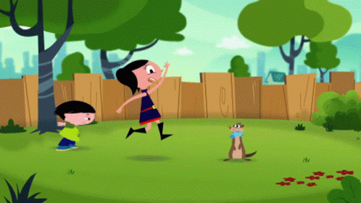
What is the Problem?
Many Prekindergarten students come to class without the proper clothing to play outside at temperatures of 26 degrees and up.

Slide 4
Turn and Talk
What are some of the things you need to wear when you go outside when it is cold.

Slide 5
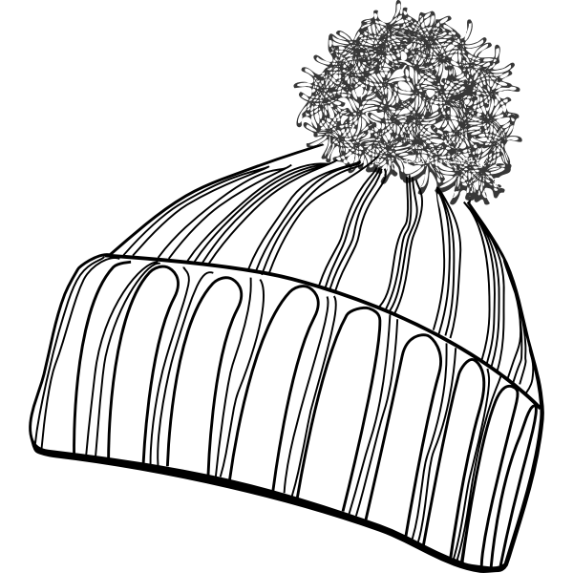
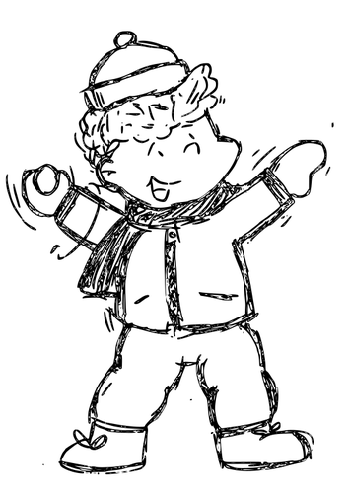
2-Evidence of the Problem
On Cold Days, when the temperature is between 26 and 36 degrees…students will be missing hats, gloves and scarves for outdoor activities.
Parents have walked students to the classroom door, and have attempted to bring home their jackets.

Slide 6
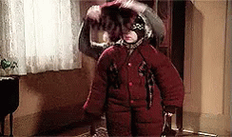
3-Identify the Causes:
Why we are not Dressed for the weather
Parents Bring Home Jackets/Hats/Gloves/Scarves at Drop Off because:
Students are not yet independent in putting on their own winter gear.
Parents feel we will not be going outdoors so they will not need the Winter Items.

Slide 7
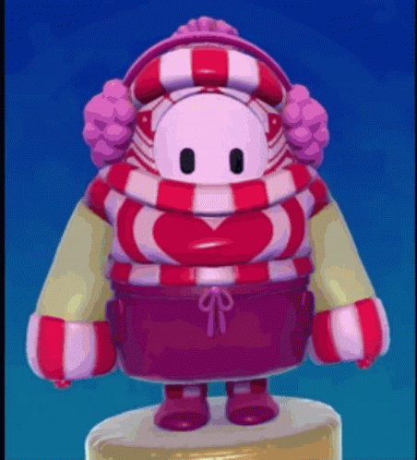
4 - Evaluate Existing Policy
The Early Childhood Environment Rating Scale (ECERS-3) is a national tool that looks at the pre-K learning environment. This includes things like the classroom and playground layout, the way children are supervised, the materials they have to use, and the amount of time they have to play.
According to ECERS-3 children need many opportunities to be active, gross motor play should occur both in the morning and afternoon.
Children should be dressed appropriately and taken outside except for very extreme times:
if it is raining,
there is a weather advisory,
there is ice on the playground,
The “real feel” temperature is below 25 degrees.
Click for NYCDOE DECE Policy

Slide 8
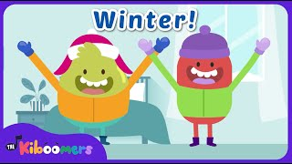
5 - Develop Solutions
Provide Instruction on Getting Dressed for Outside
Check Children’s Winter Gear During Line Up.
Create survey on Winter supplies.

Slide 9
Select the Best Solution
Feasibility
 | High | Medium | Low
High |  |  | Provide instruction on getting dressed to go outside.
Medium |  | Check Children’s Winter Gear During Line Up.
Low |  | Create survey on Winter supplies.
Effectiveness

