Slide 1
Public Policy Analyst - Flooding in NYC
How to Become a Real-Life Problem Solver - Mike Farrell, PS 148Q

Slide 2
The 6 Steps of the Public Policy Analyst (PPA)
Define the Problem
Gather the Evidence
Identify the Causes
Evaluate an Existing Policy
Develop Solutions
Select the Best Solution (Feasibility vs. Effectiveness)

Slide 3
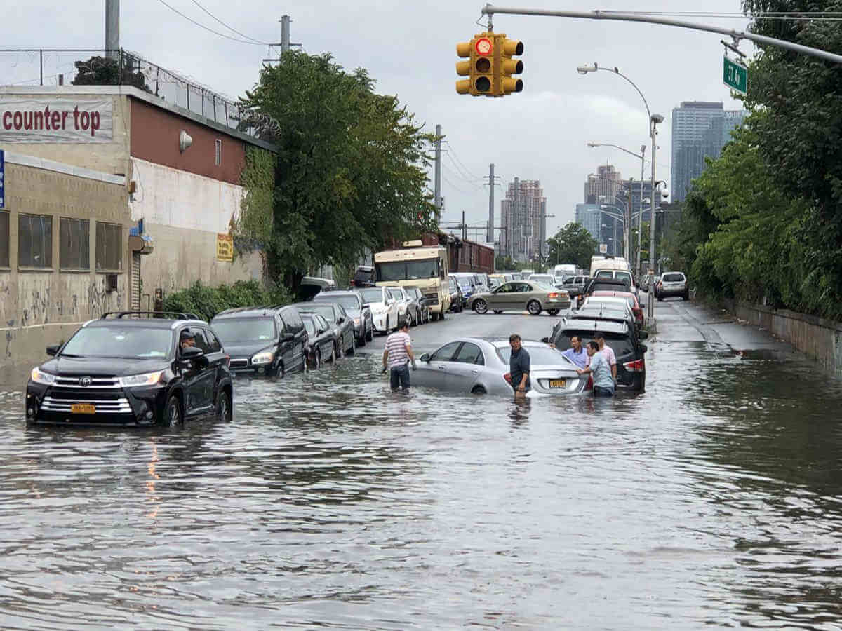
Step 6 - Select the Best Solution
(Feasibility vs. Effectiveness)
Flooding in New York City What can we do to help?

Slide 4
Step 1 - Define the Problem (worksheet)
In one or two sentences, state the nature of the social problem.
What is the specific community location of the social problem? Your answer should include both the governmental authority (e.g. school-board, city council) and the particular geographic location.
List three undesirable social conditions that result from this problem.

Slide 5
Step 1 - Define the Problem (example)
Flooding in New York City has become a problem in recent years. Sometimes, during periods of heavy rainfall, we experience flooding of streets, subway stations, businesses, and even homes.
Flooding in our area disrupts transportation, ruins businesses, destroys property, and most importantly, cost lives.
What are our state and local governments doing to correct this issue? What can we do?
Check out this video:
What's Being Done To Prevent Future Flooding At NYC Subway Stations?

Slide 6
Step 2 - Gather the Evidence (worksheet)
Present evidence that a problem exists. Be as specific as possible and cite at least one source of data:

Slide 7
Step 2 - Gather the Evidence (example)
As we saw in the video, flooding in New York City is a real problem.
According to the New York City Flood Hazard Mapper, the city’s coastal areas are susceptible to flooding and will continually get worse.
How Can New York City Prepare for the Next Ida? Here’s a To-Do List.

Slide 8
Step 3 - Identify the Causes (worksheet)
Briefly list several underlying factors that contribute to the problem that you have identified (support these factors with evidence):

Slide 9
Step 3 - Identify the Causes (example)
According to New York City’s Department of Environmental Protection, there are three major factors that contribute to local flooding:
Extreme weather and climate change
Blocked catch basin grates
Surcharged sewers - sewers that fill up too fast and overflow
Check out this link for further information: Flood Prevention - Causes of Flooding

Slide 10
Step 4 - Evaluate an Existing Policy (worksheet)
State one of the major existing policies that attempts to deal with the social problem.
What are the advantages of this policy (consider effectiveness, costs, enforcement, public acceptance).
What are the disadvantages of this policy? Consider effectiveness, costs, enforcement, public acceptance).
Based on your evaluation of the advantages and disadvantages, should the current policy be totally replaced, strengthened, or improved? What advantages, if any, from the current policy should be retained? What disadvantages, if any, should be eliminated?

Slide 11
Step 4 - Evaluate an Existing Policy (example)
In January of 2020, New York City released the City-wide Open Waters Plan; an ambitious, 10 year, $20 billion initiative to combat both flooding and water pollution. The city’s plan addresses many of the flooding and pollution issues plaguing the city's waterway but critics argue it isn’t enough.
According to the article: NYC's New Plan ..., the city’s plan still allows high levels of raw sewage to flow into our waterways. The article points out that the city’s plan only reduces the amount of overflow by 2%. 10.5 million gallons of raw sewage and runoff would still flow into the city’s waterways annually.
After evaluating both the plan and the article, I surmise the plan needs to be strengthened.

Slide 12
Step 5 - Develop Solutions (worksheet)
Propose at least three new/original public policy alternatives. Be sure that all of your public policy alternatives are at the same geopolitical level as your social problem. Each alternative must specify the actual government or agency that will carry out the proposed action.

Slide 13
Step 5 - Develop Solutions (example)
Causes of Flooding in New York City
Extreme weather and climate change
Blocked catch basin grates
Surcharged sewers - sewers that fill up too fast and overflow
Proposed Solutions
Reduce the amount of runoff by building “umbrella” canopies to cover the entire city.
Build a “weather machine” to control how much it rains.
Petition the city to invest more money in “Green Infrastructure.”

Slide 14
Step 6 - Select the Best Solution (worksheet pt. 1)
List the three public policy alternatives from Worksheet 5. Create a short word or abbreviation to summarize each policy and write it at the end of each policy.

Slide 15
Step 6 - Select the Best Solution (worksheet pt. 2)
Use the format in the example to complete the matrix below:
Feasibility
 | High | Medium | Low
High | Green Infrastructure |  | Weather Machine
Medium |  |  | Umbrella
Low
Effectiveness

Slide 16
Step 6 - Select the Best Solution (worksheet pt. 3)
Discuss the reasons for your decisions in the matrix.
Discuss why your group prefers one alternative over the other two.

Slide 17
Step 6 - Select the Best Solution (example)
The city’s plan to reduce flooding and improve the sewer system is an ambitious call for spending twenty billion dollars over the course of ten years. The plan, however, only calls for spending $1.6 billion on green infrastructure. Since the city’s plan only reduces a fraction of the runoff caused by heavy rain, we recommend strengthening their plan by increasing spending on green infrastructure.

Slide 18
Step 6 - Select the Best Solution (continued)
Green infrastructure such as:
Rain Gardens
Infiltration Basins
Stormwater Greenstreets
Green Roofs etc.
will greatly reduce the amount of runoff that will make it into our sewer system.
Our recommendation addresses the need to prevent flooding in New York City while greatly reducing the amount of runoff and sewage being dumped in our waterways.

