Slide 1
Parent Engagement
Jennifer Duran at PS151Q

Slide 2
The Six Steps of the Public Policy Analyst
Step #1: Defining the Social Problem
Step #2: Gathering Evidence of the Problem
Step #3: Identifying the Causes of the Problem
Step #4: Evaluating Existing Public Policies
Step #5: Developing Public Policy Solutions
Step #6: Selecting the Best Public Policy Solution

Slide 3
Step 1:
Define the Problem
Parents are not attending to school wide events.

Slide 4
Step #2: Gathering Evidence of the Problem
Review Parent Attendance data from previous years and document any patterns and/or trends.
Attendance from Parent/Teacher Conferences.
Attendance from PA Meetings
Attendance from Virtual Parent Workshops
Review Meeting Times to see if Morning, Evening, and virtual were offered.
Survey parents to see why they are unable to attend school-based meetings, workshops, and activities.

Slide 5
Step 3: Identifying the Causes of the Problem
Families and caregivers may not fully understand the growth and development of their children.
Between working and having multiple school-aged children, Families and caregivers find it challenging to fit attending and volunteering at school events into their busy schedules.
For many immigrant parents, not being able to speak the language is a major complication that keeps them from getting involved in their children’s school.
Many immigrant families who attended school in a different country, found themselves overwhelmed and lost when it came to understanding the processes and functioning of the american school system and that of the PTA.

Slide 6
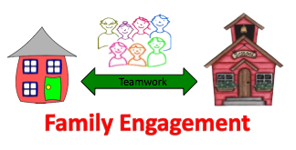
Step 4:
Evaluating Existing Public Policies
Host weekly Virtual Parent/Teacher meetings. This allows teachers to provide guidance on how parents can help with certain assignments. Parents can also provide feedback on areas where their child may need extra help.
Communicate with parents via School’s website and social media platforms since social media provides excellent ways to connect and engage parents.
Host an Open House event aka Family Night in which a student’s entire family can visit the school and classroom in an informal and laid back setting. This also builds the parent-teacher relationship.

Slide 7
Step #5: Developing Solutions
Move to online Forms which are more accessible since they can be translated into another language with a browser's translator.
Teachers will schedule a time each week to meet with parents virtually. The weekly day and time will remain the same throughout the school year.
The school will maintain and consistently update the School’s website and social media platforms to ensure that parents’ are being informed and kept up-to-date on important communications.
Schedule and host monthly Family Night at the school that are accessible to all parents.

Slide 8
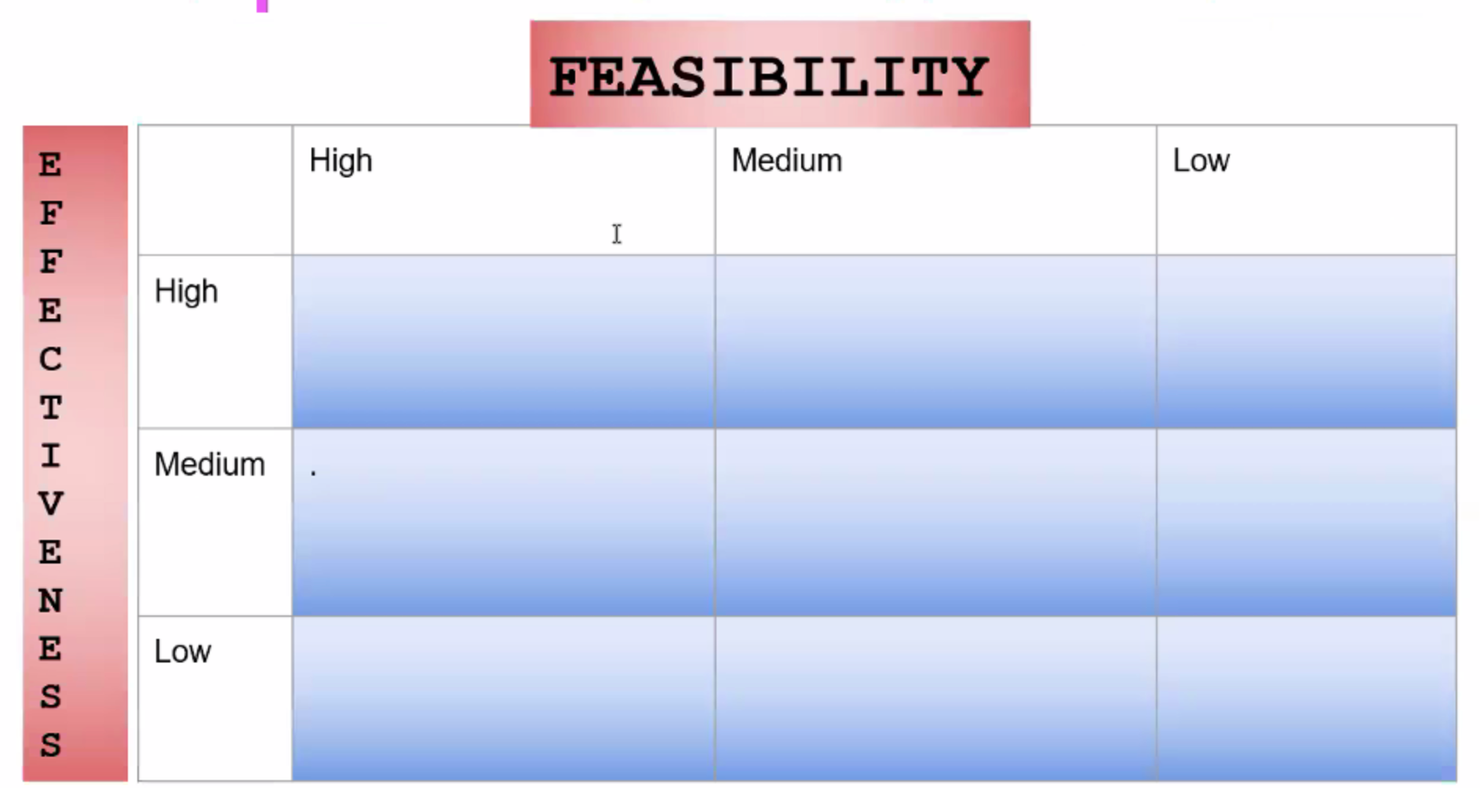
Step 6: Selecting the Best Public Policy Solution

