Slide 1
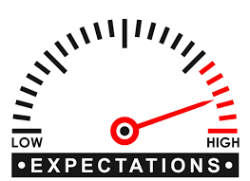
Optimistic Thinking
Many students in Class 3-302, at P.S. 69Q,
don’t set high goals for themselves.
Students have low expectations.
Lisa DiSunno
P.S. 69Q
Ldisunn@schools.nyc.gov

Slide 2
PPA STEPS
Step 1: What is the problem?
What is something that should be fixed or made better in our class, school or community.
Step 2: What is the evidence?
What proof or data shows this is a problem.
Step 3: What are the causes?
Why is this problem happening?
Step 4: Current Policies
What is currently being done to address this problem
Step 5: What policies can you create to correct the problem?
What rules or activities can we make that will help fix this problem?
Step 6: What is the best policy to correct the problem?
Think back to step 4, which suggestion would work the best.

Slide 3
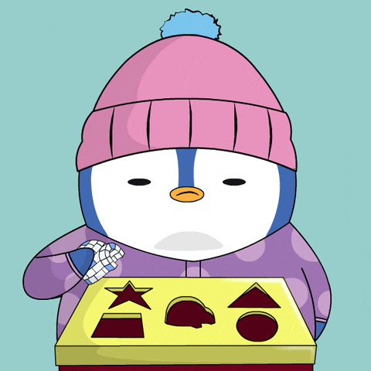
What is the problem?
Many students in Class 3-302 don’t set
high goals for themselves.

Slide 4
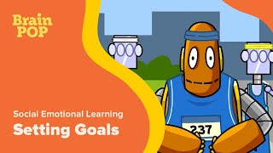
What is the evidence?
Why should we set high goals for ourselves?

Slide 5
What are the causes?
Students feel the assignments are too challenging, so why bother?
Students rather rush and finish assignments so they can play, rather than challenging themselves to do more.
It is easier to do the minimum and get by, rather than going above and beyond.
Students don’t recognize the importance of goals.
Students aren’t aware of their individual potential because they don’t often hear praise.

Slide 6
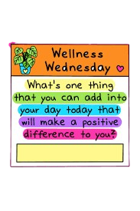
Current Policies
Wellness Wednesday Announcements
Positive Thinking/ Strategy Announcement each week.
Coloring Contest
Work of the month coloring contest.
Monthly Rising Stars

Slide 7
How can we fix this?
Individual rewards for students who show growth in a subject area.
Students set small, achievable goals with weekly checks in to see if they achieved them and if not how can they work on them.
Model the “Power of Yet!”
Focus on “I can” and not “I can’t”

Slide 8
Feasibility
High
Medium
Low
High
The Power of Yet
I can statement
Set small, achievable goals
Medium
Accessibility
Individual rewards
Low

