Slide 1
respectful talk with each other AT CS111Q?
Ms. Cottoy, CS111Q

Slide 2
the six steps of the PPa
Define the problem
Gather the evidence
Identify the causes
Examine an Existing Policy
Develop New Solutions
Select the best solution

Slide 3
IN OUR SCHOOL COMMUNITY STUDENTS ARE CHOOSING TO SPEAK WITH PROFANITY TO EACH OTHER

Slide 4
Showing respect is the regard of feelings, wishes, rights or traditions of others
Now that we have
Discussed the meaning of respect, what are
Ways to ensure we show respect to others
RESPECT

Slide 5
WHy is it important to be show respect to others?
Being respectful is an important part of being around different people in your environment. Seeing that we live in New York City in which we are considered a melting pot it is very important to know how to respect peoples beliefs, thoughts, and every their choices in life no matter the way “you think” they should be. Using respectful tone and words to others are also very important in our day to day lives.

Slide 6
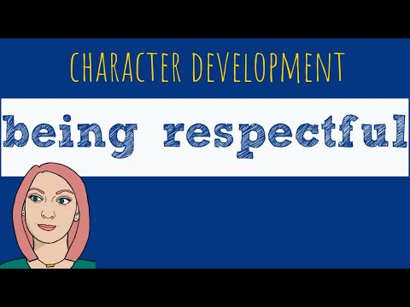
What does being respectful to others look like?

Slide 7
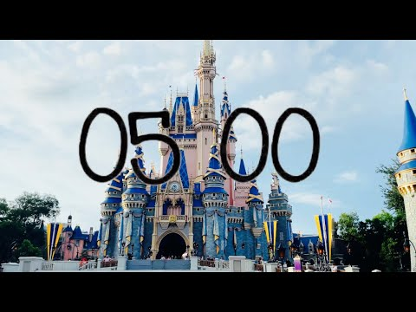
What is the evidence?
Let’s have Scholar Talk!!
What is some evidence that we can put together that you all as a community have not used respectful words with your peers?

Slide 8
What is the evidence you came up with?
1.
2.
3.
4.
5.
6.

Slide 9
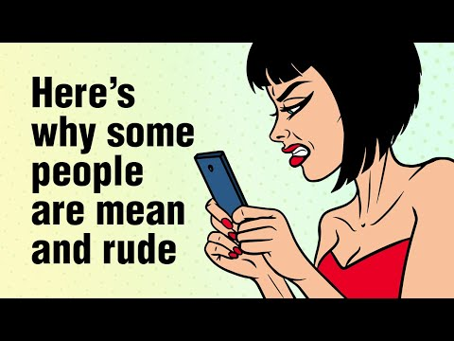
What causes disrespect in our community?
Let’s think about together what causes scholars to disrespect their peers in their community
1.
2.
3.
Watch this video on
how why
people
become rude?

Slide 10
WHat are some existing policy in our community around being respectful to our peers?
Restorative circles
Peer resolutions
Discussions as necessary
WHat are some new policies our community can
create for us to be respectful to our peers?
You create an idea that you believe with your group that will help create more respectful space for our community

Slide 11
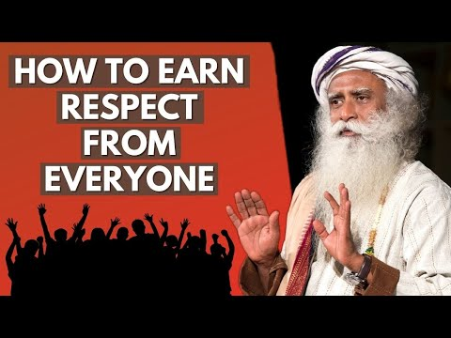
How can we help fix this problem?

Slide 12
How you can prevent disrespectful tone or talk?
Make sure your questions are genuine
Authority is not the truth. Always be truthful
Be honest
Be open
Think before you speak
No judgement

