Slide 1
The Power of Words
3rd to 5th Grade STEM
Mr. Chasva
P.S. 361Q The Woodside Community School.

Slide 2
6 Steps of the Public Policy Analyst
Define the problem!
Get evidence!
Identify the causes of my problem.
Existing policy.
How are we solving the problem?
Develop Solutions!
Selecting the best solution! (Feasibility vs. Effectiveness)

Slide 3
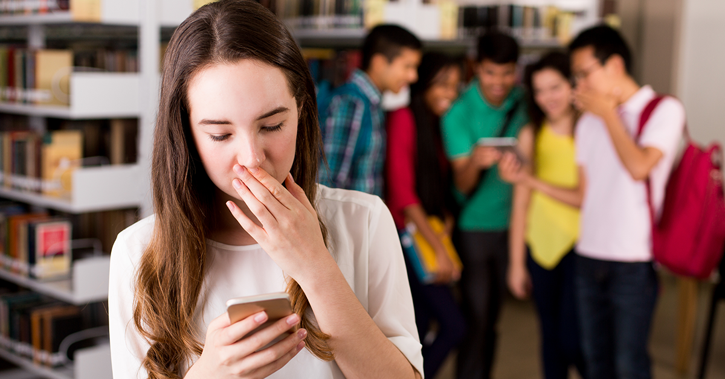
Does it sound familiar?
Many of us have heard about Cyberbullying before, but what is it?

Slide 4
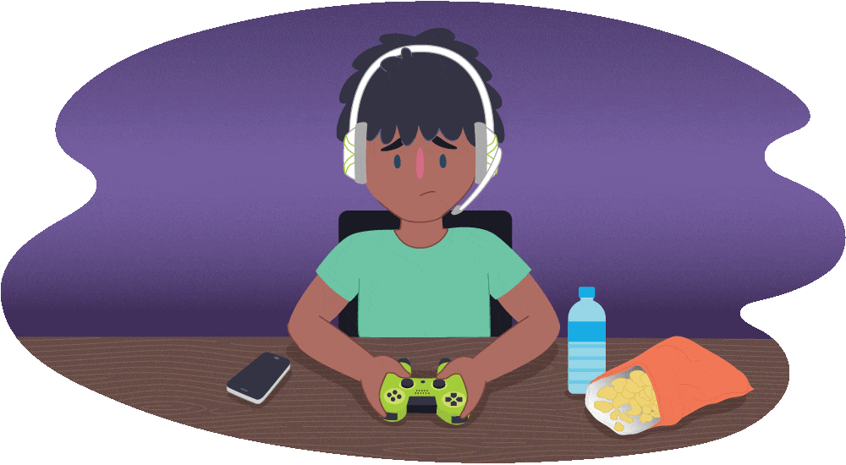
What is Cyberbullying?
Cyberbullying is bullying that happens on the Internet.
It can happen on social media and when you are playing games.

Slide 5
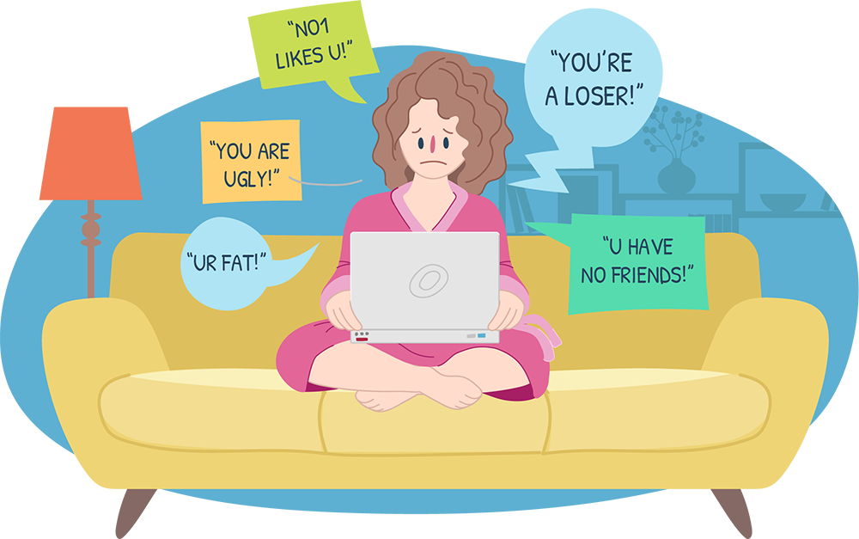
What is Cyberbullying?
Saying mean things to others on the internet is Cyberbullying.

Slide 6
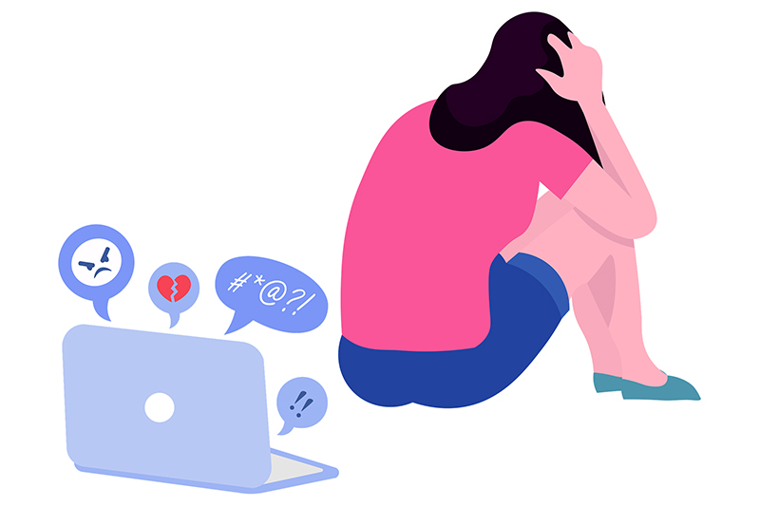
Gather Evidence - How does it affect us?
Students may be embarrassed from mean messages.
Students can feel alone.
Students may feel angry and powerless.
Cyberbullying can give a student more anxiety.
Students may feel stressed.
https://www.verywellfamily.com/what-are-the-effects-of-cyberbullying-460558

Slide 7
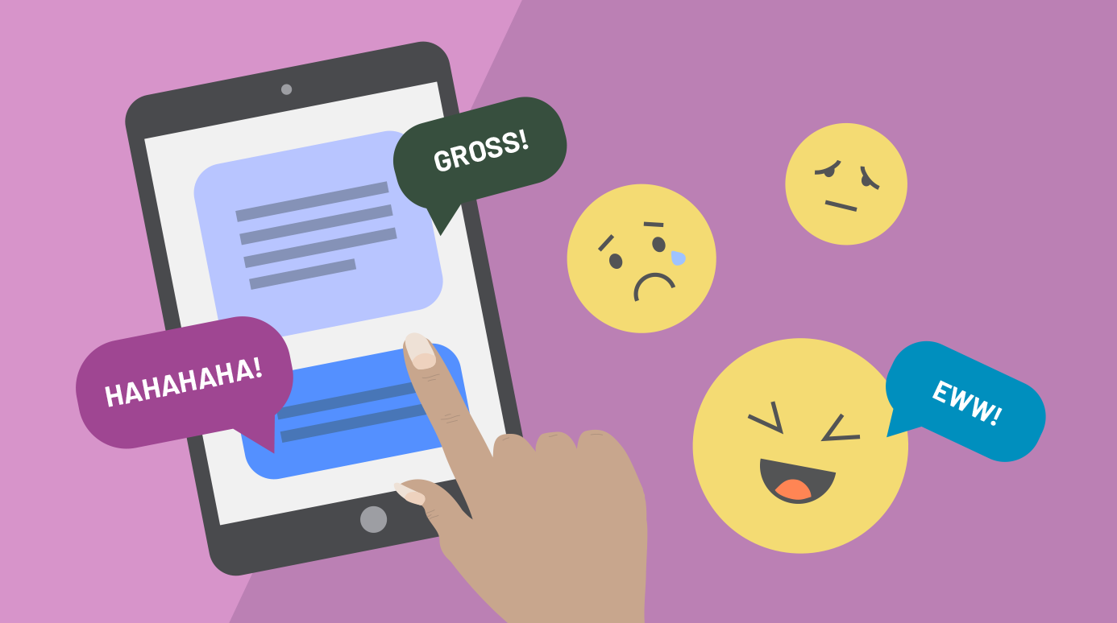
What do you think causes Cyberbullying? Why?
Turn + Talk
I think _____________ causes Cyberbullying because…

Slide 8
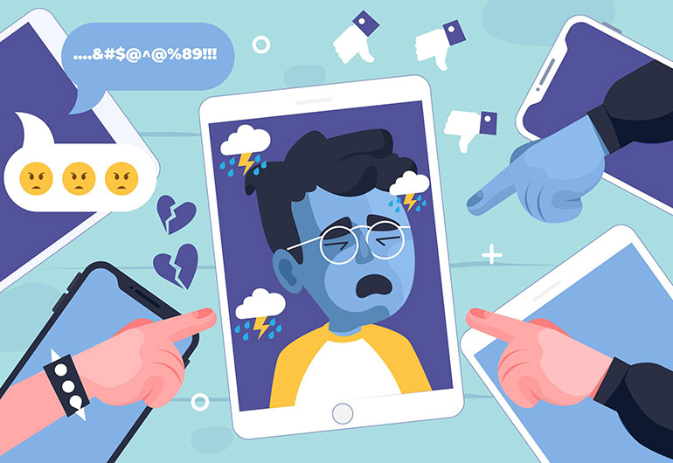
Identify causes of Cyberbullying
A lot of students can easily go on the internet!
You can easily message your classmates online.
Students may not think it’s a big deal.
Some students Cyberbully to make someone they don’t like feel bad.
Some parents may not watch what their kids do online.

Slide 9
What are we doing about it?
(Existing Policy)
Respect for all week!
Celebrating Kindness.
Anti-Bullying.
No one eats alone day!
Digital Citizenship in the Classroom
Learning about how to be a good citizen in the classroom and on the internet.

Slide 10
How can we stop Cyberbullying?
(Develop Solutions)
Turn + Talk

Slide 11
How can we stop Cyberbullying?
(Develop Solutions)
I think we can stop Cyberbullying by __________

Slide 12
Select the best solution!
 | High | Medium | Low
High
Medium
Low

