Slide 1
Lateness at PS76Q
Mr. Byrne
mbyrne2@schools.nyc.gov

Slide 2
The 6 Steps of the Public Policy Analyst (PPA)
1. Define the Problem
2. Gather the Evidence
3. Identify the Causes
4. Evaluate an Existing Policy
5. Develop Solutions
6. Select the Best Solution (Feasibility vs. Effectiveness)
Link to PPA Information

Slide 3
Define the Problem
Lateness - When a student arrives to school after 8:00 am
Activity: Vocabulary Discussion - non examples (Early/On time)

Slide 4
2. Gather the evidence
Statistics: Link: NY State Chronic Absentee Numbers and Percentages
PS76Q - An average of 50-70 students are late each day out of 395 (information provided by our main office)

Slide 5
Let’s look at our visual data of our schools lateness

Slide 6
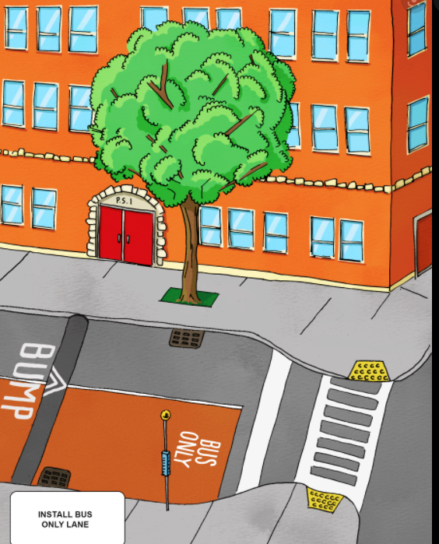
3. Identify the causes
What are some reasons children are late to school?
Poor Health - Being sick
Safety - There is something dangerous
preventing students to get to school.
Transportation - Having difficulty get a ride to school
Lack of sleep - Tired in the morning

Slide 7
4. Evaluate an Existing Policy
Link:Regulation of the Chancellor
Link: Every Student Every Day

Slide 8
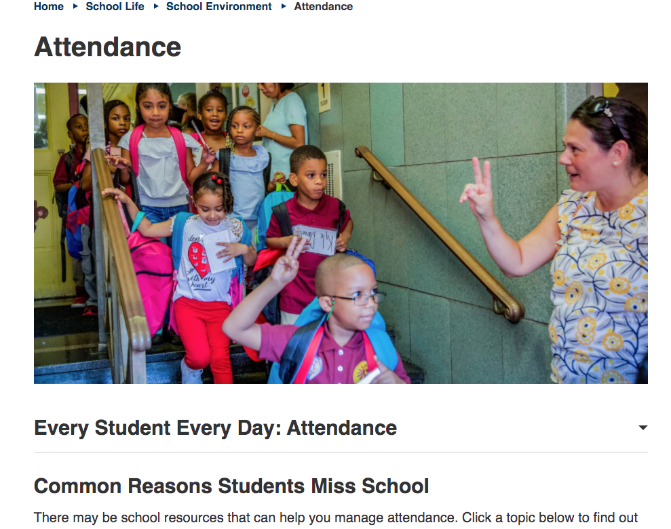
5. Develop Solutions
Develop school wide attendance incentives
Increase awareness of “Every Student Every Day” as this program has amazing resources for families
Increased parent contact

Slide 9
6. Select the best solution
We need to increase parent awareness of the “Every Student Every Day.”
Let’s Make a list of ways we can get the word out about the resources available? (class discussion)

Slide 10
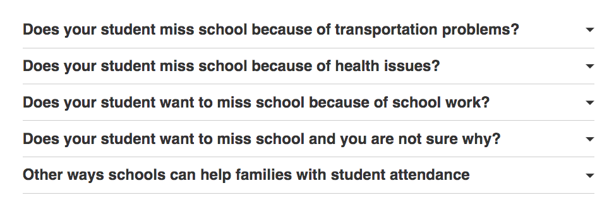
If People knew that they could explore each of the drop downs below to find support for their specific issue it could be greatly beneficial!!! Let’s click the link below and find out what resources are available!!!
Link: Every Student Every Day

