Slide 1
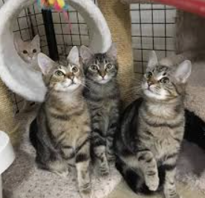
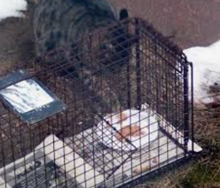
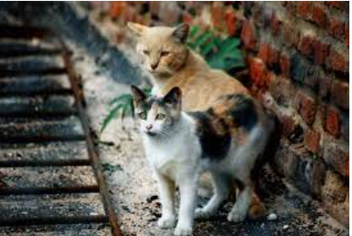
Problem: Large Population of Stray Cats in Jackson Heights, Queens
How to address the problem of local stray cats, as well as how to help them by doing our part to protect them and reduce the overpopulation of cats
Jennifer Butler - P.S. 149Q

Slide 2
Gather Evidence
There are sadly over 500,000 feral street cats in NYC alone. Being a large overpopulated city, a lot of these cats have either been lost or abandoned. Since Jackson Heights has many buildings as well as smaller residential homes with multiple families, there is a large abundance of street cats in the area of Jackson Heights alone.
Stray cats are born and live outdoors. Sometimes, they are abandoned. Stray cats may live in vacant lots, alleys or backyards and are usually not socialized to humans, making their lives difficult. They must learn to survive in whatever way they can. Feral cats are usually not spayed or neutered, contributing to more of a problem. Since these cats have no official owner, only animal shelters, organizations or “good samaritan” people of the neighborhood who go out of their way to help, are supporting these defenseless animals, especially during the harsh winter months, which are even more difficult for cats to survive in.

Slide 3
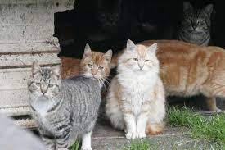
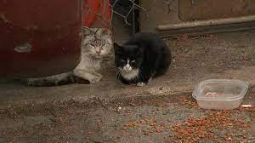
Identify Causes
Feral cats are the offspring of abandoned or lost pet cats.
The majority of feral cats are not spayed or neutered, causing them to reproduce quickly (eg. Kitten Season)
Human cat owners release their unspayed and unneutered cats to roam the streets throughout the day leading to cat fights with stray cats over territory, spread of feline diseases, and overpopulation of kittens, growing up to become part of the feral cat population in NYC.

Slide 4
Evaluate Existing Public Policies
Disadvantages
People who are not interested in supporting can turn a blind eye or refuse to help a cat in need, in turn causing one person’s work to go to waste and contributing to the problem.
Adoption is sometimes done haphazardly (e.g. kittens given away for free and then abandoned as adults) so people change their minds leading to overpopulation and understaffed animal shelters.
To give an example, many cats were adopted during the pandemic for companionship or out of impulse. When things started opening back up, many were surrendered to shelters or abandoned.
Awareness of the importance of adoption and the huge undertaking and responsibility it is needs to be addressed.
Advantages
Less stray cats on the streets means less breeding, less of a need for people who want to help with TNR (Trap-Neuter-Return). TNR leads to ear-tipping cats, where they can be easily identified by the community as being spayed and neutered. Anyone in the community can help with TNR, it doesn’t have to just be cat owners and this further helps with people being able to help without having to commit to adopting a cat.
Encouraging adoption leads to people becoming more aware of the stray cat problem and wanting to help more in whatever way possible.

Slide 5
Develop Solutions
During the harsh winter months…
Have students tell neighbors and family to save and collect any firm styrofoam packaging from home delivery boxes, which could be used to build makeshift cat shelters with at home materials.
Teach students how to build these makeshift shelters in class by building one together in the classroom, make it a service project. These makeshift shelters can be kept outside during the cold months. It’s a super easy, affordable, and fun, and most of all rewarding process!
Any student who has a cat should ask parents if the cat is spayed/neutered.
Provide flyer to parents and families which can be given out to community members on how to make appointments with the ASPCA which provide low cost spay/neuter services.
Set up a school drive to provide dry food, canned wet food, toys scratchers, beds, catnip and medicine and towels/blankets for stray cats. These are high need items which can be donated to local animal shelters (e.g. Puppykittynyc in Queens)

Slide 6
Select Best Solution
Advocate with students and families to not let their cats roam freely during the spring and summer months, especially if their cat is not spayed/neutered and microchipped.
Inform families on what an ear tipped cats means. This also allows people with insight into cats that have been a part of and benefited greatly from TNR (Trap-Neuter-Release).
Help families through the process of applying for low cost spay/neuter services. Services are as low as $5 with any local ASPCA if families show proof of public assistance. Many local veterinarians will provide this service for free using the “good samaritan” clause if a stray cat is brought in.

Slide 7
Benefits and costs
Costs
By providing proof of government assistance, SSI or any other form of government assistance, families can have their cats spayed, neutered and microchipped (for tracking in case the animal ever gets lost) for only $5. Many local veterinarians will even provide this service for free under the “good samaritan” clause.
If people of the neighborhood want to support stray cats not of their own, they can support financially by purchasing high need products for shelters and providing food and water bowls in the neighborhood which these poor cats need for daily survival.
Benefits
Less cats suffering on the streets
Less breeding of kittens means less street cats in the near future (kittens are truly adorable, but unless there is someone who is looking to adopt and care for one, these kittens grow up and live hard rough lives on the streets subject to danger, susceptibility to feline diseases and harsh weather conditions)
-

Slide 8
Resources
http://www.animalalliancenyc.org/initiatives/nycfci/index.htm
https://www.aspca.org/pet-care/general-pet-care/low-cost-spayneuter-programs
https://puppykittynyc.org/
https://www.nycacc.org/FoundAStrayCat

